Slide 1
Status Report: Measuring and Modeling Purdue’s Engineer of 2020 Attributes using a Neural Network Model of Student Success
P. K. Imbrie and Teri Reed-Rhoads
School Of Engineering Education
Purdue University
Purdue’s Engineer of 2020
Seed Grant Funding for 2009-2010

Slide 2
The specific research objectives are to
Begin developing additional affective (noncognitive) measures related to the Purdue Engineering of 2020 (PE 2020) attributes that can be incorporated into the model (e.g., adaptable in a changing environment, innovation). Said information can also provide programmatic information on how these attributes develop (or fail to develop) over the course of a student’s undergraduate program; and
Use an existing AAN model of student success developed by the authors to study how changes in students’ core attributes over time (i.e., from year-to-year) influence persistence/success as well as investigate the NN model’s sensitivity to gender and ethnicity.

Slide 3
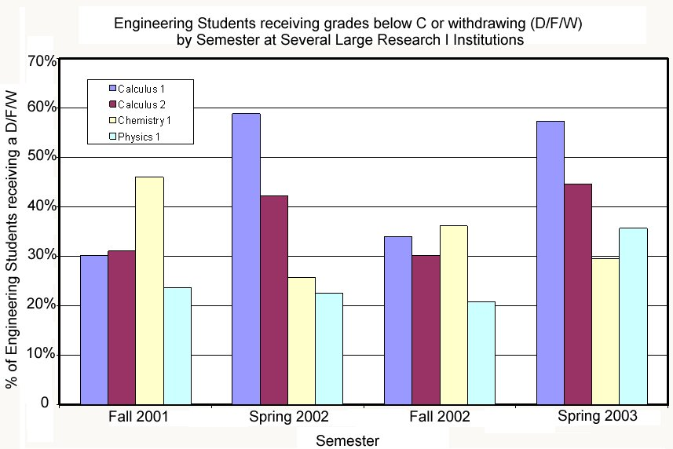
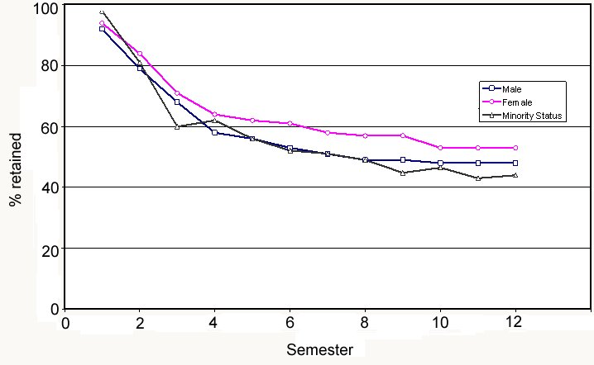
Background
Why do so many good students do what they do?

Slide 4
Retention of engineering first-year students at Purdue University
A predictive model can help identify students who may benefit from specific early intervention;
this should improve academic performance in the Freshman year, thus leading to improved retention (and improved individual student success)
In year 2004, about 21% of Purdue’s engineering freshman left engineering program after the first year.

Slide 5
Student Success Model

Slide 6
Independent variables
Non-cognitive scales across nine dimensions
Expectancy (26)
Meta-cognitive scale (20)
Motivation scale (25)
Major-decision Making scales (21)
Leadership scale (20)
Deep Learner type (10)
Surface Learner type (10)
Self-Efficacy scale (10)
Team vs. Individual Orientation (10)
Cognitive data: High school metrics
HS overall and core GPAs;
Standardized tests-SAT & ACT;
Number of semesters of Math, Science and English taken in high school
Average grade for Math, Science and English taken in high school

Slide 7
Comparison of success instrument to current ABET outcomes.
ABET Criterion 3 a-k as appropriate | Success Scale Sub-Scales
(a) an ability to apply knowledge of mathematics, science, and engineering | Academic self-efficacy
(c) an ability to design a system, component, or process to meet desired needs (e) an ability to identify, formulate, and solve engineering problems | Academic self-efficacy, Leadership, Deep learner/Surface learner
(d) an ability to function on multi-disciplinary teams | Teamwork, Academic self-efficacy Leadership
(f) an understanding of professional and ethical responsibility | Expectancy-value
(g) an ability to communicate effectively | Academic self-efficacy, Leadership
(h) the broad education necessary to understand the impact of engineering solutions in a global and societal context | Deep learner/Surface learner
(i) a recognition of the need for, and an ability to engage in life-long learning | Deep learner/Surface learner, Motivation, Expectancy-value
(k) an ability to use the techniques, skills, and modern engineering tools necessary for engineering practice | Academic self-efficacy

Slide 8
Educational Setting
Participants
First-year engineering students (N= 1523).
Gender: 19.17% females, 80.83% males
Ethnicity: 82% Caucasian, 10% Asian American, 2% African American, 3% Hispanic, 1% Native American, 2% other
Engineering freshmen students’ persistence status after 1st year
Five possible statuses | Dichotomous statuses
Upper-division engineering: completed first year requirements and move to upper divisions (UE) | 1. Retained in engineering
Lower-division engineering: still remained in the first year program (LE)
Transferred to Science or Technology schools in the same university (ST) | 2. Not retained in engineering
Transferred to schools in the same university other than Engineering, Science or Technology (O)
Left the university (L)

Slide 9
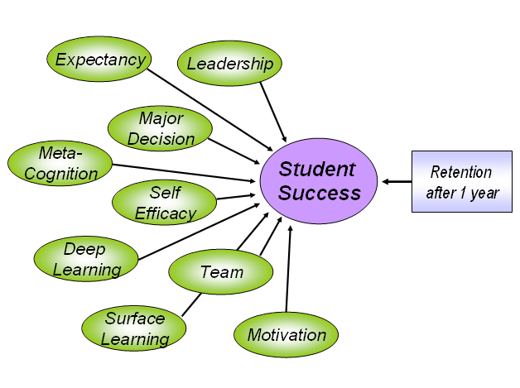
Theoretical Framework: Non-cognitive scales as inputs
Non-cognitive scales (159 items) across nine dimensions
Cronbach's coefficient alpha > .8 for all sub-scales except surface learning, which was 0.77
Construct validity of the individual scales has been supported by CFA (Immekus, Imbrie, & Maller, 2005; French & Oakes, 2003)

Slide 10
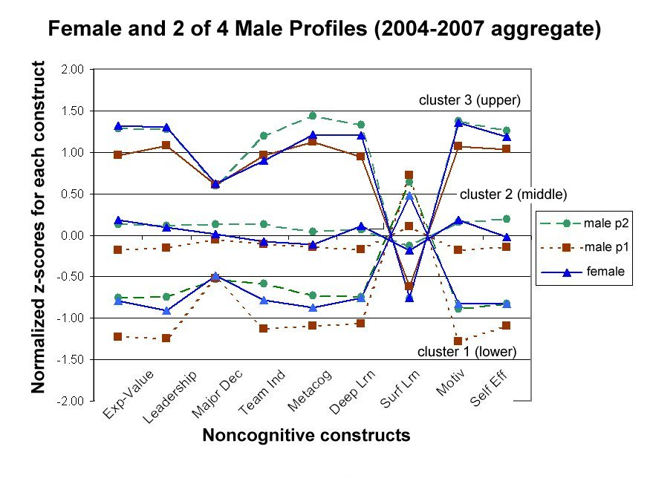

Slide 11
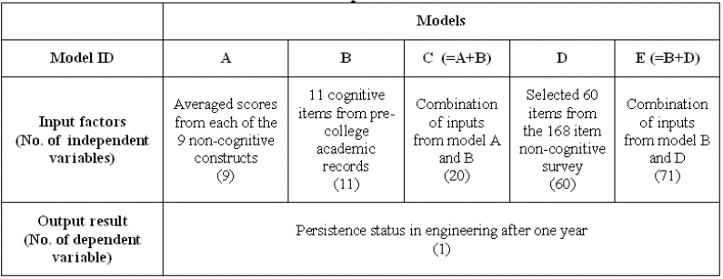
Models and Methods
Five retention models with different input factors were developed.
Four different modeling methodologies were implemented
Logistic Regression, Discriminant Analysis, Structural Equation Modeling (SEM) and Neural Networks (NN).
Notes:
#2 is less important and not covered in the REES paper … should row #2 be dropped?

Slide 12
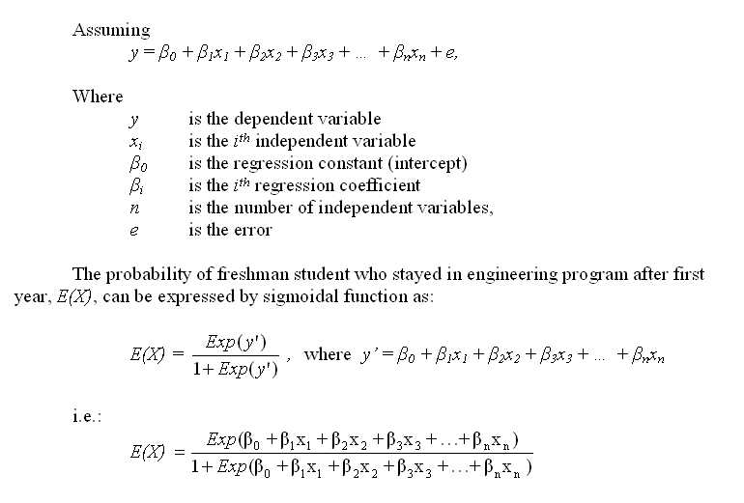
Methods: Logistic Regression

Slide 13
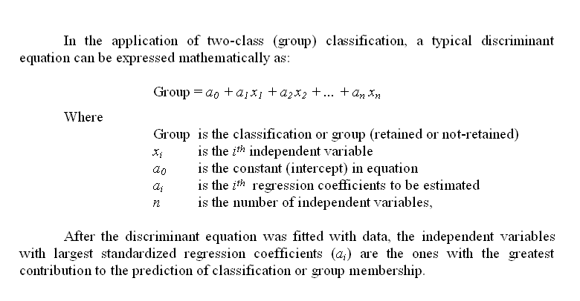
Methods: Discriminant Analysis

Slide 14
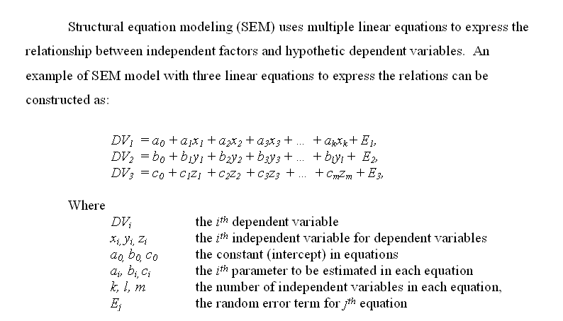
Methods: Structural Equation Modeling (SEM)

Slide 15
Method: Neural Networks
w₁₁
z₁
u₁
x₁
w₁₂
w_{1y}
w_{1m}
z₂
u₂
w₂₁
w_{2y}
Inputs
x₂
w_{3y}
y
Prediction
u₃
w_{2m}
z₃
…
w_{my}
w_{n1}
…
x_{n}
w_{n3}
The weights (W_{ij}) between neurons were
adjusted during the back-propagation
training process.
w_{nm}
z_{m}
u_{m}
x₁
Sum of weighted
inputs
Activation
function
n
Activation function selected:
Hyperbolic tangent sigmoid function
x₂
w_{1m}
v_{m} =
( ∑ W_{im}*X_{i} +b_{m} )
n
u_{m}
i=1
…
v_{m} = ∑ W_{im}*X_{i} +b_{m}
u_{m} = Φ(v_{m})
n
w_{nm}
i=1
u_{m} = Φ(v_{m}) = Φ
( ∑ W_{im}*X_{i} +b_{m} ), whereΦ(v)=
x_{n}
Neuron Z_{m}
i=1

Slide 16
PODN plot with four methods

Slide 17
Important Factors Identified by Different Methods
Method (Ranking criteria) | Logistic regression, p<0.05 (regression coefficient) | Discriminant analysis, p<0.05 (discriminant function coefficient) | SEM, p<0.05 (estimate of regression weight) | Neural Network (sensitivity coefficient, ∆=0.25)
Model A: Non-cognitive scales only* | Surface Efficacy | Surface Efficacy | Surface Leadership Efficacy | Leadership Surface Efficacy
Model B: Cognitive items only** | SEM_Sci SAT_M SEM_Math AVE_Engl | SAT_M SEM_Sci SEM_Math AVE_Engl | SEM_Sci SEM_Math SAT_M AVE_Engl SAT_All AVE_Sci | SEM_Sci SAT_M SAT_All SEM_Math
Model C: Both Non-cognitive scales and cognitive items | SAT_M SEM_Sci Leadership SEM_Math Surface AVE_Engl | SAT_M SEM_Sci SEM_Math Leadership Surface AVE_Engl | SEM_Sci SAT_M SEM_Math Leadership AVE_Engl Surface SAT_All Ave_Sci | SEM_Sci SAT_M SEM_Math SEM_Engl Leadership SAT_V
* Non-cognitive factors from SASI survey:
Efficacy: Academic self-efficacy (Immekus et al, 2004, 2005).
Leadership: Student’s self appraisal of their leadership abilities. (Immekus et al, 2004, 2005).
Surface: Surface learning measured by Study Process Questionnaire (SPQ) (Biggs, Kember and Leung, 2001).
** Cognitive factors from high school:
AVE_Engl: Average grade of English courses taken in high school.
AVE_Sci: Average grade of Science courses taken in high school.
SAT_All: The sum of scores from both Math and Verval sections of SAT (or equivalent from ACT).
SAT_M: Math score from SAT (or equivalent from ACT).
SAT_V: Verbal score from SAT (or equivalent from ACT).
SEM_Math: No. of semesters of math courses taken in high school.
SEM_Sci: No. of semesters of science courses taken in high school.
+ All factors were normalized to range of [0,1] .
Notes:
Notable negative terms: Surface, SEM_Engl, SAT_V

Slide 18
Thank You
Questions?

