Slide 1
Development and Assessment of “Ethics in Engineering Practice”: A New Technical Support Elective
Prof. Rod Trice and Prof. Matthew Krane
School of Materials Engineering

Slide 2
Motivation for Teaching an Ethics Class in the Schools of Engineering
Part of Purdue’s leadership for the Engineer of 2020 initiative

Slide 3
Motivation for Teaching an Ethics Class in the Schools of Engineering, Cont.
Nearly ¾ of engineering programs in the U.S. allow some students to graduate without taking a course whose description mentions ethicsª
To address specific ethical issues engineering students would encounter (different than an ethics class taught in a Phil. Dept.)
Personal interest in the topic by Profs. Krane and Trice
ªKarl D. Stephan, “A Survey of Ethics-Related Instruction in U.S. Engineering Programs,” J. Eng. Ed., 10 459-64 (1999).

Slide 4
Objective of the New “Ethics in Engineering Practice” Course
To demonstrate that such a course could mature the moral reasoning skills of engineering students who participated.
Approach/Class Outline
I. Presentation and discussion of common ethical theories
II. Faculty application of the theory in an engineering context
III. Student application of the theory via student-led case studies

Slide 5
I. Presentation and Discussion of Common Ethical Theories – 8 Weeks
Haws^{b} noted that not grounding students in ethical theory is “probably the greatest single weakness in engineering ethics instruction.”
Why study ethics in an engineering class?
What elements should ethical theory consider?
What are the basic elements of different ethical systems? In-depth coverage of consequentialist, principled, and virtue-based ethical systems
If you adopt an ethical theory, what are the implications of it?
Skills:
Be conversant about the common ethical theories (allow time for classroom discussion)
Read a passage or analyze a choice and understand what ethical system was in play
Approach ethical issues/life with a mature approach
David Haws, “Ethics Instruction in Engineering Education: A (Mini) Meta-Analysis,” J. Eng. Ed, 4 223-9 (2001).

Slide 6
II. Faculty-Led Application of the Theories in An Engineering Context – 5 Weeks
Applications of Theory
Professionalism
Professional Virtues
Professional Codes of Ethics
Risk and Reliability (Liability in Design),
- Michael Lotus, Attorney
Trust and Loyalty (Confidentiality and Whistleblowers)
Role of Organizational Culture and Authority/Milgram Experiments
Human Subjects/Patient Rights (Prof. Laura Sands)
Research Fraud
Practical Advice for Dealing with Ethical Questions
Faculty-Led Case Studies
Bjork-Shiley Heart Valve
Challenger
Prozyr Femoral Head Failures
Bell Labs Research Fraud
Kansas City Skywalk Failure

Slide 7
Case Study Format
Short synopsis of the case
Engineering explanation of failure (i.e. the technical details)
Discuss the defining issues in the case
A timeline that shows the decision making of the important individuals or groups
An analysis of the decisions made in the case with respect to common ethical theory(ies),
assigning responsibility for those decisions and subsequent actions.
The legal fallout and/or design changes, changes technical societies, etc., in light of the failure.

Slide 8
1981 Kansas City Hyatt Regency Skywalk Collapse
Case Study Example
MSE 497 Case Study 2
Prof. Rod Trice

Slide 9
The Story as it Appeared in the Media
Case Study Example
On July 17, 1981, the Hyatt Regency Hotel in Kansas City, Missouri, held a videotaped tea-dance party in their atrium lobby. With many party-goers standing and dancing on the suspended walkways, connections supporting the ceiling rods that held up the second and fourth-floor walkways across the atrium failed, and both walkways collapsed onto the crowded first-floor atrium below. The fourth-floor walkway collapsed onto the second-floor walkway, while the offset third-floor walkway remained intact. As the United States' most devastating structural failure, in terms of loss of life and injuries, the Kansas City Hyatt Regency walkways collapse left 114 dead and in excess of 200 injured. In addition, millions of dollars in costs resulted from the collapse, and thousands of lives were adversely affected.
http://ethics.tamu.edu/ethics/hyatt/hyatt1.htm

Slide 10
Original Layout of the Walkways
Case Study Example
Length of each skywalk is approximately 120 feet across

Slide 11
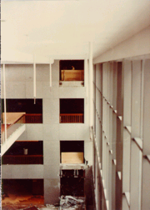
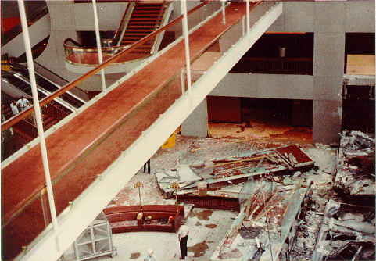
Photographs of the Destruction
Case Study Example

Slide 12
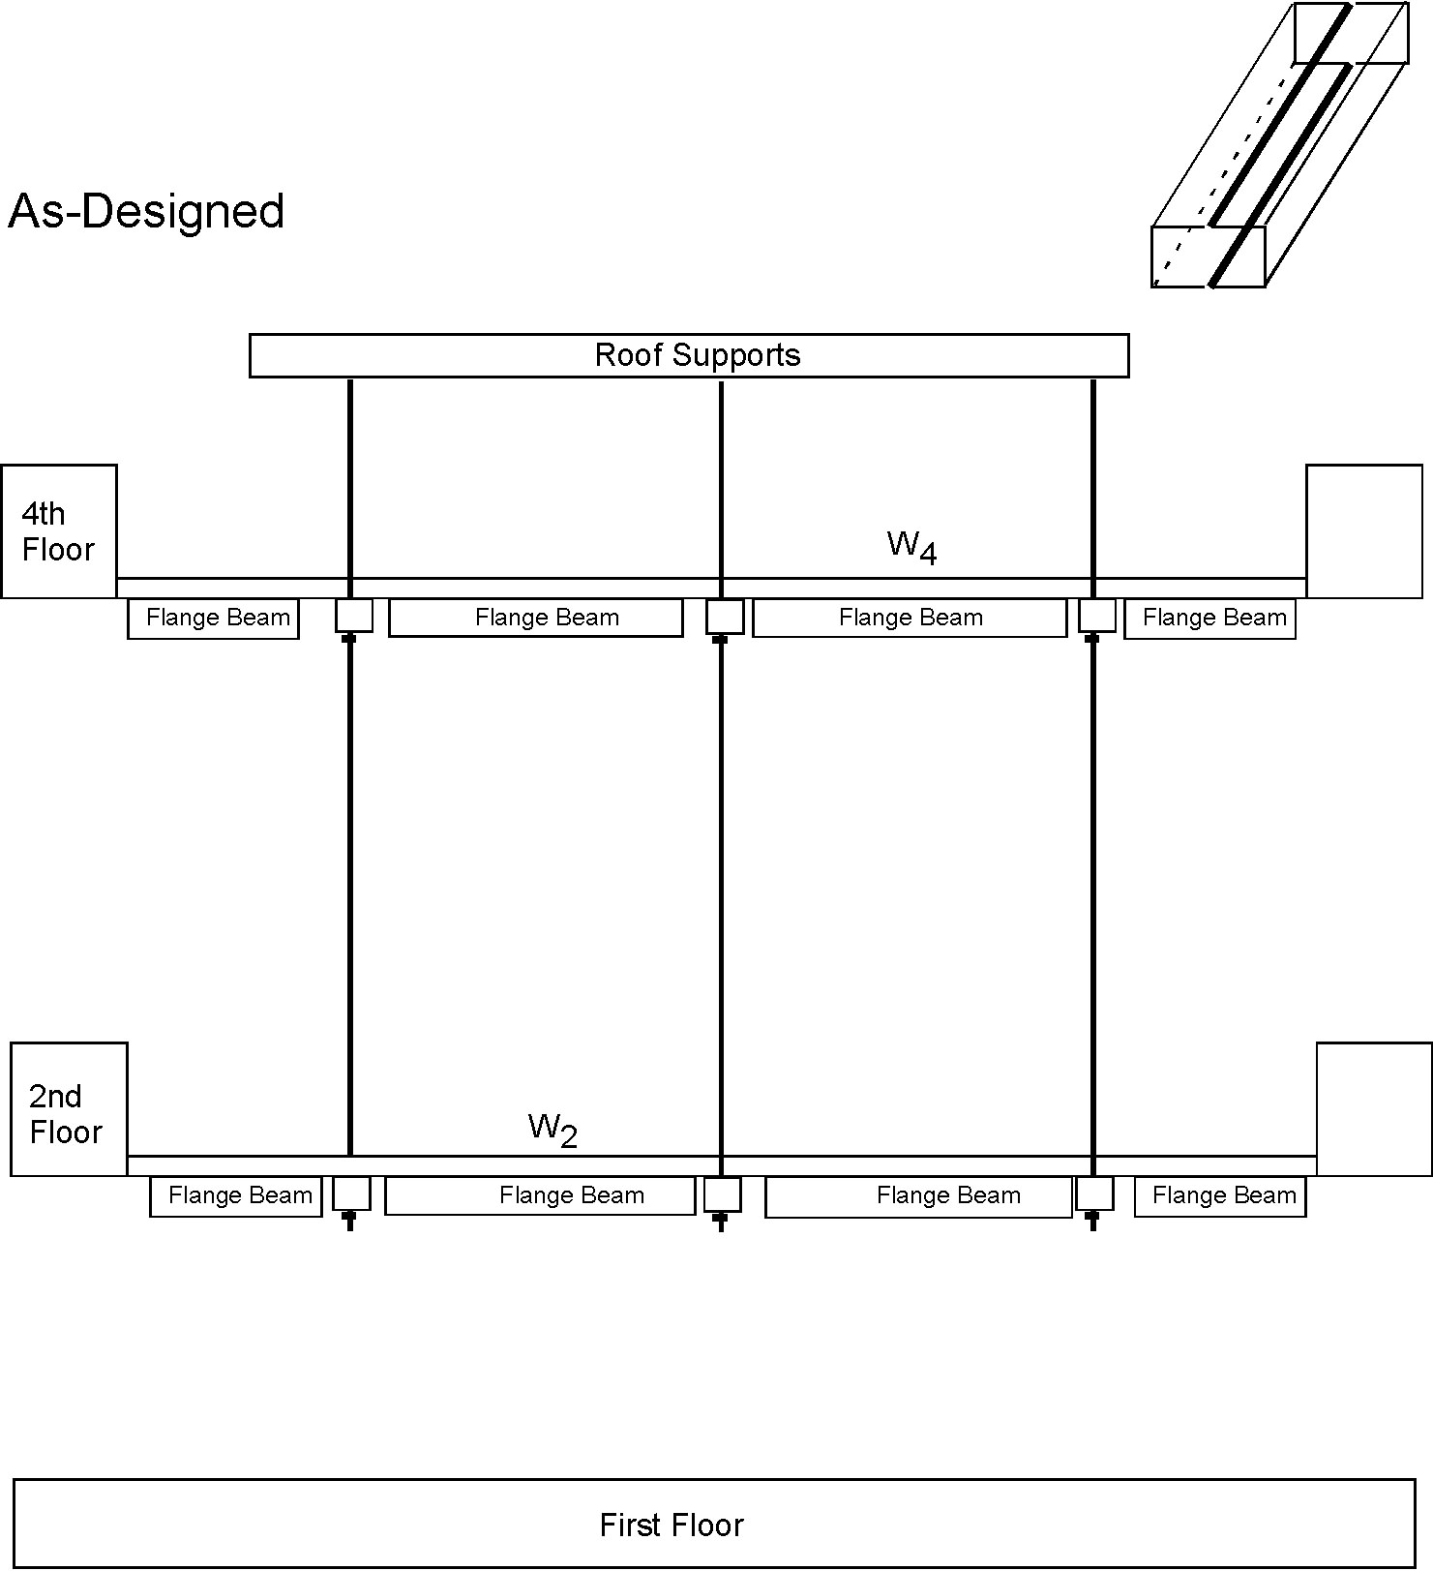
The Original Design of the Walkway
W4 box beams carry only the mass of the 4th floor (structure and people). This weight is transferred through the 4th floor nuts to the rod, which is attached to the roof.
W2 box beams carry only the mass of the 2nd floor (structure and people). This weight is transferred through the 2nd floor nuts to the rod, which is attached to the roof.
2D Image shows side view of the skywalks
Case Study Example

Slide 13
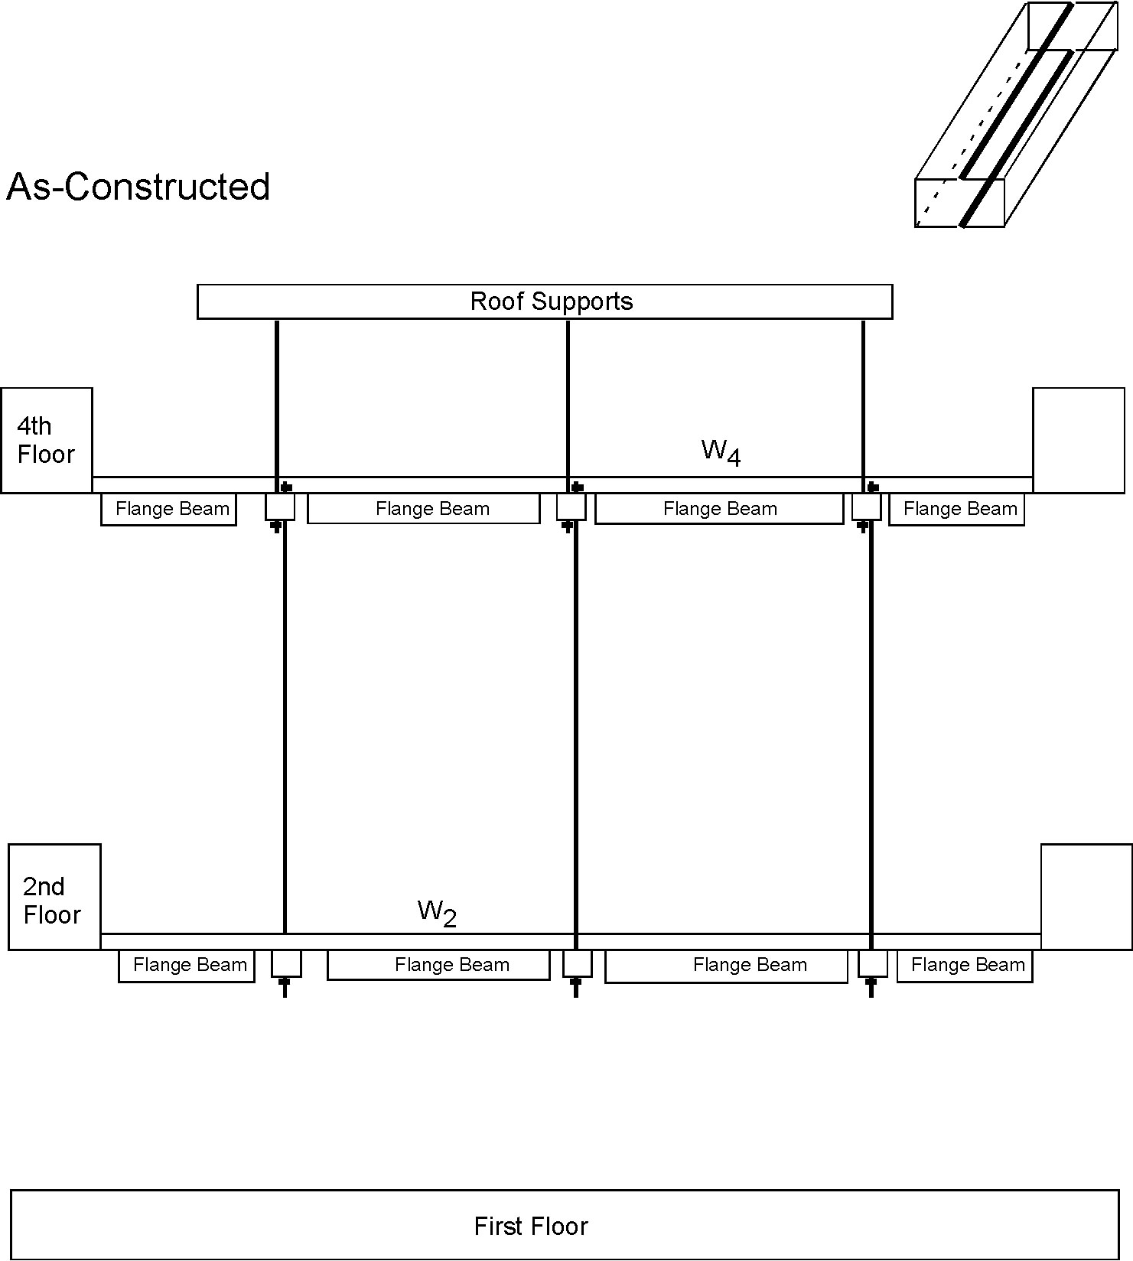
How the Design Changed the Loading Profile on the Walkway
W4 box beams now held the W4 (structure and people) and the W2 (structure and people). The weight of W4 and W2 was transferred to the upper rod through the bottom nuts on the 4 floor.
The approx. 2x load on the 4th floor walkway cracked the under weld in beams near each of the bottom nuts. The nuts, with 2x load on them, deformed through the cracked box beam, releasing the 4th floor skywalk. This collapsed to the 2nd floor, which collapsed to the first floor.
2D Image shows side view of the skywalks
Case Study Example

Slide 14
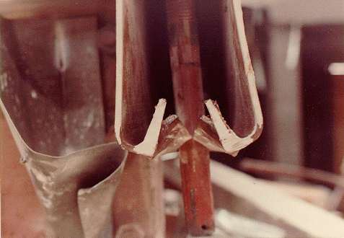
Failure of the As-Constructed Design
Case Study Example
Note: the steel rods never yielded.
http://ethics.tamu.edu/ethics/hyatt/hyatt2.htm

Slide 15
What are the Defining Issues?
Case Study Example
What are the most important question(s) to ask to understand critical issues in the case?
Who is responsible?
What did they know and when did they know it?
What choices were made?
Who is liable and why?

Slide 16
Timeline
Case Study Example
Early 1976: Crown Center Redevelopment Corporation commences project to design and build a Hyatt Regency Hotel in Kansas City, Missouri.
PBNDML Architects Chosen to do the design; they selected the rest of the design team
July 1976: Gillum-Colaco, Inc. (G.C.E. International, Inc., 1983), a Texas corporation, selected as the consulting structural engineer for the Hyatt project. President was Jack Gillum (state licensed since February 26, 1968); Engineering in charge of this project was Daniel Duncan (state licensed since February 27, 1979). No portion of the Hyatt project could commence until the drawings were approved by the structural engineer.
July 1976- Hyatt project in schematic design development.
Summer 1977: G.C.E. assisted owner and architect (PBNDML Architects, Planners, Inc.) with developing various plans for hotel project, and decided on basic design.
Late 1977- Bid set of structural drawings and specifications
Early 1978: Project prepared, using standard Kansas City, Missouri, Building Codes.
April 4, 1978: Actual contract entered into by G.C.E. and the architect, PBNDML Architects, Planners, Inc. G.C.E. agreed to provide "all structural engineering services for a 750-room hotel project located at 2345 McGee Street, Kansas City, Missouri."
1978: Duncan designed the box beams and hanger rods that were the structural steel members supporting the 2nd, 3rd, and 4th floors. Used 1.5 inch diameter steel. Approved by Gillum with his personal seal.
Spring 1978: Construction on hotel begins.
August 28, 1978: Specifications on project issued for construction, based on the American Institute of Steel Construction (AISC) standards used by fabricators.
December 1978: Eldridge Construction Company, general contractor on the Hyatt project, enters into subcontract with Havens Steel Company. Havens agrees to fabricate and erect the atrium steel for the Hyatt project.
http://ethics.tamu.edu/ethics/hyatt/hyatt1.htm and G.D. Baura

Slide 17
The Legal Fallout
Case Study Example
Dec. 1983: U.S. Attorney found no evidence to convict anyone of criminal negligence
February 3, 1984: Missouri Board of Architects, Professional Engineers and Land Surveyors files complaint against Daniel M. Duncan, Jack D. Gillum and G.C.E. International Inc., charging gross negligence, incompetence, misconduct and unprofessional conduct in the practice of engineering in connection with their performance of engineering services in the design and construction of the Hyatt Regency Hotel in Kansas City, Missouri.
According MO law, the case was presented before Judge James Deutsch to obtain permission to discipline the 2 engineers
Duncan and Gillum maintained their innocence; Though they had “nominally” approved the change, they refused to concede it made them responsible; “it was poor communication” between engineers and steel builders
Lawrence Grebel, the St. Louis attorney who represented Duncan and Gillum at the hearings, said it was not fair that his clients were found responsible for a change that was made without their knowledge.
But, MO licensing law states that a professional engineer is “responsible for the contents of all documents on which he/she places his seal.” (the plans were sealed by Gillum)
Gillum and Duncan claimed because of the complexity of most engineering projects and the number of people involved that many professional engineers routinely sealed plans that they had not personally checked.”
Judge Deutsch, “While those in authority may properly delegate the work of performing engineering design functions, he/she cannot delegate the responsibility”
Gillum and Duncan argued, “we aren’t the leaders of the design team, just members of it.”
Duncan testified at hearings that he never checked the connections. He said it was the responsibility of the fabricators to make sure the connections would hold.
Judge Deutsch: “this attempt by G/D to join the construction team occurred not because of the realities of practice, but for no greater purpose than their own convenience and financial benefit.”
November, 1984: Duncan, Gillum, and G.C.E. International, Inc. found guilty of gross negligence, misconduct and unprofessional conduct in the practice of engineering. Subsequently, Duncan and Gillum lost their licenses to practice engineering in the State of Missouri, and G.C.E. had its certificate of authority as an engineering firm revoked.
ASCE suspends Gillums membership for 3-years. Duncan and Gillum are now practicing engineers in states other than Missouri.
Pfatteicher, The Hyatt Horror: Failure and Responsibility in American Engineering, J. of Performance of Constructed Facilities, May 2000

Slide 18
Connection to Ethical Theory
Which underlying ethical theory(ies) did Judge Deustch use to come to his decision?
Should Gillum and Duncan (the structural engineers responsible for the accident) be allowed to practice engineering in other states? Why or why not?
What is the engineering society's responsibility in this realm?
Case Study Example

Slide 19
III. Student-Led Application of the Theory: Case Studies (1-2 weeks)
Ford Pinto Recall – Exploding Gas Tanks
Dan Applegate and the DC-10
Wm. LeMessurier and the Citicorp Building
Chernobyl
Three Mile Island
Ford Explorer Rollover
Ceiling Collapse and Boston’s Big Dig
Format: 20 min presentation,
5 mins Q&A

Slide 20
Class Promotion, Class Enrollment and Assignments
Flyer and individualized emails to academic advisors, with an idea of how the course would fit into the school’s plan of study
Taught in Spring 2010 with an enrollment of 21 students (10 MSEs, 2 MEs, 2 ECEs, 3 NEs, 3 IDEs, 1 Grad)
Assignments: Journal of reading assignments, eight 1-3 page essays, midterm exam, case study presentation

Slide 21
Assessment of Changes in Class Reasoning Ability
Defining Issues Test-2 (DIT2) devised at the University of Minnesota Center for the Study of Ethical Development
“The DIT is a device for activating moral schemas (to the extent that a person has developed them) and for assessing them in terms of importance judgments.”
“Higher N2 scores reflect an individual’s increased capacity for reasoning about moral issues based on a system of fairness that serves the public good.”
5 scenarios are presented and scored.

Slide 22
Assessment of the Course/ DIT2 N2 Score
The N2 score correlates with educational levels:
Senior high students ≈ 30s
College students ≈ 40s
Professional school graduate ≈ 50s
Philosophy doctoral students ≈ 60s
We gave the students the DIT-2 test on the 2nd day of class, prior to any “official” lectures, and again on the last day of class

Slide 23
Results of the DIT2 Assessment for Spring 2010
An average “pre-class” N2 score of 40±13, with only 5 students above 50.
correlates well with the N2 scores for first year college students in a large multi-university study.
After taking the course, we measured N2 scores of 51±11 with an increase to 12 students above 50
17 of 19 students improved their N2 score after the taking the class
Indicates substantial improvement in their moral reasoning ability as defined by the DIT2 test.
Pre-Class N2 Score on DIT2 | Post-Class N2 Score on DIT2 | Number of Students With Increased N2 Scores | Number of Students Scoring Above 50
40.4 ± 13.6 | 50.7 ± 11.4 | 17 of 19 | 5 Pre-Class/ 12 Post-Class
Pre-Class N2 Score on DIT2 | Post-Class N2 Score on DIT2 | Number of Students With Increased N2 Scores | Number of Students Scoring Above 50
40.4 ± 13.6 | 50.7 ± 11.4 | 17 of 19 | 5 Pre-Class 12 Post-Class

Slide 24
Conclusion
Students enrolled in “Ethics in Engineering Practice” increased their overall ethical reasoning ability as measured by the DIT2 test

Slide 25
ASCE Professional Codes and the KC Skywalk
ASCE (American Society of Civil Engineers) made dramatic changes to their Professional Codes of Conduct in the 70s because it did not:
Express concern for public safety
Dealt primarily with the business aspects of engineering
It stated what you should not do rather than what you should do
Prior to 70s, only the technical aspect of failures was considered not the role of the engineer in that failure.
New code should be written to address “the professional man and his relations to society” with these changes:
A hierarchy of engineer’s responsibilities was present
Public welfare should be the primary concern
Second should be the engineering’s duty to his clients, employer, etc.
Third should be the engineer’s loyalty to his profession
“The earlier code assumed an engineer was ethical until he was found otherwise; the replacement code assumed an engineer was unethical unless he fulfilled certain fundamental obligations.”
Changes in the codes made it easy to bring the charges up against Gillum/Duncan
Case Study Example

Slide 26
Lessons Learned: The Engineer’s Responsibility
When the engineer's actions are compared to professional responsibilities cited in the engineering codes of ethics, an abrogation of professional responsibilities by the engineer in charge is clearly demonstrated in the KC Skywalk Case.
Parting Comments:
Edward Pfrang, who headed the National Bureau of Standards' investigation into the collapse, blamed the disaster on a design change during construction.
Pfrang said one simple, but important lesson was learned from the collapse: all parties to the project have responsibilities they can't walk away from.
He said the Hyatt was "one of the worst examples of people trying to push off their responsibilities to other parts of the team."
After the collapse, the American Society of Civil Engineers adopted a policy that would have held the structural engineers responsible. It's now clearly stated that structural engineers are ultimately responsible for reviewing shop drawings by fabricators, Pfrang said.
While the society's policy is not legally binding, it would carry some weight in court, Pfrang said.
Case Study Example
http://www2.ljworld.com/news/2001/jul/15/lives_forever_changed/

Slide 27
Example Question Type on the DIT2
HEINZ AND THE DRUG
In Europe a woman was near death from a special kind of cancer. There was one drug that doctors thought might save her. It was a form of radium that a druggist in the same town had recently discovered. The drug was expensive to make, but the druggist was charging ten times what the drug cost to make. He paid $200 for the radium and charged $2,000 for a small dose of the drug. The sick woman's husband, Heinz, went to everyone he knew to borrow the money, but he could only get together about $1,000, which is half of what it cost. He told the druggist that his wife was dying, and asked him to sell it cheaper or let him pay later. But the druggist said, "No, I discovered the drug and I'm going to make money on it." So Heinz got desperate and began to think about breaking into the man's store to steal the drug for his wife.
Should Heinz steal the drug? __Should Steal __Can't Decide __Should not steal

Slide 28
Next, Rank the Defining Issues in the Case…
Please rate the following statements in terms of their importance. (1=Great importance, 2=Much importance, 3=Some Importance, 4=Little importance, 5=No importance)
__1. Whether a community's laws are going to be upheld.
__2. Isn't it only natural for a loving husband to care so much for his wife that he'd steal?
__3. Is Heinz willing to risk getting shot as a burglar or going to jail for the chance that stealing the drug might help?
__4. Whether Heinz is a professional wrestler, or had considerable influence with professional wrestlers.
__5. Whether Heinz is stealing for himself or doing this solely to help someone else.

