Slide 1
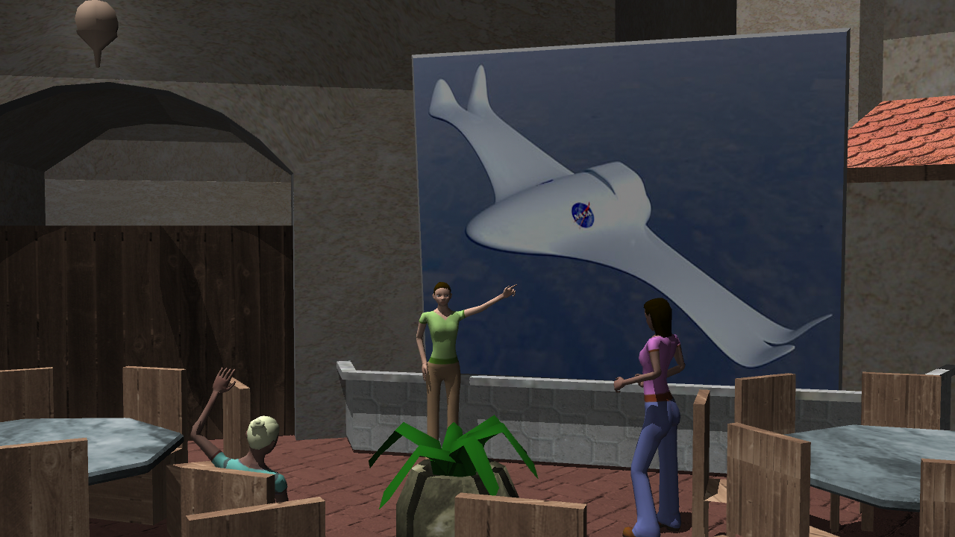
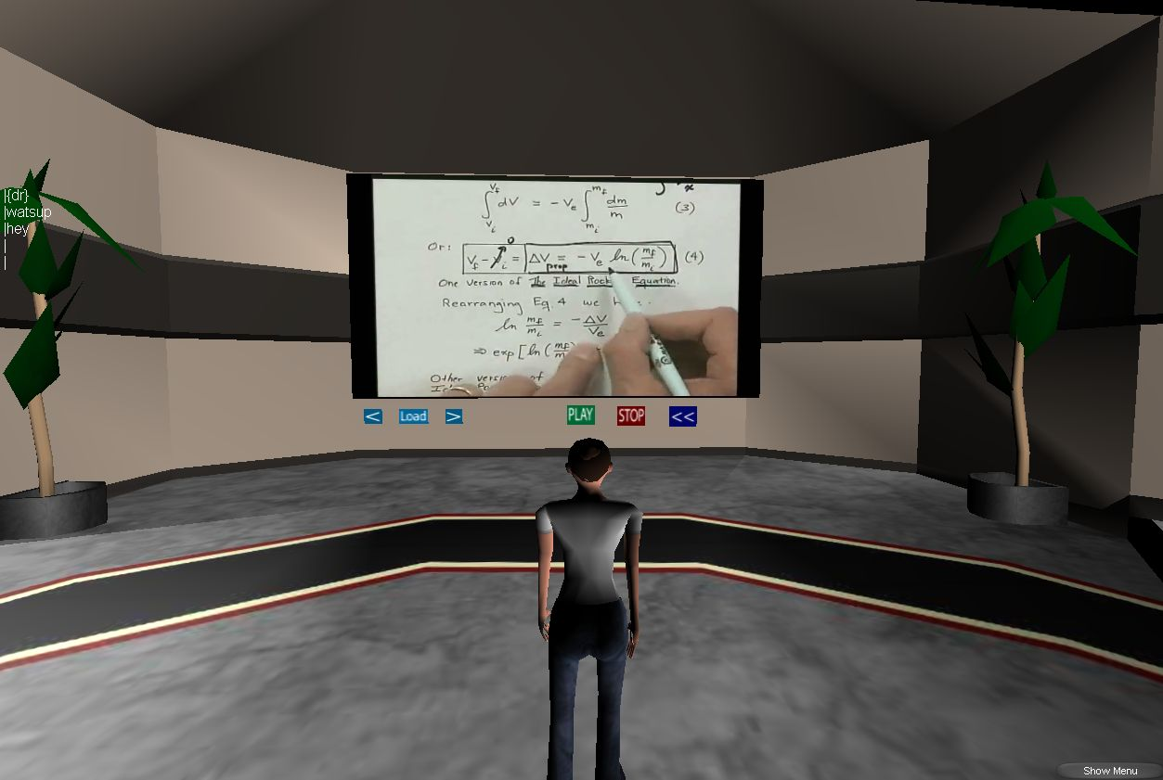
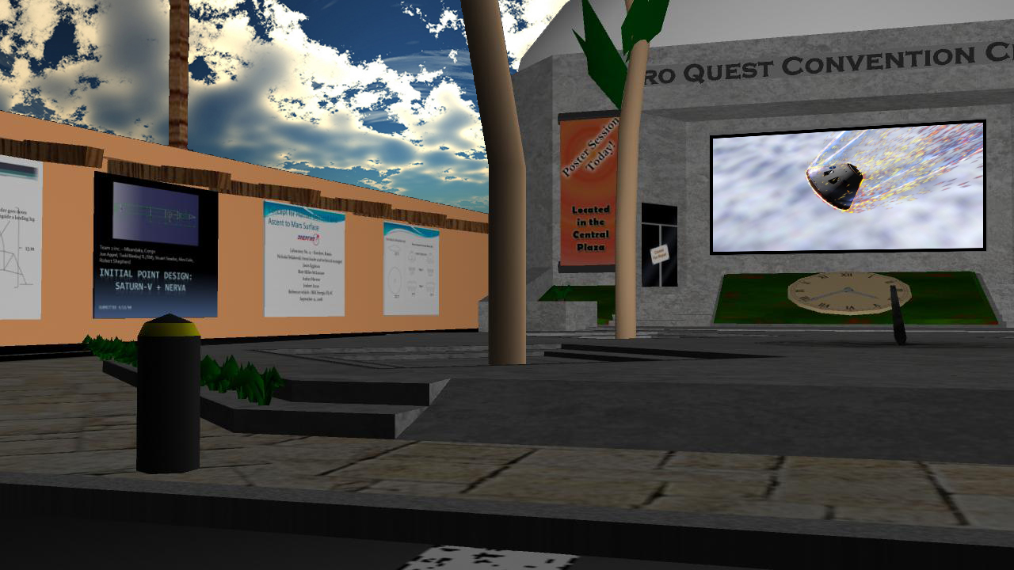
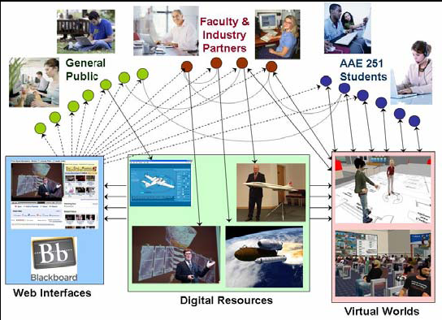
Multidisciplinary Insights for Learning Engineering Aerospace Design
Dr. Daniel Delaurentis (AAE) ddelaure@purdue.edu
Dr. Sean Brophy (ENE) sbrophy@purdue.edu
Dr. Kathleen Howell (AAE) howell@purdue.edu
Target Attributes Studied
Abilities
Develop abilities in cross-disciplinary design, teaming, and communication.
Knowledge
Solve open-ended design problems banking on digital videos and engineering simulators.
Qualities
Adapt to new borderless workplace filled with ubiquitous technology.
Learners, represented by customizable characters, interact within a virtual corporation to design aerospace vehicles. Public forums provide space and opportunities for learners to display their research projects and receive feedback.
Teams generate and discuss ideas in private design rooms using various collaboration tools, while individuals solve smaller problems via learning aids such as videos and simulators.
The simulated corporate environment provides a rich dynamic interaction with evolving technologies and other learners.
PE 2020 Project
The PE 2020 funds provide the opportunity to capture and share multiple perspectives from experts (from industry and academia), leveraging our ongoing research on learning via virtual worlds. Experts share insights into complex engineering problems through video contents and interactive avatars (player characters).
To date, a set of video lectures have been incorporated within a virtual world where players are engaged in solving “quests” in aerospace design.
Initial testing was conducted in Summer 2008. Preliminary version was released to AAE251 in Fall 2008.
Objective
Simulate corporate experiences with access to digital resources and simulation tools that support collaborative design.
Expected Impact
Our collaborative design tools and methods will create authentic decision-making experiences and enhance peer-to-peer learning.
Notes:
Dr. DeLaurentis can be contacted at School of Aeronautics & Astronautics, 701 W Stadium Ave, West Lafayette, IN 47907 or Office Phone: 765 494-0694

