Slide 1
Statics Outline Overview
STATICS, p. 131
INTRODUCTORY CONCEPTS IN
MECHANICS, p. 132
Newton’s Laws of Motion
Newton’s Law of Gravitation
Dimensions and Units of Measurement
Notes:
STATICS, p. 131
Forces applied to a body may not cause acceleration; analysis of such situations is statics.
INTRODUCTORY CONCEPTS IN MECHANICS, p. 132
Newton’s Laws of Motion
Newton’s second law states that force equals mass times acceleration; this chapter deals with cases in which the acceleration is zero. His third law states that the forces exerted by one body on a second body are equal and opposite to the forces exerted by the second body on the first; this law is not as simple as it looks.
Newton’s Law of Gravitation
The gravitational attraction between two objects is proportional to the product of their masses and the inverse of the square of the distance between them; for objects near the surface of the Earth this force simplifies to the product of the object’s mass and g, the Earth’s gravitation (formulas p. 132).
Dimensions and Units of Measurement
The fundamental units of mass, length, and time can be variously combined to express every other quantity in mechanics; various systems exist so use care in expressing units (table p. 133).

Slide 2
Statics Outline Overview Continued
VECTOR GEOMETRY AND ALGEBRA,
p. 133
Addition and Subtraction
Multiplication by a Scalar
Dot Product
Unit Vectors and Projections
Notes:
VECTOR GEOMETRY AND ALGEBRA, p. 133
A vector has both magnitude and direction; it is visualized as an arrow with length and orientation.
Addition and Subtraction
The sum of two vectors is a vector determined by the parallelogram law. The sum is the vector represented by the diagonal of the parallelogram formed by the two vectors placed with their tails coincident. The negative of a vector b has the same magnitude as but opposite direction to b and it is written as –b. Subtraction of two vectors is then defined by a – b = a + (-b) (Figures and formulas pp. 133-134).
Multiplication by a Scalar
The magnitude of the product of a scalar and a vector is the product of the two magnitudes; the direction of the product is determined by the direction of the vector and the sign of the scalar; a negative sign reverses the vector’s direction (formulas p. 134).
Dot Product
The product of two vectors is the scalar product of their magnitudes and the cosine of the angle between them (formulas p. 135).
Unit Vectors and Projections
A vector may be expressed as the product of its magnitude and a unit vector; dot-multiplying a vector by a unit vector in the direction of a line makes it possible to evaluate the vector projection onto that line (figure and formulas pp. 135-136).

Slide 3
Statics Outline Overview Continued
VECTOR GEOMETRY AND ALGEBRA
(Continued)
Vector and Scalar Equations
The Cross Product
Rectangular Cartesian Components
Notes:
VECTOR GEOMETRY AND ALGEBRA (CONTINUED)
Vector and Scalar Equations
Expressing vectors as the product of magnitudes and unit vectors simplifies isolating magnitude relationships from a vector relationship (figure and formulas p. 136).
The Cross Product
The magnitude of the cross product of two vectors equals the product of their two magnitudes and the sine of the angle between them; the direction of the product is perpendicular to the plane of the two original vectors and in the direction of the advancement of a right hand screw being turned from the first toward the second of the two original vectors (figure and formulas p. 125).
Rectangular Cartesian Components
Three mutually perpendicular unit vectors can be used to project a vector onto rectangular Cartesian components; useful formulas result (formulas p. 137).

Slide 4
Statics Outline Overview Continued
FORCE SYSTEMS, p. 139
Types of Forces
Point of Application and Line of Action
Moments of Forces
Notes:
FORCE SYSTEMS, p. 139
An accounting system is needed to understand the cumulative effect of multiple forces on a body.
Types of Forces
It may or may not be accurate to simplify analysis of a distributed force by considering it as being applied at a single point of application; forces may act on the body’s surface or throughout its mass.
Point of Application and Line of Action
A force vector acting on a body defines a line of action through the point of application.
Moments of Forces
The moment of a force about any point is the cross product of the force and the position vector from the point to any point on the line of action of the force; for an axis of rotation, the moment is a measure of the rotation caused by the force, and can be expressed in terms of the moment about a point on the axis and a unit vector along the axis (figures and formulas pp. 140-141).

Slide 5
Statics Outline Overview Continued
FORCE SYSTEMS (Continued)
Resultant Forces and Moments
Couples
Moments about Different Points
Equivalent Force Systems
Notes:
FORCE SYSTEMS (CONTINUED)
Resultant Forces and Moments
The sum of several forces, each with its own line of action, is the resultant force; the sum of the cross products of the forces and the position vectors from one point to any points on the force’s lines of action is the resultant moment about that single point (formulas pp. 141-142).
Couples
A pair of forces may have zero resultant force but nonzero resultant moment, for instance if they have separate lines of action; in that case they are called a couple.
Moments about Different Points
The resultant moment of a set of forces about a first point is equal to the sum of their resultant moment around a second point plus the moment their resultant would have about the first point if the line of action of the resultant passed through the second point (figure and formulas p. 142).
Equivalent Force Systems
If two sets of forces have the same resultant force and the same resultant moment about a point, they are termed equivalent; they will also have the same resultant moment about any other point.

Slide 6
Statics Outline Overview Continued
EQUILIBRIUM, p. 143
Free-Body Diagrams
Equations of Equilibrium
TRUSSES, p. 150
Equations from Joints
Equation from Sections
Notes:
EQUILIBRIUM, p. 143
For any one of the external forces acting on a material element of a system of bodies, the moment about any point equals the cross product of the position vector from that point to that element and the product of the mass and acceleration of the element; the sums include all of the external forces and material elements, so in static equilibrium the accelerations, resultant of all external forces, and resultant moment of those forces about any point are all zero (formulas p. 143).
Free-Body Diagrams
In defining an equilibrium relationship, a free-body diagram can be used to show which body part, body, or body system is part of the relationship, and what outside forces are acting on the part or parts (figures p. 144).
Equations of Equilibrium
Free-body diagrams of isolated elements can lead to understanding of an overall system in equilibrium.
TRUSSES, p. 150
A truss is defined as a structure made up of pieces connected at flexible joints; the pieces can transmit forces of tension or negative tension (compression) along their axes.
Equations from Joints
By isolating the portion of a truss around one joint as a free-body, forces in those members can be determined; by taking those values and working progressively through the truss, remaining forces can be evaluated (figures and formulas pp. 150-151).
Equation from Sections
By finding the free-body of a section of a truss with an axis having only one unknown force with nonzero moment, the rest of the forces making up the resultants of force and moment can be found, because both resultants are zero in static equilibrium (figures and formulas pp. 152-154).

Slide 7
Statics Outline Overview Continued
COUPLE-SUPPORTING MEMBERS, p. 154
Twisting and Bending Moments
SYSTEMS WITH FRICTION, p. 157
Notes:
COUPLE-SUPPORTING MEMBERS, p. 154
Unlike a truss element, a rigid member may carry loads that do not run along its axis; lateral forces with nonzero moments across a section complicate analysis.
Twisting and Bending Moments
Taking a section through the member, isolating a free-body on each side, and finding the forces and moments reacting at the section makes it possible to evaluate forces and moments of the member (figures and formulas pp.154-157).
SYSTEMS WITH FRICTION, p. 157
For two bodies in contact, resistance to their sliding movement along a tangent to the surface of contact is approximately proportional to the force they exert on each other (figure and formulas pp. 157-158).

Slide 8
Statics Outline Overview Continued
DISTRIBUTED FORCES, p. 160
Single Force Equivalents
Center of Mass and Center of Gravity
Centroids
Second Moments of Area
Parallel Axis Formulas
Notes:
DISTRIBUTED FORCES, p. 160
Forces which act throughout a volume, such as gravity, or over a surface, such as water pressure, require computational summation for evaluation (formulas pp. 160-162).
Single Force Equivalents
Instead of evaluating integrals, some distributed forces can be found by using the concepts of the center of mass or centroids of volume, surface, or a line.
Center of Mass and Center of Gravity
Finding the moment about any point of a force acting equally throughout a body makes it possible to determine the intersection of the line of action of the resultant force and a position vector from that point; such an intersection is the center of mass and its resultant moment is zero regardless of the direction from which the line of action passes through it (figure and formulas pp. 163-164).
Centroids
For bodies of uniform density, the centroids of volume, surface area or a line segment may be found using a formula similar to that for the center of mass but substituting appropriate units; a composite centroid may be found from a summation using the known centroids of several volumes, areas, or line segments (formulas pp. 165-167).
Second Moments of Area
Forces on a plane area that vary linearly with distance from a zero-force line on the plane have a resultant force with a resultant moment about a point on the zero-force line that may be expressed in terms of the rectangular Cartesian components; integrals in these expressions are the second moments of area (figures and formulas pp.168-170).
Parallel Axis Formulas
A known value for one of the second moments of area may be used to find another value for a different origin (figure and formulas p. 170).

Slide 9
Basic Concepts

Slide 10
Solution

Slide 11
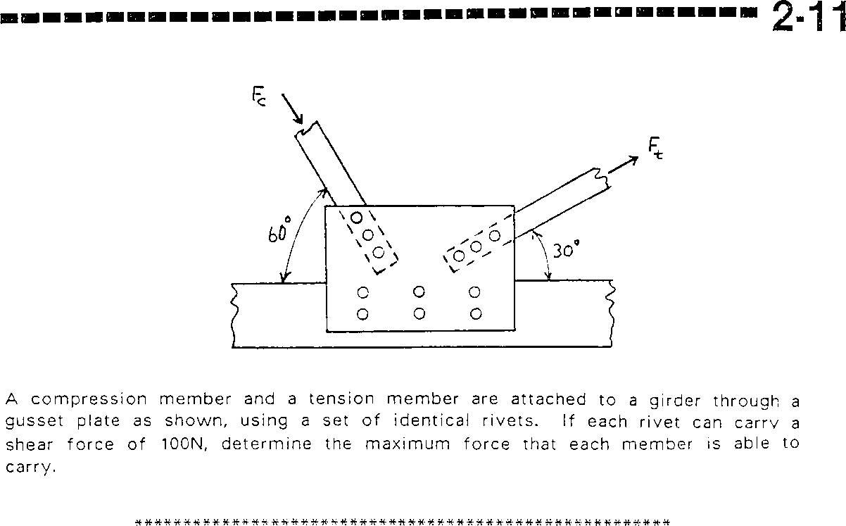
Resolving Forces in Two Dimensions

Slide 12
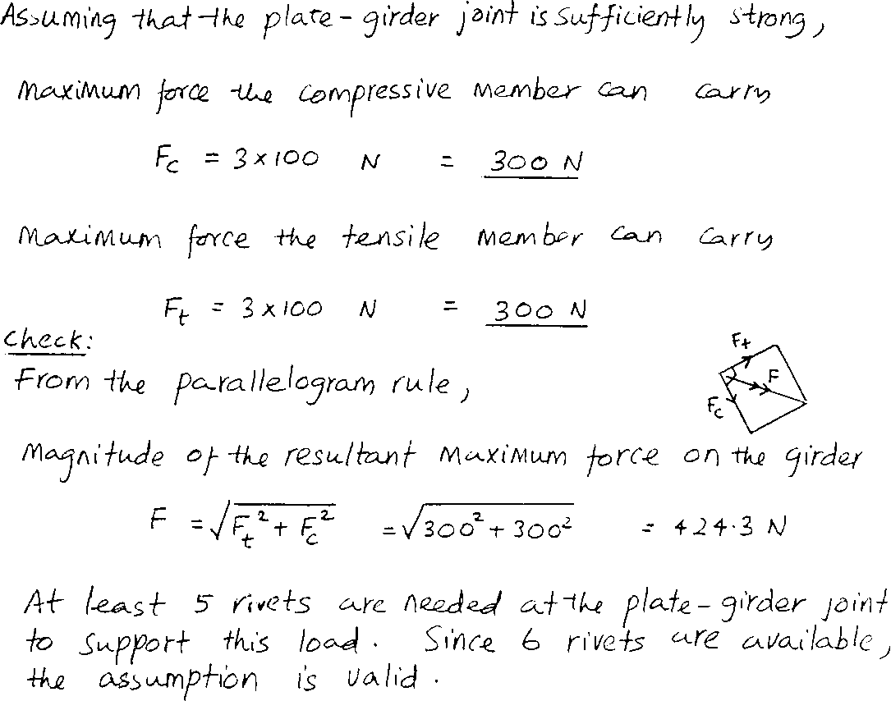
Solution

Slide 13
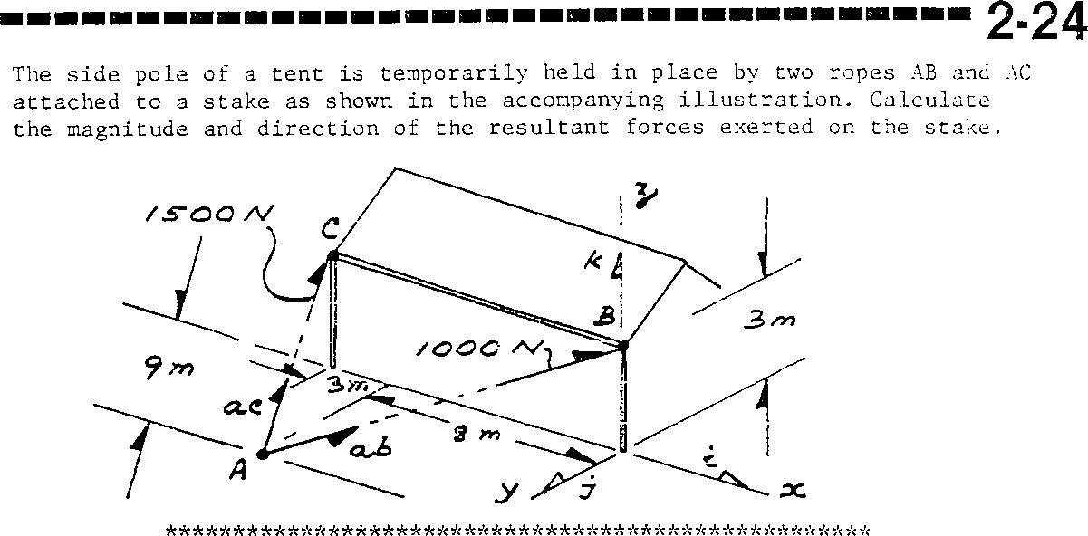
Resolving Forces in Three Dimensions

Slide 14
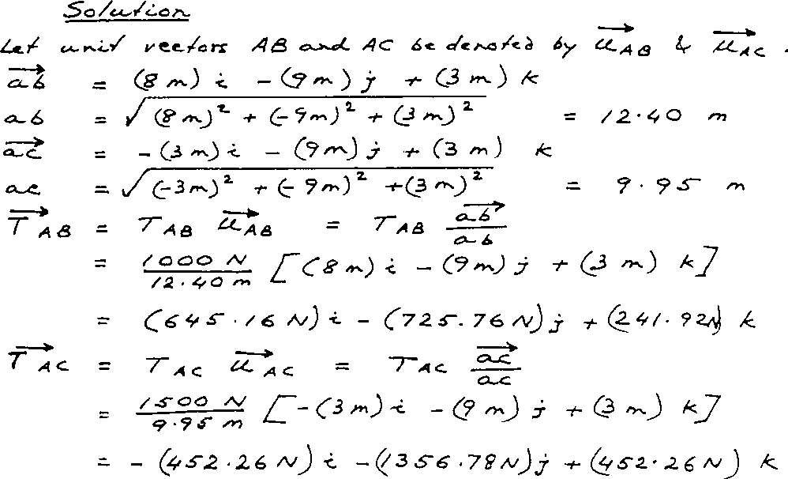
Solution

Slide 15
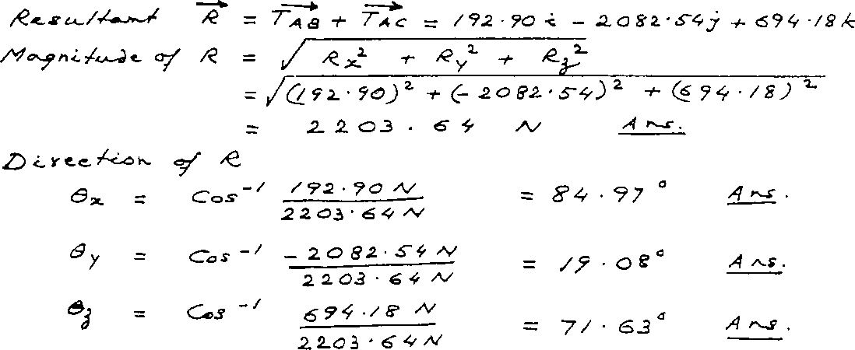
Solution (continued)

Slide 16
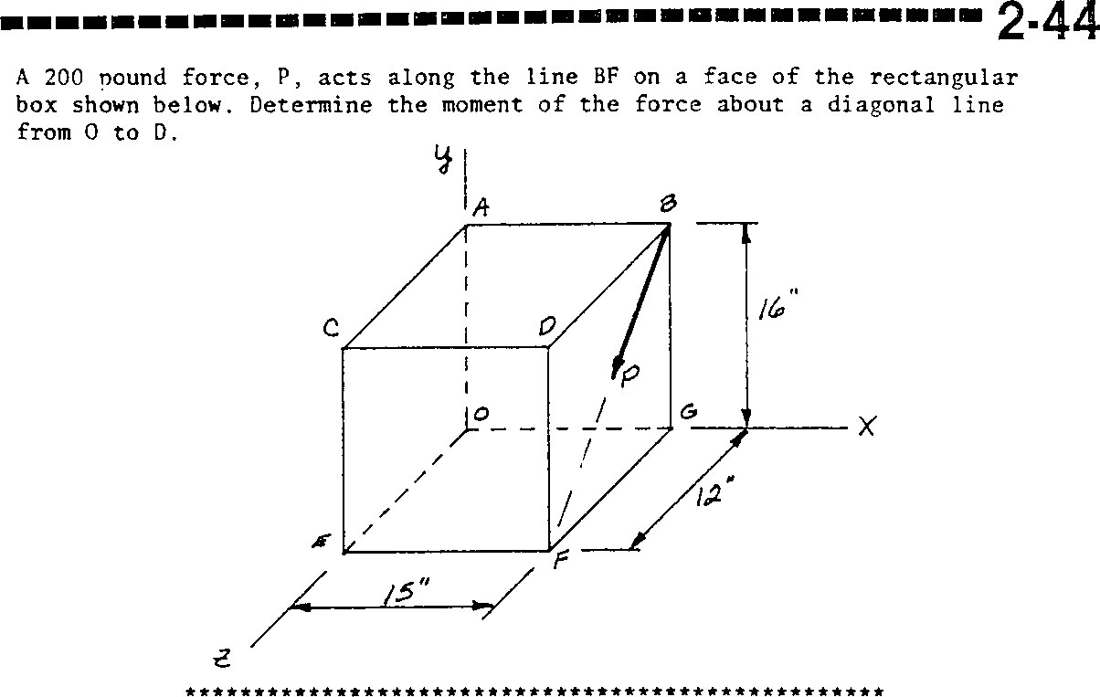
Moments of Forces

Slide 17
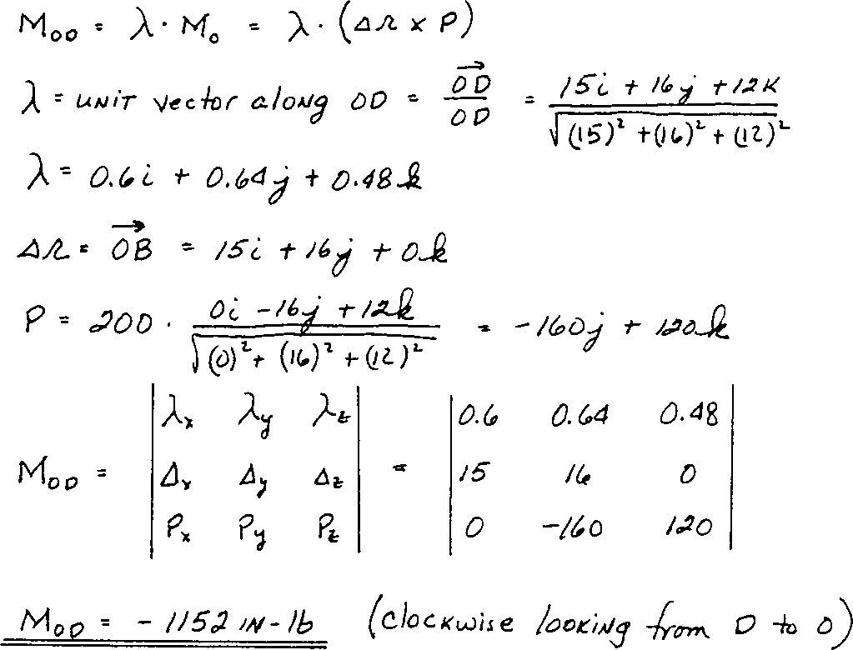
Solution

Slide 18
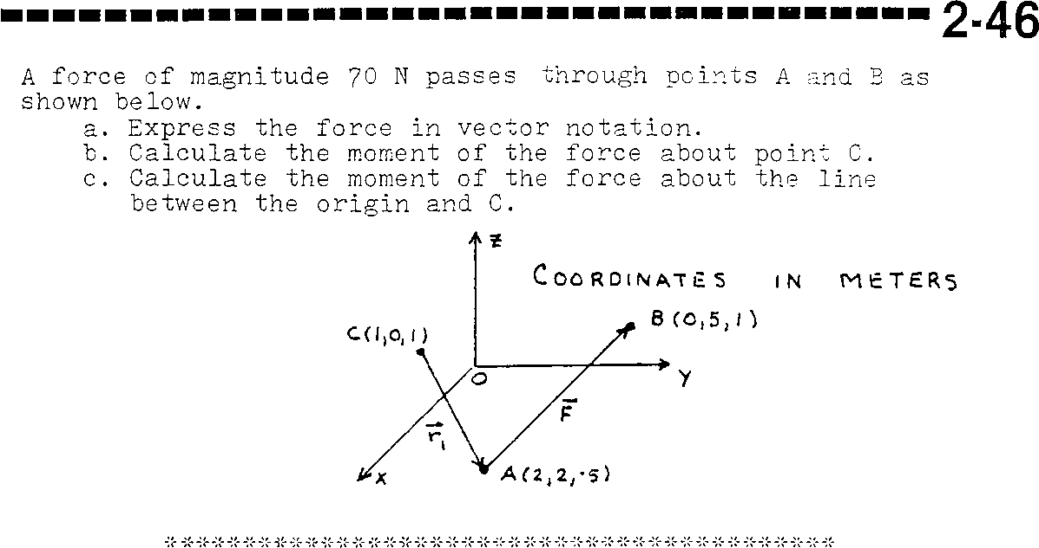
Moments of Forces

Slide 19
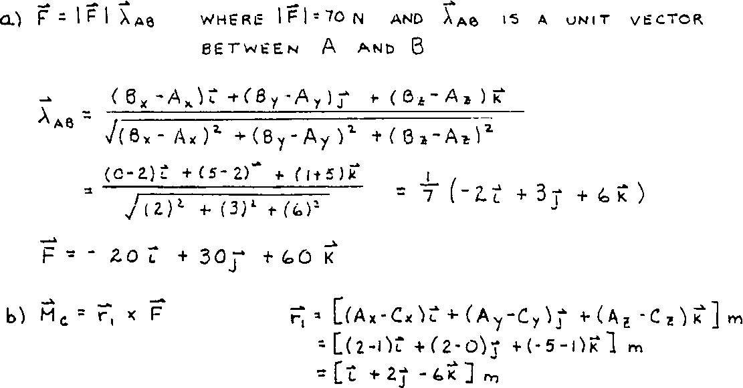
Solution

Slide 20
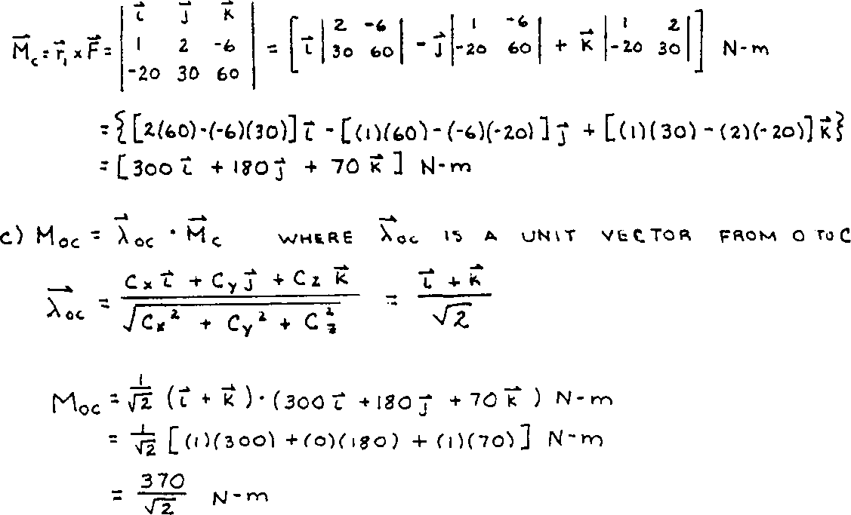
Solution (continued)

Slide 21
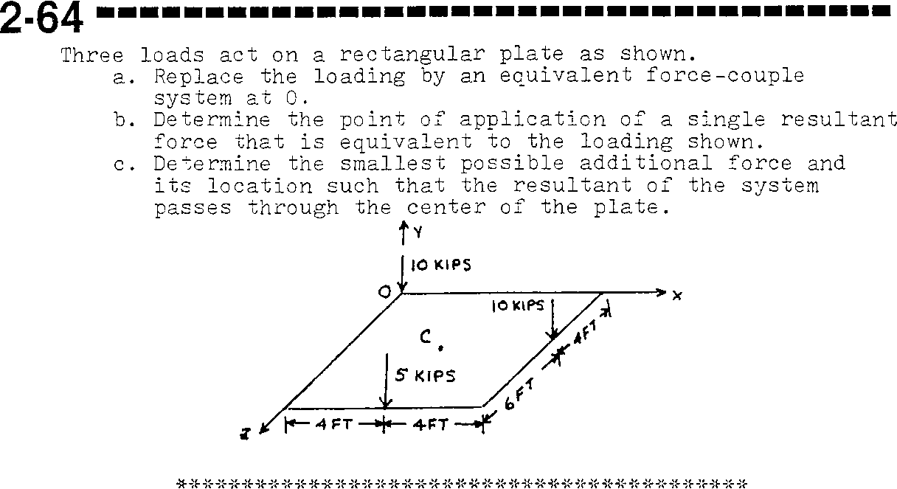
Equivalent Force Systems

Slide 22
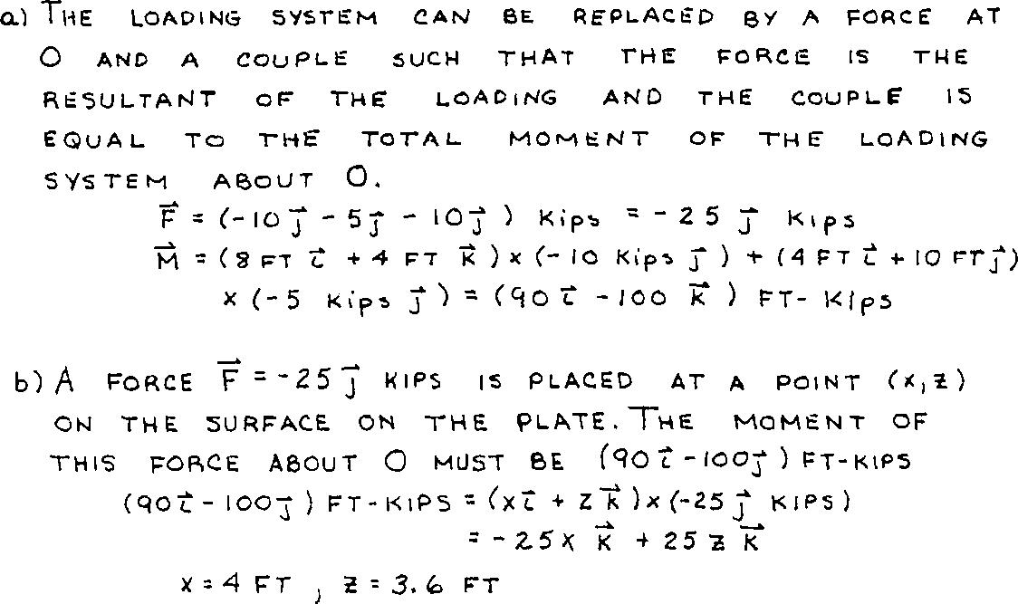
Solution

Slide 23
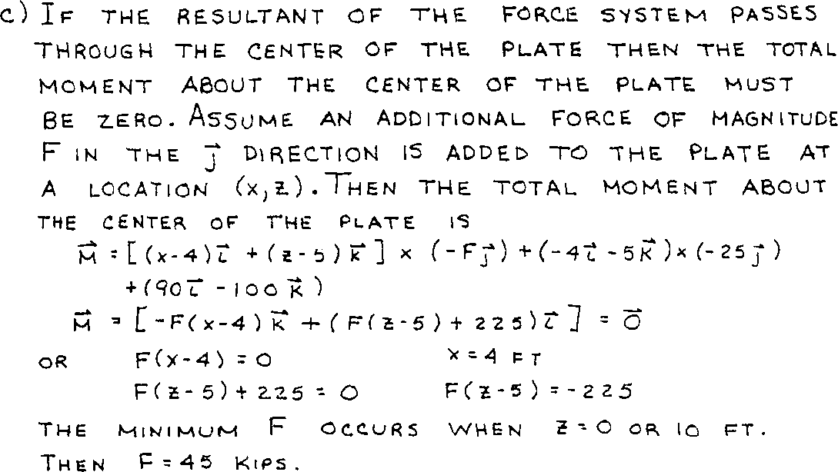
Solution (continued)

Slide 24
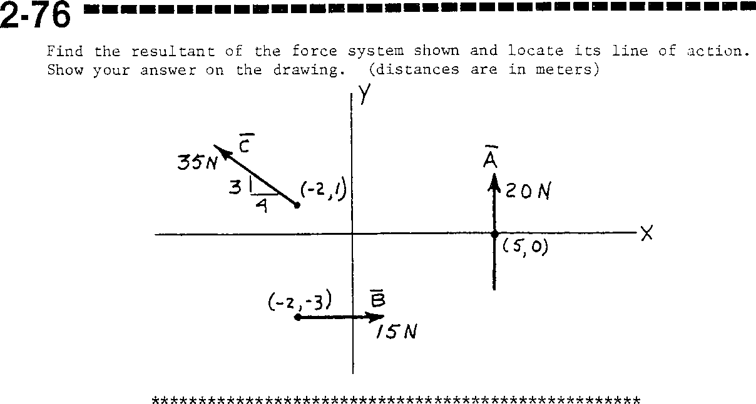
Equivalent Force Systems

Slide 25
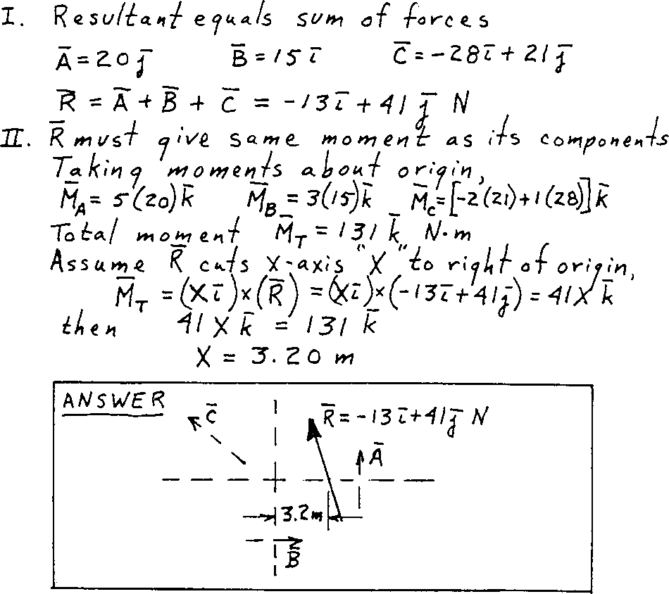
Solution

Slide 26
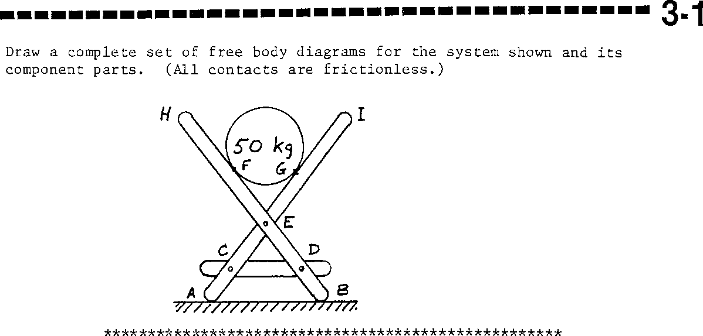
Free Body Diagrams

Slide 27
Solution

Slide 28
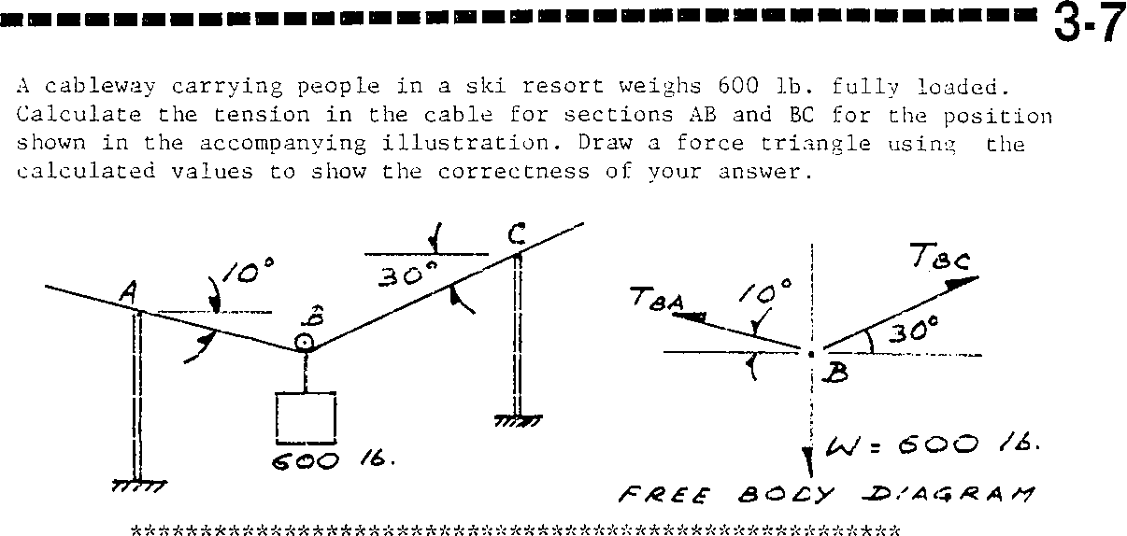
Equilibrium of Particles

Slide 29
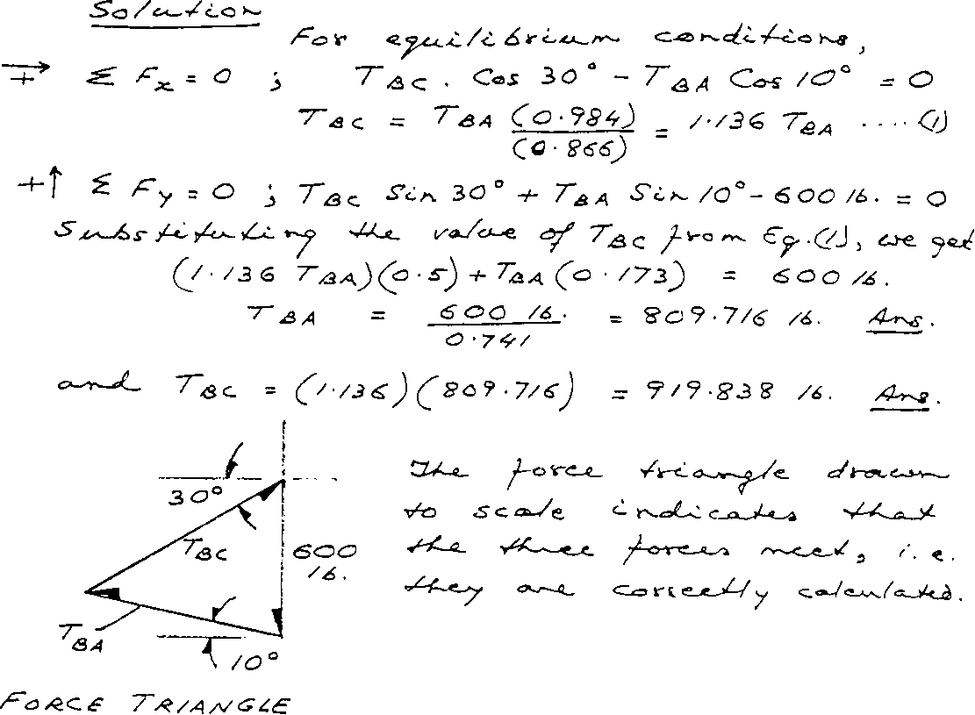
Solution

Slide 30
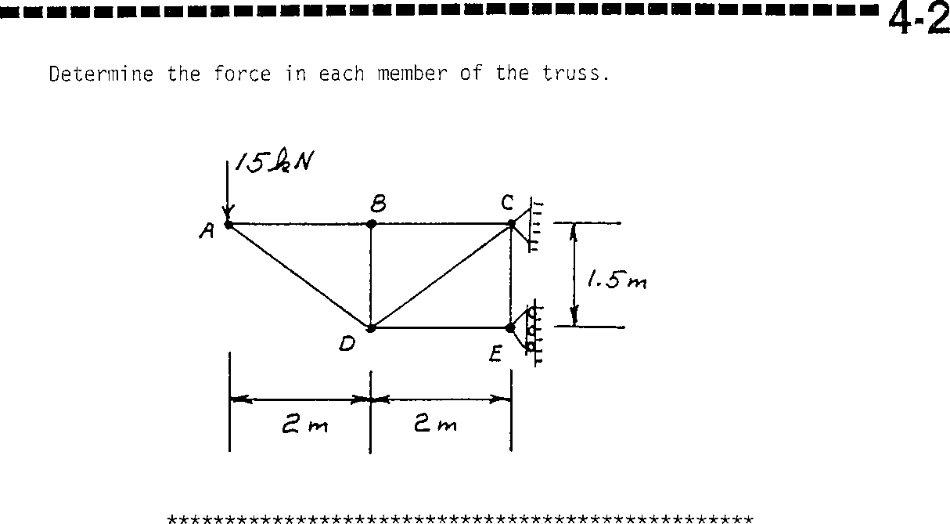
Trusses: Method of Joints

Slide 31
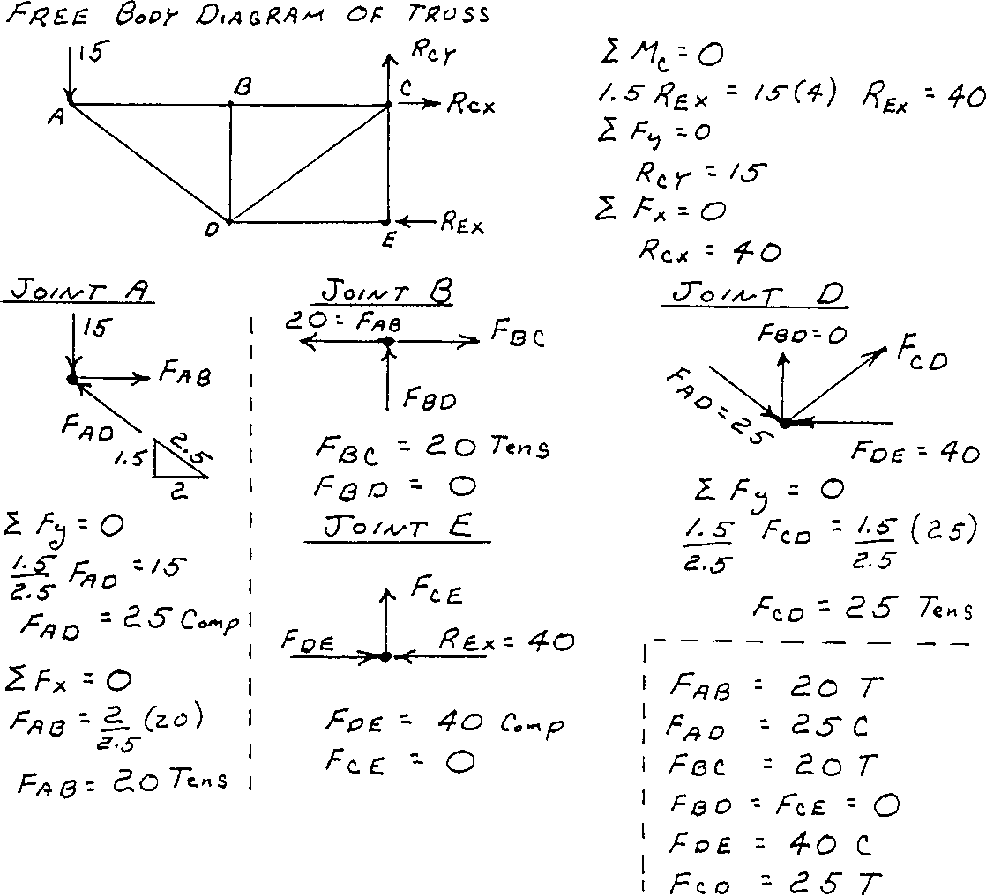
Solution

Slide 32
Trusses: Method of Sections

Slide 33
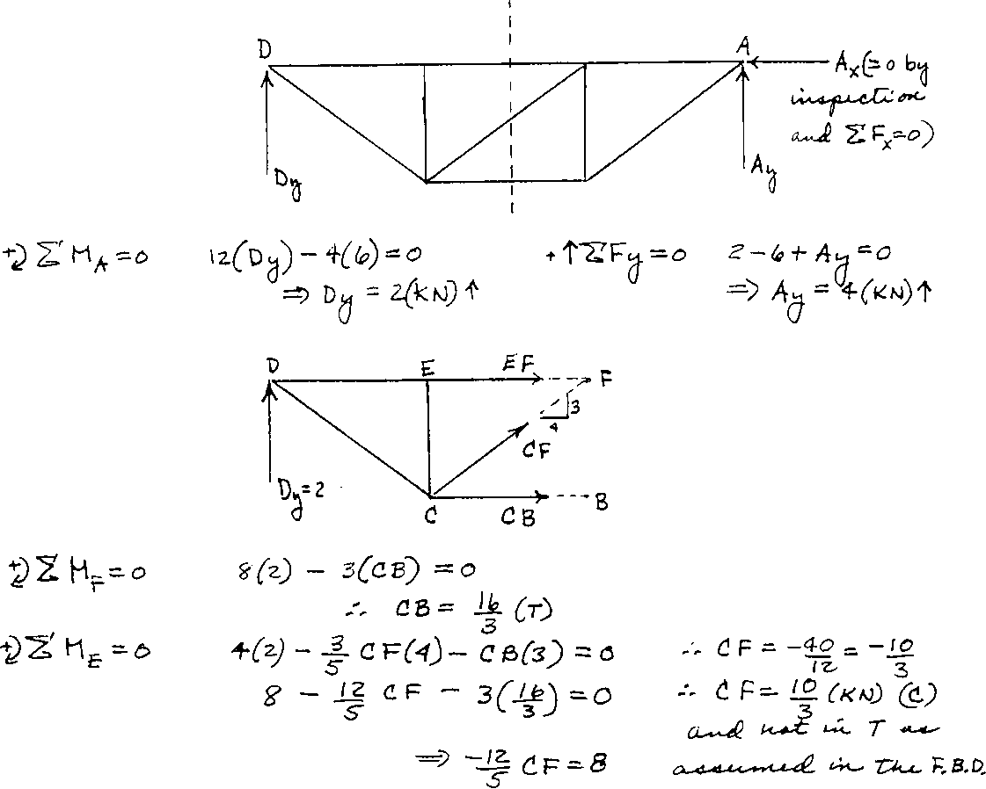
Solution

Slide 34
Centroids

Slide 35
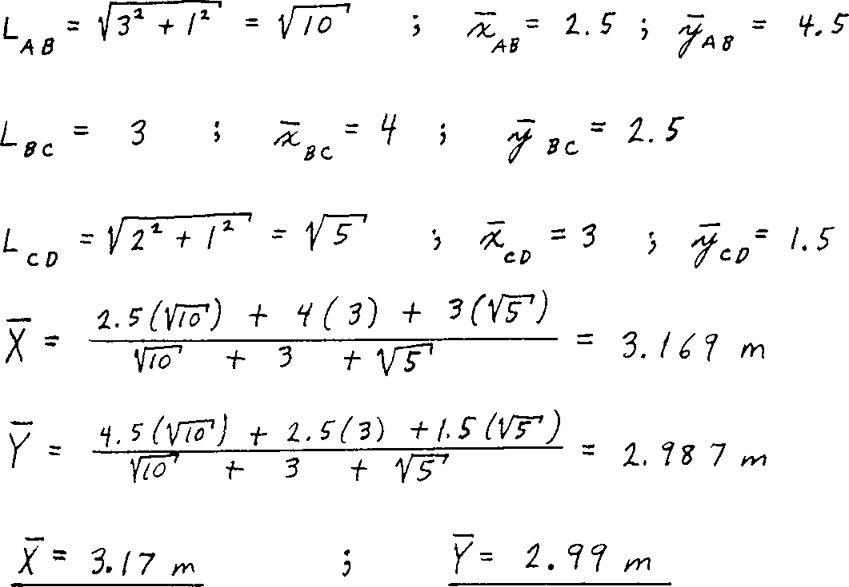
Solution

Slide 36
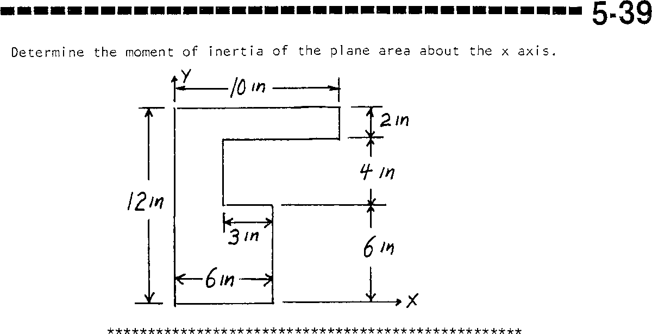
Second Moments of Area

Slide 37
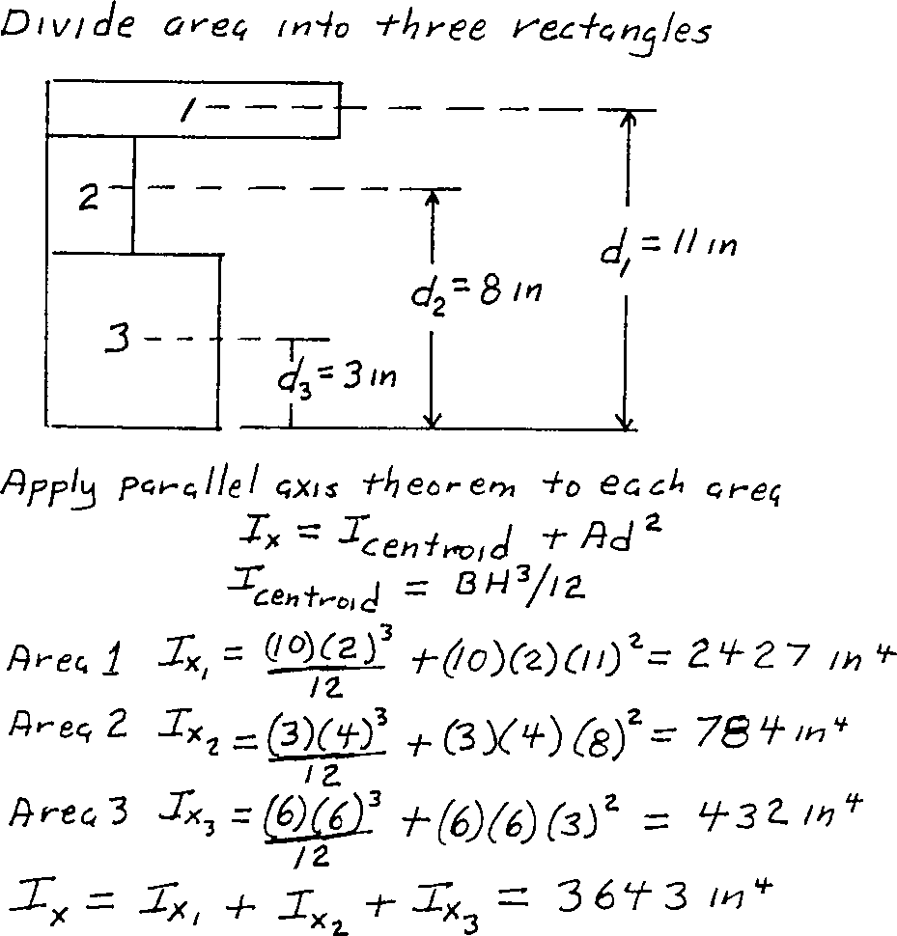
Solution

Slide 38
Friction

Slide 39
Solution

