Slide 1
FE Hydraulics/Fluid Mechanics Review
School of Civil Engineering
Hydraulics/Hydrology Group

Slide 2
Preliminaries, Fluid properties
Preliminaries
Units and dimensions
Forces and stresses
gage and absolute pressures: p_{abs}=p_{gage}+p_{atm}
Fluid properties
Density (ρ), specific gravity (s), specific weight (γ=ρg)
Dynamic (absolute) viscosity (μ)
relationship to shear stress, τ=μ(du/dy)
Kinematic viscosity (ν = μ/ρ)
idealizations: ideal fluid (μ=0), incompressible (ρ=constant)

Slide 3
Fluid properties problems
(p. 1, #1) What is the atmospheric pressure on a planet if the absolute pressure is 100 kPa and the gage pressure is 10 kPa?
(p_{atm}=p_{abs}-p_{gage})
Ans: C
(p. 1, #3) 100 g of water are mixed with 150 g of alcohol (ρ = 790 kg/m³). What is the specific gravity of the resulting mixture, assuming the fluids mix completely?
Ans: C
(p. 1, #4) Kinematic viscosity can be expressed in which units?
(ft²/s)
Ans: A

Slide 4
Fluid statics
pressure at depth, h: p = γh
manometer eqn.: p₂-p₁=-γ(z₂-z₁)
heads: pressure (p/γ), piezometric, (p/γ)+z
1
h₂
2
h₃
3
z

Slide 5
Forces on plane surfaces
Say you have a plane surface of area A inclined at an angle α with the free surface. To find the magnitude of the resultant force due to hydrostatic pressure:
Find the vertical distance of the centroid from the free surface.
Determine the hydrostatic pressure at the centroid.
Determine the force.
To find the line of action of the resultant force:
Find the moment of inertia of the surface about its centroidal axis. (Look up from appropriate tables)
The point of application of this force is
where is the distance measure along the incline.
F
Line of action
Centroid
Center of pressure

Slide 6
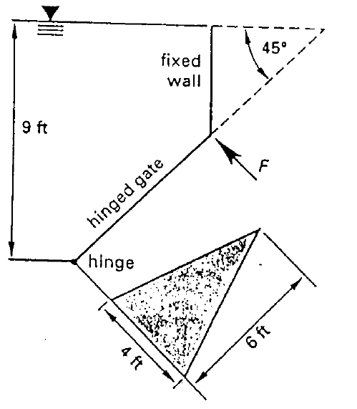
Example: forces on inclined planes
(Page 2, #6)
What force F must be applied at the gate vertex to keep it closed?

Slide 7
Example: forces on inclined planes
Solution steps:
Figure out total force from water on gate
Figure out where it acts
Sum moments about hinge

Slide 8
Example: forces on inclined planes
Total force from water on gate
Pressure at centroid times area

Slide 9
Example: forces on inclined planes
2. Location of action
Force acts at y_{cp}
Note that I_{xc} is moment about horizontal centroidal axis (could be labeled x or y in handbook)

Slide 10
Example: forces on inclined planes
Sum moments about hinge
Use geometry to figure out moment arms from y_{cp}

Slide 11
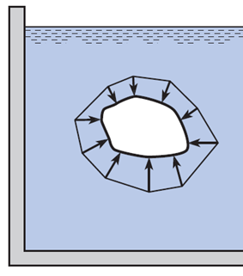
Buoyancy principles
Buoyancy: vertical force on a partially or fully submerged body in a fluid of different density.
Net horizontal force = ? zero
Net vertical buoyant force (F_{B}): the magnitude of the net vertical force is equal to the weight of the fluid displaced by the body; the line of action is upwards through the center of buoyancy (centroid of the fluid volume that is displaced) of the body
F_{B}
+
W
For submerged bodies:
F_{B}<W

Slide 12
Statics force problem
(p. 2, #4) What is the resultant force on one side of a 10 in diameter vertical circular plate standing at the bottom of 10 ft pool of water?
Ans: C A

Slide 13
Manometer problem
(p. 2, #3) One leg of a mercury U-tube manometer is connected to a pipe containing water under a gage pressure of 14.2 lbf/in². The mercury in this leg stands 30 in below the water. What is the height of the mercury in the other leg, which is open to the air? The specific gravity of mercury is 13.6.
add together to get Ans: C

Slide 14
Kinematics and dynamics
non-uniform motion, streamlines, control volumes and surfaces
discharge, Q, average velocity, V: Q = VA
momentum balance (ma=F) for steady flows (single-inlet, single-outlet)
vector equation: direction and components

Slide 15
Mass flow problems
(p. 3, #2) What is the mass flow rate of a liquid (ρ = 0.690 g/cm³) flowing through a 5 cm (inside diam.) pipe at 8.3 m/s?
Ans: A
(p. 6, #4) Water flows at 10 ft/s in a 1” diam. pipe What is the velocity if the pipe diameter suddenly increases to 2”?
Ans: A B

Slide 16
Momentum problem
(p. 3, #6) What horizontal force is required to hold the plate stationary against the water jet? All of the water leaves parallel to the plate.
1
2
F
Ans: B
x

Slide 17
Energy equation
total head, H=(p/γ)+z+V²/2g, head delivered by pump, h_{p}, head losses, h_{L}, head loss due to turbine work, h_{t}
grade lines: hydraulic (piezometric head) and energy (total head)

Slide 18
Energy equation problem
(p. 3, #1) Water flows through a multisectional pipe placed horizontally on the ground. The velocity is 3.0 m/s at the entrance, and 2.1 m/s at the exit. What is the pressure difference between these two points. Neglect friction.
Ans: B

Slide 19
Flow measurement
measurement of flow by measuring difference in piezometric head or depth
Venturi and orifice flow (Torricelli’s theorem):
Δh_{p}, change in piezometric head
discharge coefficient, C_{d} = C_{c}C_{v},
C_{c}: contraction coefficient,
C_{v}: coefficient of velocity

Slide 20
Venturi meter problem
(p. 4, #5) A Venturi meter with a diam. 6” at the throat is installed in a water main. A differential manometer is partly filled with mercury (the remainder of the tube is filled with water), and connected to the meter at the throat and inlet. The mercury column stands 15” higher in one leg than in the other. Neglecting friction, what is the flow through the main? The specific gravity of mercury is 13.6.
apply energy equation between inlet and throat plus manometer analysis to relate manometer info to flow rate
Ans: B

Slide 21
Orifice problem
(p. 5, #9) A sharp-edged orifice with a 2-in diam. opening is located in the vertical side of a large tank. The coefficient of contraction is 0.62, and the coefficient of velocity is 0.98. The orifice discharges under a hydraulic head of 16 ft. What is the velocity at the vena contracta?
Ans: D

Slide 22
Dimensional analysis
dimensional homogeneity
Buckingham-Pi theorem and determining dimensionless groups
standard dimensionless groups: Reynolds number, Re = ρVL/μ, and Froude number,

Slide 23
Flow in pressure conduits
continuous head loss or friction relationship, h_{f}=f(L/D)(V²/2g), f : friction factor
laminar flow: f=64/Re
turbulent flow: Moody diagram, f=fn(Re,k_{s}/D), k_{s}: roughness height of pipe material
minor losses, h_{m}=K(V²/2g), K : loss coefficient

Slide 24
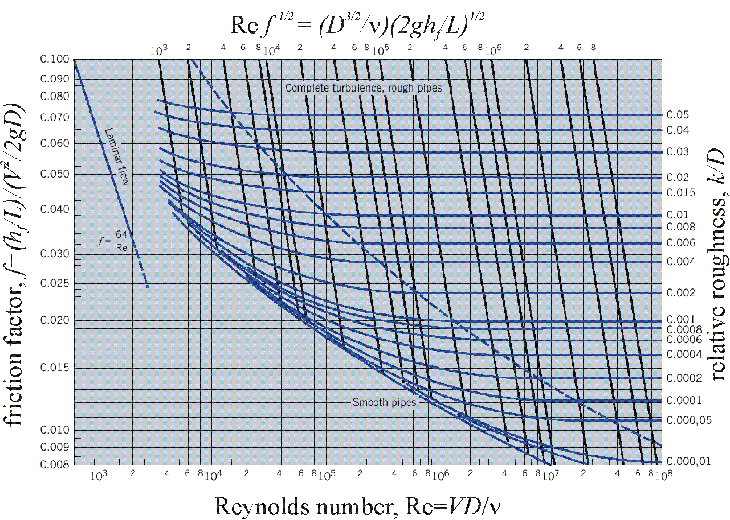
Moody diagram

Slide 25
Using Moody’s diagram
(p. 3, #7) Water flows with a velocity of 17 ft/s through 18 ft of cast-iron pipe (roughness = 0.00085 ft). The pipe has an inside diameter of 1.7 in. The kinematic viscosity of the water is 5.94 × 10⁻⁶ ft²/s. The loss coefficient for the standard elbow is 0.9. What percentage of the total head loss is caused by the elbow?
determine the friction factor, f, and compare K with (fL/D+K)
compute Re=VD/ν=4×10⁵, and k_{s}/D=0.006, and find f =0.034 from
Ans: D

Slide 26
Flow in open channels
geometry: wetted perimeter, P, and hydraulic radius, R_{h} = A/P
uniform flow: S_{f} = S₀ , where S₀ is channel slope
concept of critical flow and importance of Froude number
for rectangular channels of width, B, and depth, y:
subcritical flow (Fr < 1 or y > y_{c}),
supercritical flow (Fr > 1 or y < y_{c})

Slide 27
Open channel problems
(p. 6, #3) What is the hydraulic radius of a rectangular flume 2 ft high and 4 ft wide, which is running half full?
Ans: B E
(p. 6, #12) The critical depth in a rectangular channel 8 ft wide flowing at a critical velocity of 2 ft/s is approximately?
Ans: A

