Slide 1
Engineering Ethics
FE Review
Rachael Bisnett
October 14, 2009

Slide 2
Model Rules
Licensee’s Obligation to Society
Licensee’s Obligation to Employer and Clients
Licensee’s Obligation to Other Licensees
pp. 121-122 in FE Reference Handbook, 8th Ed.

Slide 3
Elements of a Contract
Mutual agreement
Subject matter must be lawful
Valid consideration
Parties must be legally competent
Formal contract must be expressed in a particular form

Slide 4
Ethical vs. Legal Behavior Examples
Advertising: While it is legal and not regulated, it can damage the reputation of the profession
Environment: Consider sustainability

Slide 5
Conflict of Interest
The obvious…
Also, avoid apparent conflicts of interest – any situation that might appear to be a conflict of interest from an outside observer
Falls under obligation to public
Disclosure important

Slide 6
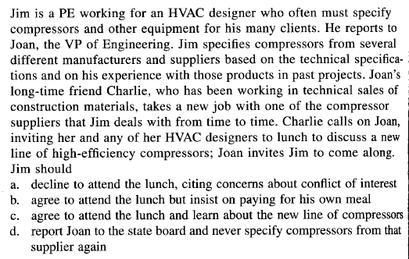
Example 1

Slide 7
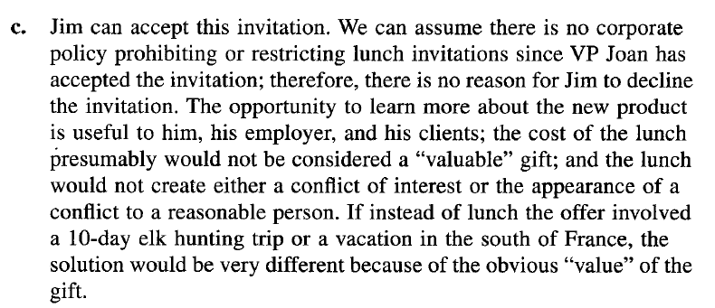
Example 1 Solution

Slide 8
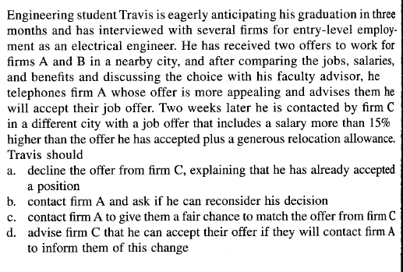
Example 2

Slide 9
Example 2 Solution

Slide 10
Example 3

Slide 11
Example 3 Solution

Slide 12
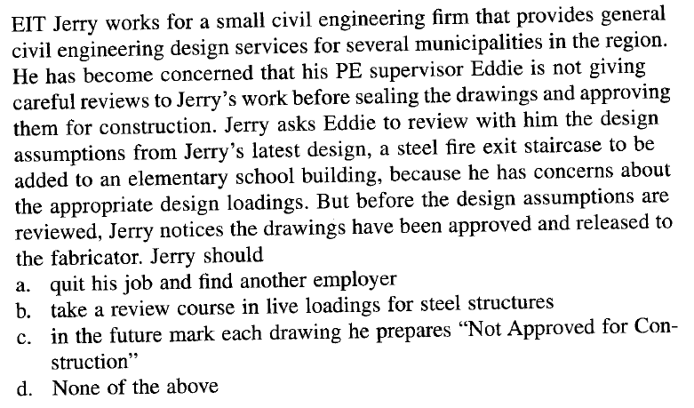
Example 4

Slide 13
Example 4 Solution

Slide 14
FE Exam Strategy
FE Review
Rachael Bisnett
October 14, 2009

Slide 15
General Notes
4 hour General test in the Morning Session with 120 questions - Covers first 2.5 years of typical undergraduate engineering program - Everyone takes the same AM exam
4 hour Choice test in the Afternoon Session with 60 questions - Don’t change your mind at the last minute – TAKE THE EXAM YOU PREPARED FOR!
1 hour lunch break
3 versions of the exam, so don’t cheat
If you finish more than 15 min. early, you can leave, otherwise stick around and check your work

Slide 16
Supplies
Calculator requirements are online at NCEES site and should have been in your registration booklet
You will get a new Handbook, so don’t bring yours
Do not bring your own pencil or eraser – yes, this means you will have a really cool mechanical pencil to take home at the end of the day as proof of your efforts!

Slide 17
Tips
Get to know the layout of the reference handbook
Answer every question – use your engineering logic to narrow down multiple choice answers (work backward if you need to)
“Harvest your points” – answer the easy ones for you first, then spend more time on the others
Go with your gut choice

Slide 18
Exam Day
Get a good night’s sleep and eat breakfast!
Don’t forget your Admit ticket and ID – or your scientific calculator!
Arrive early, but not too early
Don’t stress out – you either know it or you don’t at this point

