Slide 1
College of Engineering
Performance Review System
Prepared by: Dean’s Staff Advisory Committee
January 5, 2011
1

Slide 2
Background Statistics
In Spring of 2010:
296 PRS reviews were initiated
115 Reviews were complete
Many stalled after the One on One meeting
A Survey of Users indicated:
The system was too complex
The PRS system was not easy to use

Slide 3
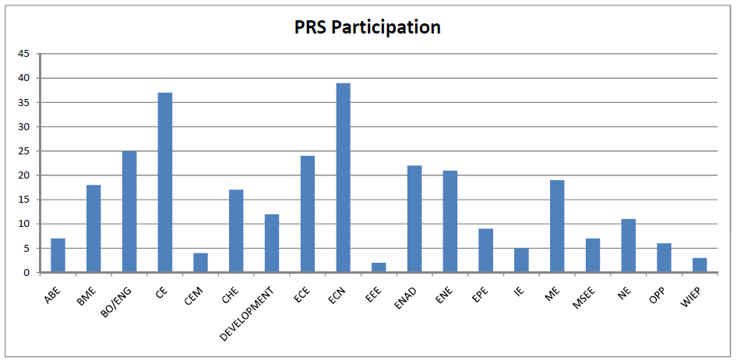
CoE PRS Participation

Slide 4
Survey Analysis
M – “Very long and time
consuming”
O – “Job descriptions can be
cumbersome”
R – “Difficult to use”
V – “Need multiple reminders”
W – “Instructions need
simplification”
Z – “Employee needs a copy
of the final result”

Slide 5
Goals of the PRS
Goals of the Performance Review System (PRS)
Consistent performance reviews for all CoE staff
Template for review process
Peer feedback mechanism
Goal setting and forward looking
Electronic archiving
With the 2011 revisions to:
Reduced Complexity
Simplified user interface

Slide 6
New Process Flow Diagram
Key
Supervisor
Employee
Reviewers

Slide 7
Opening Page of PRS
2

Slide 8
Supervisor Use Only— To Initiate Review of Employee
3

Slide 9
Supervisor Check list
10

Slide 10
Employee Approval Request Email
To: Employee_alias@purdue.edu
From: Supervisor_alias@purdue.edu
Subject: Performance Review Approval from %(supervisor)s
Employee,
Your Supervisor has initiated a review of your performance using Engineering's online performance review system. The first step in this process is for you to approve this review. Login using your career account login and password at the URL below. After logging in locate the review initiated by %(supervisor)s and click "Approve". If you have questions about this review process please contact your immediate supervisor.
Participation in the evaluation process and the results will be archived as part of a personnel
file and will be held confidentially.
https://engineering.purdue.edu/PRS2/ptReview?review_id=%(review_id)s
Thank you for your assistance in this process. If you have any questions or concerns please
contact me.
4

Slide 11
Employee Approve/Reject Review
5

Slide 12
Employees Choice to Add Reviewers
6

Slide 13
Employee Self-Review form
13

Slide 14
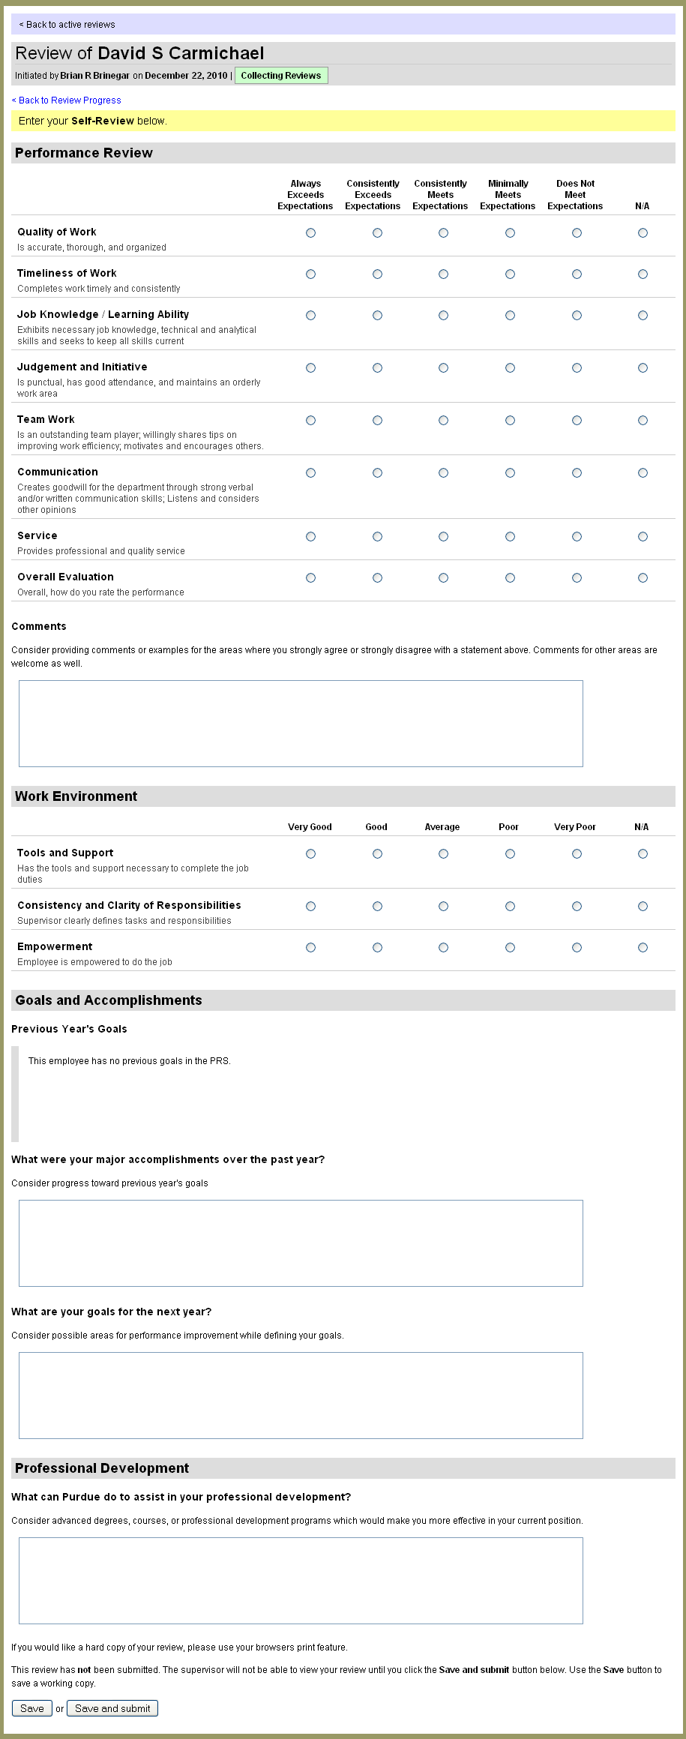
Employee Self-Review form (cont’d)
14

Slide 15
Supervisor Review form
11

Slide 16
Reviewer Notification Email
To: Reviewer_alias@purdue.edu
From: Supervisor_alias@purdue.edu
Subject: Assistance with Performance Review of %(employee)s
Reviewer)s,
Supervisor_alias is in the process of performing a performance evaluation of %(employee)s. The review was initiated on %(initiated)s.
As part of this process they have asked that you provide input using Engineering's online performance review system.
Your review is: Reviewer_status
If you are unable or unwilling to participate in this review process please let Supervisor know so that an alternate reviewer can be selected.
Participation in the evaluation process and the results will be archived as part of a personnel file and will be held confidentially.
Confidentiality is comparable to OnePurdue and not released except by the College or University Administrator or by court order.
Use your Career Account login and password to access the web site below to begin the review process. If you have any questions please contact %(supervisor)s by replying to this e-mail.
Thank you for your assistance in this process.
15

Slide 17
Reviewer form
16

Slide 18
Reviews Collected Notification
To: Supervisor_alias@purdue.edu
From: donotreply@ecn.purdue.edu
Subject: Performance Review Notification for %(employee)s
Supervisor,
The performance review of %(employee)s which you initiated on %(initiated)s has been completed.
To finish this review you must complete the following steps:
- Lock reviewer feedback*
- Print the summary report
- Meet with the employee
Use the link below to continue processing the review.
https://engineering.purdue.edu/PRS2/ptProgress?review_id=%(review_id)s
*employees may edit personal review until locked.
17

Slide 19
Summary Report Printing Options
18

Slide 20
Printed Report for Meeting
19

Slide 21
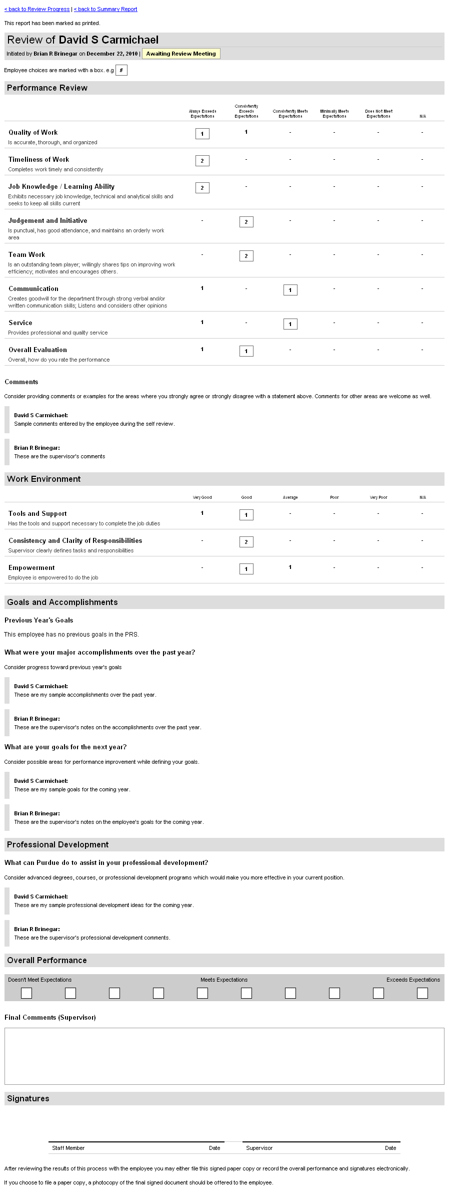
Printed Report for Meeting (cont’d)
20

Slide 22
Supervisor Completes Survey
21

Slide 23
Screen of Completed Survey
22

Slide 24
Summary Report for Supervisor
23

Slide 25
Summary Report Printing options
25

Slide 26
Shared Access
26

Slide 27
Report Viewing Access Shared
To: %(viewer_alias)s@purdue.edu
From: %(supervisor_alias)s@purdue.edu
Subject: %(employee)s's Performance Review Report
%(viewer)s,
%(supervisor)s has granted you access to view a summary of %(employee)s's performance review.
To access the summary report login using your career account login and password at the URL below.
https://engineering.purdue.edu/PRS2/ptReport?review_id=%(review_id)s
27

Slide 28
Acknowledgements
Current DSAC Members
HR Adedayo Adeniyi
ECN Brian Brinegnar
Name | Department | Term
Diane Beaudoin | Staff 1010 Liaison | 2013
Kristin Deckard | ENE | 2013
Cristina Farmus | ChE, APSAC rep. | 2011
Melissa Geiger | CE,CEM | 2013
Vicki Haddock | IE | 2013
John Haberman | CE | 2012
Andrew Hughes | ECE | 2012
Elaina Lesher | ME | 2013
Cheryl Leuck | ECE | 2012
Patricia Metcalf | MSE | 2011
Terri Moore | AAE | 2011
Truda Strange | BME | 2012
Jeff Valley | ChE | 2013
Karen White | EEE | 2012
Patricia Williams | Libraries. CSSAC | 2011

Slide 29
Next Steps
Presentations to CoE Schools and Programs.
Expand use to all staff in 2011.
Increased completion rate.
Follow-up survey.

Slide 30
https://engineering.purdue.edu/PRS2
Thank you for your attention !
28

