Slide 1
Future Manufacturing: Bio/Pharma
April 6, 2018

Slide 2
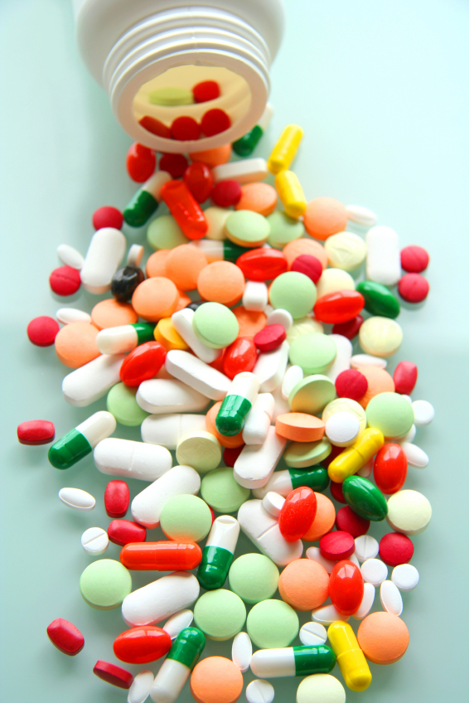
Pharma Industry Context
$1+ T/y Business with global supply chain
US represents 40% of global sales
Characteristics
15-20 Innovator companies, 1-2 new patented products/y/company
100’s of producers of (off-patent) generic products, most ex-US
Mid-size generic company produces 50+ products
US market: 90+% of prescriptions filled are generic products
Products highly regulated
Increasingly price controlled
Cost & quality of manufacturing emerging as significant issues
COGS 25+% innovators; 50+% generics
Growing concerns with quality & reliability of generics supply

Slide 3
PharmaCeutical Product Space
Synthetic organics
(small molecule)
Oral solid dose (65%+)
Injection / Infusion
Drug
Substance
Drug
Product
Liquid & topical
Biologics
(large molecule)
Powder inhaler
Transdermal & other innovative delivery forms
Dominance of Batch Manufacturing Mode
Features:
Dynamic processes – end state is path dependent
Limited on-line sensing & process control
Batch to batch variability due to human input
Low equipment / poor capital utilization

Slide 4
PharmaCeutical Manufacturing state
Continuous Manufacturing Focus by FDA & Innovators
Accelerating progress in solid oral product manufacture
Significant attention to small molecule continuous production
Nascent effort in biologics manufacture
Emerging Manufacturing Innovations
Process Intensification
Point of use manufacturing
Generic industry very slow in adopting new manufacturing modes
Opportunity to return generics industry to US
Model-based product development
Flexible, highly efficient plants
On-line sensing, automatic control, real time release

Slide 5
Technical issues
Manufacturing System Design
Focus on most common product forms: solid orals & injectables
Issue: Design of flexible manufacturing systems : Innovations in Unit operations & Sensing technologies
Product Development Support
Most Pharma Products are Formulations
Issues: Model-based development of formulation
Component selection, performance prediction
Manufacturing Schema Development
Selection of manufacturing path, operating conditions & automation strategy
Issues: Simulation of manufacturing operations
Sensor network & control system design & management
Manufacturing data management, lot release

Slide 6
Back-up Example
April 6, 2018

Slide 7
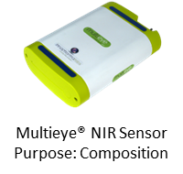
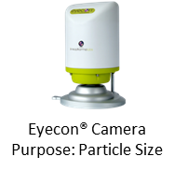
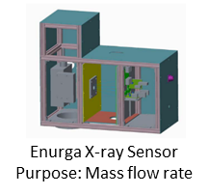
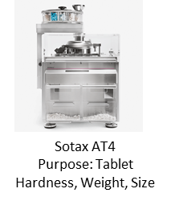
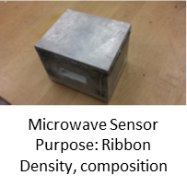
Example: Continuous Tableting Plant
Capabilities
Direct compression, dry /wet granulation
On-line sensing of properties
Automatic control
Material tracking & real time release

Slide 8
Example Strategy
Partner with strong generic company: PGC, Mylan
Partner with equipment & technology companies
Natoli, Alexanderwerk, Enurga, etc
Develop flexible facility
Testing & demonstrating new technologies
Development site for generic companies
FDA, BARDA, DARPA support for innovation
State & PRF support for facility implementation & workforce training

