Slide 1
Manufacturing of High Performance Engineering Parts
(Areas of Strengths at Purdue)
Composite Manufacturing (IACMI, preeminent team) –IMI building
SMART films/nanomanufacturing (industry consortium, preeminent team, NextFlex) –Birck
Additive manufacturing – Flexlab, Armstrong, BIDC
  Metal 3D printing, alloy synthesis
  Nonmetal 3D printing
    Nanoscale 3D printing
Laser-based manufacturing (CLBM) - Flexlab
Smart manufacturing
Digital factory (Advanced Manufacturing Enterprise)

Slide 2
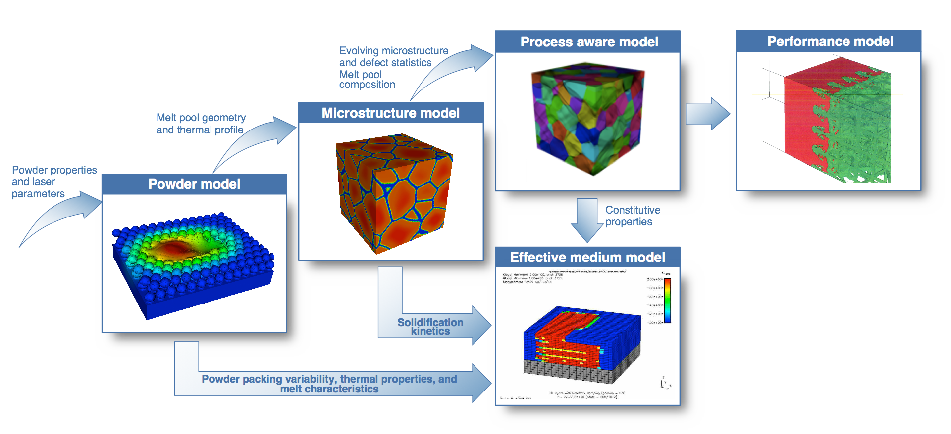
Additive Manufacturing (3D printing)
Processes used at Purdue
  Powderbed (AM Center), directed energy deposition (Shin), binder jetting (BIDC), extrusion (Pipes), sheet lamination
  (Gilbert), inkjet printing (Chiu, Xu), cold spray (Jun), streolithography, FDM, many other low cost 3D printers.
  New AM-based research example: novel functional and composite material synthesis, new novel product realization, a new frontier for 4-D printing of load-bearing structures, acoustic metal materials, crack growth resistant material, 3-D printing for nanomechanical Raman spectroscopy, fabrication of new fuel injectors for the aircraft engines, bioimplants and sensors, etc.
Modeling and Material Design
  Mechanical properties (Sangrid, Siegmund, Yu)
  Process-microstructure (Mukherjee, Shin, Zavattieri)
  Design and material selection for AM (Ramani, Tomar, Zhang )
Sensing
  Surface texture (Song), melt pool and geometry (Shin)
  Thermal field (Shakouri),
Environmental issues
  Life cycle analysis (Zhao, Sutherland)
Applications
  Aerospace, biomedical, automotive, electronics, energy, DOD, etc.
Future Opportunities
  New AM Center (regional, national, strategic partnership with industry such as GE), DOD Center
Source: LLBL

Slide 3
Composite Manufacturing
  IACMI, preeminent team
    Pipes, Mansson, Steriehnburgm, Yu, Goodsell
    Manufacturing processes, simulation, validation, and recycling
  Other activities
    Metal matrix composites: Cheng, Shin, Benxin Wu
    Fiber based materials: Siegmund
Laser-based Manufacturing
  Current capabilities and facilities (20+ lasers)
    Flexlab, Birck - Cheng, Jun, Shin, Wu, Xu
  Processes
    Laser welding, laser machining, surface coating, heat treatment, surface texturing, nano-scale manufacturing, synthesis of nanocomposites, laser direct writing, hybrid processes, novel material synthesis
  Applications
    All industries

Slide 4
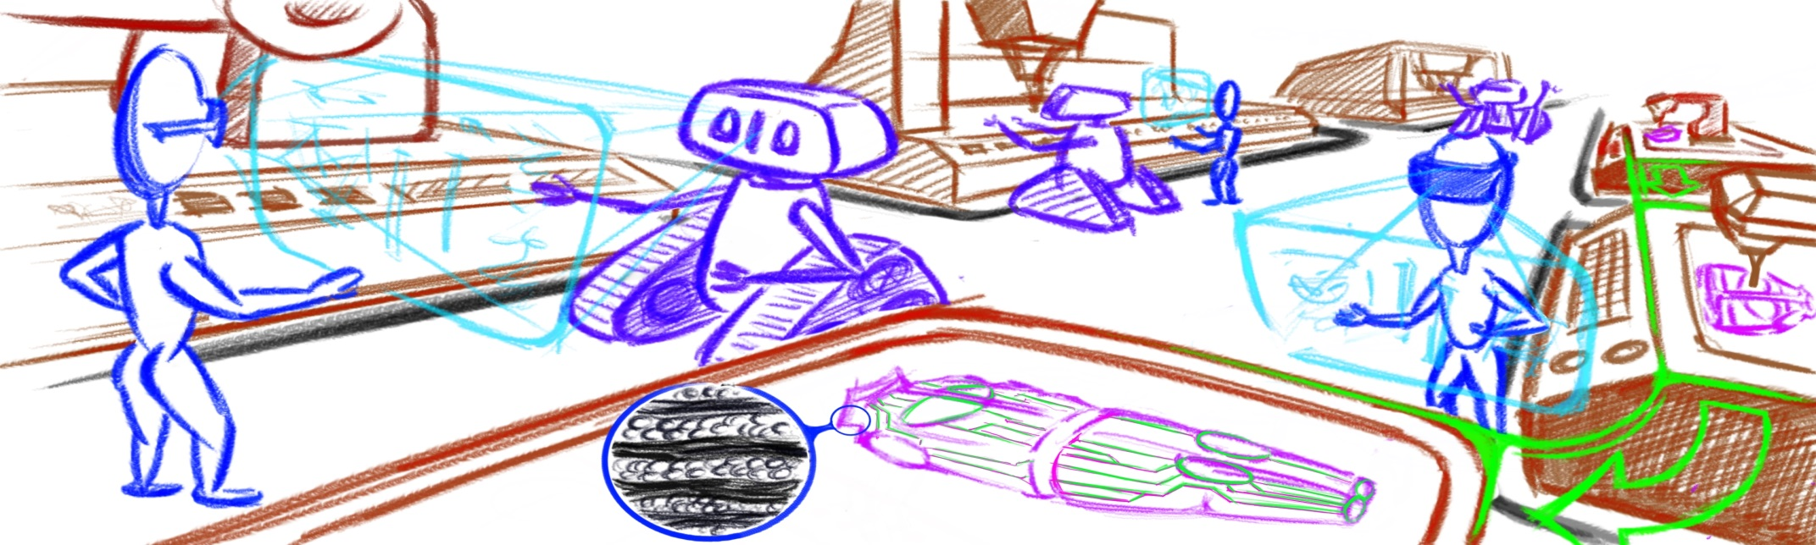
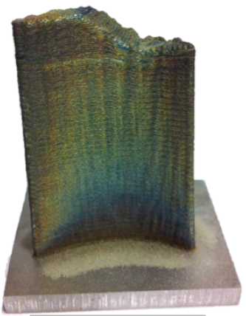
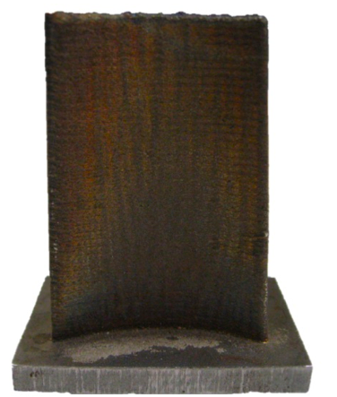
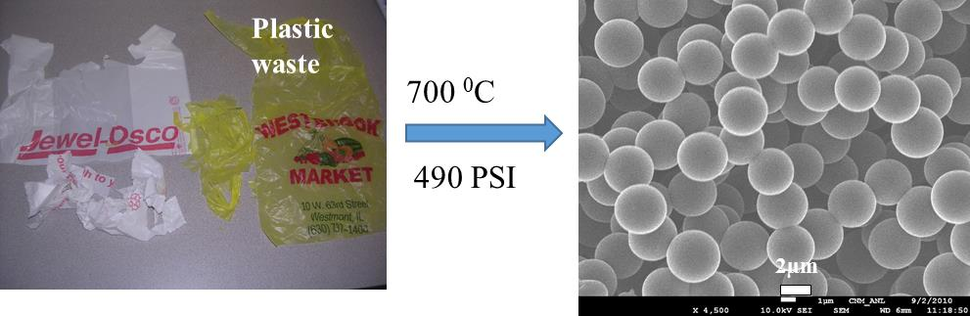
Smart Manufacturing/Sensors
  Multi-functional film R2R manufacturing - Cakmak
  Data-driven science for monitoring and design - Tomar, Zhang
  Smart connected machines and factories – Ramani
  Advanced sensors – Peroulis, Savran, Chiu, Wenzhou Wu, Stanciu
Digital factory (Advanced Manufacturing Enterprise)
  Sutherland, Zhao, Ramani, Schmidt, Spafford, Hartman
Metal casting
  Casting Center – Krane, Han, Johnson, Trumble
Modulation-assisted machining
  Chandrasekar, Jamieson, Trumble, Compton, Mann
Remanufacturing/Recycling
  Upcycling of plastic waste to carbon products - Pol
  Remanufacturing of high performance products - Shin
  Life cycle assessment – Sutherland, Zhao

Slide 5
How to bring manufacturing at Purdue to the next level? Create an International center of excellence?
Pursue Large and Very Large Grant Opportunities as a Strategic Initiative
  Establish Purdue as a leader and national resource in advanced manufacturing technology
  Catalyze collaborations across Indiana and USA
  Showcase existing Purdue nationally recognized excellence in manufacturing science, industry engagement (e.g., strategic partnerships with GE and FCA, MEP, TAP), etc.
Co-location of activities on campus (Flex lab and Birck) as well as IMI building for major testbeds and pilot manufacturing facilities
Testbeds bring faculty/students together and increase our visibility
  What is missing in current testbeds?
  How to engage more faculty to use the testbeds?
  How to increase synergy among different testbeds/manufacturing efforts?
  How to engage industry? Have them donate their latest tools and send their engineers to maintain the equipment.
  Develop courses that use the testbeds? (UG or G)
  Workforce development?

