Slide 1
Your Project Title (It is YOUR project, not the team's project, not CAM2)
Your Name
Date

Slide 2
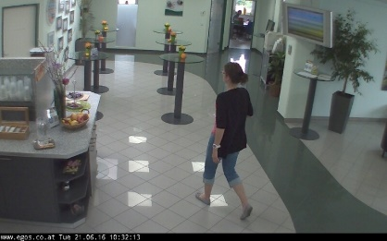
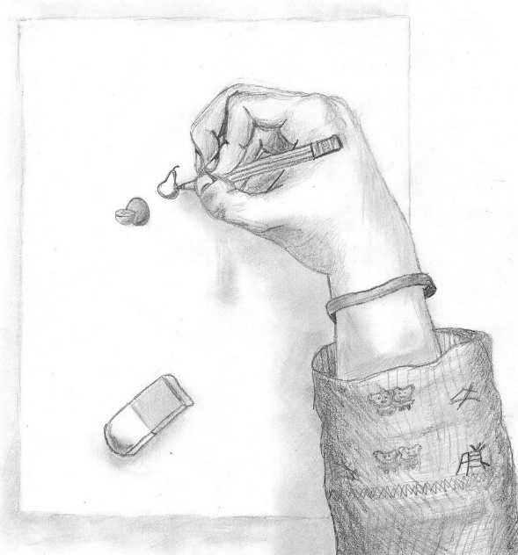
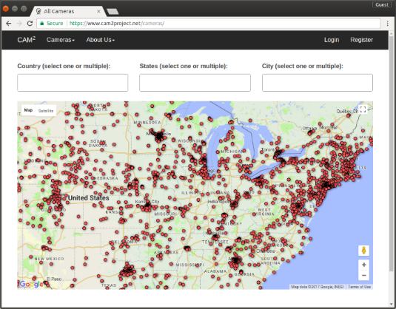
What is the problem? Why is it important?
Focus the problems YOU are solving. Not the team's problem. Not CAM2
Use Figures, Drawing, Screenshoots, Photos, Tables, Source Code ...
DO NOT USE BULLETS OF WORDS

Slide 3
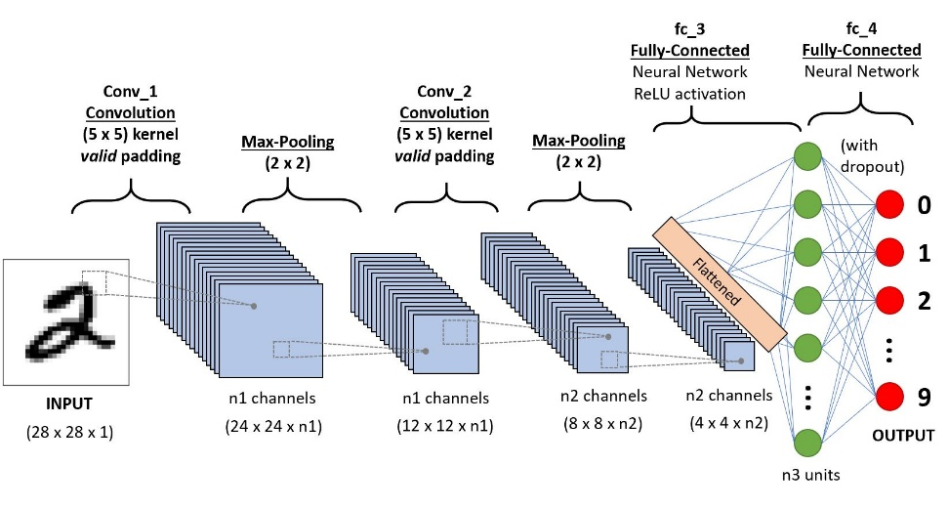
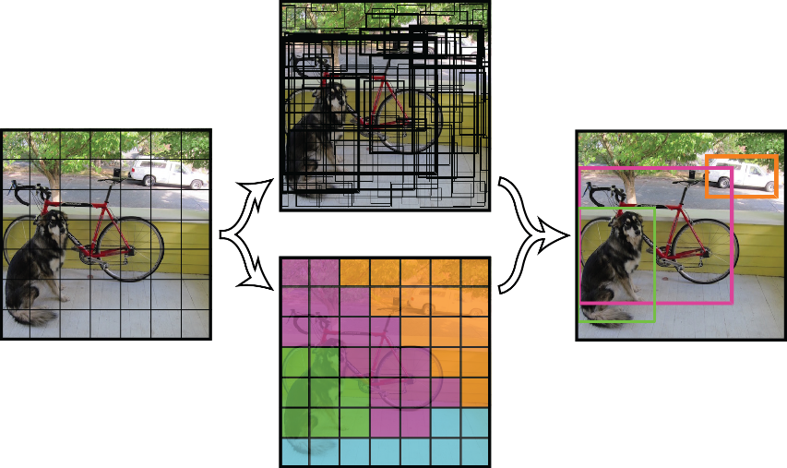
Explain the Content If it is on your slides, you need to explain

Slide 4
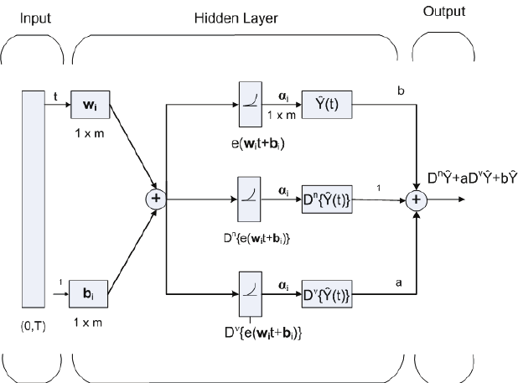
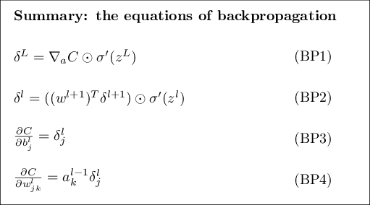
Use Drawings, Figures, Tables, Equations, Photos, ....
DO NOT USE BULLETS OF WORDS
If you can say it, don't put it in slides

Slide 5
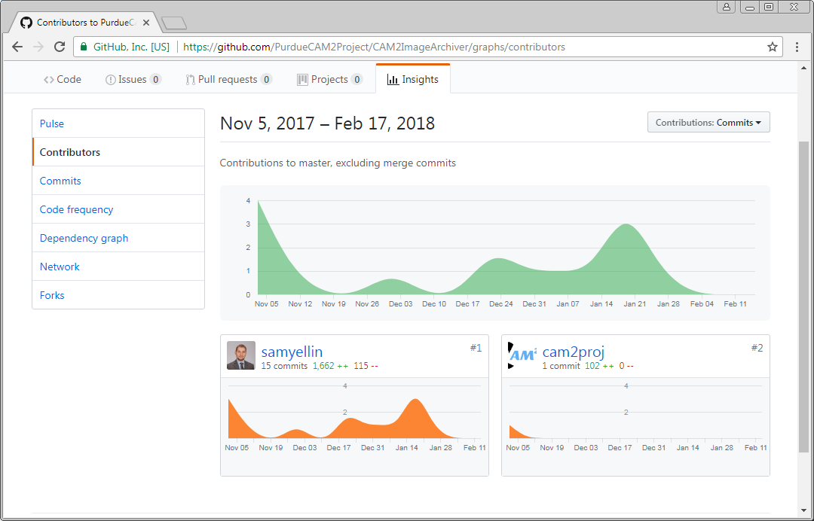
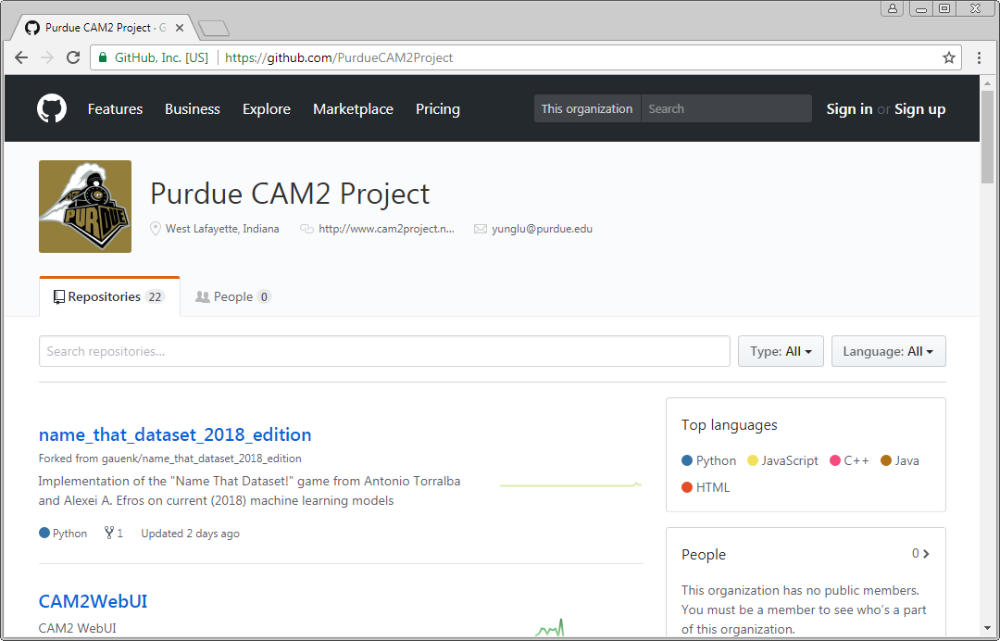
What Have You Done?
What have you contributed?
Where is your work?
Who else has seen it?
How will it be integrated?
What have you learned?
How do you know what you are doing works?
How is your work documented?
Show evidence

Slide 6
Who are in your team? What do they do?
List all members and their photos.
Explain how your work interact with theirs.

Slide 7
DO NOT USE BULLETS OF WORDS DO NOT USE BULLETS OF WORDS Typing words without efforts is easy. You know it. Everyone knows it.

Slide 8
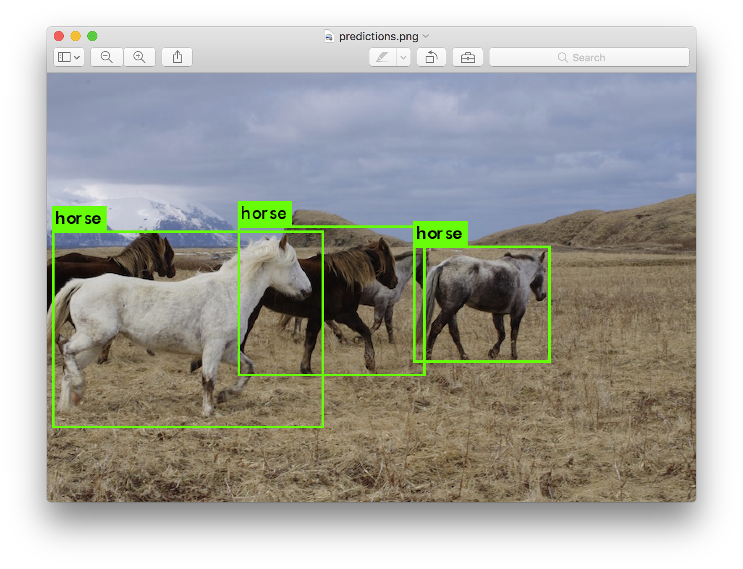
Demonstration
If you spend more time learning, show what you have learned.

Slide 9
What grade do you deserve? Why?
A: Suggest tasks not assigned by team leader. Does more than what the leader asks.
B: Accomplish what the leader asks. High quality work and on time.
C: Accomplish what the leader asks. High quality work but late. On time but quality needs improvement.
D: Accomplish parts of what the leader asks. Quality needs improvement. Late.

Slide 10
Common Mistakes
Presentation = Oral exam. Wait for questions
Everyone knows everything. Professors know everything. No need to provide details.
Use too many words.
Words only. No figures, photos, drawing....
Too short. No practice in advance.

