Slide 1
Safety Issues/Incident Reporting & Investigations
4/10/24

Slide 2
Reporting and Communicating
Reporting Safety Issues/Incidents
All safety issues and incidents should be report
Includes Injuries, near misses, and unsafe acts & conditions
Where to report them?
EHS – Via website and contacting them directly
911??
Department Head/Direct Supervisor
Determine by department’s reporting structure
Communicating Safety Issues/Incidents
Issues & Incidents should be communicated
How will largely depend on departments structure
Guidance:
To anyone that this incident or issue would be applicable to
Safety Committee
All faculty

Slide 3
Understanding Terms
Acronyms and definitions, oh my…
Unsafe Condition – broken or damaged equipment
Unsafe Act – Person not following safety precautions
Near Miss – An incident occurs, but no one is injured (e.g. material dropping next to someone)
FROI – First Report of Injury
Injury – Incident occurs, and person is injured (e.g. strain, lacerations)
First Aid – No prescriptions; no treatment beyond being wrapped; minor restrictions not affecting employee’s ability to do their job
Recordable – Prescriptions; fractures; can’t fulfill main job duties; stitches/glue; type of medical diagnosis
Lost Time – Employee’s injury and/or treatment preventing them from returning to work
Reportable – Fatality; amputation; loss of eye(s); hospitalization
Good Catch

Slide 4
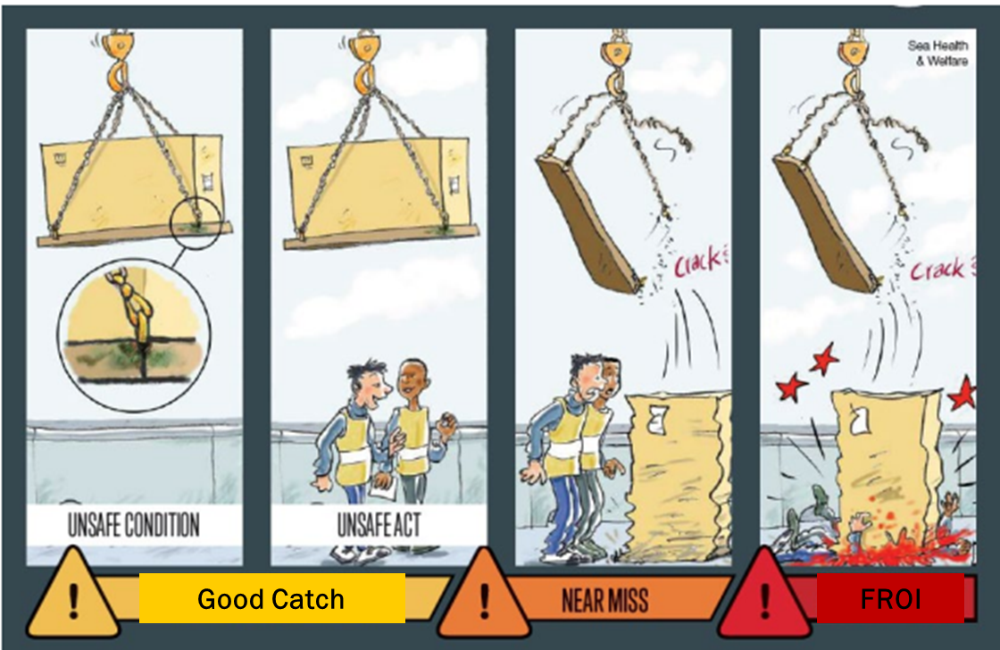
Understanding Terms
Picture of difference between Good Catch, Near Miss, and Injury

Slide 5
Reporting and Communicating
Why this matters
Little Things can create Disaster
Trip hazards can negatively impact lives
Hides the big things
Impact culture and safety discipline
Even Minor Incidents can be Major
Don’t just think about the outcome
The potential outcome is what matters
Effective and Open Communication Protects Others
Improve safety awareness
Helps prevent reoccurrence
Creates a positive snowball effect with more communication

Slide 6
Good Catch
I found a Safety Issue “Good Catch,” now what?
*Depends on department structure*
General Guidelines/Structure:
Determine immediate and potentially long-term solution
Put immediate solution in place
Inform affected parties (e.g. staff, students) on issue and immediate solution
Includes applicable people in upper admin support and safety committee
Investigate a long-term solution is applicable with safety committee, and EHS if applicable
Contact Building Deputy, EHS, or applicable facilities department if needed
Inform affected parties of long-term solution when completed

Slide 7
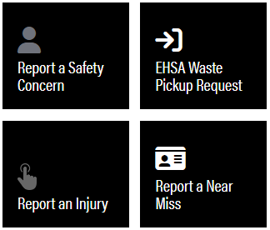
Near Misses
I had a near miss, now what?
*Depends on department structure*
General Guidelines/Structure:
Determine immediate and potentially long-term solution
Remove hazard -- put immediate solution in place
Inform affected parties (e.g. staff, students) on issue and immediate solution
Includes applicable people in upper admin support and safety committee
Report near miss via EHS Website
Complete Investigation Form as a Team – ask for EHS support if needed
Investigate to determine if current solution is adequate or more robust safety measures are needed
Conduct with at least 2-3 people. Have person involved and potentially a safety committee member, upper admin, peer, and/or EHS
Contact Building Deputy, EHS, or applicable facilities department if needed
Inform affected parties of long-term solution when completed

Slide 8
Injury
Someone was injury, now what?
Get injured person medical attention
Students (non-employee status) can go to PUSH
Employees need to go to ROCC or Working Well (this matters!)
Medical Emergency --- wherever they can get immediate care – call 911!
Transportation assistance – call 911
Remove hazard – put immediate solution in place
Inform affected parties (e.g. staff, students) on issue and immediate solution
Includes applicable people in upper admin support and safety committee
Submit FROI via EHS Website & Risk Management Form for Students (non-employee)
Employee injury needs to be submitted within 24 hours of injury for Workers Compensation & adequate treatment
If it is a medical emergency, for an employee, EHS needs contacted ASAP
Complete Investigation Form as a Team – ask for EHS support if needed
Investigate to determine if current solution is adequate or more robust safety measures are needed
Conduct with at least 2-3 people. Include injured person and potentially a safety committee member, upper admin, peer, and/or EHS
Typically completed within 3 business days (enough time to gather information)
Student (non-employee) vs Employee Injury – Team Investigation Form via EHS Website

Slide 9
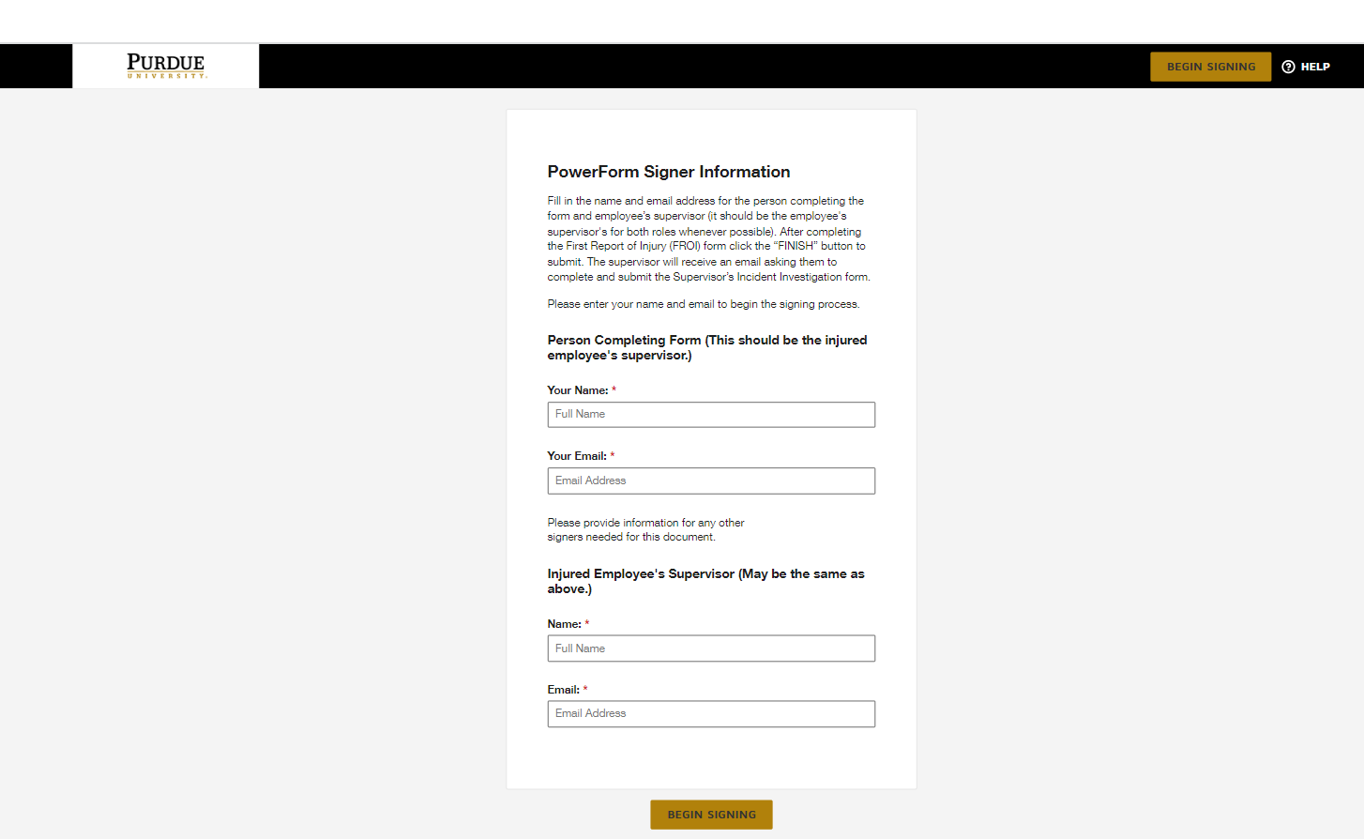
Reporting an Injury
FROI Submissions
To submit FROI,
Click Begin Signing

Slide 10
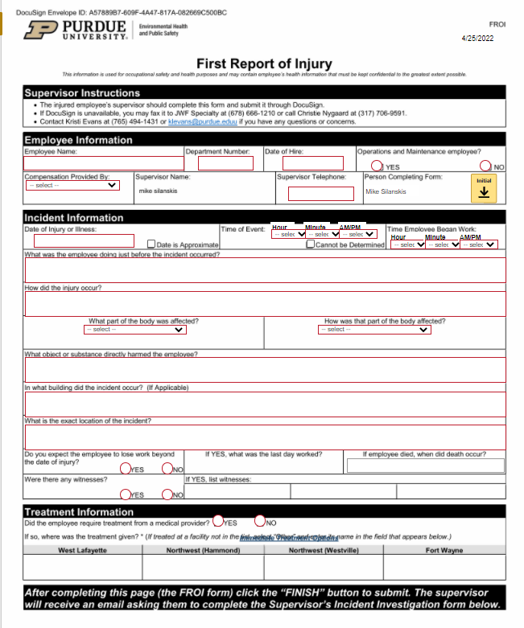
Reporting an Injury
FROI Submissions
FROI Completion
Complete with the injured employee, if available
Include witness if applicable
Complete as accurately as you can

Slide 11
First Things First
Learning from the Injured Person
Listen – Not a Fault-Finding Mission
Tell the employee this is a fact-finding mission
Let the person describe the circumstances leading up to the injury in their own words
Take notes
Don’t interrupt!
If you have a question, jot it down and ask at the end as a clarifying question
This can help with the person’s recollection of the event and provide a lot of insights

Slide 12
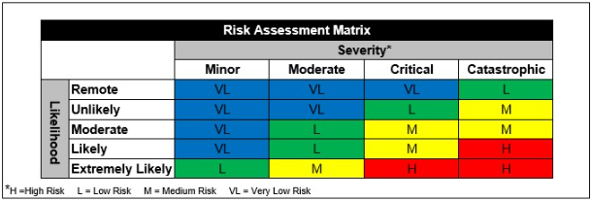
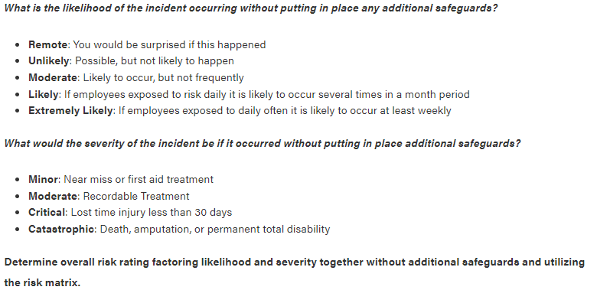
Investigating an Injury or Near Miss
Completing Incident Investigation

Slide 13
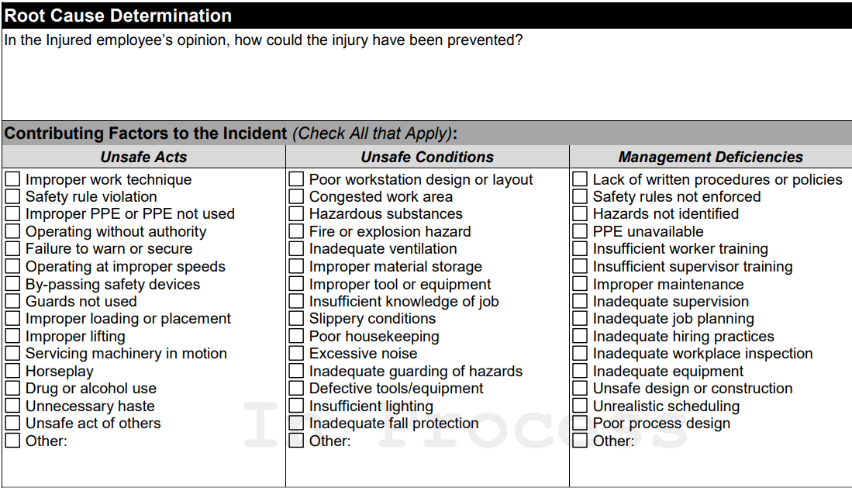
Investigating an Injury or Near Miss
Completing Incident Investigation

Slide 14
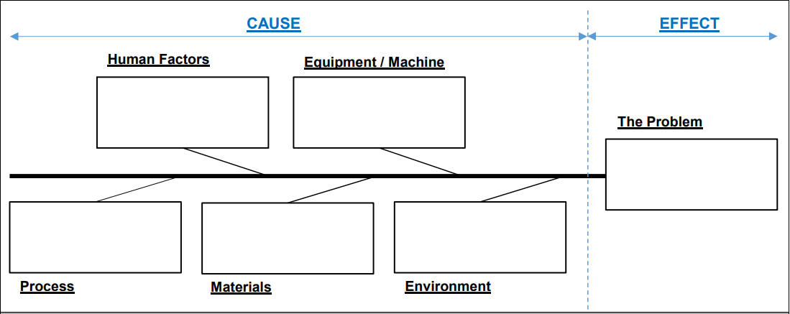
Investigating an Injury or Near Miss
Human Factors
Human behavior(S) (not following policy)
Personal Factors (physical limitations, not eaten)
Experience (new employee)
Training (didn’t understand)
Equipment/Machine
Not adequate (has tool, but not effective)
Damaged (not working as intended)
Not available (no tool, missing)
Process
Unidentified hazards (missed during assessment)
Inadequate hazards controls
Procedures for job (none; inadequate)
Training (inadequate; not finished)
Wrong tool (procedures says hammer, but should be using a pry bar)
Materials
Characteristics (weight, temp, shape)
Environment
Low staff (absenteeism)
Employee Comfort (work environment)
Condition of Workplace (disorganized)
Work Load (how work is distributed)

Slide 15
Investigating an Injury or Near Miss
Selecting and Putting Solutions in Place
What will lower the risk of this happening again?
Reassess Risk with Countermeasure – Are we making an impact?

Slide 16
Finishing it up & Tying it all Together
Communicate the Investigation
Share what was learned with all applicable people
Share the cause and the solution
Share it across the department and upper admin support – based on department structure
If more support is needed to address the issue:
Follow department’s reporting structure
Get Safety Committee Involved
Contact EHS
Working as a team and communication matters!
Remember SNOWBALL EFFECT!
Gets people thinking and looking for improvements
Helps educate everyone on hazards and risk perception

Slide 17
Thank You
Purdue Marketing and Communications, marcom.purdue.edu

