Slide 1
Office Ergonomics
Presented by:
FLEX-Lab Monthly Safety Meeting

Slide 2
Introduction
ElAzab’s Xtal Theory Group
Theoretical and computational development of models related to material irradiation and defects.
Spend most of the day either reading/coding.
No we don’t eat pizza at every group meeting.

Slide 3
Ergonomics
What does Ergonomics encompass?
The study of the relationship between people and their work environments.
The goal of an ergonomics program is to reduce work – related musculoskeletal disorders by adapting the workstation to the worker rather than the worker to the workstation.

Slide 4
Musculoskeletal disorders
What are Musculoskeletal disorders (MSD’s)?
Injuries and illnesses that affect muscles, nerves, tendons, ligaments, joints or spinal discs.
Often MSD’s occur over a period of time rather than in one “accident”

Slide 5
MSD’s
Common MSD’s
Common signs of MSD’s
Carpal tunnel syndrome
Tendonitis
Herniated spinal disc
Rotator cuff syndrome
Tennis elbow
Raynaud’s syndrome
Hand-arm vibration syndrome
Tension neck syndrome
Painful joints
Pain, tingling or numbness in hands or feet
Shooting or stabbing pains in arms or legs
Swelling or inflammation
Pain in wrists, shoulders, forearms, knees
Fingers or toes turning white
Back or neck pain
Stiffness
Burning sensation

Slide 6
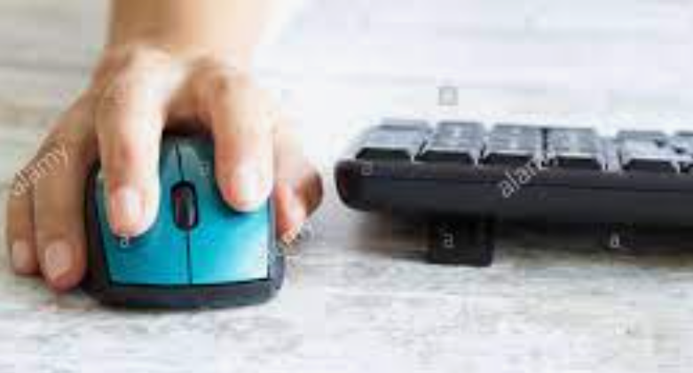
Risk Factors
Repetition
Making the same motions over and over places stress on the muscles, and tendons.
Severity of risk depends on frequency, speed, the number of muscles involved, and the required force.

Slide 7
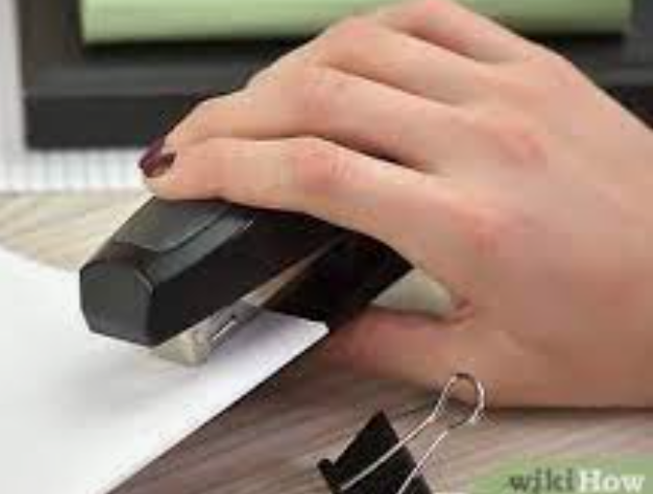
Risk Factors
Forceful Exertions
The amount of physical effort required to perform a task or to maintain control of equipment or tools.
Force is dependent on: type of grip, weight of object, body posture, type of activity and duration of task.

Slide 8
Risk Factors
Awkward Postures
Position of the body and how it affects the muscle groups that are involved in physical activity.
Awkward postures include repeated or prolonged reaching, twisting, bending, kneeling, squatting, overhead work or holding fixed positions.

Slide 9
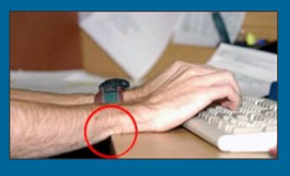
Risk Factors
Contact Stress
Pressing the body against a hard or sharp edge can place too much pressure on nerves, tendons and blood vessels
For example resting the arm against a corner while working can increase the likelihood of an MSD.

Slide 10
Manual Material Handling Guidelines
*High Frequency manual materials handling activities have lower maximal allowable limits
© Meg Honan

Slide 12
Summary
Introduced the scope of ergonomics.
What are MSD’s?
Risk Factors in the working environment.
So what to do about it?

Slide 13
Action Plan
What to do to minimize?
Set up your desk and chair correctly
Do stretches
Equipment that help/set up.
CUergo: Guides & Information (cornell.edu)

Slide 14
Setup the desk
What to do?
Keep frequently used objects within reach (mouse and keyboard).
Adjust monitor to be at arms length and slightly tilted upwards
The top of the monitor should be on the same eye level sight.
If you are using dual monitor setup, depending on your use (50-50/80-20) adjust monitors accordingly.
Adjust chair so that the distance between your leg and the desk is about a closed fist
Make sure your leg is rested on the floor flat and supported by the chair

Slide 15
Safe work zone

Slide 16
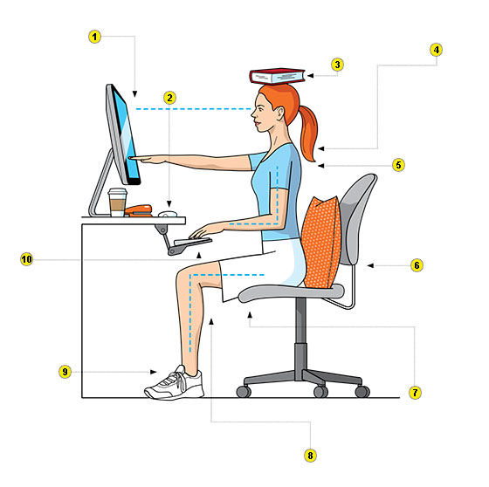
Workstation Setup
Notes:
Keep moving!
… Don’t stand all the time. Despite the scary sitting research, Dennerlein says standing 24/7 isn’t a great solution, either. “Everybody says sitting is the new smoking. You have to remember standing is the old smoking,” he says.
That’s because sitting strains the arms, shoulders, and neck, but standing too much can lead to back pain. Your best bet, Dennerlein says, is to rotate between the two positions. “By mixing it up, you can change your posture,” he says.

Slide 17
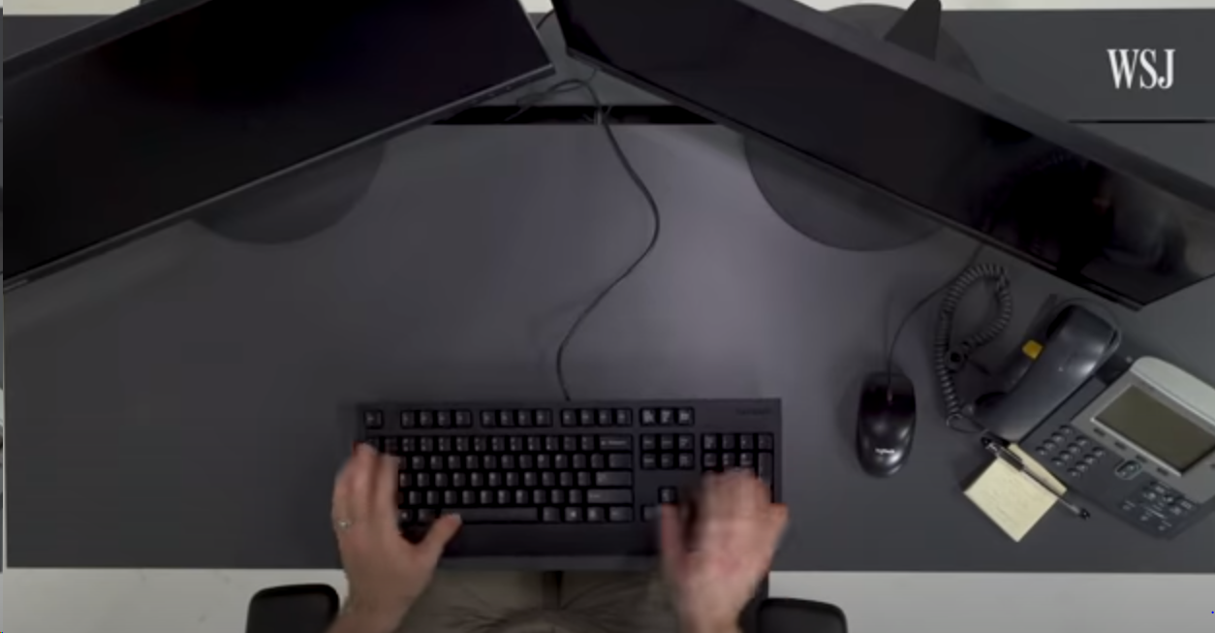
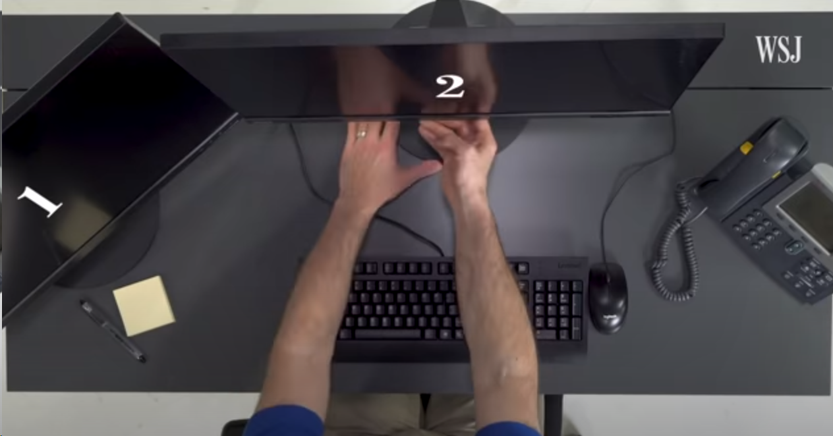
50-50 setup
80-20 setup

Slide 18
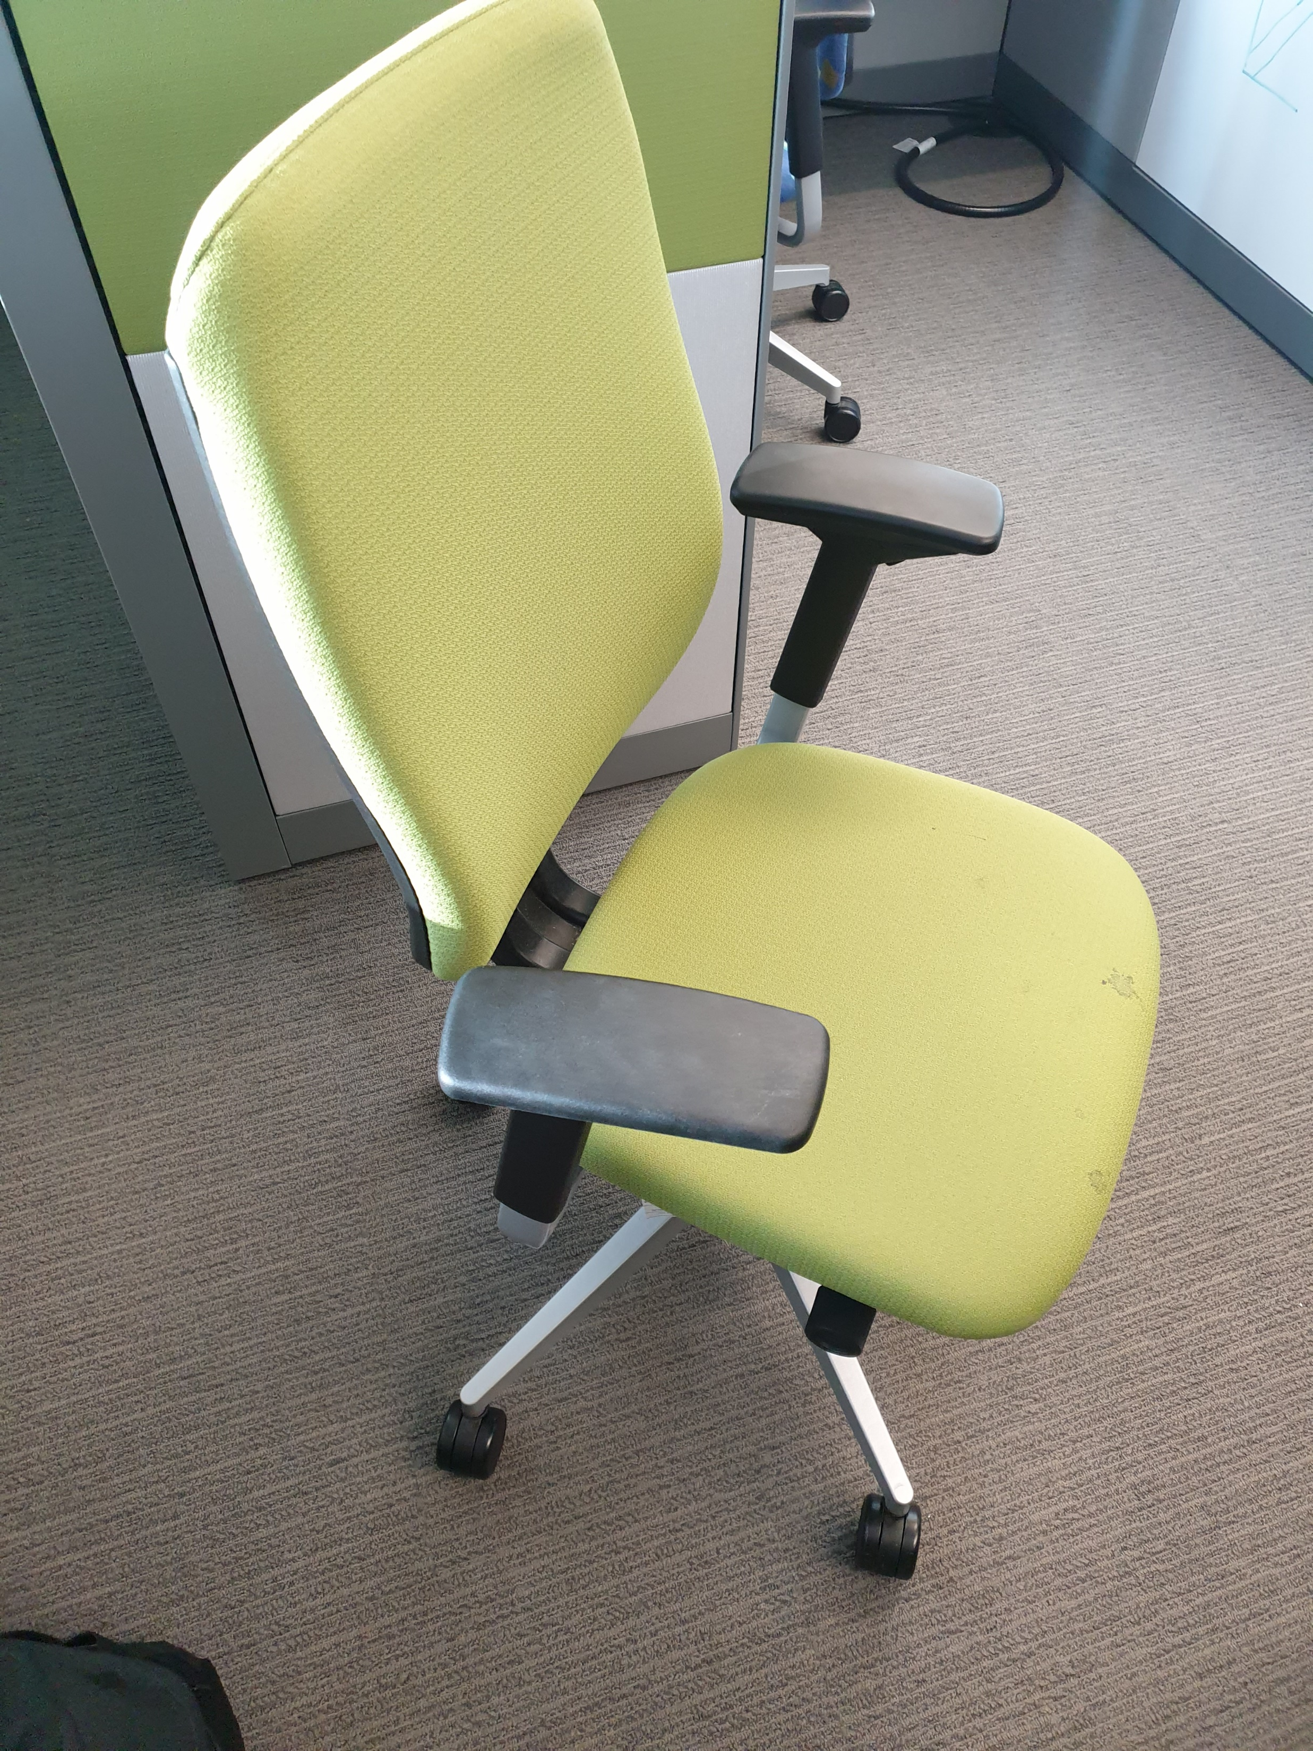
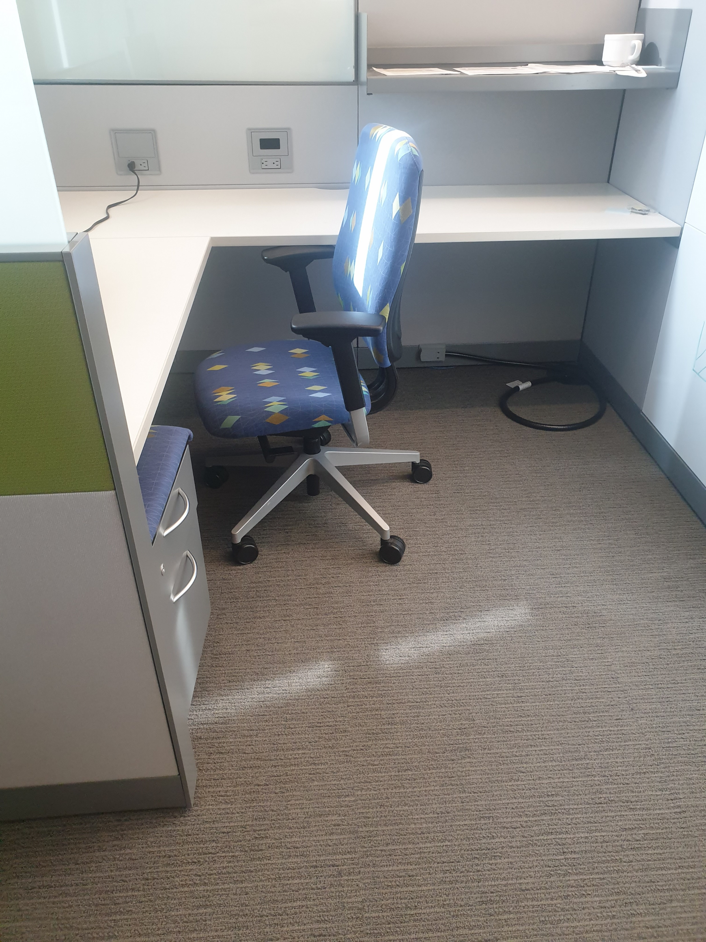
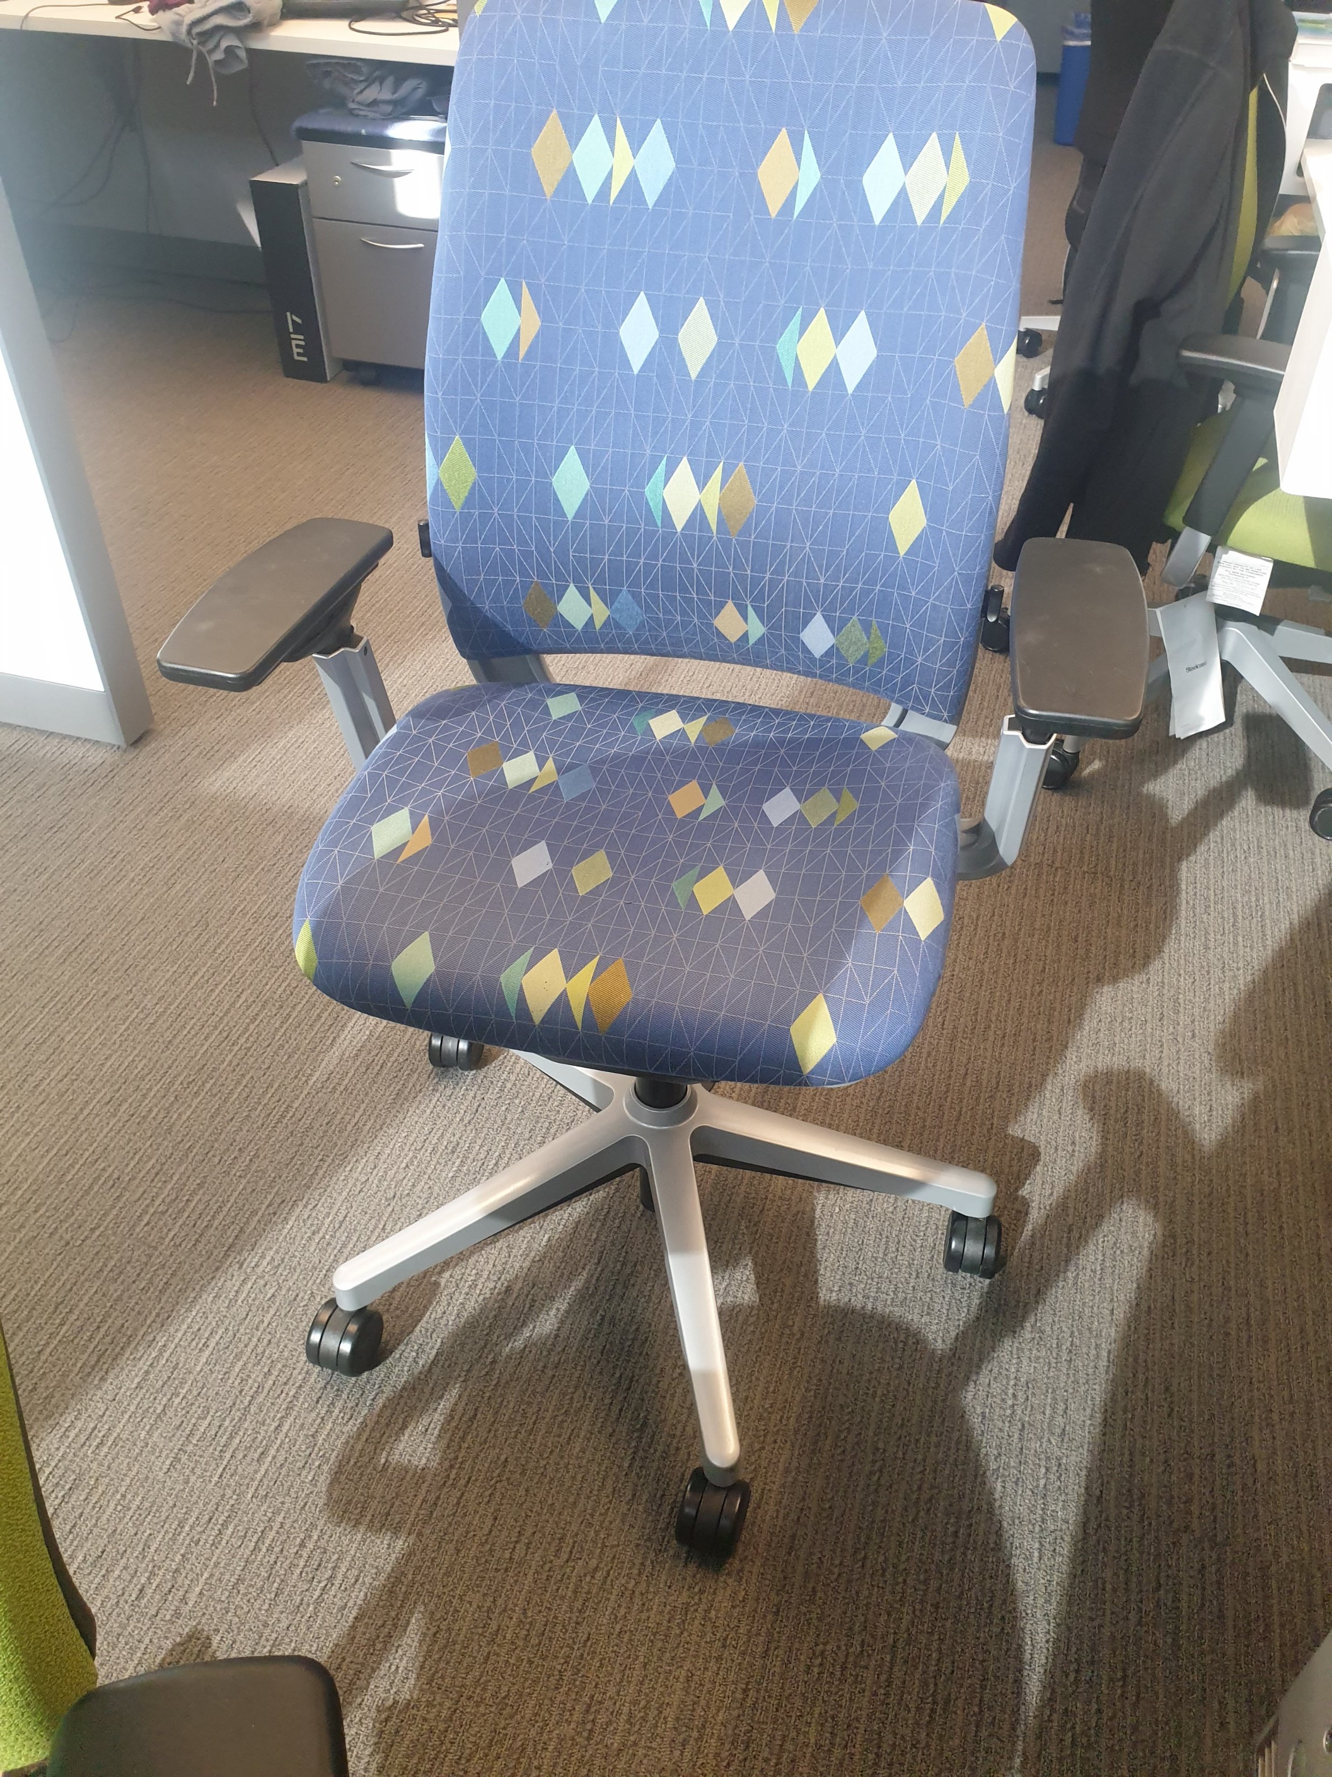
Chair Adjustment
Office chairs:
Seat Depth:
Seat Height
Seat tilt stiffness
Seat tilt
Lumbar Support
Armrests

Slide 19
Micro Breaks
Whether your work is manual labor or at a desk
Take a micro break every 20-30 minutes
These only need to be a few seconds long, stretch, change body positions and return to the task.
Have you ever been working and found yourself surfing random news sites? That’s because your brain needs a break, rather than taking a “fake break” take a real break.

Slide 20
To sit or stand; that is the question
Change it up
… Don’t stand all the time. Despite the scary sitting research, Dennerlein says standing 24/7 isn’t a great solution, either. “Everybody says sitting is the new smoking. You have to remember standing is the old smoking,” he says.
That’s because sitting strains the arms, shoulders, and neck, but standing too much can lead to back pain. Your best bet, Dennerlein says, is to rotate between the two positions. “By mixing it up, you can change your posture,” he says.
Take micro breaks, similar to Pomodoro time technique: 40 min work, 10 min break, 4th cycle 30 min break. Use this time to stretch/cycle physical activity.

Slide 21
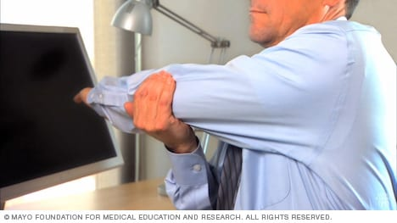
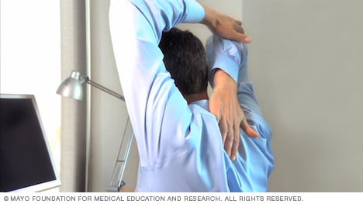
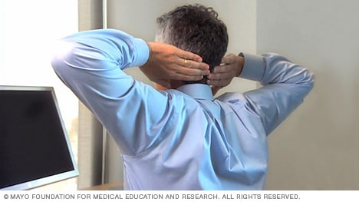
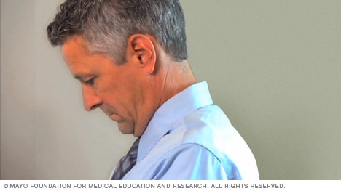
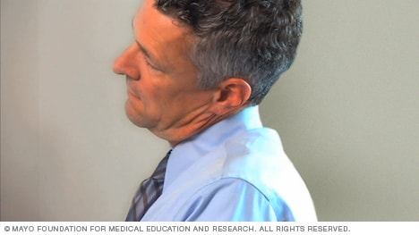
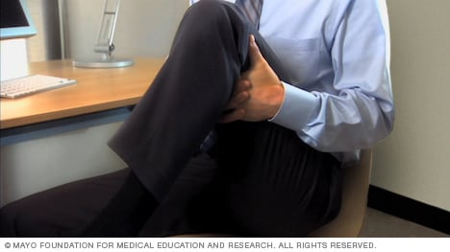
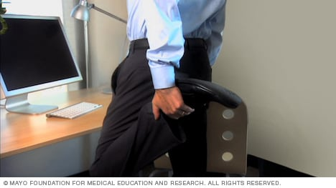
Office Stretches
Shoulder Stretch
Upper Arm
Chest Stretch
Chin tuck
Place one hand under your elbow.
Lift your elbow and stretch it across your chest. Don't rotate your body as you stretch.
Hold the stretch for 30 seconds. You'll feel tension in the back of your shoulder.
Relax and slowly return to the starting position.
Repeat the stretch with the other arm.
Lift one arm and bend it behind your head.
Place your other hand on the bent elbow to help stretch your upper arm and shoulder.
Hold the stretch for 30 seconds.
Relax and slowly return to the starting position.
Repeat the stretch with the other arm.
Place your hands behind your head.
Squeeze your shoulder blades together, bringing your elbows back as far as possible.
Hold the stretch for 30 seconds.
Relax and slowly return to the starting position.
Repeat.
Face straight ahead.
Lower your chin to your chest.
Hold the stretch for 30 seconds. You'll feel tension in the back of your neck.
Relax and slowly return to the starting position.
Repeat.
Head Turn
Side Neck
Lower Back
Chin tuck
Face straight ahead.
Turn your head to one side while keeping your shoulders straight.
Hold the stretch for 30 seconds. You'll feel tension in the side of your neck and your shoulder.
Relax and slowly return to the starting position.
Turn your head to the other side and repeat the stretch.
Face straight ahead.
Tilt your head so that you're moving your ear toward your shoulder. Don't bring your shoulder up to your ear.
Hold the stretch for 30 seconds. You'll feel tension in the side of your neck.
Relax and slowly return to the starting position.
Tilt your head to the other side and repeat the stretch.
Sit forward in your chair.
Bring one of your knees toward your chest. Use your hands to grab the back of your thigh and gently pull it toward you. Keep your back straight, being careful not to lean forward.
Hold the stretch for 30 seconds. You'll feel tension in your lower back and the upper part of your buttock.
Relax and slowly return to the starting position.
Repeat the stretch with the other leg.
Stand up straight, placing one hand on a chair or desk for stability.
Grab one of your ankles — or your pant leg — and bring it up toward your buttock. Remember to maintain an upright position, keeping your back straight and your knees parallel to one another.
Hold the stretch for 30 seconds. You'll feel tension in the front of your thigh.
Relax and slowly return to the starting position.
Repeat the stretch with your other leg.
Slide show: Office stretches - Mayo Clinic

Slide 22
Office Stretches
Printable Posters

Slide 23
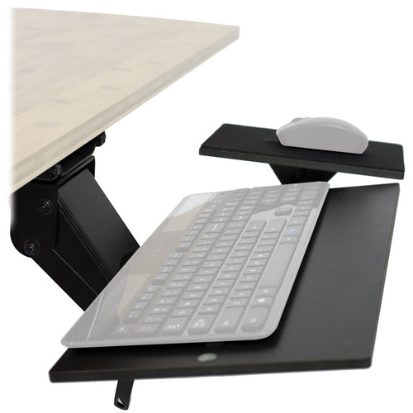
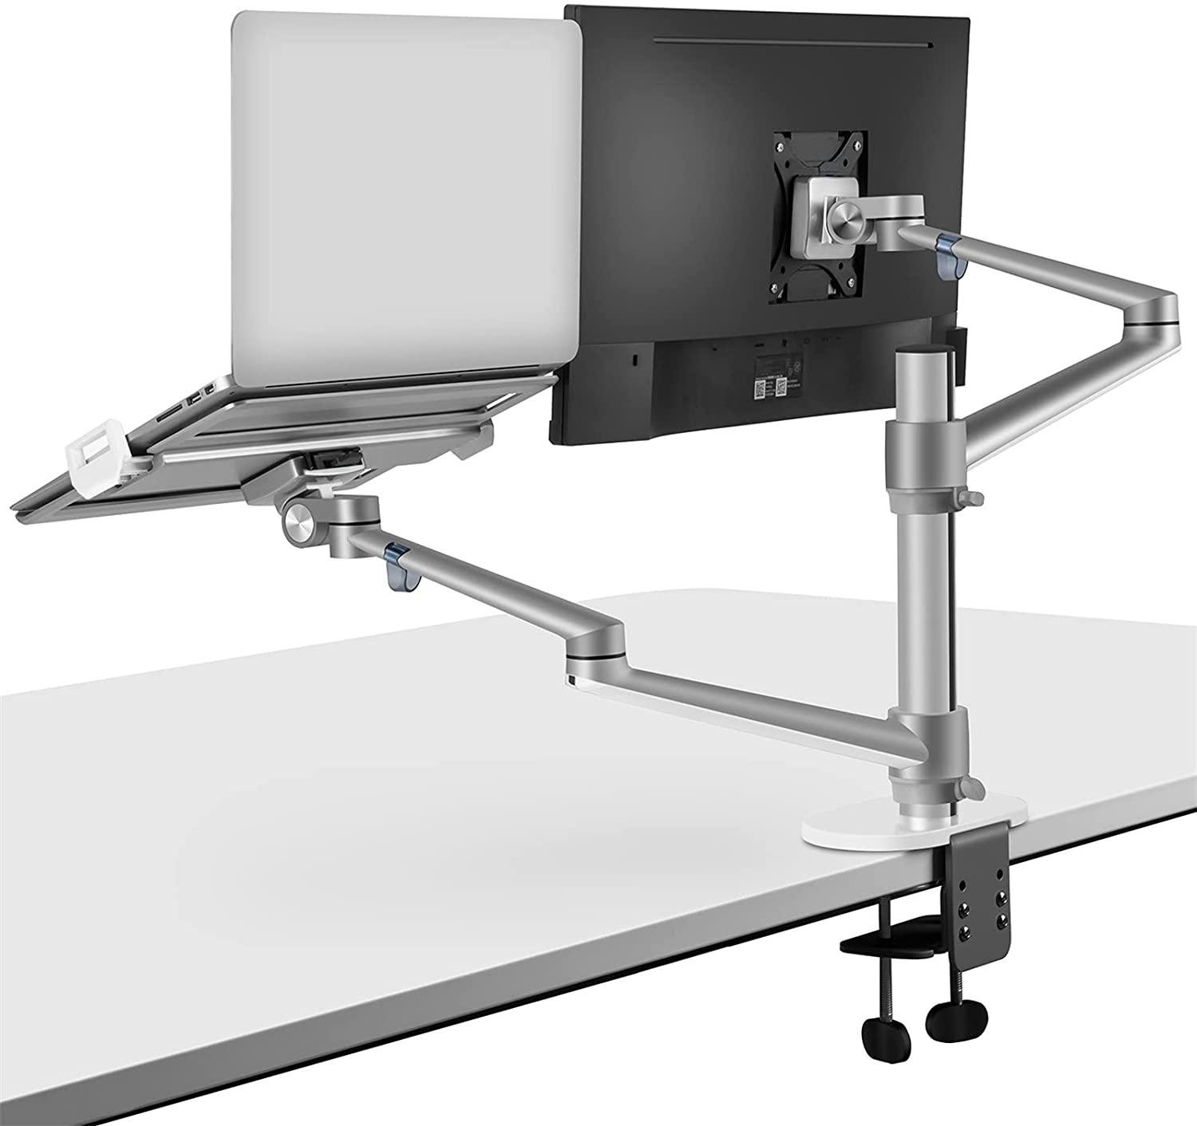
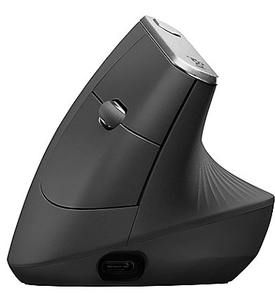
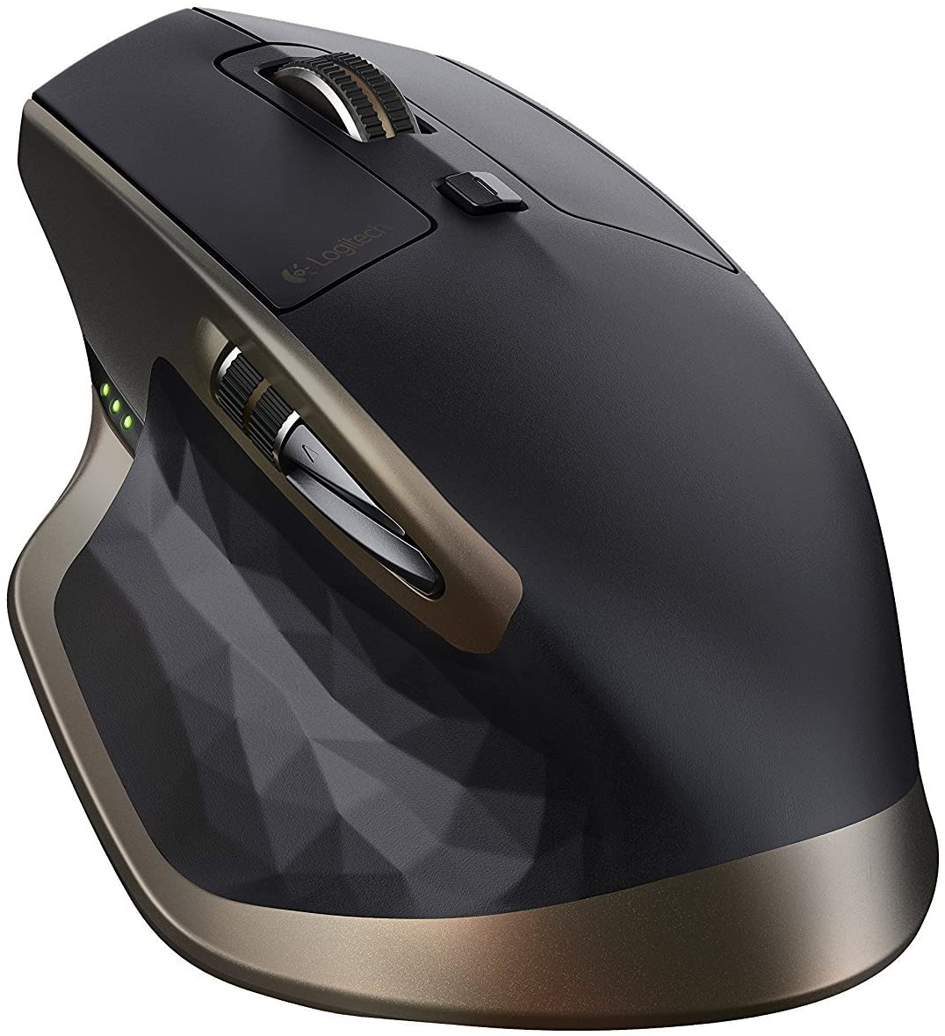
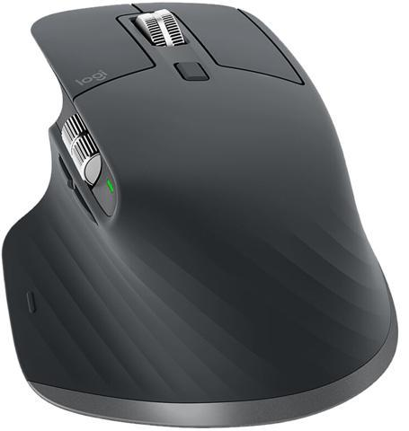
Equpiment that may help
For desk office
Keyboard Tray with an external keyboard.
A secondary Monitor with stand or Laptop Stand/docking station.
An ergonomic mouse.

Slide 24
Summary
Covering
The potential hazard:
Introduced the scope of ergonomics.
What are MSD’s?
Risk Factors in the working environment.
Suggested action plan:
Set up your desk and chair correctly
Do stretches
Equipment that help/set up.

Slide 25
Thanks to Kristi Evans for discussions and material provided to help us have this presentation ready.
Presentation prepared by Kyle & Khaled

