Slide 1
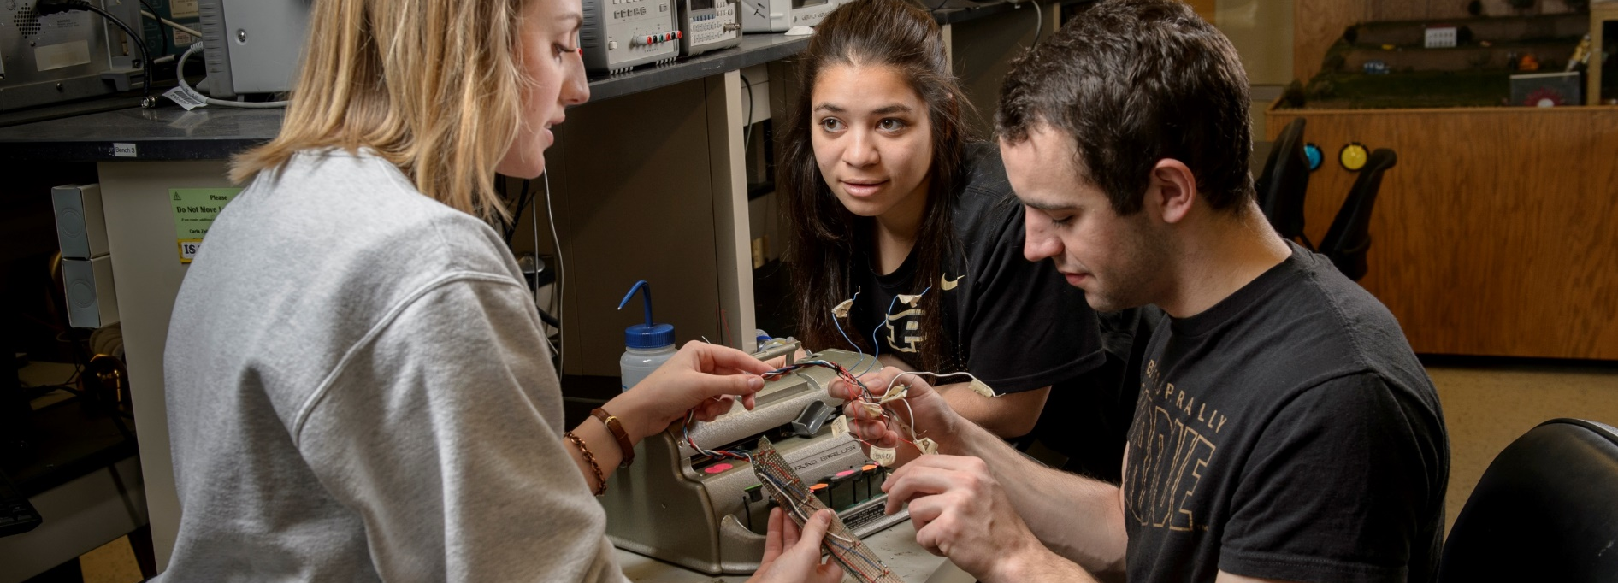
Senior Design Module
Real Design for Real People
https://engineering.purdue.edu/EPICS
Revision: Spring 25

Slide 2
Outline
What is Senior Design?
Outcomes
Verification process & documentation
Other requirements
Grading
Questions

Slide 3
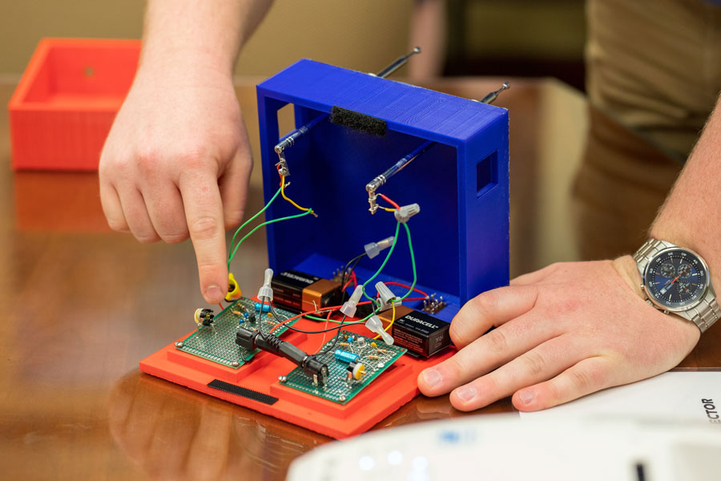
What is Senior Design?
A culminating major engineering design experience that incorporates
appropriate engineering standards
multiple constraints
based on the knowledge and skills acquired in earlier course work.
Students are expected to independently acquire new knowledge necessary for the successful completion of their project.

Slide 4
ABET Definition of Design
Engineering design is a process of devising a product to meet desired needs and specifications within constraints.
It is an iterative, creative, decision-making process in which the basic sciences, mathematics, and engineering sciences are applied to convert resources into solutions.
Engineering design involves identifying opportunities, developing requirements, performing analysis and synthesis, generating multiple solutions, evaluating solutions against requirements, considering risks, and making trade- offs, for the purpose of obtaining a high quality solution under the given circumstances.

Slide 5
Design is NOT just Analysis
If only one answer to the problem exists, and finding it involves using mathematical/computational models or tools, then the activity is probably analysis.
Examples: simulating the response of a circuit using circuit simulation tools, conducting an experiment to obtain data, or deriving simple equations of motion to determine expected forces.

Slide 6
Design is NOT Reproduction
Process of recreating something that has already been designed.
Example: copying oscillator circuit from an electronics book and substituting resistor values to set the frequency is an example of reproduction, not design.

Slide 7
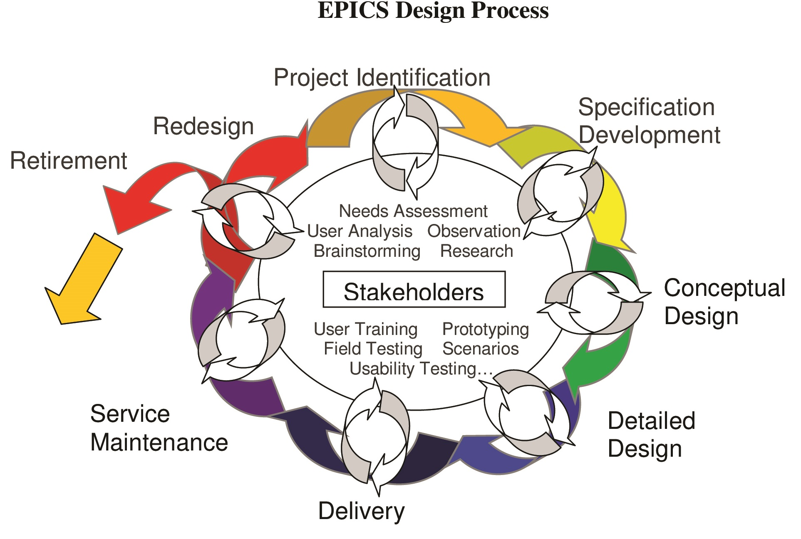
More Information About Design
Design is a process from the origin of the project idea through the deployment and maintenance of the project. It includes specification development, conceptual design, detailed design, etc.
Visit Brightspace or EPICS website for more information about the EPICS Design Process.

Slide 8
Senior Design Outcomes
Each student is expected to demonstrate the abilities they have acquired throughout their academic career.
A student who successfully fulfills the senior design requirements will have demonstrated the 7 outcomes

Slide 9
Senior Design Course Outcomes
i. an ability to apply engineering design to create a product that meets the specified needs of this engineering design experience with consideration of public health, safety, and welfare, as well as global, cultural, social, environmental, and economic factors.
ii. an ability to develop and conduct experimentation, analyze and interpret data, and use engineering judgment to draw conclusions related to the development of the product of this engineering design experience.
iii. an ability to identify, formulate, and solve complex engineering problems arising from this engineering design experience by applying principles of engineering, science, and mathematics.
iv. an ability to function effectively on a team whose members together provide leadership, create a collaborative and inclusive environment, establish goals, plan tasks, and meet objectives associated with this design experience.

Slide 10
Senior Design Course Outcomes
v. an ability to communicate effectively with a range of audiences appropriate to this design experience in both a written report and oral presentation.
vi. an ability to acquire and apply new knowledge as needed, using appropriate learning strategies to complete the engineering design experience associated with this course.
vii. an ability to recognize ethical and professional responsibilities associated with this engineering design experience and make informed judgments which must consider the impact of the product of this engineering design experience in global, economic, environmental, and societal contexts.

Slide 11
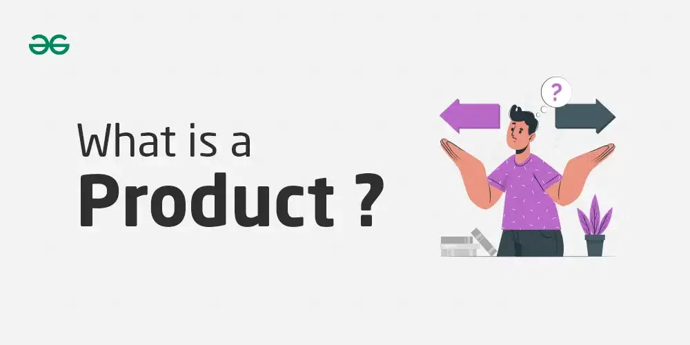
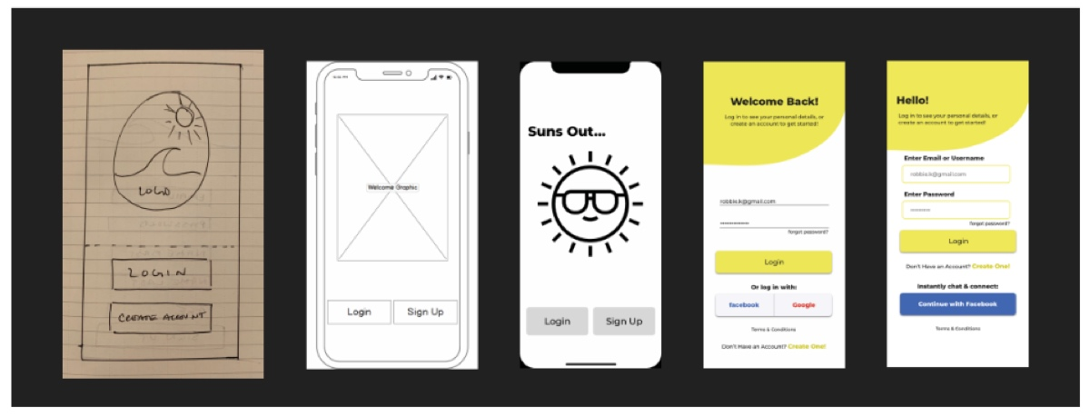
Definition: Product
Refers to any device, system, process, software, etc. resulting from this design experience

Slide 12
Verification Process
Students will demonstrate that they have met the Senior Design requirements by a verification process
Found on Brightspace under the ‘Senior Design’ tab
Also found on the EPICS senior design website
This is facilitated through four (4) documents:
Outcome Matrix (individual) – maintained throughout the 2 semesters, due 1st and 2nd semester
Project Proposal (individual) – Due 1st semester
Project Description (team) – Due 2nd semester
Final Reflection (individual) – Due 2nd semester

Slide 13
Outcomes Matrix
Purpose: Documents how outcomes have been fulfilled and points to appropriate evidence
Individual; Follow template: posted on Brightspace
Should contain:
Specific statements about accomplishments which demonstrate the outcome
Specific reference to evidence to support the statement.
Turned in at every midterm and final grading – must indicate progress towards meeting outcomes.
All outcomes must be met at the end of the design experience
Advisors should provide feedback on the satisfaction of the outcomes, indicating which outcomes have met minimum requirements and which require further work.

Slide 14
Project Proposal
Purpose: ensures the project is appropriate, describes the different design approaches considered, and details the final proposed design. It also helps plan the achievement of all the outcomes.
Individual, Follow template: posted on Brightspace
First draft due: Week 6
Completed forms should be posted in Senior Design folder of student’s team folder on Microsoft Teams
Approved by advisor

Slide 15
Project Description
Purpose: summarizes the work completed and how outcomes have been met across senior design students.
One per project, MUST use template: posted on Brightspace
1st Draft due week 6
If it is a continuing project, the Project Description can build on previous semester’s report. However, the current version of the Project Description should accurately reflect what work was completed prior to the student’s activity on the team, what was completed during the student design experience.

Slide 16
Project Description
Final approval of Senior Design Project Description must be completed by week 15 by advisor(s).
This final version should describe the work completed on the project, and not the work that will be accomplished in the future. It should distinguish work completed by previous team members from the work completed by the Senior design students submitting the Project Description.
Final forms should be posted in Senior Design folder of student’s team on Microsoft Teams
Project descriptions are included in Semester Senior Design reports to each school and reviewed by Senior Design Committees.

Slide 17
Final Reflection
Purpose: summarizes personal contributions, learning strategies, and impact
Individual, follow template: posted on Brightspace
This is instead of the EPICS final reflection
Due at the end of second semester
First semester students will complete the regular EPICS reflection

Slide 18
Templates
Very important that you are using the templates for all 4 documents
2 Locations:
Under senior design tab on Brightspace
EPICS Senior Design website: https://engineering.purdue.edu/EPICS/purdue/individual-documents/senior-design
Do not use past senior design student’s documents. The documents are edited, so you should be using the most recent that are posted

Slide 19
Senior Design students are expected to…
In addition to the senior design docs and meeting the outcomes, senior design students must:
Maintain a design notebook that details all accomplishments, all technical details for the project, and weekly reflections. Note → reflections are done differently in each EPICS section, so follow your advisor’s guidelines
Complete PDH requirement
Present in BOTH the mid-semester and Final Design reviews
Demo final product → informal and should be scheduled with your TA and advisor at the end of 2nd semester
Details regarding each of these requirements are fully described in Brightspace and the EPICS senior design website

Slide 20
Additional Requirements - ECE
For the demo in 2nd semester – if your advisor is not ECE, consider inviting a ECE faculty/ representative

Slide 21
Additional Requirements - MDE
You must let Robin Adams (add link) know when you will be presenting for design review (mid-term and final). Be sure to send her an invite
Second semester: you must schedule an appointment with Robin Adams to present to her and the MDE department
You must receive C- or higher each semester in senior design or it won’t count towards graduation requirements
Highly encouraged by MDE to pursue the Design Lead position

Slide 22
Verification Process
Students will demonstrate that they have met Senior Design requirements by the verification process. This is a timeline with due dates for all required documents.
This is available on Brightspace and the EPICS senior design website: https://engineering.purdue.edu/EPICS/purdue/individual-documents/senior-design-verification
Please note there are different timelines depending if you are in you first or second semester of senior design.

Slide 23
Info Location & Submissions
EPICS Senior design website: https://engineering.purdue.edu/EPICS/purdue/individual-documents/senior-design
Brightspace under the ‘Senior Design’ tab
All Submissions:
Check off on Brightspace under the Senior Design tab
Post documents in senior design folder in Microsoft Teams
You should create a folder with your name on it under the Senior Design tab in Microsoft Teams

Slide 24
Grading
Instead of submitting Individual Evaluation Rubrics for grading (mid-semester, final), Senior design students submit Outcome Matrices and/or Project Proposal or Project Description (see Verification Process for what is required.)
Specific rubric is used to grade senior design students: Senior Design Rubric

Slide 25
Feedback
Throughout the semester, you should be having conversations with your advisor and TA to receive feedback on your projects and documentation
Do not wait to hear from your TA and Advisor – reach out!
Be proactive in discussing your project goals and receiving feedback

Slide 26

Keep in mind…
You are responsible for paying attention to how you are doing with respect to the senior design requirements
Appropriateness of project
Your role on the project
Outcomes
If you don’t meet the senior design requirements, you won’t graduate. Discuss concerns with your TA, advisor, and/or EPICS Senior Design Coordinator

Slide 27
Where to Get Help
Advisor/EPICS Senior Design Coordinator:
Lakshmy Mohandas – lmohanda@purdue.edu
EPICS Senior Design TA:
Phone Myat Paing – ppaing@purdue.edu

Slide 28
Credit for Attending SD Meeting
You can count this as 1 PDH
Just include it in the PDH report as ‘EPICS mandatory Senior Design meeting’

Slide 29
Thank You! Any Questions?

