Slide 1
Financial officer Training

Slide 2
Your role as the financial Officer
To manage your team’s budget and expenses during the semester or year.

Slide 3
What do I do as the financial officer?
As the financial officer, you will:
Learn how to create and maintain a budget for multiple projects
Track expenditures for multiple projects
A detailed description of the role and responsibilities can be found here.

Slide 4
Budget Planning

Slide 5
Why do I need to submit a team budget?
EPICS is just like any other group – we operate on a budget. Knowing what each team might need and spend is how we determine our yearly budget. We make our overall project budget from your budget submissions.
We want your team to be successful and don’t want project progress to be held up by insufficient funds.

Slide 6
Seed allocation
Each team starts with a $200 seed allocation. It is automatically included on your budget form.
Your budget submission is your opportunity to request additional funding. The EPICS staff will take the project scope into consideration when evaluating your budget submission.
Question: Do I need to submit a budget if I know my team will not exceed the seed money?
Answer: Yes. Even if you are not spending over the $200 seed money, we need to know what your expenses will be.

Slide 7
How do I create my budget?
Have each project team on your team give you an estimate for what they will spend. It is a team budget and you need your team’s help in preparing it.
You must use the budget form found here, which will start a DocuSign document.
Tips:
Include shipping costs in your purchase estimates if you know them.
Do not include tax in your estimates. Purchases through the university are tax exempt.
Be realistic about room for error in your project.

Slide 8
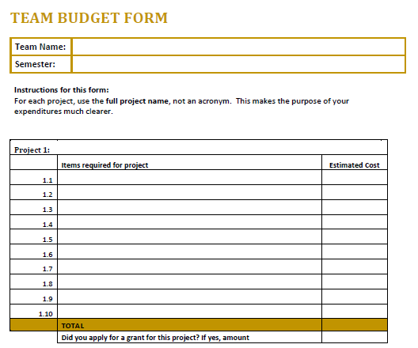
Sample Budget
You will fill out one of these boxes for each of your projects with the help of that project team. If additional item lines are needed, continue in box for next project.
The box for Project 1 includes room for 20 line items, so please use it for your biggest project.
If you have applied for, or are going to apply for a grant, enter the amount here.

Slide 9
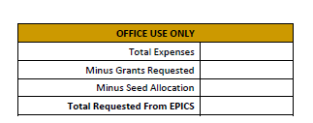
Sample Budget
These boxes will autofill based on the information entered for each project. The seed allocation and grant funds you have requested are subtracted to calculate the additional funds needed to support your projects.
It is important to use meaningful names for each project to facilitate accurate tracking.

Slide 10
What do I do with my completed budget form?
Submit the DocuSign budget form.
Your advisor will review and sign.
EPICS administration will review and approve.
You will receive notification in the Teams Budget channel when your budget is approved. Any modifications will be noted and a copy will be posted in your budget folder, files, in Teams.

Slide 11
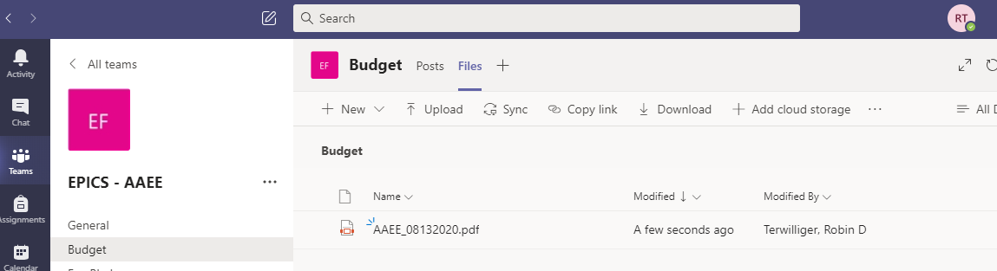
Expense Tracking
When your budget is approved, it will appear on Teams > Budget > Files
An updated accounting of your budget and expenses will be added monthly in that location.
You should make a monthly report to your team to discuss your financial standings.

Slide 12
Grants

Slide 13
Service Learning Grants
You are encouraged to apply for a service learning grant. You can either apply for a grant for your team as a whole or for each individual project. When completing the application, please use the following naming convention for each project to aid in tracking expenses.
EPICS: Team name - Project name
e.g., EPICS: AT - Colton Fishing
These grants allow EPICS to do more projects and maximize community impact. This is also a great opportunity for you to learn about grant writing.
A grant workshop is available online here to provide you with detailed information about grant writing and the submission process. A grant application example can be found here.

Slide 14
Purchasing on Grant Funds
You will be notified by the Office of Engagement if your application is approved. You must provide this information to the EPICS office, epics@purdue.edu, for the funds to be reflected in your budget.
The purchase request form has a place for you to indicate if grant funds are to be used. Please indicate your team, your project, and which grant you would like the purchase applied to.

Slide 15
Grant fund accounting
You will be required to provide a detailed accounting of your grant purchases to the Office of Engagement at the end of the semester.
The accounting for your grant purchases will be included in the MS Teams budget folder in the Files tab and updated monthly.

Slide 16
Purchasing

Slide 17
How can my team purchase items?
The first step to purchasing anything is filling out the purchase request form found here. As the financial officer, you are responsible for familiarizing yourself and your team with the form and its requirements.
You can either have the items ordered for you, or request to check out a credit card for purchases at local vendors.
Additional purchasing guidelines are detailed here.

Slide 18
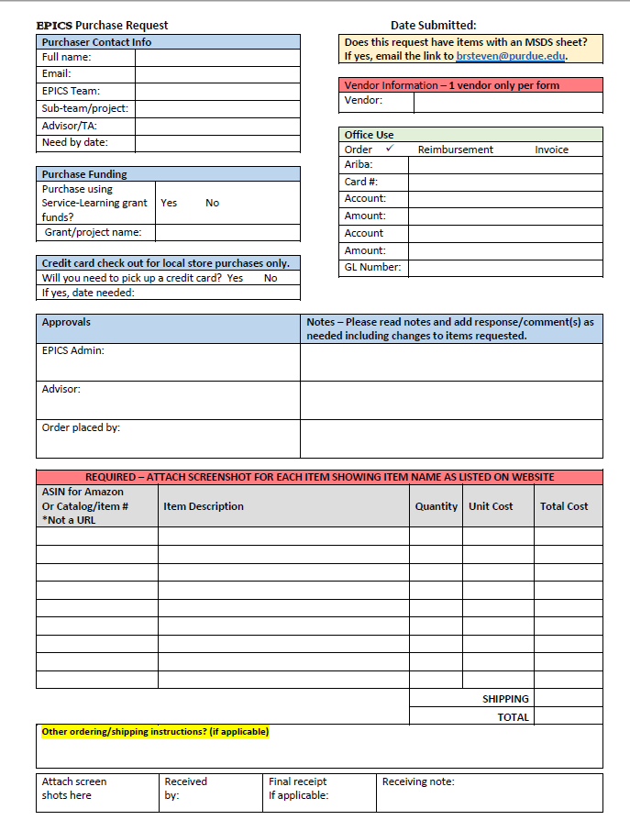
Sample Purchase Request
After providing your personal and advisor information, you will be directed to this form.
Read all fields to ensure that your order gets placed efficiently and accurately.
After you complete all required fields as indicated on the form, it will be sent to your advisor for approval.

Slide 19
Purchase request Tips
Submit a separate purchase request for each vendor (e.g., Amazon, Home Depot, Menards, etc.).
If you are ordering too many items to fit in the lines on the document, attach a spreadsheet and indicate “spreadsheet attached” on the form. Make sure you still include the ASIN for Amazon, catalog number, item description, quantity, unit cost, and total cost for all items.
Make sure your shipping cost is consistent with the speed with which you want it shipped (“Need by date”).

Slide 20
Purchase Process
You will be notified via email when:
Your purchase request is submitted
When your order is placed
When your item is available for pickup from the EPICS office (ARMS 1200).
If you don’t receive an email that your order has been placed within a reasonable amount of time, check with your advisor to see if they have approved the request.
Please pick up your packages in a timely manner. If you have not received an email, your package has not arrived.

Slide 21
Thank you
If you have questions
talk to Robin Terwilliger (ARMS 1200), rterwill@purdue.edu, or on Teams.

