Slide 1
Nanotechnology

Slide 2
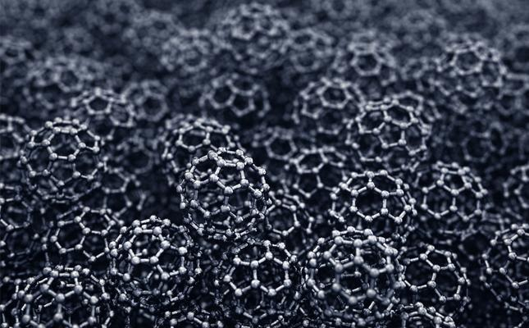
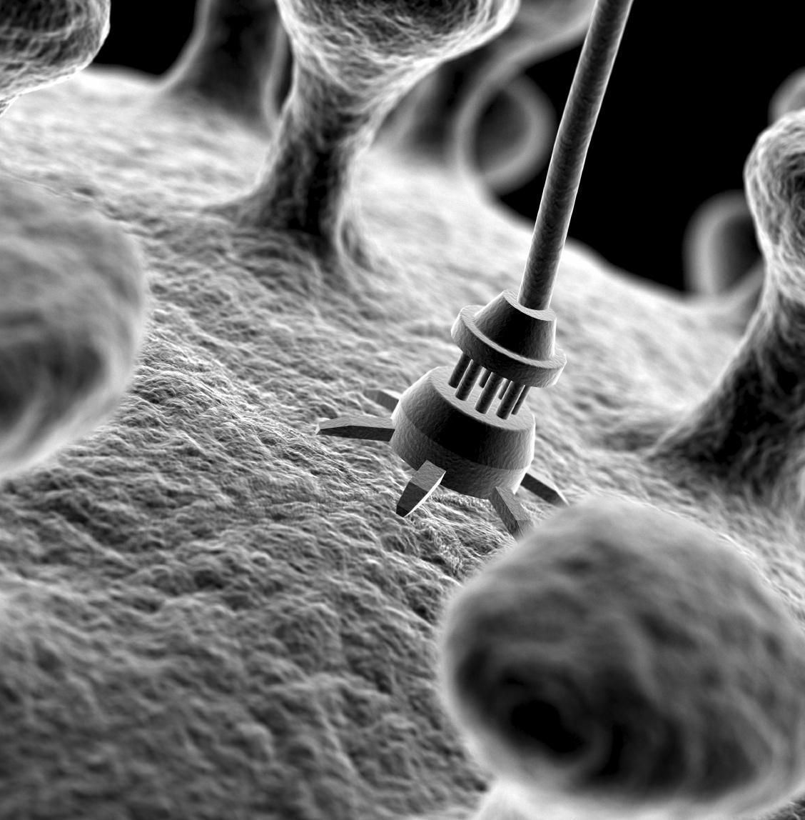
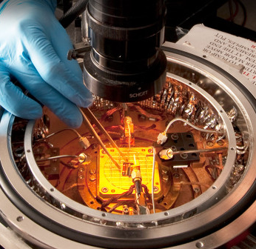
What Is Nanotechnology?
Nanotechnology is the study and application of things measuring less than 100nm.
Nanotechnology can be used across all the other science fields, such as chemistry, biology, physics, materials science, and engineering.
Nanotechnology is a relatively new field of study and is allowing scientists to solve problems that couldn’t be solved on the macroscopic scale.

Slide 3
Current Uses of Nanotechnology
Transistors
Water and residue resistant coating for lenses
Coating machine parts to increase durability
Nanoparticles can be used with medicine to improve their absorption into the body
Nanotubes can be used in tennis rackets to decrease bending during impact, ensuring a more accurate rebound.

Slide 4
Future uses of Nanotechnology
Nanotechnology can be used for its hydrophobic properties.
When added to a polymer composite material, makes them durable, but lightweight
Nanosensors are being developed to detect salmonella.
Machine parts coated with a nanostructured ceramic coating are more durable than those with a regular coating.
Nanoparticles can be used as catalysts in chemical reactions.
Can potentially be used to convert waste heat into usable electrical power.
Notes:
FIX PHRASING AND SPLIT INTO 2 (OR MORE) SLIDES

Slide 5
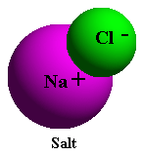
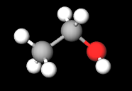
Hydrophilic Compounds
The word Hydrophilic comes from the Greek roots meaning “water” and “loving”.
Hydrophilic compounds tend to dissolve readily in water, or simply do not repel it.
Hydrophilic compounds are usually polar or ionic in nature. Some examples include sodium chloride (an ionic salt) and ethanol (a polar compound).
Ethanol

Slide 6
Hydrophobic Compounds
The word Hydrophobic comes from the Greek roots meaning “water” and “fearing”.
Hydrophobic compounds do not dissolve in water, and some hydrophobic compounds will actively repel water.
Hydrophobic compounds are generally nonpolar in nature, and resemble lipids (i.e. oils and fats). Examples include fats (lipids) and decane (a nonpolar molecule).
Decane A molecule of saturated fat

Slide 7
The Lotus Effect
Notes:
https://www.youtube.com/embed/VHcd_4ftsNY?start=04&end=157
https://www.youtube.com/watch?v=BvTkefJHfC0 <-- Video Demoing uses

Slide 8
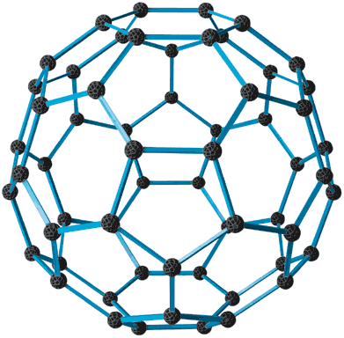
C60 Molecules
The C60 molecule, also known as a buckminsterfullerene or “Buckyball”, is a structure of carbon discovered in 1996.
It is a highly hydrophobic, hollow, soccer ball shaped structure comprised of 60 carbon atoms.
A buckyball’s structure consists of two ‘domes’ made with a pentagon in the middle surrounded by hexagons

Slide 9
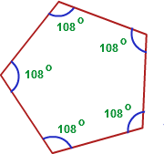
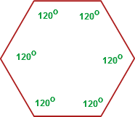
Angles of Regular Pentagons and Hexagons

Slide 10
Carbon Nanotubes
A carbon nanotube is a tube constructed purely out of carbon atoms, the diameter of which is on the scale of nanometers.
Carbon nanotubes are extremely strong and flexible as well as conductive.
Carbon Nanotubes come in three main types
Zig Zag
Armchair
Chiral
https://www.ncnr.nist.gov/staff/taner/nanotube/n0tube.jpg
https://www.ncnr.nist.gov/staff/taner/nanotube/nntube.jpg
https://www.ncnr.nist.gov/staff/taner/nanotube/nmtube.gif
What we will build

Slide 11
Citations
"Benefits and Applications." Nano.gov. National Nanotechnology Initiative, n.d. Web. 21 Oct. 2016. https://www.nano.gov/you/nanotechnology-benefits
“Types of Nanotubes.” https://www.ncnr.nist.gov/staff/taner/nanotube/types.html. National Institute of Standards and Technology (NIST) Center for Neutron Research, n.d. Web. 7 April 2017
10 Ways Nanotechnology Impacts Our Lives. (n.d.). Retrieved April 07, 2017, from https://www.asme.org/engineering-topics/articles/technology-and-society/10-ways-nanotechnology-impacts-lives

