Slide 1


Cyber Resilience in the Small to the Large
Saurabh Bagchi
School of Electrical and Computer Engineering
Purdue University
Presentation available at: www.purdue.edu/crisp

Slide 2
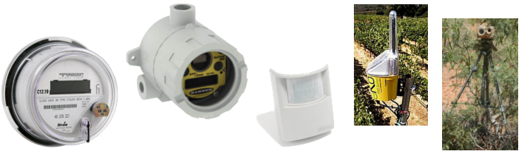
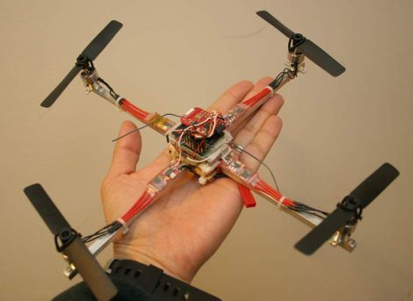
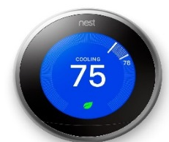
Cyber Resilience in the Small: The Big Problems
The Internet of Small Intelligent Things needs dependability
  But they have fundamental resource constraints
  They are often deployed in hostile or uncertain environments
  Nodes have low-end microcontrollers and lightweight OS without security protection
Constraints include: Energy, Wireless bandwidth, Untrusted nodes, Disconnected networks
Autonomous Mobile Things
Industrial Monitoring
Precision Agriculture
Smart Grids
Smart Buildings
Surveillance

Slide 3
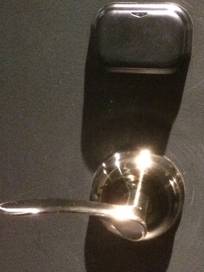
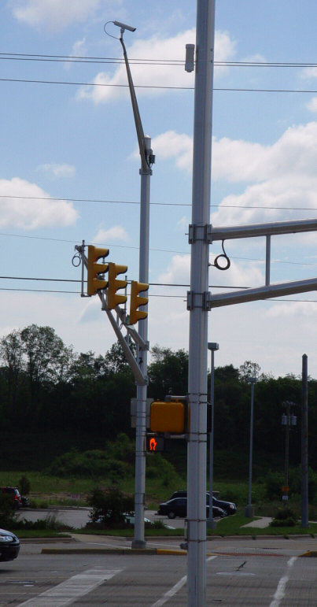
Cyber Resilience in the Small: Specific Problems
Resilience needs to become invisible
  Zero configuration
  Authentication without intervention
  Adaptible to different environments
Compartmentalization
  Error containment boundaries
  Protection scales w/ hardware capability
  Applicable to legacy code
Application Logic
Image
Proc.
TCP
Stack
Serial
Coms
Signal
Proc.
Camera
HAL
WIFI
HAL
UART
HAL
ADC
HAL
Camera
2.4Ghz Radio
UART
ADC
Debuggability
  In the field, remote debugging
  Low energy
  Near real-time

Slide 4
Solution Landscape Today
Resilience needs to become invisible
  Offload heavy duty processing to an edge device [Wood, Bagchi et al.-CACM18]
  Use the collective resilience that comes from multiple devices in spatial proximity [Zhang, Bagchi et al.-Middleware17]
  Continuous authentication using biometric signals on wearables or daily activity [Roy Choudhury-CHI15]
Compartmentalization
  ACES: automatically create compartments through static analysis and apply principle of least privileges [Clements-Bagchi et al.-S&P17, UsenixSec18]
  Orthogonal process to application development process
  Use dynamic monitoring to white list accesses
  ARM’s mBed OS μVisor [ARM-17, Xu-NDSS18]

Slide 5
Active Research Directions
What are the failure modes of new classes of devices ⎯ autonomous IoT devices, wearables, home automation devices? [Lin-Mobisys17, Yi, Bagchi et al.-DSN18]
How can seamless offloading among classes of devices increase resilience? [Chiang-Sensys17]
How can we quickly emulate diverse large-scale systems to assess resilience? [Vigna-NDSS15, Brumley-NDSS16]

Slide 6
Cyber Resilience in the Large: The Big Problems
Goal: Provide highly available applications (e.g., datacenter infrastructure applications) in distributed environment
  Perform failure prediction
  Perform bug localization
Challenges in today’s distributed systems
  Large number of entities and large amount of data
  Interactions between entities causes error propagation
  High throughput or low latency requirements

Slide 7
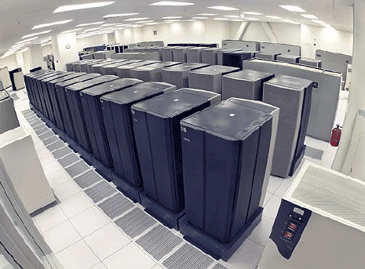
Specific Problem #1: Automatic Continuous Fault Localization
Application
Requests rate, transactions, DB reads/writes, etc..
Middleware
Virtual machines and containers statistics
Operating System
CPU, memory, I/O, network statistics
Hardware
CPU performance counters
Tivoli
Operations Manager
How can we use these metrics to localize root cause of problems?

Slide 8
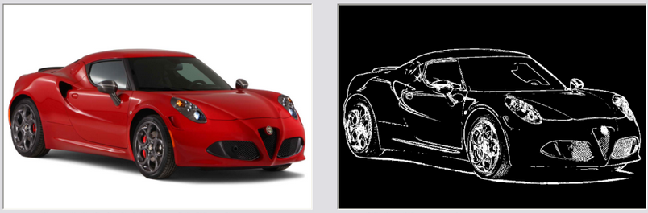


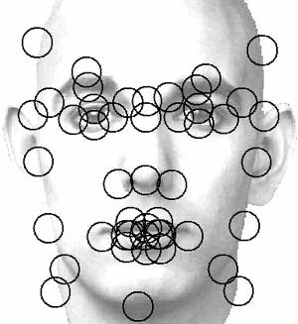
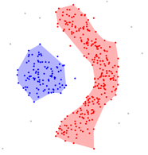
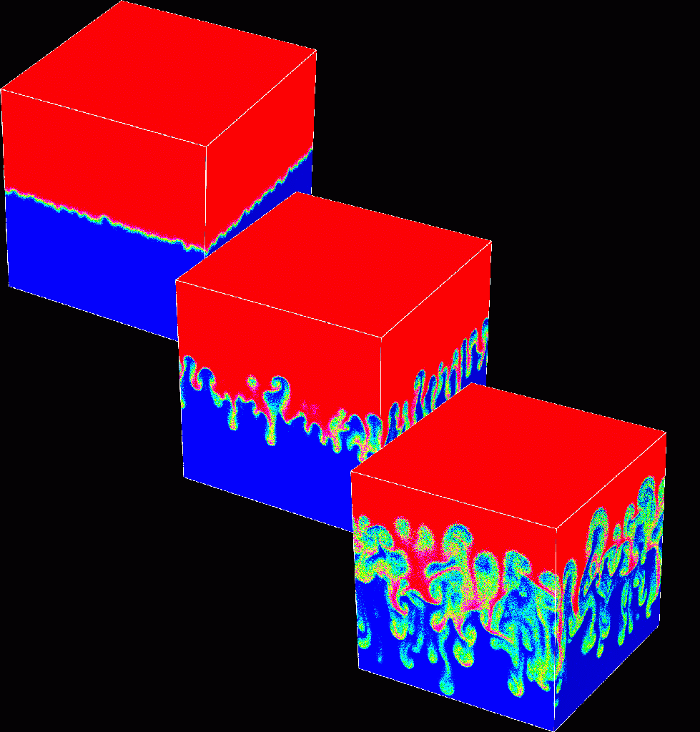
Specific Problem #2: Trade off Accuracy for Speed
Image Processing
Data Analytics
Can tolerate some imprecision
Media Applications
Computer Vision
Scientific Simulations
Machine Learning

Slide 9
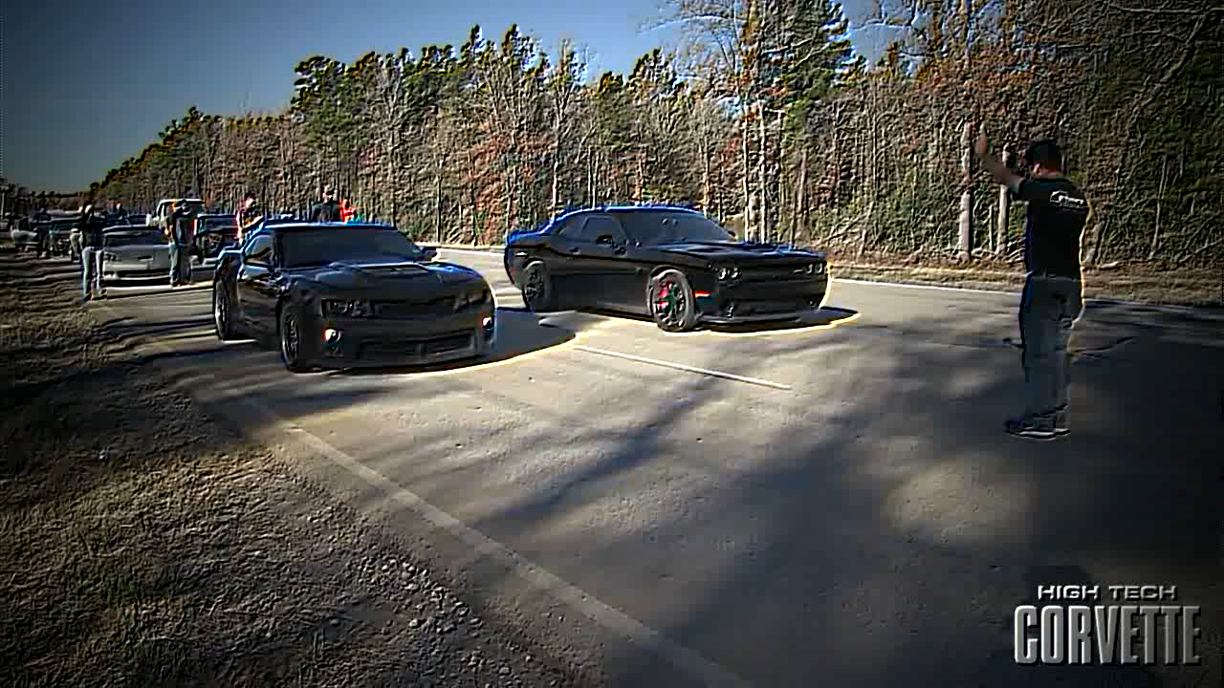
Spot the Difference?
Oracle
VideoChef
[Xu, Bagchi et al.-ATC18]

Slide 10
Presentation available at:
CRISP web site www.purdue.edu/crisp

