Slide 1
Graduate student organization for AAE at Purdue
16th August 2018

Slide 2
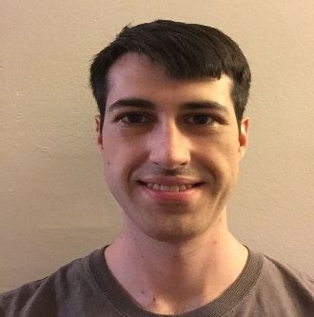
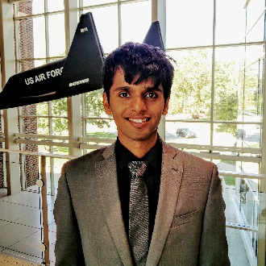
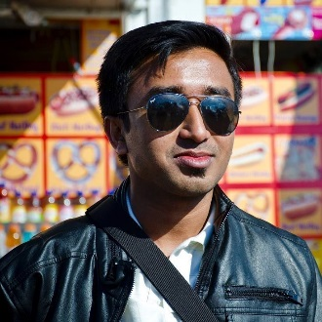
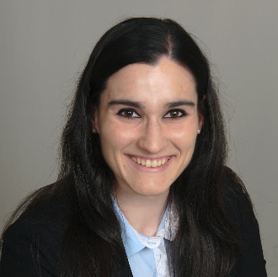
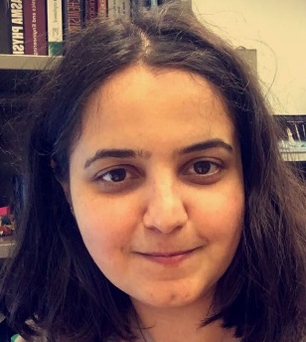
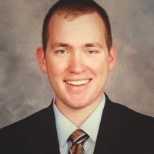
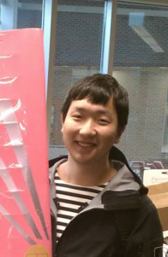
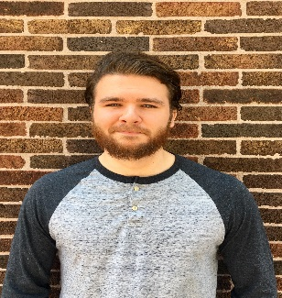
Aero Assist: Executive Team
MENTORSHIP
Mentoship
James
Utsav
(President)
Akshita
(Treasurer)
Paul
(PGSG Senator)
Orzuri
(Social Media
and Webmaster)
FUNDRAISING
Mentoship
PROFESSIONAL DEVELOPMENT
SOCIAL AND CULTURAL
Tugba
OUTREACH
Mentoship
Dominik
Robert
Siwei
Tracy
Weston

Slide 3
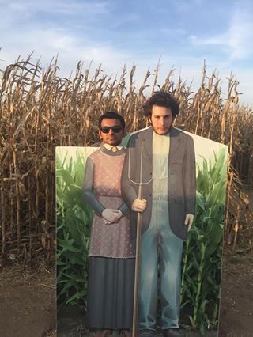
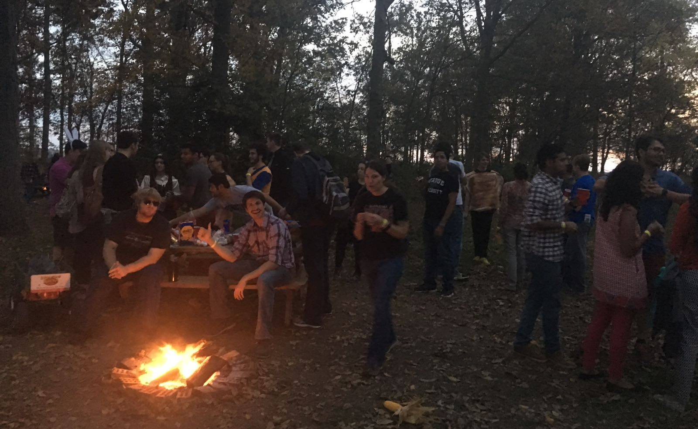
Aero Assist: Making your life less boring!

Slide 4
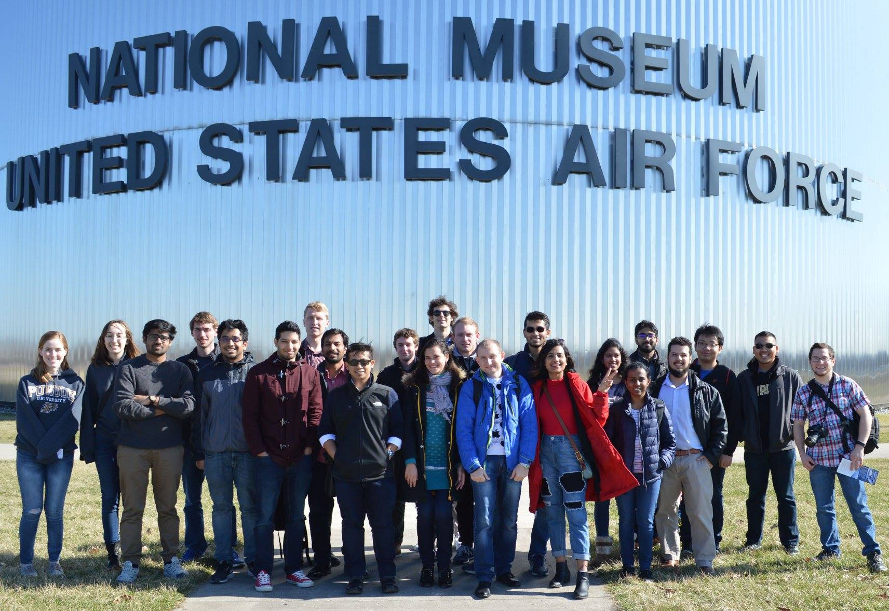
Aero Assist: Making your life less boring!

Slide 5
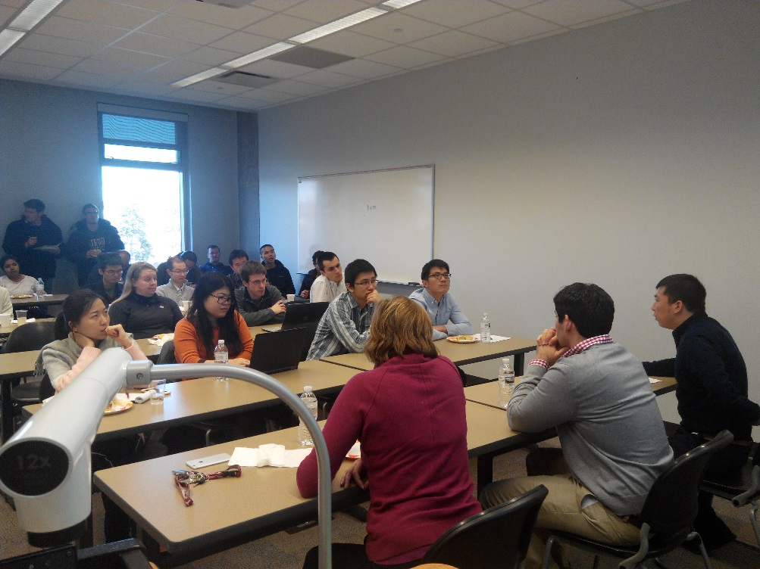
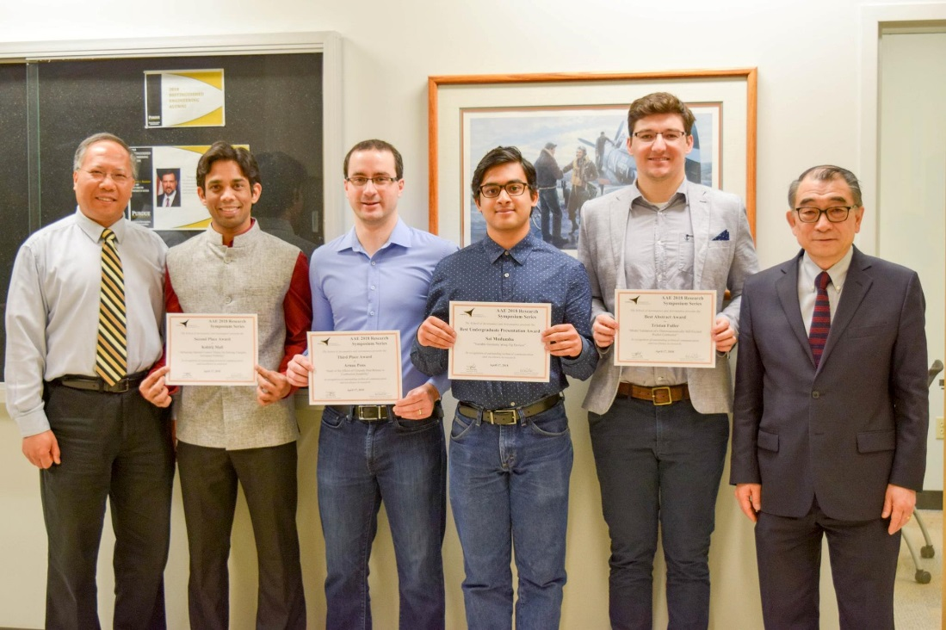
Aero Assist: developing your professional skills!
Resume Workshops and Expert Panels
Annual Research Symposium

Slide 6
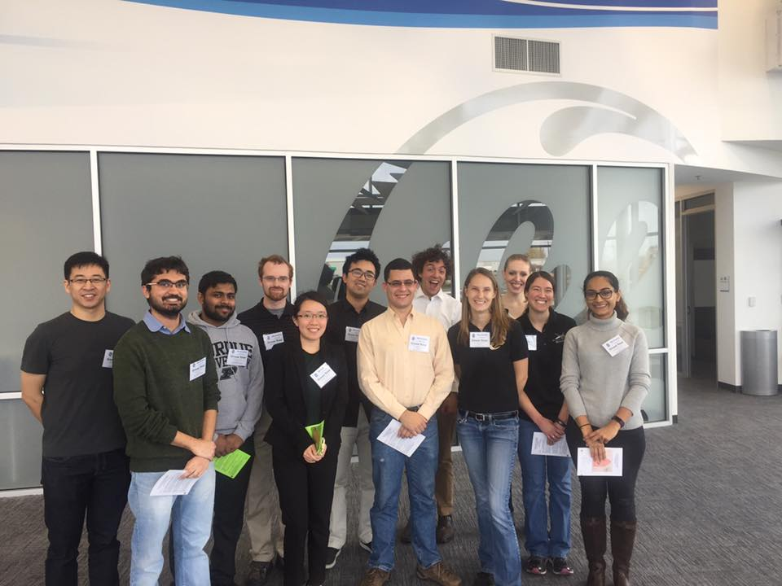
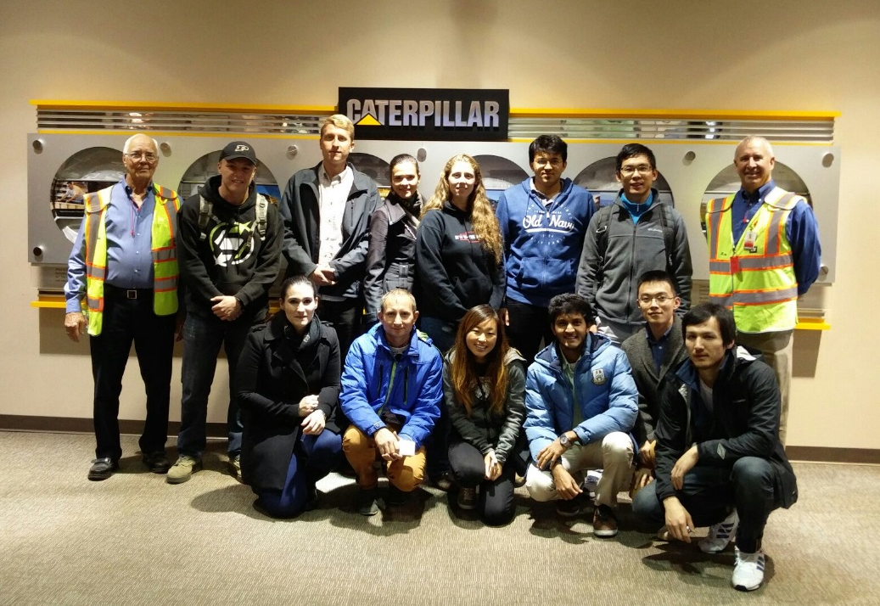
Aero Assist: Industry Visits!
General Aviation
Caterpillar Incorporation
Other industry we plan to visit are NASA, Rolls Royce etc.

Slide 7
Orientation week: Mentorship events
Aero Social Night
Friday (8:30 PM), August 17th Nine Irish Brothers
Aero Barbeque
Friday (5:30 PM), August 24th Pickett Park
Star-gazing
Friday (7:00 PM), August 31st
If you are still looking for a mentor, send an email to aeroassist@purdue.edu today and we will pair you up with a mentor

Slide 8
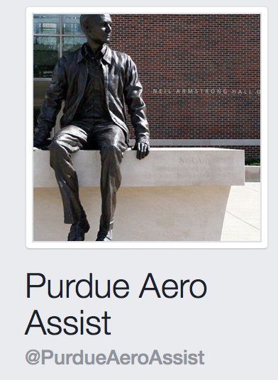
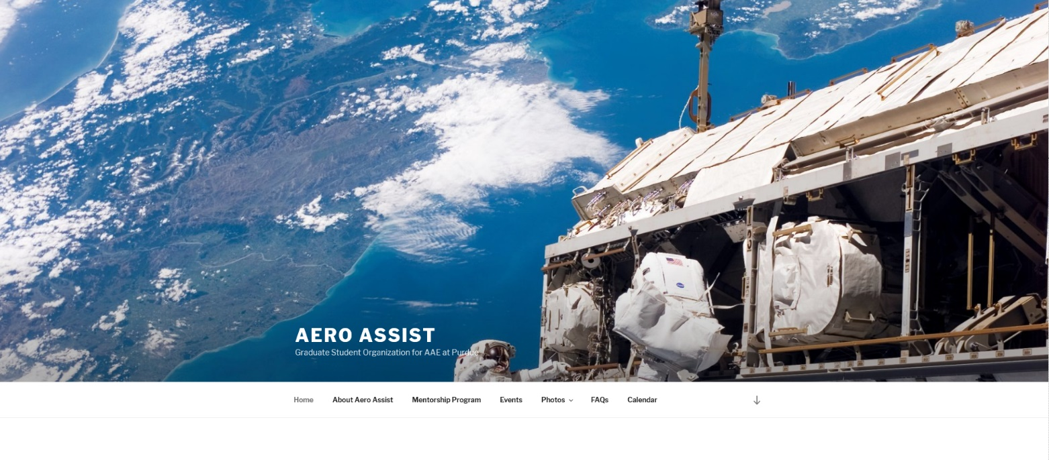
Follow us @
Webpage: Purdue Aero Assist https://engineering.purdue.edu/AeroAssist/
Facebook: Purdue Aero Assist https://www.facebook.com/PurdueAeroAssist/?fref=ts
Instagram: https://www.instagram.com/aeroassist/
Linkedin: https://www.linkedin.com/company/purdue-aeroassist/

Slide 10
Questions? aeroassist@ecn.purdue.edu

Slide 11
Graduate School Survival Kit

Slide 12
Facebook Groups – AAE Student Organizations & More
Aero Assist (GSO)
https://engineering.purdue.edu/AeroAssist/
AAE Graduate Women's Gatherings (GWG)
Purdue Space Day
https://www.facebook.com/PurdueSpaceDay/?fref=ts
Sigma Gamma Tau Purdue
https://www.facebook.com/Sigma-Gamma-Tau-Purdue-146651778706792/?fref=ts
Zucrow Student Association
https://www.facebook.com/groups/1718811978396868/?fref=ts
Purdue AIAA
https://www.facebook.com/PurdueAIAA/?fref=ts
Purdue SEDS
https://www.facebook.com/PurdueSEDS/?fref=ts
Purdue Graduate Student Government PGSG Events
https://www.facebook.com/groups/189798133207/

Slide 13
Facebook Groups - Work & Buy/Sale
Jobs & Internships
https://www.facebook.com/groups/357226557647692/?ref=bookmarks
Free & For Sale (Student Sales)
https://www.facebook.com/groups/357226580981023/?ref=bookmarks
Purdue Student Market (Student Sales)
https://www.facebook.com/groups/202090003202954/
Graduate Students
https://www.facebook.com/groups/358389494198065/
Textbook Exchange
https://www.facebook.com/groups/357226547647693/?ref=browser
Purdue University Rideshare Group
https://www.facebook.com/groups/53093636813/

Slide 14
Purdue Graduate Employment
Manual
http://www.purdue.edu/hr/pdf/GradStudentEmploymentManual.pdf
Purdue Employee Portal
http://www.purdue.edu/employeeportal/
Concur Travel (Traveling to Conferences)
http://www.purdue.edu/business/travel/concur/faq/index.html#item1
Health
http://www.purdue.edu/push/Insurance/EnrollmentInformation/graduate.html#graduate
Payroll & Tax Services
https://www.purdue.edu/business/payroll/taxes/Tax_Information/index.html
Remote Desktop Connection –> Really useful!
https://engineering.purdue.edu/ECN/Support/KB/Docs/RemoteDesktopWin7
Research Computing (IT Consultation with a Coffee)
https://www.rcac.purdue.edu/coffee

Slide 15
Seeking for a Job/Internship?
Purdue Center for Career Opportunities (CCO)
https://www.cco.purdue.edu/students/
Office of Professional Practice
https://opp.purdue.edu/about/index.html
List of Career Fairs at Purdue
https://www.cco.purdue.edu/Calendar/
Industrial Round Table 2016
http://www.purdueesc.org/careerfairs/ir2016/
National Labs @ Purdue
http://www.purdue.edu/gradschool/nlap/
Aerospace Career Expo
https://engineering.purdue.edu/aaesac/ace.php

Slide 16
Some Funding Opportunities
Graduate School Database
https://ias.itap.purdue.edu/rgs/wfd_funding.Search_form
College of Engineering – PhD travel grants
https://engineering.purdue.edu/Engr/Academics/Graduate/ProfessionalDevelopment/TravelGrantProgram
PGSG Grants (Travel, Child Care & Professional)
http://web.ics.purdue.edu/~pgsg/projects/travel-grants/
http://web.ics.purdue.edu/~pgsg/projects/professional-grants/
http://web.ics.purdue.edu/~pgsg/projects/child-care-grant/
Indiana Space Grant Consortium
https://engineering.purdue.edu/INSGC/competition_files/INSGC_Graduate_Fellowship_Application

Slide 17
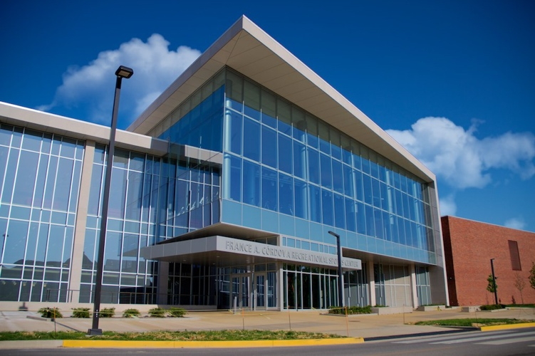
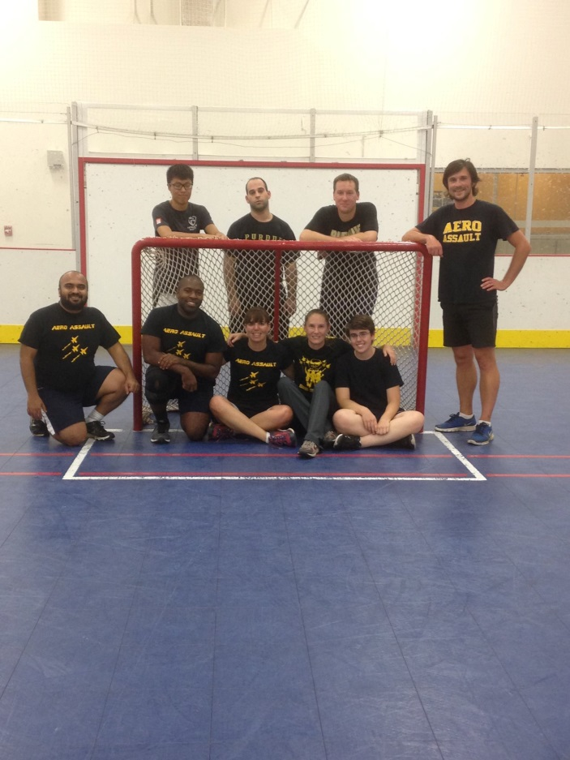
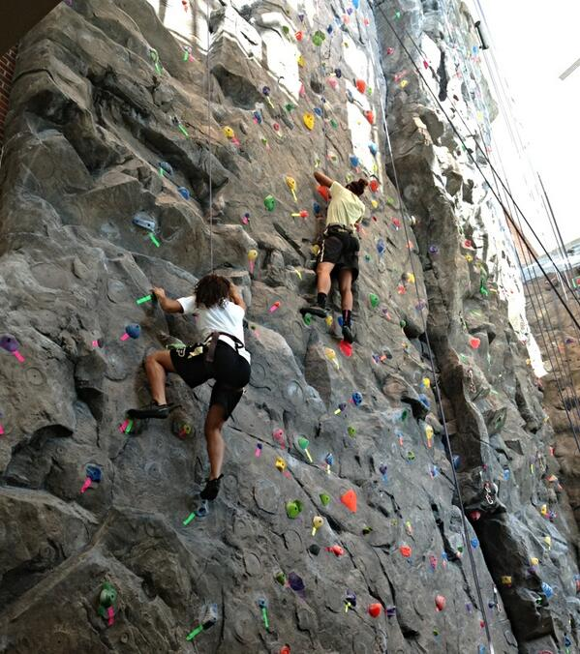
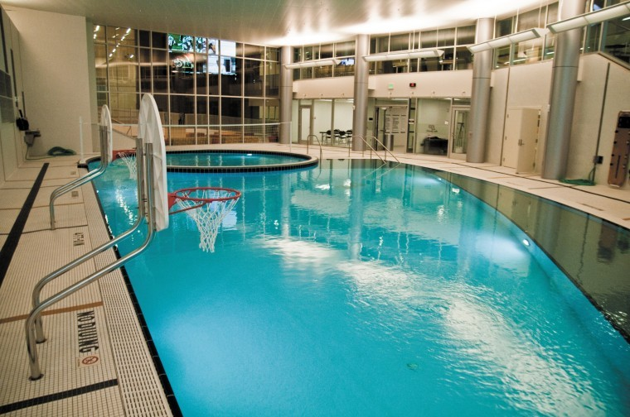
Physical Wellness
Purdue Recreational Sports
http://www.purdue.edu/recwell/
Students Fee already included with the tuition fee (access free to the facilities)

Slide 18
Mental Wellness
Office of Dean of Students
http://www.purdue.edu/odos/
Student Legal Services
http://www.purdue.edu/odos/sls/faq/index.html
CAPS (Counseling and Psychological Services)
http://www.purdue.edu/caps/
Center for Healthy Leaving (Stress management etc.)
http://www.purdue.edu/hr/CHL/index.html
Sexual Violence Awareness
https://www.purdue.edu/sexual_assault/advocate.html

Slide 19
TRANSPORTATION BUY/SHARE
Zagster Bike Share
https://www.facebook.com/groups/53093636813/
Zipcar Purdue- Car Share
http://www.zipcar.com/universities/purdue-university
Campus Bus Service
http://www.gocitybus.com/Maps-Schedules
Purdue University Rideshare Group
https://www.facebook.com/groups/53093636813/
Purdue University Parking
http://www.purdue.edu/parking/
Indiana Bureau of Motor Vehicles
http://www.in.gov/bmv/
West Lafayette: http://www.in.gov/bmv/2558.htm
Lafayette: http://www.in.gov/bmv/2491.htm

Slide 20
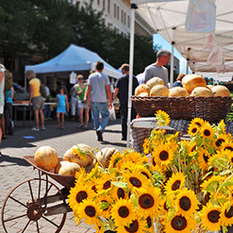
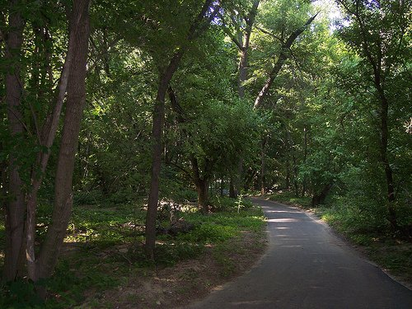
What to do in Lafayette /West Lafayette
Downtown Lafayette
http://www.readysetgodowntown.com
Purdue Convos
https://www.purdue.edu/convocations/
Lafayette Farmer’s Market
http://www.lafayettefarmersmarket.com
Wabash Heritage Trail

