Slide 1
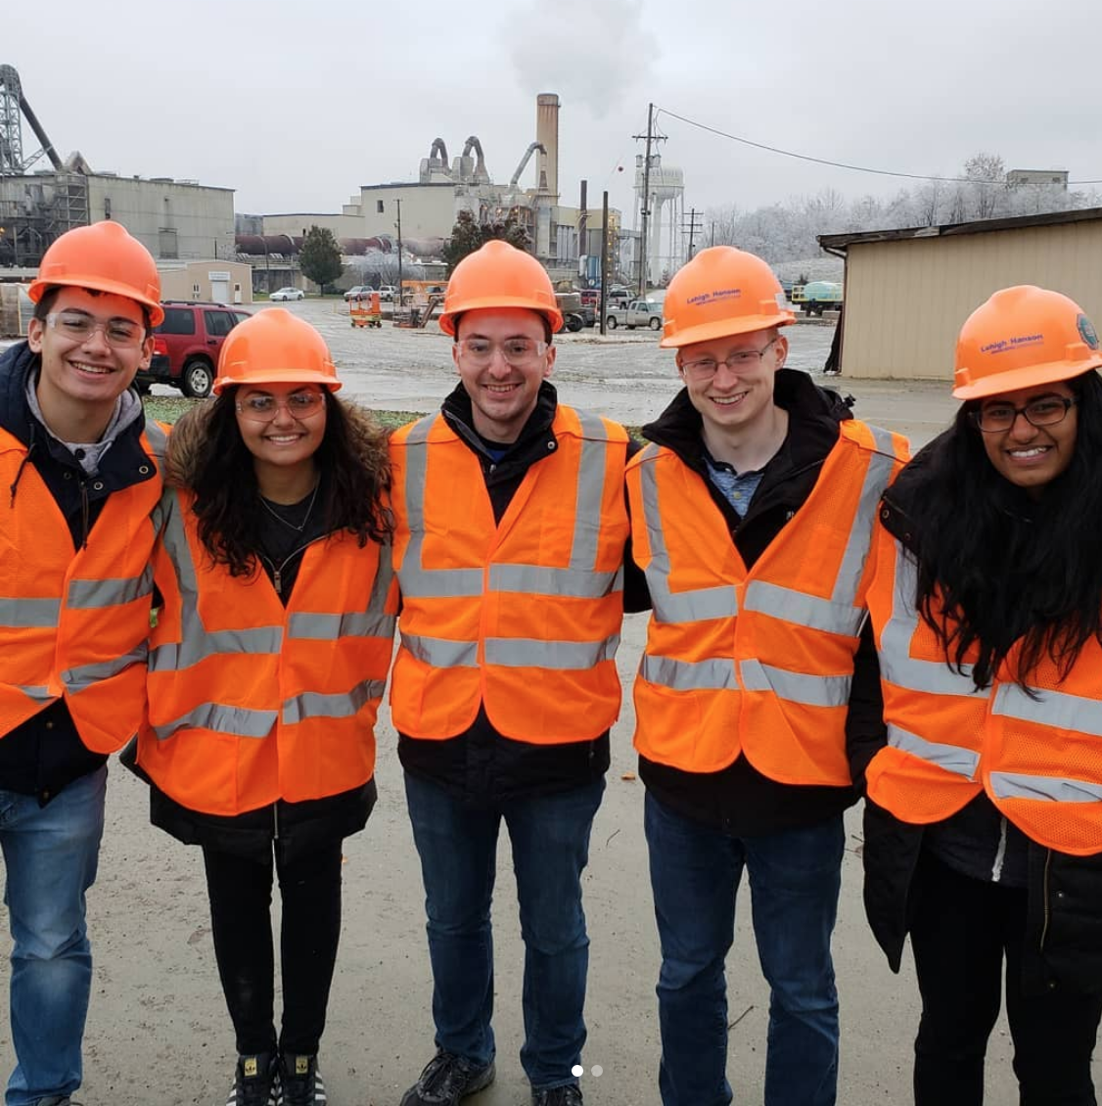
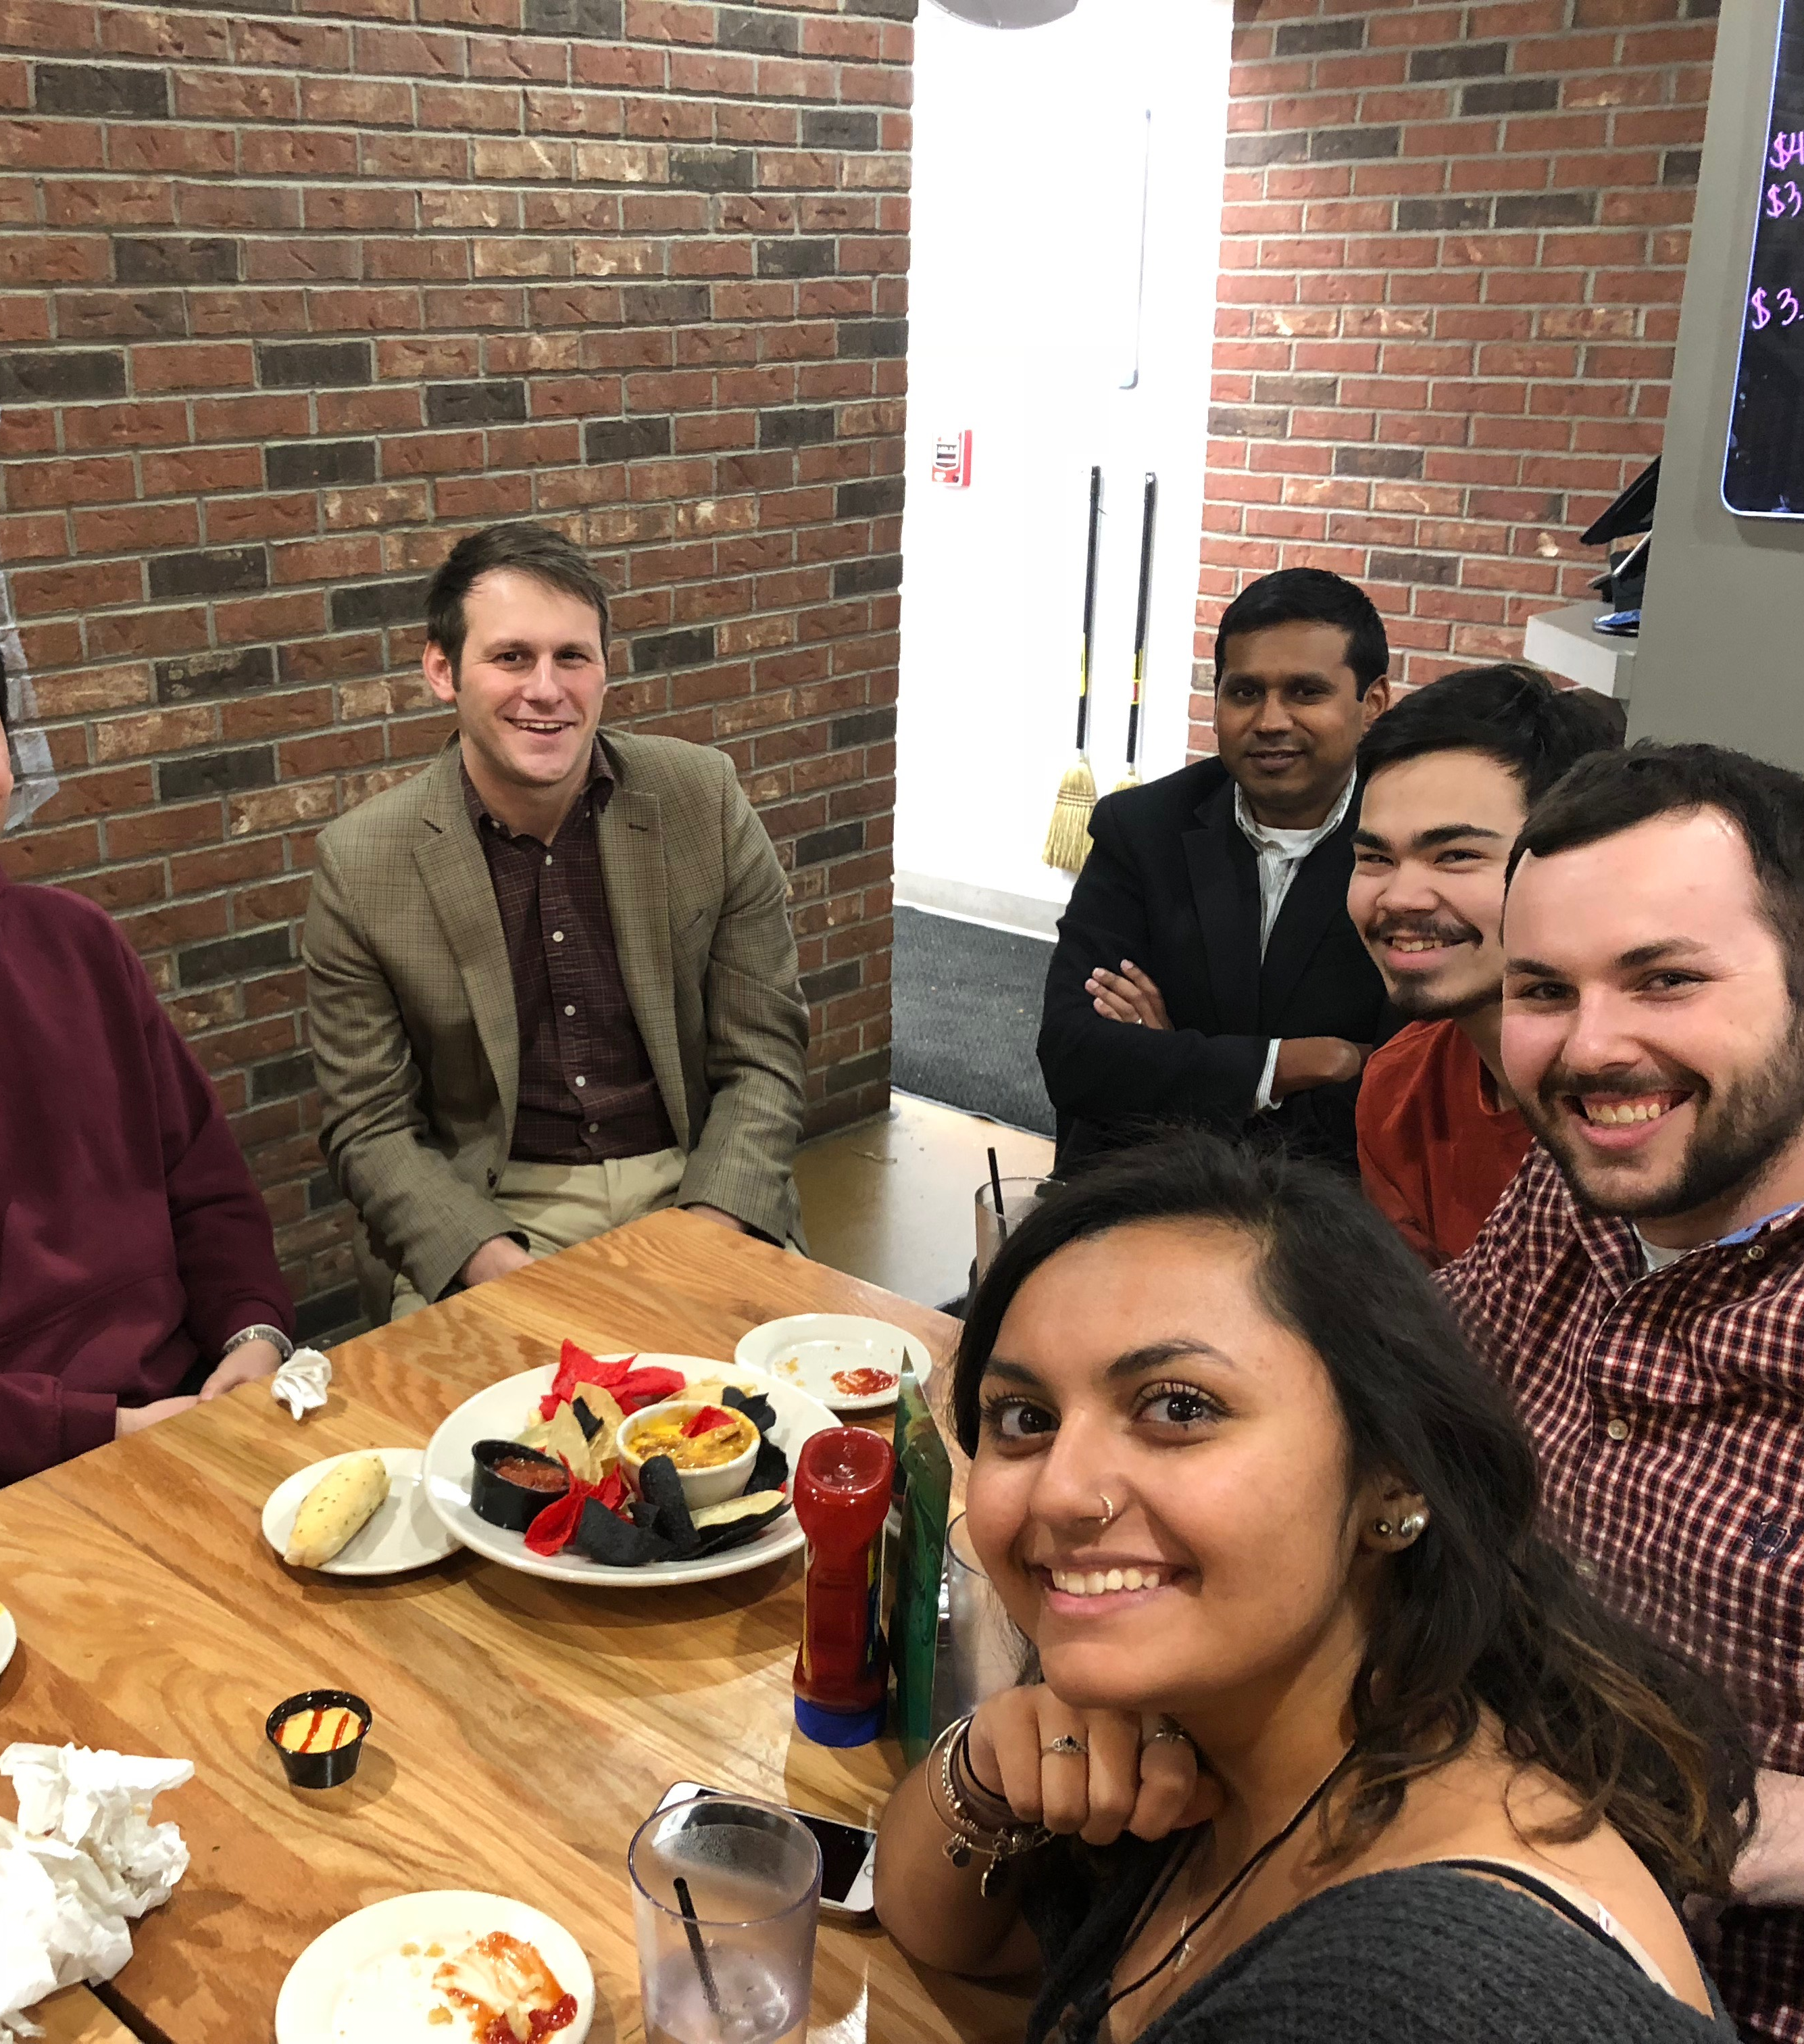
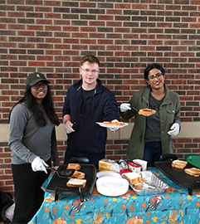
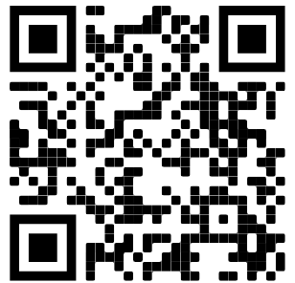
Purdue American institute of chemical engineers (aiche) January amm/callout
1/16/2020
SIGN IN - https://tinyurl.com/AIChEJanAMM

Slide 2
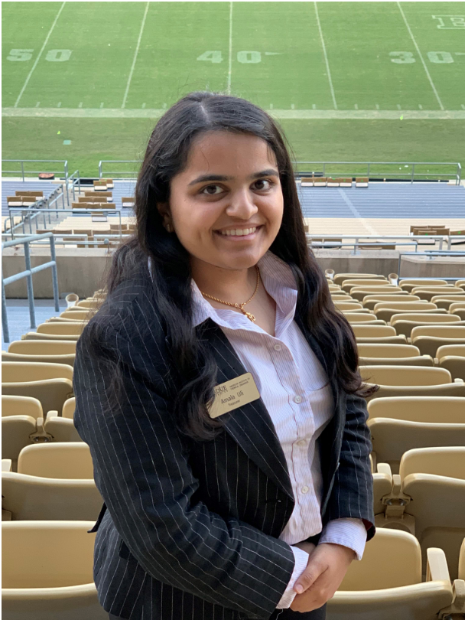
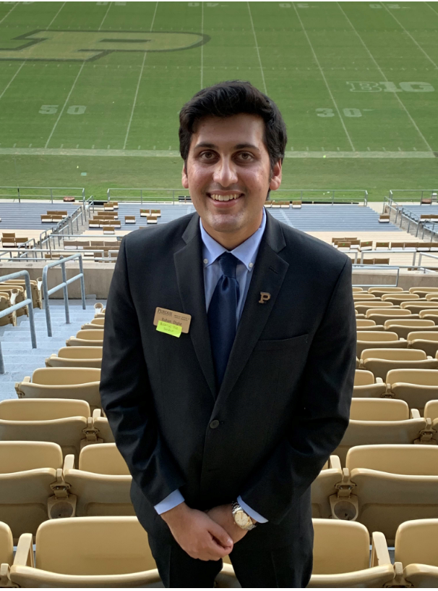
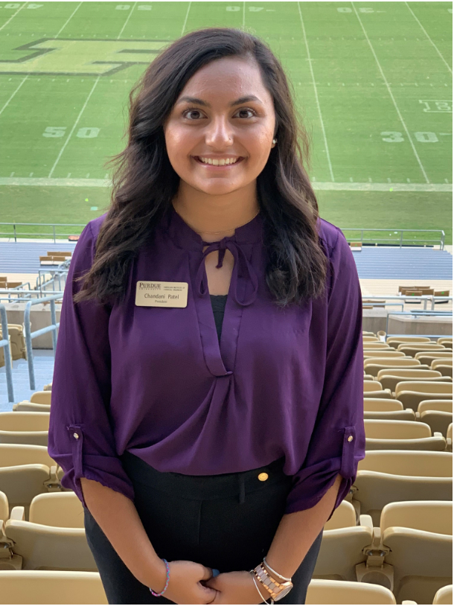
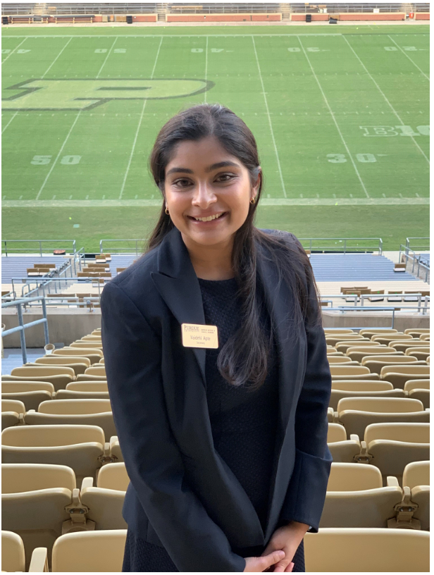
Meet the executive board
Amala Uli
Treasurer
Rohan Dighe
External Vice President
Chandani Patel
President
Takashi Yokokura
Internal Vice President
Vaidehi Apte
Secretary

Slide 3
Promo video

Slide 4
What is aiche?
Students
Peers
Faculty
Industry
Community
We are a personal and professional student organization
Founded in 1908, Purdue founded in 1929
Global organization:
- 60,000+ members
- 23,000+ student members
- 333 student chapters
Purdue has gotten “Outstanding Student Chapter” 4 years in a row!
Leading organization for ChemE professionals
We make connections

Slide 5
Some of our company partners/sponsors

Slide 6
some of our community partners

Slide 7
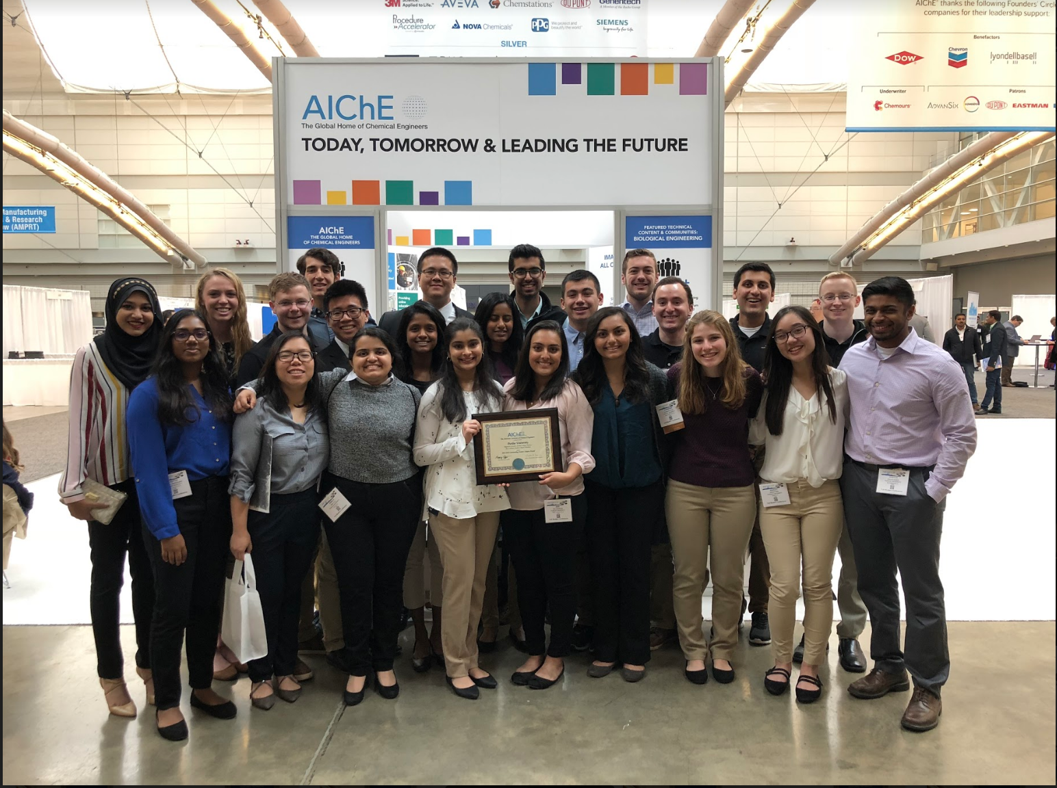
How are these connections made? Events!
…and SO many more!
Pancake Breakfasts
IR and Expo Mega Prep Nights
Volunteering at Dog Shelters
Habitat for Humanity
Insomnia Study Nights
Plant Tours
Research Poster Symposium
Company Information Sessions

Slide 8
Fall 2020 Recap
34 Incredible Events with
17+ company partnerships
3+ community partners
8+ Faculty partners
New connections with Professors and industry partners
Strengthened connections with Community partners
Increased Student engagement - New AMMs, strong attendance at events overall, stronger bonding

Slide 9
4 levels of membership
Executive Board
Committee Head
Committee Member
General Member

Slide 10
General member
AMM Schedule
Date | Time | Location
1/16/20 | 6-7 PM | FRNY G124
2/27/20 | 6-7 PM | FRNY G124
3/26/20 | 6-7 PM | FRNY G124
4/23/20 | 6-7 PM | FRNY G124
- Subscribes to our mailing list for weekly event updates
- Can and is strongly encouraged to attend any and all events you find interesting
- Attends monthly AMMs – Committee featured
- Completely Free!
- Sign up on our website: https://engineering.purdue.edu/AIChE

Slide 11
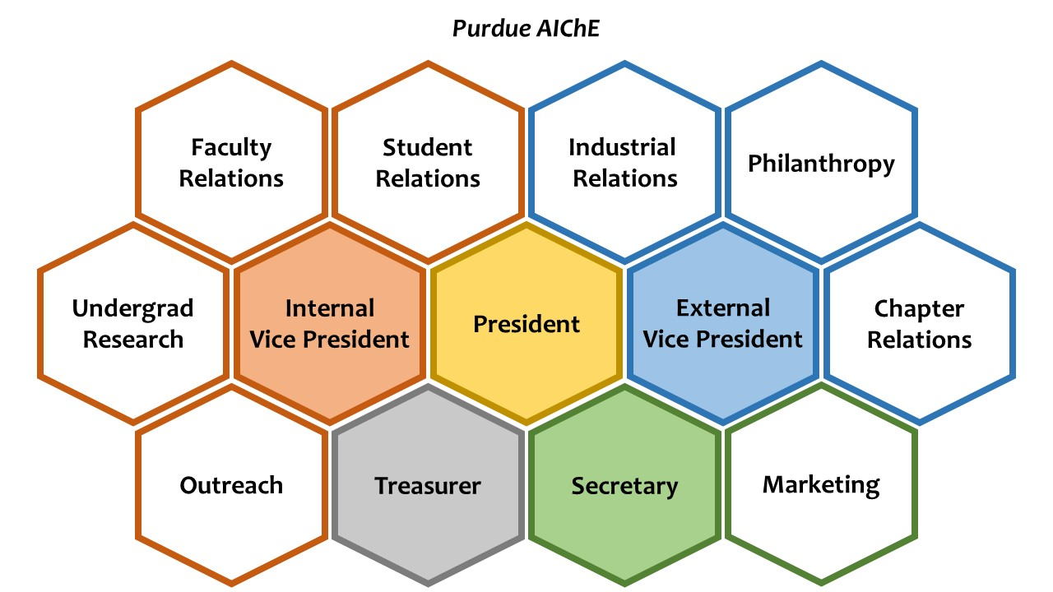
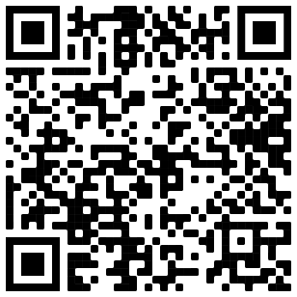
Committee Member
- Leadership position
- No experience required, freshmen welcome
- Planning events
- 8 committees
- Must apply and interview
- Applications are due by 5 pm Tomorrow (Fri., January 17th).
- Interviews will be held Tuesday, Jan. 21, acceptance will be sent out Jan 22nd.
- Must attend biweekly CMMs on Thursdays at 6-7
- Attend any and all events of interest
Committee Member Applications found here →
Or go to
https://tinyurl.com/CMAppS2020

Slide 12
Upcoming events and Programs
Lots of exciting opportunities!

Slide 13
Who’s hungry?
Grilled Cheese Social
Pancake Breakfast
DATE: Tuesday, September 21st, 2020
TIME: 9:00 AM – 12:00 PM
LOCATION: Armstrong Atrium
DATE: January 30TH, 2020
TIME: 9:00 AM – 12:00 PM
LOCATION: Forney Atrium

Slide 14
INTERESTED IN CHE RESEARCH? Take a tour!
WHAT: Tour of Dr. Pol’s Battery Lab
DATE: Thursday, January 30th, 2020
WHERE: 10:00 – 11:00 AM

Slide 15
aiCHE Group Mentorship Program *New*
- Connecting underclassmen to upperclassmen and their peers. “Family style” program
- Leadership and mentoring opportunity for Juniors and Seniors
- Mentees will be able to gain insight about academics, social life, ChE, careers, etc. from their mentor and their peers.
- Mentorship Events (Kick-off, Family Game Night, Family Feud, etc.) will be hosted once a month, but it is expected that groups meet outside of these events.
- Will be paired based off interests, level of involvement, year, etc.
- Ideally groups of about 5-6 (2 mentors and 3-4 mentees) but may change based off amount of people interested.
- Great opportunity to share experiences and learn from relatable people close in age!
Interest Survey - https://tinyurl.com/PUAICHEMentorship

Slide 16
aiCHE alumni Mentorship Program *New*
- Designed to connect ChemE students with Purdue ChemE Alumni.
- Will be paired based on interests (i.e., graduate school, industry, non-traditional roles, etc.) - - Will have the opportunity to ask for general career advice, resume help, help with grad school applications and more
- AIChE is planning on hosting occasional group sessions, in person and skype
- Mentors and mentees can communicate via email, skype, and in person and featured events!
- Great opportunity to learn more about ChE paths after college!
Interest Survey - https://tinyurl.com/PUAICHEMentorship

Slide 17
Why join purdue aiche?
Networking opportunities with industry
Connecting with your fellow peers, faculty, and community
Access to tons of events throughout the year
Very well respected organization (globally!)
Leadership positions
Making friends!
Having fun!
Companies love AIChE members

Slide 18
Ready to join?
Register online at
https://engineering.purdue.edu/AIChE
OR
Indicate that you would like to be added on the sign in form
Interest in being a Committee Member?
https://tinyurl.com/CMAppS2020
APPLY BY 5 PM TOMORROW☺

Slide 19
thank you for coming!
Questions?
Check us out on social media!

Slide 20
Chem-e-car!

Slide 21
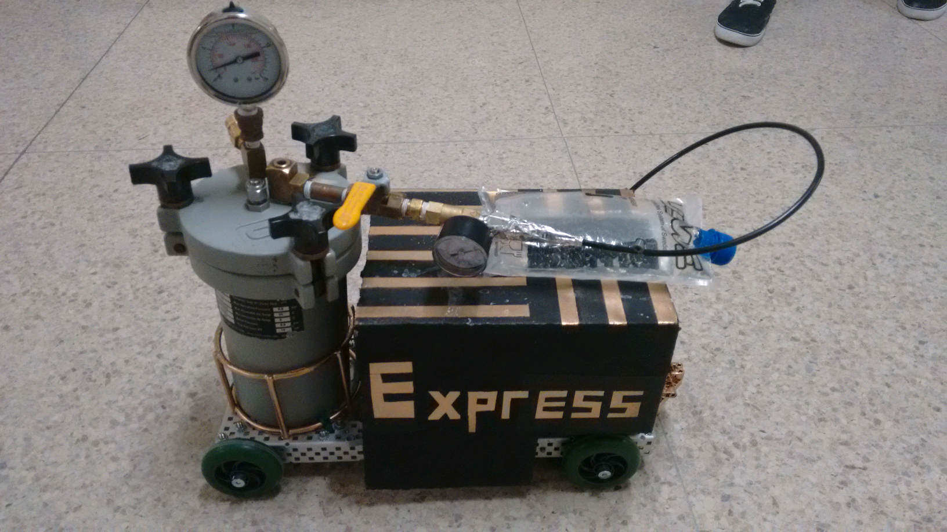
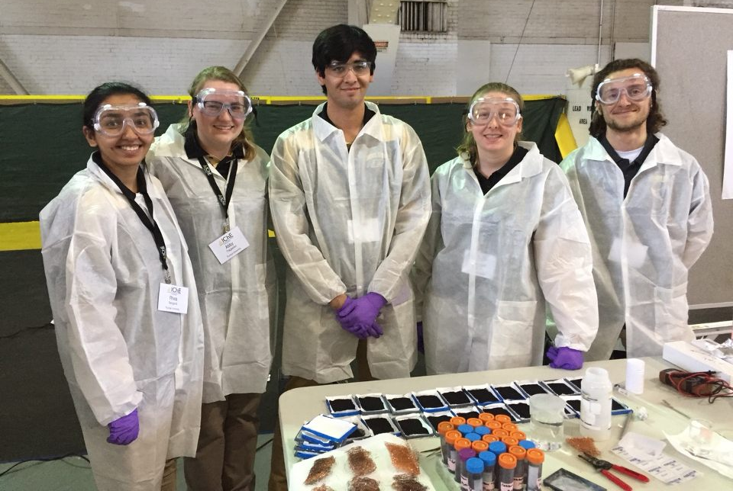
WHAT IS CHEM-E-CAR?
Construct shoebox sized car powered by chemical reaction
Must carry weight (0-500 ml Water) a certain distance (15-30 m)
Compete in two competitions
Regional (Spring)
National (Fall)
Weekly meetings and lab sessions

Slide 22
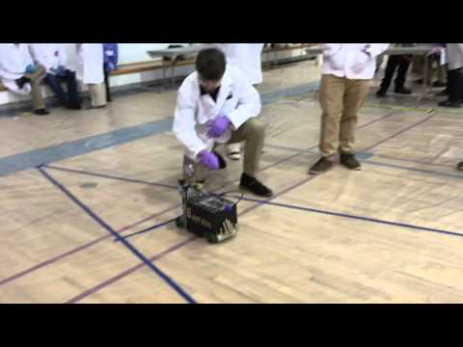

Slide 23
CLASS CREDIT
Can count as engineering, CHE, TECH, or honors research credit! (CHE 412)
Number of credits is up to you:
0 CREDIT: No minimum requirements
1 CREDIT: Attend one hour weekly meeting, one 2 hour lab session, & write 2 page paper
2 CREDITS: attend one hour weekly meeting, two 2 hour lab sessions, & write 2 page paper

Slide 24
BENEFITS
R E S U M E B U I L D E R
Class credit
Leadership opportunities
Network with other engineers
It’s fun!

Slide 25
SEMESTER GOALS
Design chassis
Build new cars
Begin test runs
Create calibration curves

Slide 26
WANT TO JOIN?
Sign up after callout to receive application
Submit application by tomorrow night, 1/22
Email to PURDUECHEMECAR@GMAIL.COM or slide under door of FRNY B020
Will review applications and make decisions ASAP

