Slide 1



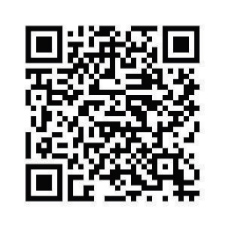
2026 NISO SCHOLARSHIPS WEEK
Join Purdue’s National and International Scholarships Office
to learn about upcoming opportunities and how to apply
Who Should Attend?
Truman & Udall Scholarships
Funds public service-oriented graduate study, or undergraduate work in the
environmental field, or Native American students in tribal policy or health care
Goldwater & Astronaut Scholarships
Rewards STEM research
Beinecke Scholarship
Funds graduate school in the arts, humanities, or social sciences,
based on merit and financial need
Gilman, Boren, & Critical Language Scholarships + Fulbright Grants
Funds undergraduate study, graduate study, independent research, language study,
and teaching English abroad
Peace Corps Prep Certificate
Prepares undergraduates for international work and enhances intercultural skills
Knight-Hennessy, Marshall, Gates Cambridge, Churchill, & Rhodes Scholarships + NSF-GRFP
Funds graduate study in a variety of fields at top universities
First-years, Sophomores,
& Juniors
Sept. 21 – 24
NISO SCHOLARSHIPS WEEK
Information, callouts, and tips for applying to prestigious, experiential programs for undergraduate and graduate students
First-years, Sophomores,
& Juniors
First-years, Sophomores,
& Juniors
Undergraduates &
Graduate Students
Undergraduates
Juniors, Seniors, &
Graduate Students
for schedule & to RSVP

