Slide 1
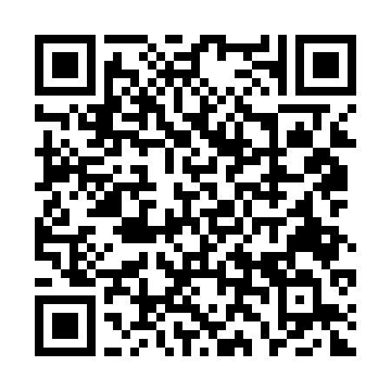
Northrop Grumman Recruiter Office Hours
Find your Purpose. Push the boundaries of what is possible. Join Northrop Grumman Recruiter, Anita Ryan, for Recruiter Office Hours. Have your Resume reviewed or simply come to learn more about Northrop Grumman.
9/10/26 from 1:00 PM- 3:30 PM
Young Hall Room 223
Register Here

