Slide 1



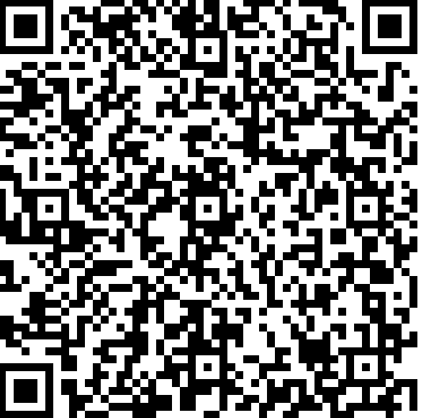
The Aerospace Corporation 2025 Lobby Day – Purdue University
The Aerospace Corporation – Meet and Greet with The Aerospace Corporation. Stop by and speak with technical representatives from our company and learn about our mission and the exciting career opportunities we have to offer including full-time, internship and co-op positions. Join our Aerospace Network to stay connected by clicking on the hyperlink below
Date: Tuesday, September 23, 2025
Time: 10:00 am – 4:00 pm EST
Location: ARMS Building Lobby
Registration: Please use the QR code or the following link Click Here
aerospace.org/careers

