Slide 1
Wind Tunnel Test Plan
Introduction
  The objective of this wind tunnel test is to verify the aerodynamic design tools and reduce the risk associated with erroneous predictions of the drag ,lift and pitching moment.
  The test article is a foam and fiberglass model of the outer mold line of the current design
  The model will be tested in the Boeing/Purdue subsonic wind tunnel
  The schedule is constrained by other project tests and must be coordinated using the Google Calendar
Safety
  The instructions for the safe operation of the tunnel will be strictly follow . A TA or professor will be present for the first test and must approve the team for future tests.
  The structural integrity of the model will be checked by slowly bringing up the speed of the wind tunnel and observing model deflection. If excessive deflection is observed, all test will be done at lower speeds.

Slide 2
Test and Evaluation
  The final data products be a comparison between the experimental data and analytical/numerical calculations including:
  C_{L} vs alpha, C_{L} vs C_{D} , L/D vs alpha , C_{m} vs alpha
  The required data are: lift and drag forces, pitching moment about the tunnel balance center, wind speed, tunnel temperature and pressure.
  Test methodology:
    mount the model in the tunnel, zero the balance (tare balance.vi) and check the readout of lift, drag and moment by placing weights on the balance. Any discrepancies will be resolved before continuing. The most common issue is a mounting strut hitting the floor of the wind tunnel. The AOA will also checked with the digital level or cell phone.
    Close the door and re-zero the balance
    start the tunnel and check for structural integrity
    Follow the test matrix schedule using wind tunnel monitor.vi to collect data
    After the first AOA sweep, the data will we reduced to check for errors or inconsistencies before proceeding

Slide 3
Test and Evaluation (continued)
  Predictions / expected results
    Graphs of C_{L} vs alpha, C_{L} vs C_{D} , L/D vs alpha , C_{m} vs alpha
    Graphs of the lift force(lbs), drag force (lbs) and pitching moment (ft-lbs) versus alpha (so we have immediately check)
  Data reduction
    He excel data sheet “wind tunnel data template” will be used to reduce and plot the data.
  Success criteria
    Agreement between the calculations and experiment or an understanding of any disagreements
Appendices
  Test article description (detail)
  Wind Tunnel description (detail)
  Test procedures and test matrix

Slide 4
Propulsion System Test Plan
Introduction
  The objectives of the propulsion test are:
    to verify the propeller and electric motor design tools and reduce the risk associated with erroneous predictions thrust, power, efficiency and battery size.
    To learn to setup and wire the propeller, motor, motor controller, receiver and transmitter
    To learn to use the Eagle Tree data acquisition system to collect data for this test and future flight test
  The test article consists of a wind tunnel mount for the motor, propeller, speed controller, receiver and battery
  The model will be tested in the Armstrong subsonic wind tunnel
Safety
  The instructions for the safe operation of the tunnel will be strictly follow . A TA or professor will be present for the first test and must approve the team for future tests.
  The structural integrity of the model will be checked by slowly bringing up the speed of the wind tunnel and propeller RPM. If excessive deflection or vibration is observed stop immediately and get help form a TA or professor

Slide 5
Test and Evaluation
  The final data products be a comparison between the experimental data and analytical/numerical calculations including:
    Propeller C_{P} , C_{T} and efficiency vs J, thrust and power(mechanical and electrical) vs speed for several RPMs.
    Electric motor current, voltage , power and efficiency vs speed for several RPMs
  The required data are: Thrust (-drag) force, Torque (rolling moment), wind speed, RPM, current, voltage, tunnel temperature and pressure.
  Test methodology:
    mount the model in the tunnel, zero the balance (tare balance.vi) and check the readout of lift, drag and rolling moment by placing weights on the balance. Any discrepancies will be resolved before continuing. The most common issue is a mounting strut hitting the floor of the wind tunnel.
    Start the tunnel and check for structural integrity and vibration
    Follow the test matrix schedule using “wind tunnel monitor.vi” to collect data
    After the first RPM sweep, the data will we reduced to check for errors or inconsistencies before proceeding

Slide 6
Test and Evaluation (continued)
  Predictions / expected results
    Graphs of C_{P} , C_{T} and efficiency vs J
    Graphs of the Thrust force(lbs), torque(ft-lbs), Power (watts), current, and voltage versus speed for several RPMs (so we have immediately check)
  Data reduction
    A matlab script will be used to reduce the data.
  Success criteria
    Agreement between the calculations and experiment or an understanding of any disagreements
Appendices
  Test article description (detail)
  Wind Tunnel description (detail)
  Test procedures and test matrix

Slide 7
Example Tests from 2013-14

Slide 8
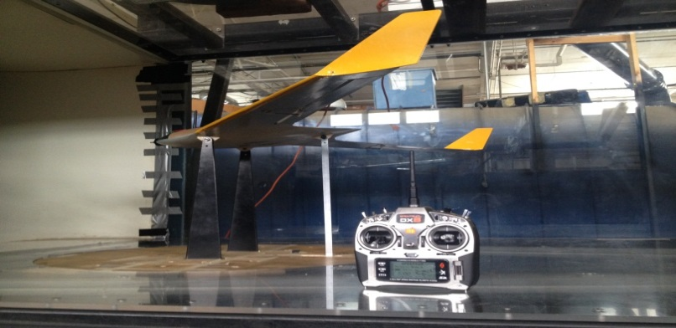
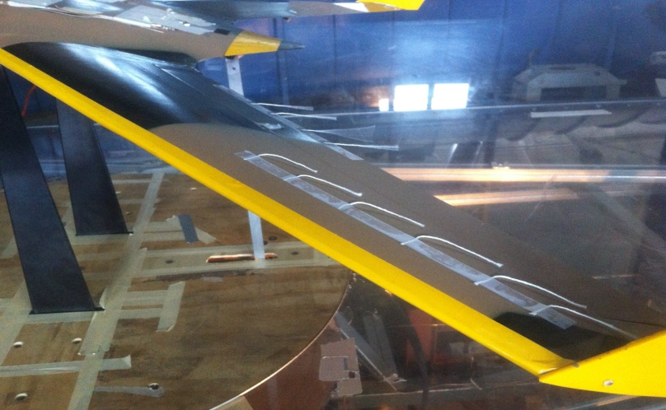
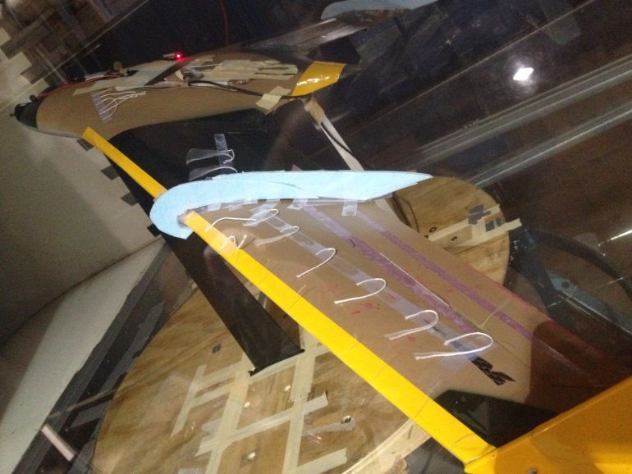
Wind Tunnel Test
First results showed low maximum lift.
Strings were used for flow visualization.
They presented strong spanwise flow with early stall.
Wing fences were used to try to solve the problem.
8

Slide 9
Wind Tunnel: 30.75 mph | Re=366,000
9
Notes:
Cl curve:
-Due to sweep, flow in wingspan direction causes early stall (lower cl max than expected)
-Possible solutions:
Wing fence
Unsweep
Cd curve:
-Inproper design of winglets + interference drag due to winglet corner
-Motor & Hatch
-Mounting on prototype caused it to have yaw

Slide 10
Wind Tunnel Tests
Strong spanwise flow with early stall
  Explore possible solutions
    Wing fence
    Lower sweep
Higher drag than predicted
  Clean up excrescence drag
    Antennas, hatch and leading edge
    Properly designed winglets
    Add motor cowling and spinner
10

Slide 11
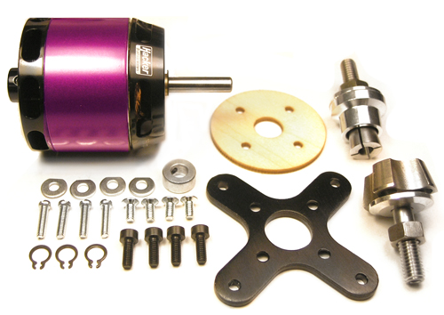
Propulsion Test Objectives
Testing:
  Determine motor thrust, power, efficiency
Analysis:
  Compare with Motocalc results to validate method
 | 2 |  |  |  |  |  |  | 3
Task | 1/20/2014 |  |  |  |  |  |  | 1/27/2014
Obtain components
Assemble test rig
Initial propulsion test
Compare w/ MotoCalc
11

Slide 12
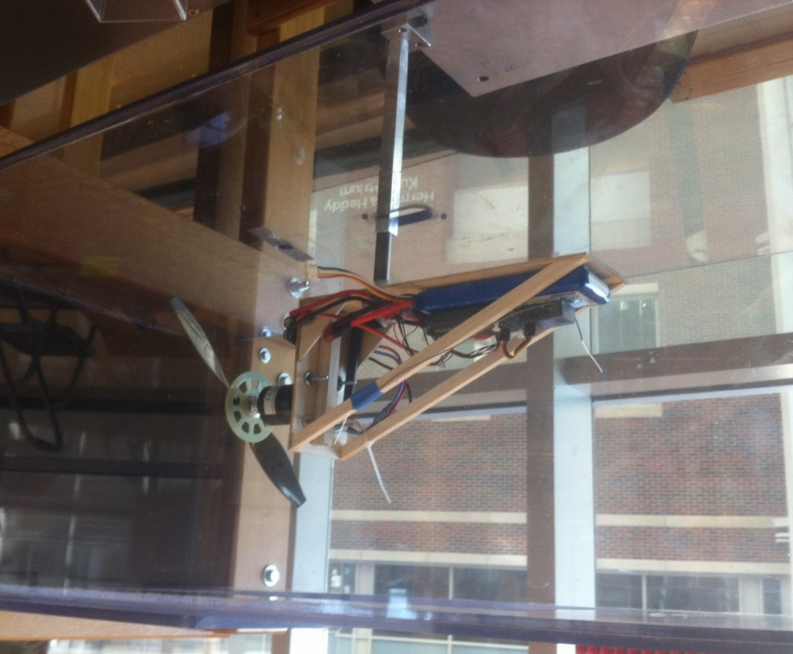
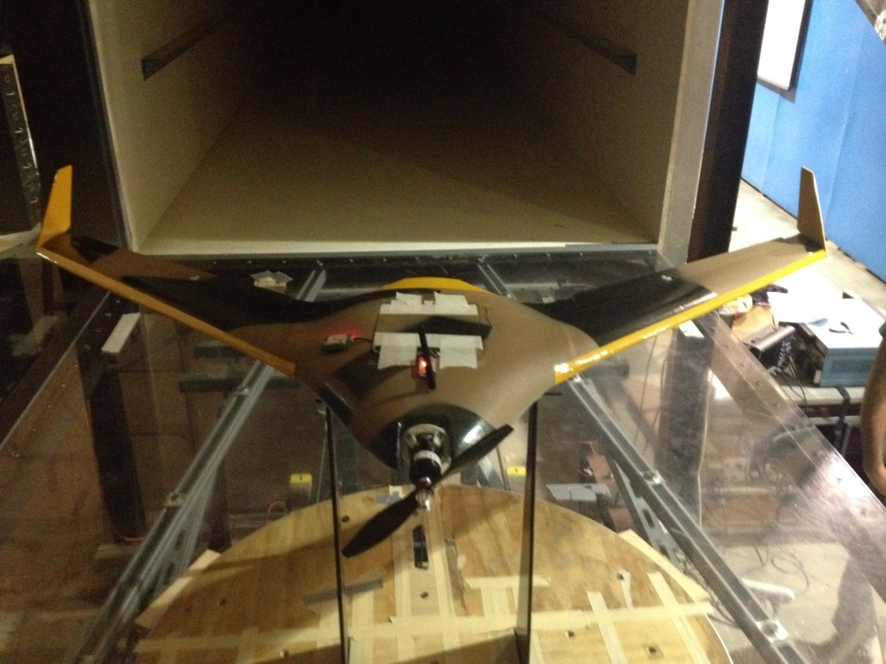
Propulsion Tests
Parkzone 480 | 9.5x7.5” propeller | 11.1V 2650 mAh battery
Test 1: Armstrong WT
Test 2: Boeing WT
12

Slide 13
13

Slide 14
Appendices

Slide 15
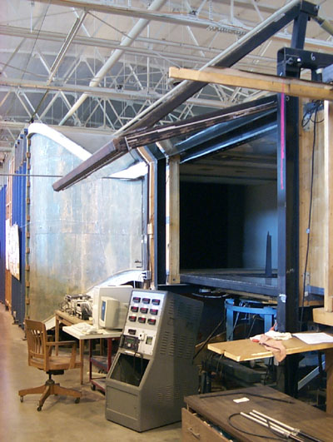
Boeing Wind Tunnel at Purdue
Located at the Aerospace Sciences Laboratory at the Purdue Airport
Closed return tunnel with 4'x6' Test Section
50 m/sec Maximum Velocity
  Limited to 20 m/sec for student projects
Aerolab 6 Component Pyramidal Balance
  Ranges and Accuracy
    Lift(lbs): -200 to +500, +-.02
    Drag and Side (lbs) -100 to +100, +-.01
    Pitch, Roll, Yaw (in-lbs) +-200, +- .05

Slide 16
Appendix PURDUE BOEING WIND TUNNEL SCHEDULING GUIDELINES
Purpose:
  To coordinate research, AAE520, DBT and other projects through Google Calendar
Instructions:
  Send your gmail address to your professor or TA and request you be added to the Google Calendar for Purdue Boeing Wind Tunnel scheduling
  In order to schedule wind tunnel time, your model must be ready to test with correct mounting fixtures and you must have a test plan. Show the model and plan to professor or TA and if approved schedule wind tunnel time
  Design your mounts so it takes less than 15 minutes to install and uninstall your model
  If you schedule and don't show up, you will be moved to the lowest priority for future scheduling.
  Remove your model when you are finished.
  Do not remove other group’s models without permission.
  Add your Email Address on all your scheduled wind tunnel testing times on the calendar so that people can reach you.

Slide 17
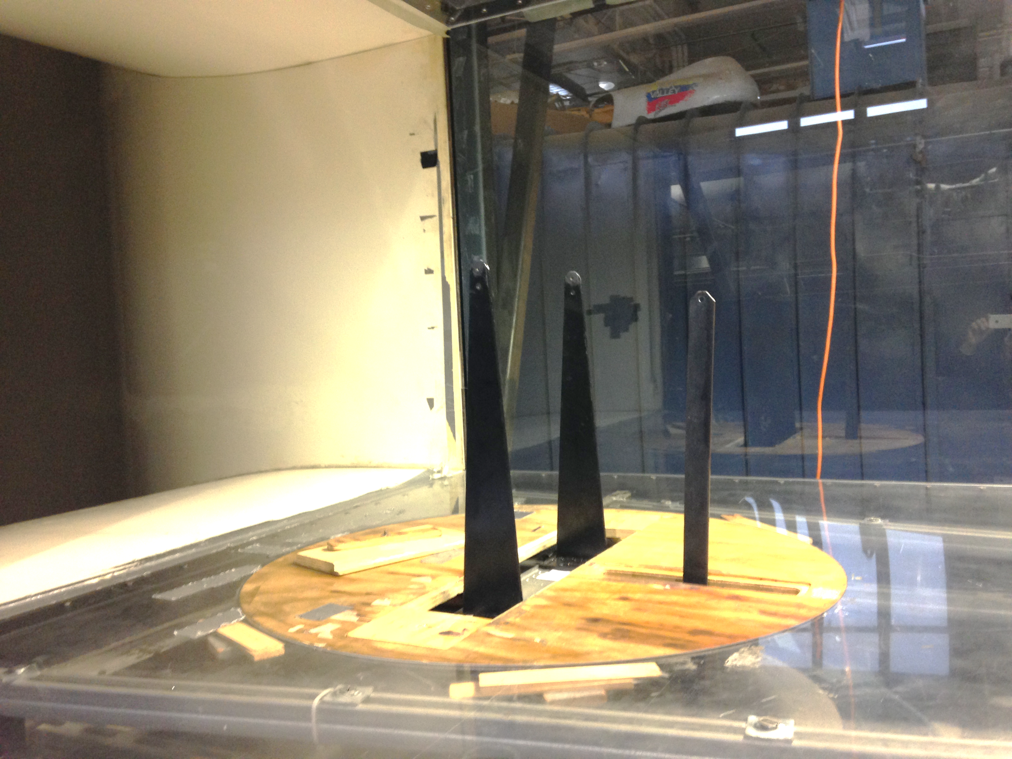
Appendix - Model Mounting:
Hole Size– Mounting Struts and Angle of Attack Strut 1/4” diameter
Distance between struts 4” to 32 “ ( 334 Wing = 12 “)
Mounting
Struts
Angle of Attack
Strut

Slide 18
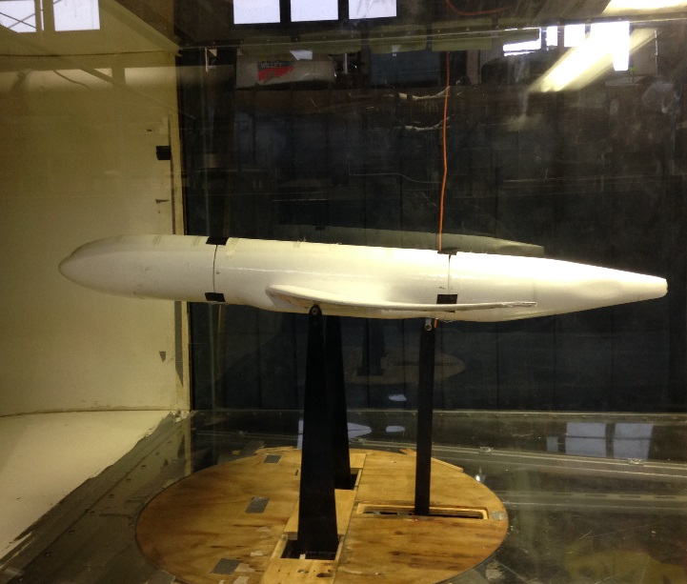
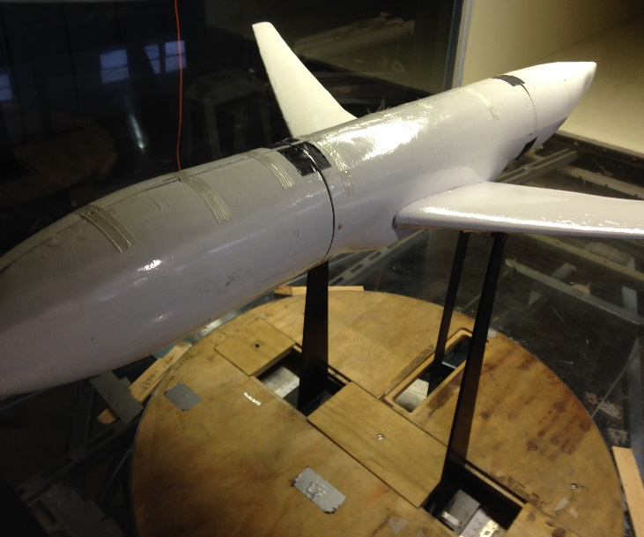
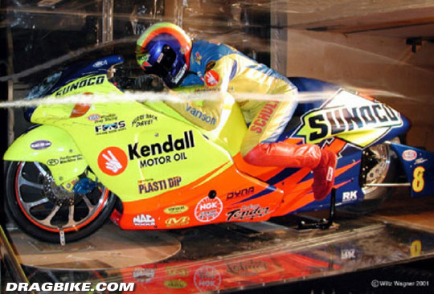
Examples

Slide 19
Armstrong Hall Subsonic Wind Tunnel

Slide 20
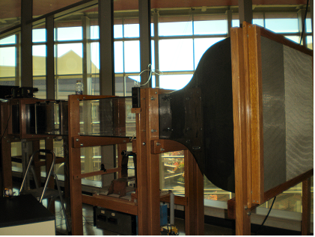
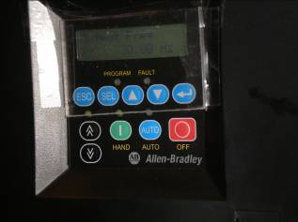
Armstrong Hall Subsonic Wind Tunnel Operation
Armstrong subsonic tunnel: 12 in. x 18 in. test section, maximum speed 50 m/s
Limited to 25 m/sec for student labs and projects
Operation
- Make sure Power Breaker is on (handle up)
- Press the green “on” button on Allen Bradley controller
- Adjust speed (motor Hz) using up and down arrow buttons
- Do not exceed 30 Hz!!!
Speed
Control
ON
OFF

Slide 21
Angle of Attack Adjustment
Pivot Point of airfoil mounting bracket
Rear Rod moves
up and down with micrometer
adjustment
.5 inch
Center to center
Adjust micrometer to set airfoil
angle of attack to zero using the level
(set level on top of the two mounting screws)
Set micrometer value to zero by pressing ABS/INC button
Use trigonometry to get the change in angle
Electronic
Micrometer

Slide 22
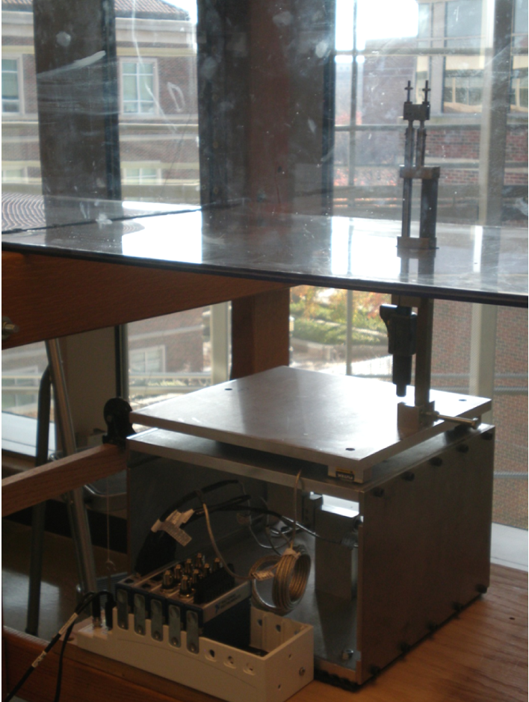
Wind Tunnel Balance
The platform balance is used to measure the drag, lift and pitching and rolling moment produced on an model in the wind tunnel. It consists of four FUTEK Force Transducers. Three of the transducers are located under the top balance plate and measure the lift, pitching moment and rolling moment. These are labeled F1, F2, and F3. The fourth transducer is located inside the parallelogram balance measuring the drag and is labeled F0. The transducers are all connected to the National Instruments Channel Amplifiers
Top Balance Plate: with three Force Transducers
FUTEK Force Transducer : (Lift/Pitching and Rolling Moment)
National Instruments 4 Channel Amp
Parallelogram Balance Frame
FUTEK Force Transducer : (Drag)

Slide 23
The balance works by taking the readings from the different transducers and manipulating them with the proper equations to output the lift, drag, pitching moment and rolling moment.
The Drag is measured by the F0 tansducer reading inside the parallelogram. It measures the force induced between the top plate and the bottom plate. D = F0;
The Lift is measured by the F1, F2, and F3 transducers located beneath the top plate. When the airfoil is placed in the wind tunnel, the lift force pulls up on the balance. This Lift Force is the sum of the transducers.
L = F1+F2+F3;
The Pitching Moment is measured by the F2 and F0 transducers. It is measured from the moments created by the lift and drag forces on the Airfoil.
P = -L*F2 + h*F0;
(where L is the distance from the airfoil base on the top plate to the F2 transducer, 10 inches, and h is the distance from the top plate to the airfoil, 13.625 inches).
The Rolling Moment is measured by the F2 and F3 transducers.
R = -d/2*(F3 – F3;
(where d is the distance between the transducers, 10 inches

Slide 24
Calibration
To calibrate the four transducers on the platform balance, it is necessary to apply a known load at three different locations on the balance to measure the lift, drag and pitching and rolling moment.
a) To Calibrate the Lift,
Open the Wind Tunnel Balance LabVIEW program located in the C:\AAE 334L\Airfoil Characteristics folder. Create a new folder and name it with your section number and Gold or Black. In LabVIEW, select that folder for the path and name the file “calibrate.txt.” You only need to create one text file for the calibrations, the program sets a time stamp for each reading you take separately.
Run the balance program and record the initial values of the drag, lift, and pitch.
Apply known weight(s) to the middle of the top balance plate and let the balance even out before hitting “write” in the LabVIEW program.
The transducer lift measurements are located in the text file you created the path to. The text file includes 7 columns of data which are Drag, Lift, Pitch, F0 (force from 0 transducer), F1, F2, and F3 respectively. The lift is calculated using the equation shown in the introduction.
b) To Calibrate the Drag
Remove the weight(s) used to calibrate the lift.
Place a known weight(s) on the pulley platform located just behind the F2 transducer and let the balance even out before writing to the text file.
The transducer drag measurements are located in the text file you created the path to. The Drag measured is the third column of data.

Slide 25
c) To Calibrate the Pitching Moment
Remove the weight used to calibrate the drag
Place known weight(s) on the bolt located just behind the airfoil stand and micrometer and let the readings balance out before writing to file.
The transducer data is located in the same text file with new timestamp. The pitching moment is the fifth column of data.
The pitching moment is calculated using the equation shown above.
c) To Calibrate the Rolling Moment
Place known weight(s) on the bolt located on the right side on the balance let the readings balance out before writing to file.
The transducer data is located in the same text file with new timestamp. The pitching moment is the sixth column of data.
The rolling moment is calculated using the equation shown above.
In Excel or MATLAB, compare your calibration values to the actual value of the weight you used and find a scale factor (calibration) for your measurements.

Slide 26
Procedure Airfoil Characteristics Testing
Calibrate the balance (see instructions above)
Remove any airfoil in the wind tunnel
Turn on Wind Tunnel
See Wind Tunnel Operation Procedure
Set the tunnel speed to 30 Hz (DO NOT RUN FASTER THAN 30 HZ).
Turn on the pressure differential meter and read off the pressure from which tunnel velocity can be found.
Take lift, drag and pitch readings without any airfoil on the stand (to get a starting reading of the lift and drag on just the stand).
Turn off the tunnel, remove tunnel lid and insert airfoil without flaps or slats. Tightly secure the airfoil to the stand using the screw mounts.
Use a level to set the angle of attack to zero (see instructions above).
Replace tunnel lid and turn on the tunnel. Remember to start the LabVIEW program before starting the tunnel for each set of runs as this sets the zero.
Take lift, drag, and pitching moment measurements for angles of attack from 0 degrees to stall in approximately one degree increments by adjusting the micrometer on the stand.
After first airfoil, have the TA check progress.
Turn off tunnel, remove lid and remove airfoil and repeat with the other two airfoils - one with flaps only and one with both flaps and slats.
** ALWAYS TURN OFF THE TUNNEL BEFORE OPENING LID TO CHANGE OBJECT IN TUNNEL.
** ALWAYS CLICK “RUN” IN THE LABVIEW VI BEFORE TURNING ON THE TUNNEL.

