Slide 1
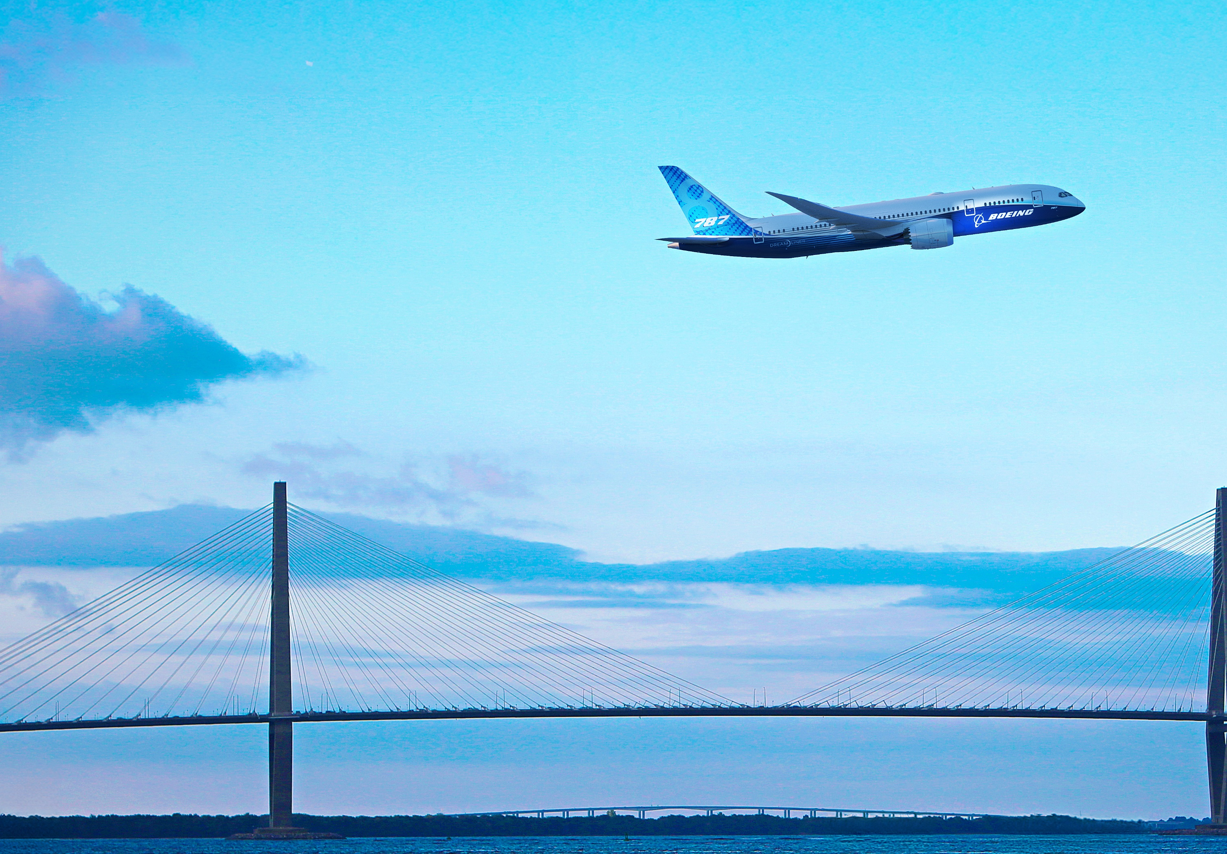

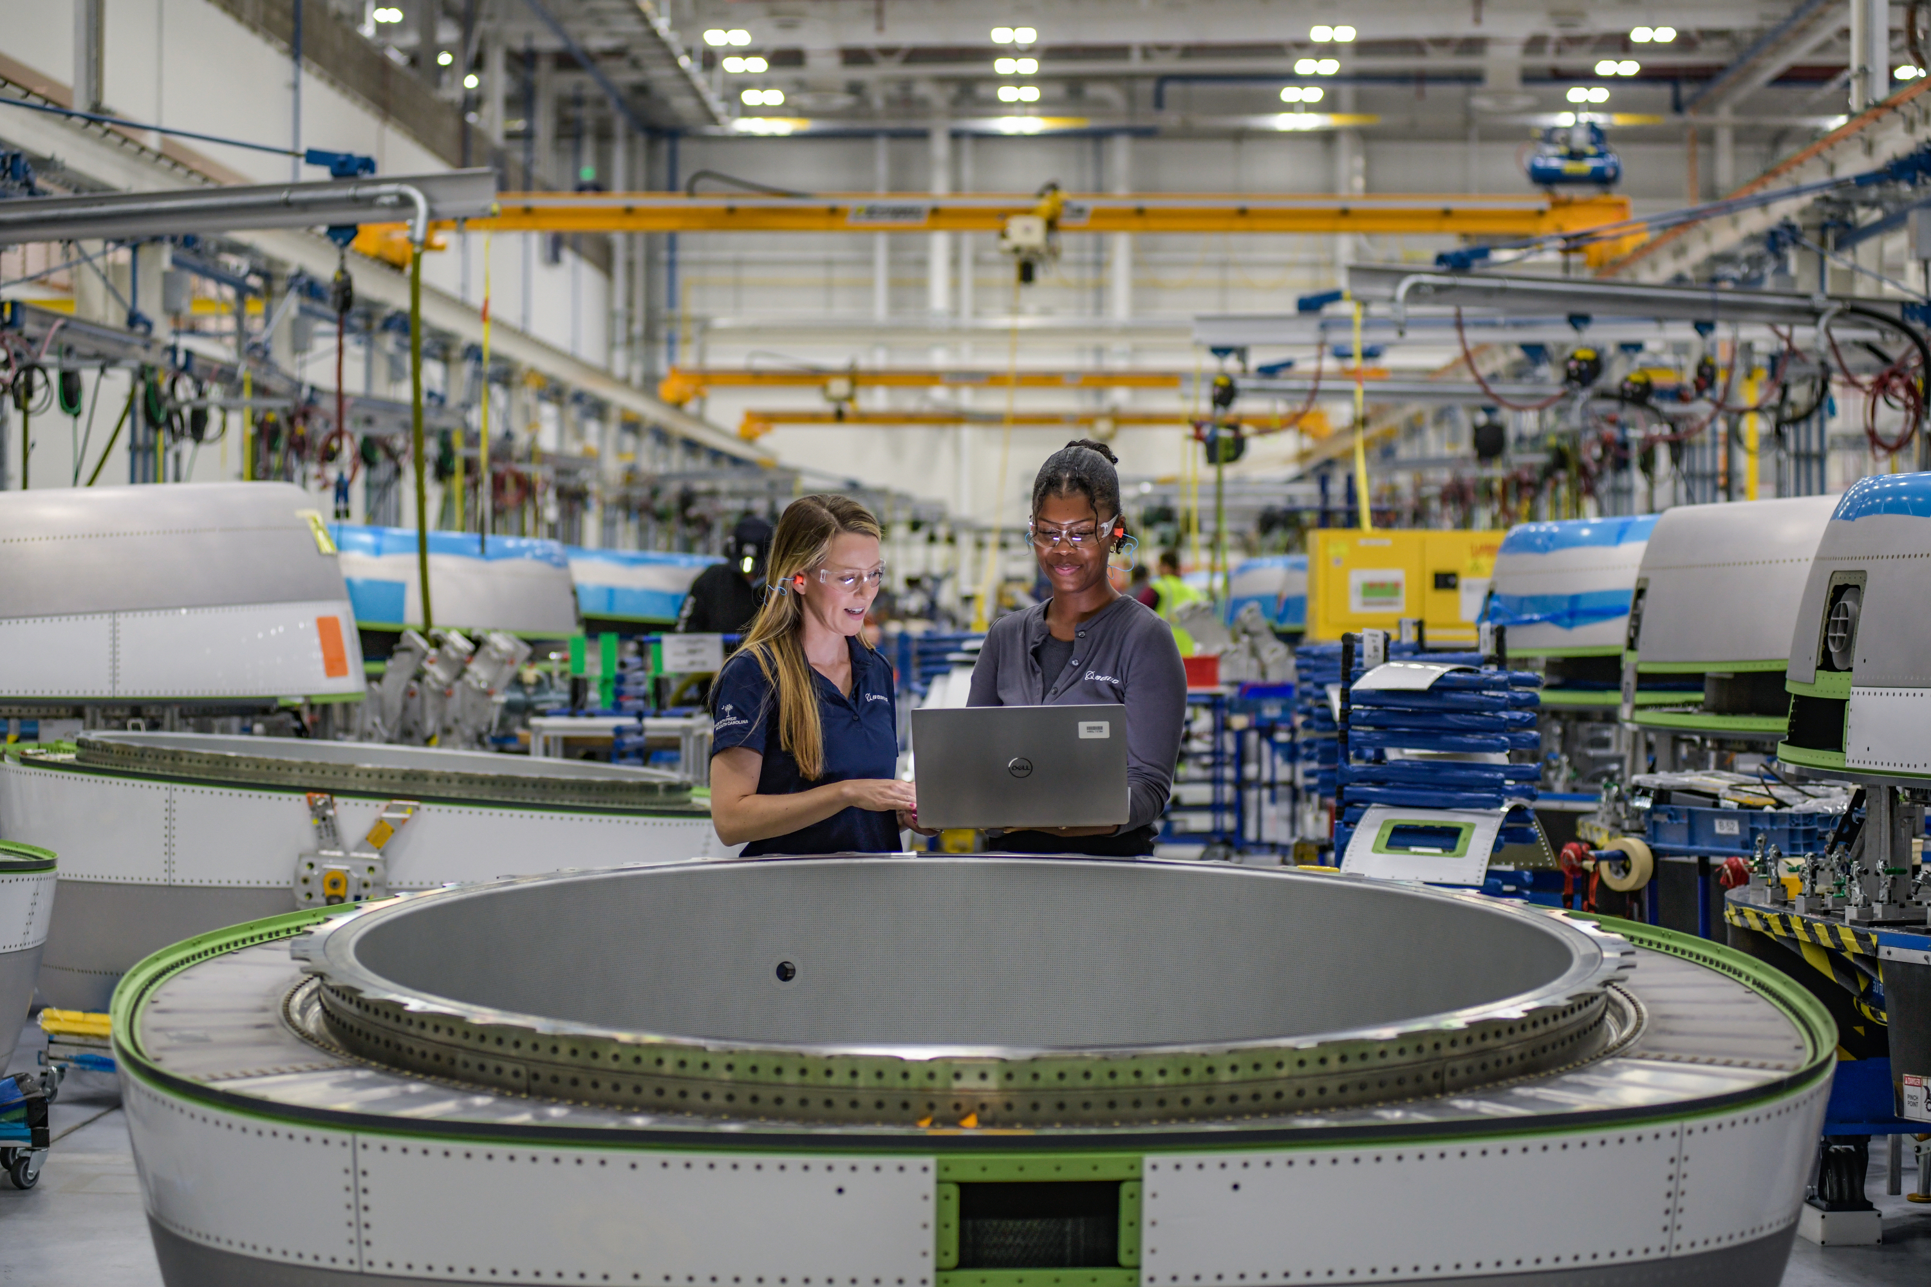
Boeing South Carolina
Info Session
Join Lisa Fahl, 787 Engineering vice president & Engineering site leader (Purdue ‘05), to learn about where the 787 Dreamliner, one of the most advanced airplanes in the world, is assembled and delivered. Hear insights about careers in aerospace and industry needs.
Thursday, Oct. 16
6:30 – 8:00 p.m.
PHYS 114

