Slide 1
Section 17
Intro to Transport – Drift, Mobility, Diffusion, Einstein Relationship
Solid State Devices

Slide 2

Section 17
Intro to Transport – Drift, Mobility, Diffusion, Einstein Relationship
I = G ^{x} V
= q ^{x} n ^{x} v ^{x} A
Materials, composition, crystals
“known” bulk materials
charge
density
velocity
area
Sections 2-14: Materials
Section 15: Intro to Non-Equilibrium
Section 16: Return to Equilibrium via Recombination
Quantum Mechanics Mechanics
Density of states and masses
Equilibrium Statistical Mechanics
Occupation factors
How does the system
go BACK to equilibrium?
Transport with scattering, non-equilibrium Stat. Mech.
Drift-diffusion equation with recombination-generation
Understanding transport in devices
Diodes, BJT/HBT, MOS

Slide 3
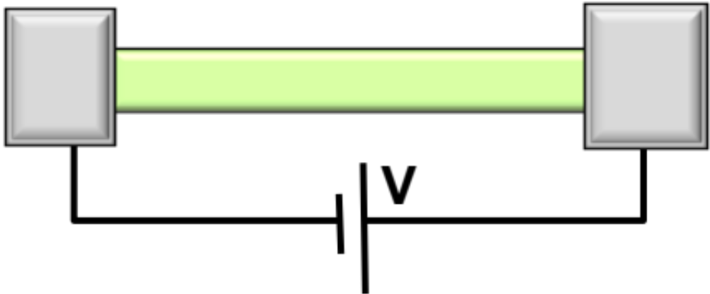
Section 17
Intro to Transport – Drift, Mobility, Diffusion, Einstein Relationship
I
I = G ^{x} V
= q ^{x} n ^{x} v ^{x} A
Materials, composition, crystals
“known” bulk materials
charge
density
velocity
area
Quantum Mechanics Mechanics
Density of states and masses
Sections 2-14: Materials
Section 15: Intro to Non-Equilibrium
Section 16: Return to Equilibrium via Recombination
Equilibrium Statistical Mechanics
Occupation factors
Vid
17.1 Drift Current
17.2 Mobility
  Matthiessen Rule
  High Field Effects
  Mobility Measurement
17.3 Carrier Concentration from Hall Effect
17.4 Physics of diffusion – Einstein Relationship
How does the system
go BACK to equilibrium?
Vid
Transport with scattering, non-equilibrium Stat. Mech.
Drift-diffusion equation with recombination-generation
Understanding transport in devices
Diodes, BJT/HBT, MOS
Vid
Vid

Slide 4
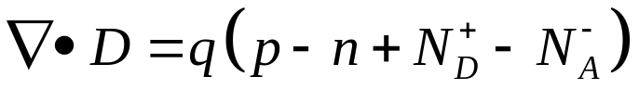
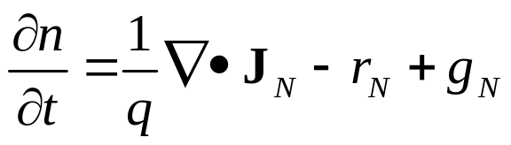
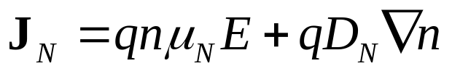
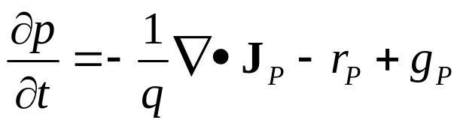
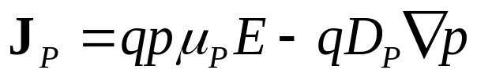
Summary of Transport Equations …
I

Slide 5
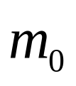
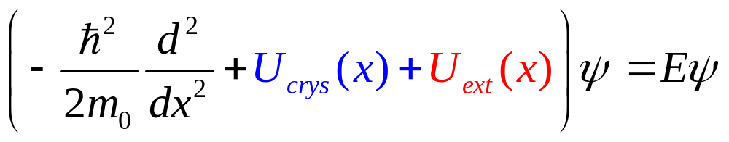
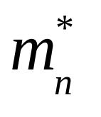
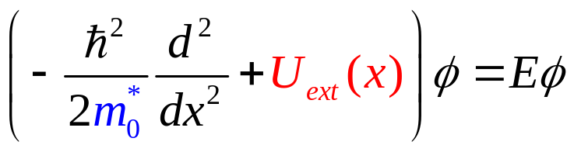
Meaning of Effective Mass …

Slide 6
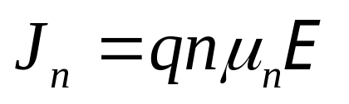
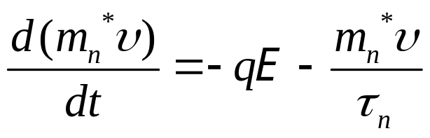
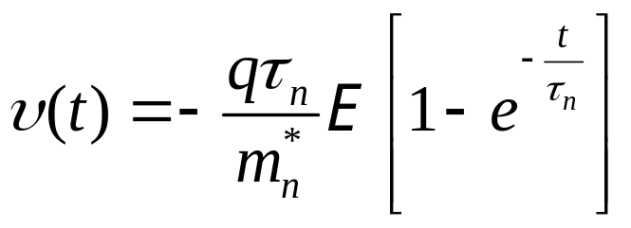
Drift by Electric field ….
x
x
x
x
Consider system to be in local equilibrium

Slide 7
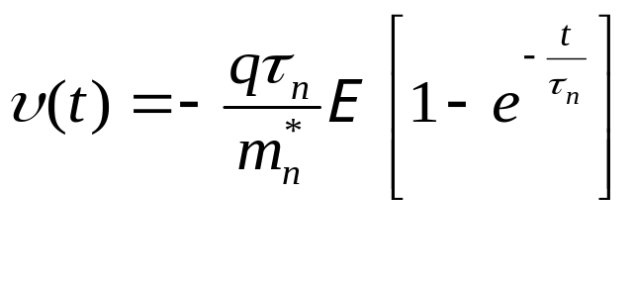
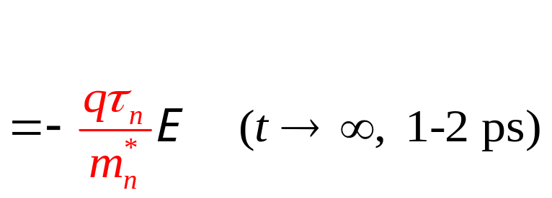
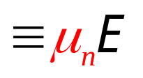
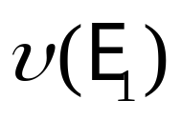

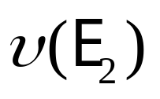

Drift by Electric field ….
x
x
x
x
friction
(Theory valid once t > 1-2 ps)
Consider system to be in local equilibrium

Slide 8
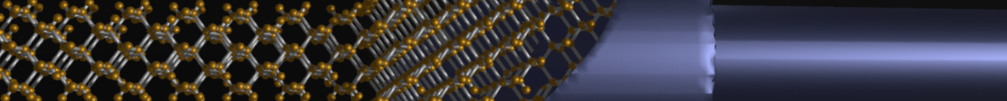
Section 17
Intro to Transport – Drift, Mobility, Diffusion, Einstein Relationship
I
I = G ^{x} V
Transport with scattering,
non-equilibrium Stat. Mech.
Drift-diffusion equation with recombination-generation
= q ^{x} n ^{x} v ^{x} A
area
charge
density
velocity
Vid
17.1 Drift Current
17.2 Mobility
  Matthiessen Rule
  High Field Effects
  Mobility Measurement
17.3 Carrier Concentration from Hall Effect
17.4 Physics of diffusion – Einstein Relationship
status
x
x
x
x
Vid
Vid
Consider system to be in local equilibrium
Vid
Drift, diffusion, and recombination-generation
=> elemental processes in semiconductor device physics.
Measurement of mobility and carrier concentration
=> characterize semiconductor devices.

Slide 9
Section 17
Intro to Transport – Drift, Mobility, Diffusion, Einstein Relationship
I
I = G ^{x} V
Transport with scattering,
non-equilibrium Stat. Mech.
Drift-diffusion equation with recombination-generation
= q ^{x} n ^{x} v ^{x} A
area
charge
density
velocity
Vid
17.1 Drift Current
17.2 Mobility
  Matthiessen Rule
  High Field Effects
  Mobility Measurement
17.3 Carrier Concentration from Hall Effect
17.4 Physics of diffusion – Einstein Relationship
x
x
x
x
status
Vid
Vid
Consider system to be in local equilibrium
Vid
Drift, diffusion, and recombination-generation
=> elemental processes in semiconductor device physics.
Measurement of mobility and carrier concentration
=> characterize semiconductor devices.

Slide 10
Section 17
Intro to Transport – Drift, Mobility, Diffusion, Einstein Relationship
Solid State Devices
17.2 Mobility

Slide 11
Section 17
Intro to Transport – Drift, Mobility, Diffusion, Einstein Relationship
I
I = G ^{x} V
Transport with scattering,
non-equilibrium Stat. Mech.
Drift-diffusion equation with recombination-generation
= q ^{x} n ^{x} v ^{x} A
area
charge
density
velocity
Vid
17.1 Drift Current
17.2 Mobility
  Matthiessen Rule
  High Field Effects
  Mobility Measurement
17.3 Carrier Concentration from Hall Effect
17.4 Physics of diffusion – Einstein Relationship
x
x
x
x
status
Vid
Vid
Consider system to be in local equilibrium
Vid
Drift, diffusion, and recombination-generation
=> elemental processes in semiconductor device physics.
Measurement of mobility and carrier concentration
=> characterize semiconductor devices.

Slide 12
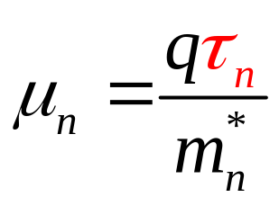
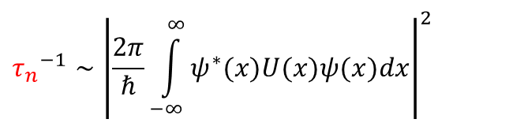
Mobility and Physics of Scattering Time
x
x
x
x
$${τ_{n}}^{−1}∼{\left|\frac{2π}{ℏ}\int_{−∞}^{∞}{ψ^{∗}(x)U(x)ψ(x)dx}\right|}^{2}$$
Fermi’s Golden rule …

Slide 13
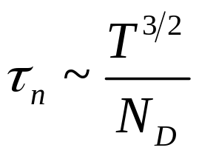
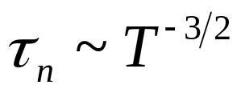
Phonon and Ionized Impurity Scattering
Ionized impurity
Higher temperature,
more phonon scattering

Slide 14
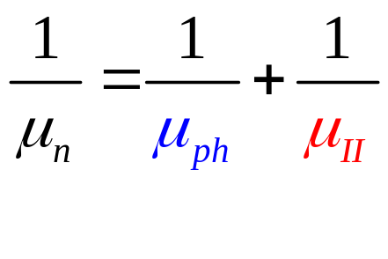
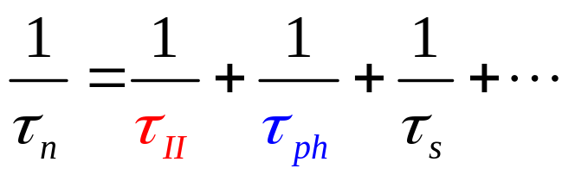
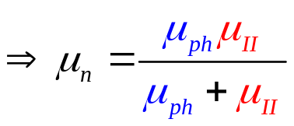
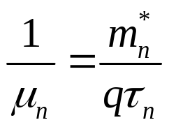
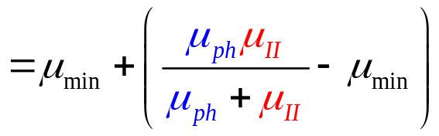
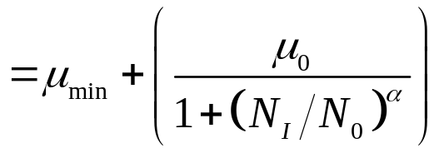
Multiple Scattering Events
Ionized impurity
Phonon scattering
others ….
Matthiessen Rule ….

Slide 15
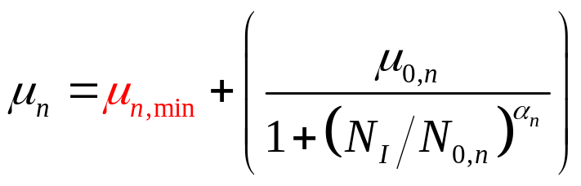
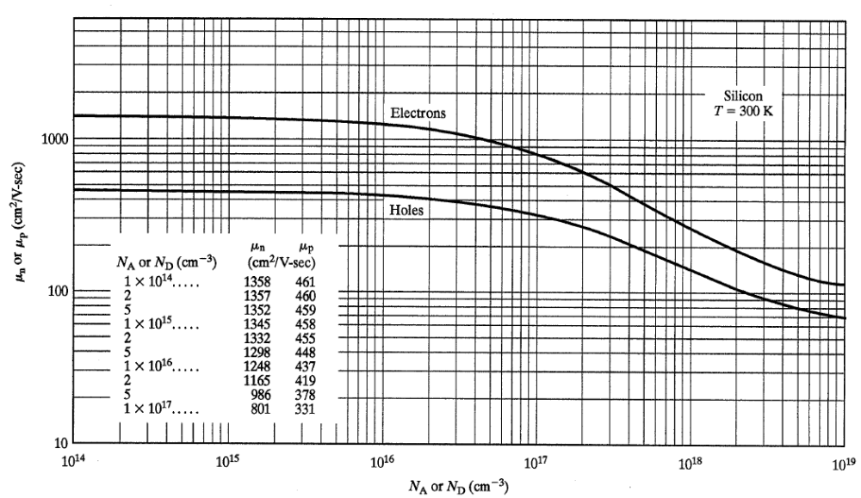
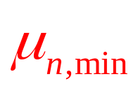
Model for Ionized impurity Scattering

Slide 16
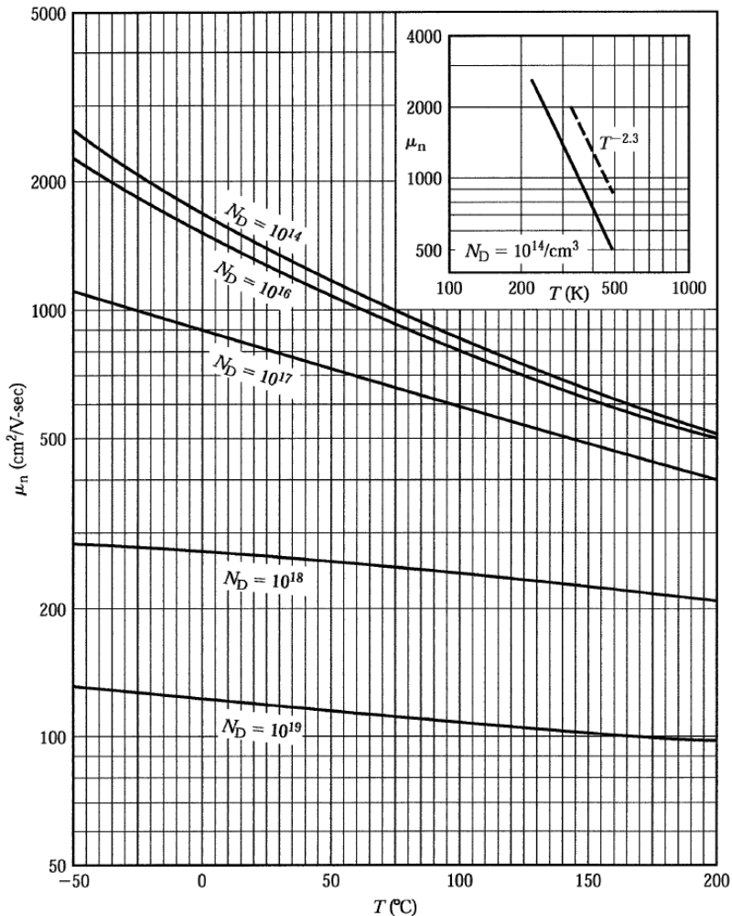
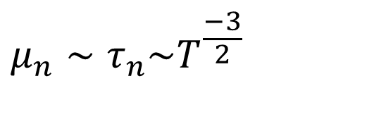
Temperature-dependent Mobility
$$μ_{n}∼τ_{n}\sim T^{\frac{−3}{2}}$$

Slide 17
Intermediate Summary
Poisson and drift-diffusion equations
  form a complete semi-classical transport model
  explain wide variety of device phenomena.
Drift current results from response of electrons/holes to electric field.
The physics of mobility is complex and material dependent.
Constancy of low-field mobility can be checked by experiments.

Slide 18
Section 17
Intro to Transport – Drift, Mobility, Diffusion, Einstein Relationship
I
I = G ^{x} V
Transport with scattering,
non-equilibrium Stat. Mech.
Drift-diffusion equation with recombination-generation
= q ^{x} n ^{x} v ^{x} A
area
charge
density
velocity
Vid
17.1 Drift Current
17.2 Mobility
  Matthiessen Rule
  High Field Effects
  Mobility Measurement
17.3 Carrier Concentration from Hall Effect
17.4 Physics of diffusion – Einstein Relationship
x
x
x
x
status
Vid
Vid
Vid
Drift, diffusion, and recombination-generation
=> elemental processes in semiconductor device physics.
Measurement of mobility and carrier concentration
=> characterize semiconductor devices.
Consider system to be in local equilibrium

Slide 19
Section 17
Intro to Transport – Drift, Mobility, Diffusion, Einstein Relationship
I
I = G ^{x} V
Transport with scattering,
non-equilibrium Stat. Mech.
Drift-diffusion equation with recombination-generation
= q ^{x} n ^{x} v ^{x} A
area
charge
density
velocity
Vid
17.1 Drift Current
17.2 Mobility
  Matthiessen Rule
  High Field Effects
  Mobility Measurement
17.3 Carrier Concentration from Hall Effect
17.4 Physics of diffusion – Einstein Relationship
x
x
x
x
Vid
status
Vid
Vid
Drift, diffusion, and recombination-generation
=> elemental processes in semiconductor device physics.
Measurement of mobility and carrier concentration
=> characterize semiconductor devices.
Consider system to be in local equilibrium

Slide 20
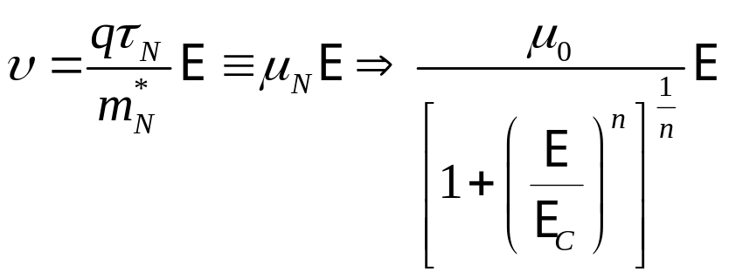
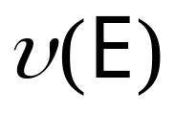


Mobility at High Fields?
x
x
x
x
What causes velocity
saturation at high fields?
Where do the various mobility formula
in device simulator come from?

Slide 21

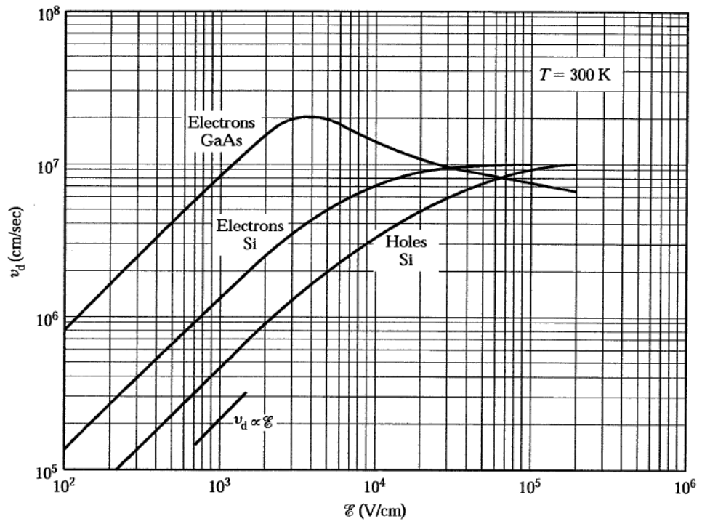



Velocity Saturation in Si/Ge
$$E≪E_{c} J_{2}=J^{+}−J^{−}>J_{1}$$
$$E≫E_{c} J_{4}=J^{+}−J^{−}≈J_{3}$$

Slide 22
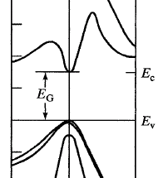
Velocity Overshoot & Inter-valley Transfer
Larger m*
Smaller m*
What type of scattering would you need for inter-valley transfer?

Slide 23
Section 17
Intro to Transport – Drift, Mobility, Diffusion, Einstein Relationship
I
I = G ^{x} V
Transport with scattering,
non-equilibrium Stat. Mech.
Drift-diffusion equation with recombination-generation
= q ^{x} n ^{x} v ^{x} A
area
charge
density
velocity
Vid
17.1 Drift Current
17.2 Mobility
  Matthiessen Rule
  High Field Effects
  Mobility Measurement
17.3 Carrier Concentration from Hall Effect
17.4 Physics of diffusion – Einstein Relationship
x
x
x
x
Vid
status
Vid
Vid
Drift, diffusion, and recombination-generation
=> elemental processes in semiconductor device physics.
Measurement of mobility and carrier concentration
=> characterize semiconductor devices.
Consider system to be in local equilibrium

Slide 24
Section 17
Intro to Transport – Drift, Mobility, Diffusion, Einstein Relationship
I
I = G ^{x} V
Transport with scattering,
non-equilibrium Stat. Mech.
Drift-diffusion equation with recombination-generation
= q ^{x} n ^{x} v ^{x} A
area
charge
density
velocity
Vid
17.1 Drift Current
17.2 Mobility
  Matthiessen Rule
  High Field Effects
  Mobility Measurement
17.3 Carrier Concentration from Hall Effect
17.4 Physics of diffusion – Einstein Relationship
x
x
x
x
Vid
status
Vid
J
Vid
Drift, diffusion, and recombination-generation
=> elemental processes in semiconductor device physics.
Measurement of mobility and carrier concentration
=> characterize semiconductor devices.
Consider system to be in local equilibrium

Slide 25
Problem of mobility measurement – unknown doping concentration
J
Can we find out the doping concentration and type by an electrical measurement without any knowledge of how the sample was prepared?
1 -http://en.wikipedia.org/wiki/Four-terminal_sensing
Notes:
We have a semi-conductor bar and we would like to measure a couple of interesting things – For instance, the mobility of the bar (which is a measure of how easily electrons or holes move through a semiconductor)
We could pump current through, measure resistivity and plot it as a function of doping concentration and using the equations above, obtain mobility from the slope of the graph.
If we have a precise knowledge of the amount of donor or acceptor ions in the bar the problem simplifies – you get a linear (logarithmic) plot for resistivity versus doping concentration.
But what if we do not have this knowledge? Can we, through a electrical measurement find out the doping concentration without knowledge of how the doped sample was prepared?

Slide 26
Problem of mobility measurement – unknown doping concentration
J
Four-Probe Measurement¹ measures voltage of device without measuring drop in current carrying wires
V
Can we find out the doping concentration and type by an electrical measurement without any knowledge of how the sample was prepared?
1 -http://en.wikipedia.org/wiki/Four-terminal_sensing
Notes:
We have a semi-conductor bar and we would like to measure a couple of interesting things – For instance, the mobility of the bar (which is a measure of how easily electrons or holes move through a semiconductor)
We could pump current through, measure resistivity and plot it as a function of doping concentration and using the equations above, obtain mobility from the slope of the graph.
If we have a precise knowledge of the amount of donor or acceptor ions in the bar the problem simplifies – you get a linear (logarithmic) plot for resistivity versus doping concentration.
But what if we do not have this knowledge? Can we, through a electrical measurement find out the doping concentration without knowledge of how the doped sample was prepared?

Slide 27

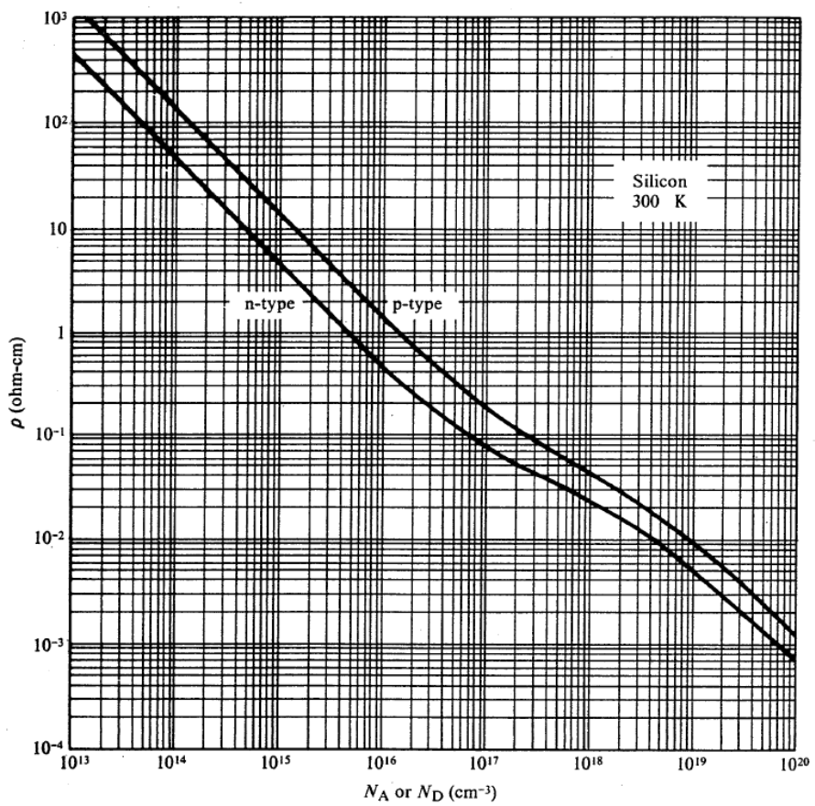

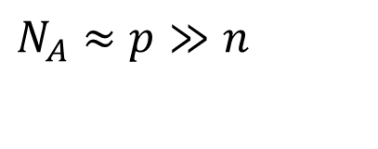
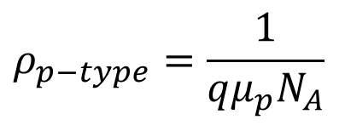
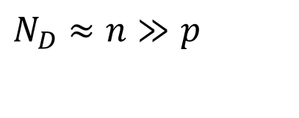
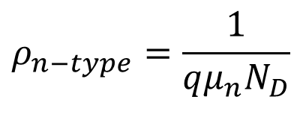
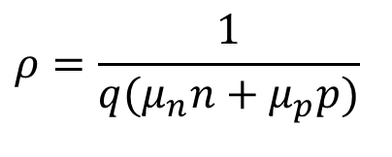
Problem of mobility measurement – unknown doping concentration
J
Four-Probe Measurement¹ measures voltage of device without measuring drop in current carrying wires
V
(in the low voltage limit where field-voltage curve is linear)
$$ρ=\frac{1}{q(μ_{n}n+μ_{p}p)}$$
$$ρ_{n−type}=\frac{1}{qμ_{n}N_{D}}$$
$$N_{D}≈n≫p$$
$$ρ_{p−type}=\frac{1}{qμ_{p}N_{A}}$$
$$N_{A}≈p≫n$$
1 -http://en.wikipedia.org/wiki/Four-terminal_sensing
Notes:
We have a semi-conductor bar and we would like to measure a couple of interesting things – For instance, the mobility of the bar (which is a measure of how easily electrons or holes move through a semiconductor)
We could pump current through, measure resistivity and plot it as a function of doping concentration and using the equations above, obtain mobility from the slope of the graph.
If we have a precise knowledge of the amount of donor or acceptor ions in the bar the problem simplifies – you get a linear (logarithmic) plot for resistivity versus doping concentration.
But what if we do not have this knowledge? Can we, through a electrical measurement find out the doping concentration without knowledge of how the doped sample was prepared?

Slide 28
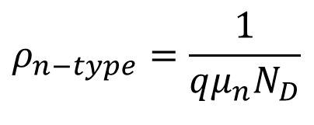
Problem of mobility measurement – unknown doping concentration
J
V
$$ρ_{n−type}=\frac{1}{qμ_{n}N_{D}}$$
Notes:
We have a semi-conductor bar and we would like to measure a couple of interesting things – For instance, the mobility of the bar (which is a measure of how easily electrons or holes move through a semiconductor)
We could pump current through, measure resistivity and plot it as a function of doping concentration and using the equations above, obtain mobility from the slope of the graph.
If we have a precise knowledge of the amount of donor or acceptor ions in the bar the problem simplifies – you get a linear (logarithmic) plot for resistivity versus doping concentration.
But what if we do not have this knowledge? Can we, through a electrical measurement find out the doping concentration without knowledge of how the doped sample was prepared?

Slide 29
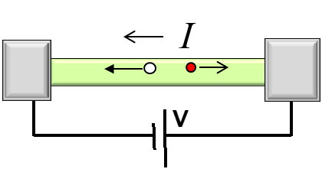
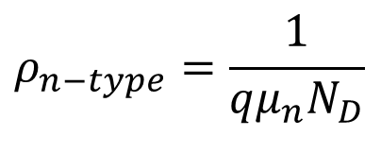
Section 17
Intro to Transport – Drift, Mobility, Diffusion, Einstein Relationship
I = G ^{x} V
Transport with scattering,
non-equilibrium Stat. Mech.
Drift-diffusion equation with recombination-generation
= q ^{x} n ^{x} v ^{x} A
area
charge
density
velocity
Vid
17.1 Drift Current
17.2 Mobility
  Matthiessen Rule
  High Field Effects
  Mobility Measurement
17.3 Carrier Concentration from Hall Effect
17.4 Physics of diffusion – Einstein Relationship
x
x
x
x
Vid
J
Vi
V
Vid
$$ρ_{n−type}=\frac{1}{qμ_{n}N_{D}}$$
Drift, diffusion, and recombination-generation
=> elemental processes in semiconductor device physics.
Measurement of mobility and carrier concentration
=> characterize semiconductor devices.
Consider system to be in local equilibrium

Slide 30
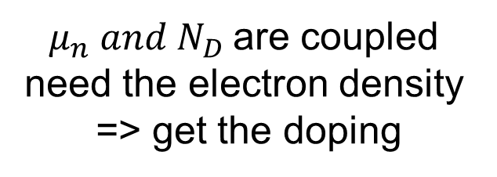
Section 17
Intro to Transport – Drift, Mobility, Diffusion, Einstein Relationship
I = G ^{x} V
Transport with scattering,
non-equilibrium Stat. Mech.
Drift-diffusion equation with recombination-generation
= q ^{x} n ^{x} v ^{x} A
area
charge
density
velocity
Vid
17.1 Drift Current
17.2 Mobility
  Matthiessen Rule
  High Field Effects
  Mobility Measurement
17.3 Carrier Concentration from Hall Effect
17.4 Physics of diffusion – Einstein Relationship
x
x
x
x
Vid
J
Vi
V
Vid
$$ρ_{n−type}=\frac{1}{qμ_{n}N_{D}}$$
$μ_{n} and N_{D}$are coupled
need the electron density
=> get the doping
Drift, diffusion, and recombination-generation
=> elemental processes in semiconductor device physics.
Measurement of mobility and carrier concentration
=> characterize semiconductor devices.
Consider system to be in local equilibrium
Notes:
Concentration

Slide 31
Section 17
Intro to Transport – Drift, Mobility, Diffusion, Einstein Relationship
Solid State Devices
17.3 Carrier Concentration from Hall Effect

Slide 32
Section 17
Intro to Transport – Drift, Mobility, Diffusion, Einstein Relationship
I = G ^{x} V
Transport with scattering,
non-equilibrium Stat. Mech.
Drift-diffusion equation with recombination-generation
= q ^{x} n ^{x} v ^{x} A
area
charge
density
velocity
Vid
17.1 Drift Current
17.2 Mobility
  Matthiessen Rule
  High Field Effects
  Mobility Measurement
17.3 Carrier Concentration from Hall Effect
17.4 Physics of diffusion – Einstein Relationship
x
x
x
x
Vid
J
Vid
V
Vid
$$ρ_{n−type}=\frac{1}{qμ_{n}N_{D}}$$
$μ_{n} and N_{D}$are coupled
need the electron density
=> get the doping
Drift, diffusion, and recombination-generation
=> elemental processes in semiconductor device physics.
Measurement of mobility and carrier concentration
=> characterize semiconductor devices.
Consider system to be in local equilibrium

Slide 33
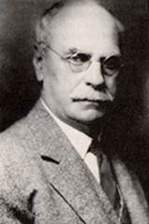
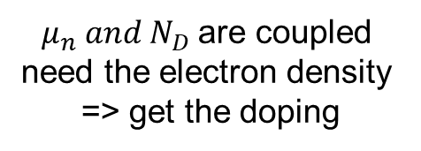
Measuring Electron Density
Hall Effect Trivia - FYI
Discovered in 1879 by Edwin Herbert Hall while he was working on his doctoral degree at Johns Hopkins University in Baltimore, Maryland.
Done 18 years before the electron was discovered.
4 Nobel Prizes associated directly with it.
Read the original article:
“On a New Action of the Magnet on Electric Currents” at http://www.stenomuseet.dk/skoletj/elmag/kilde9.html for a fascinating account of the discovery of the effect.
$μ_{n} and N_{D}$are coupled
need the electron density
=> get the doping
http://en.wikipedia.org/wiki/Hall_effect and http://en.wikipedia.org/wiki/Edwin_Hall

Slide 34



Set up for Hall Measurement
z
Force acting on a charged particle in a magnetic field
y
x
B
$\vec{F}=q\vec{ℇ}+q\vec{v}×\vec{B}+\frac{m^{∗}\vec{v}}{τ}$=0
VH
-
d
+
w
z
I
L
Applying a magnetic field one ‘pushes’ carriers towards one face
This induces a voltage across the two faces perpendicular to current flow.
We will relate this voltage to the current and magnetic field and deduce the density of carriers.
UIC system: 4-300K, 0-1.5 T
$μ_{n} and N_{D}$are coupled
need the electron density
=> get the doping

Slide 35









Drude Model for electrons *
Simple classical Newton’s law expression
m – effective mass
v – drift velocity w/ scattering
* Same model works for holes, but with +q instead of -q
z
B Field
y
I
Approximation for
Weak B=0 field …
V_{H}
$\vec{F}=q\vec{ℇ}+q\vec{v}×\vec{B}+\frac{m^{∗}\vec{v}}{τ}$=0
Approximation works iff ….
Limit of strong
scattering
Time for one magnetic orbit $\frac{1}{ω_{c}}≫τ$ Relaxation time
Must be “small”
Notes:
The third term in the first equation m*v/t represents the steady state force under the combined effect of the electric field and magnetic field. This force follows the classical expression from Newton’s law, F = ma, where the mass here is not the free electron mass, but an ‘effective’ mass that indicates the effect of the environment – phonon’s, impurities and the fields. The velcity v is the ‘drift’ velocity, the average velocity with which electrons move under the influence of the fields and the characteristic time t Is the time between scattering events during the electrons motion.

Slide 36









Drude Model & Hall Effect …
z
B Field
y
I
V_{H}
$$ρ_{n−type}=\frac{1}{qμ_{n}N_{D}}$$
$$μ_{n}=\frac{qτ_{n}}{m_{n}^{∗}}$$
$$σ_{n−type}=qμ_{n}N_{D}$$
$$σ_{n−type}=\frac{q^{2}nτ}{m_{n}^{∗}}$$
$$σ_{n−type}=q\frac{qτ_{n}}{m_{n}^{∗}}n$$
$$N_{D}≈n$$
Notes:
Simply separate out components and write a vector equation relating current density to electric field.

Slide 37






Drude Model & Hall Effect …
z
B Field
y
I
V_{H}
$$N_{D}≈n$$
$$μ_{n}=\frac{qτ_{n}}{m_{n}^{∗}}$$
$$σ_{n−type}=\frac{q^{2}nτ}{m_{n}^{∗}}$$
$$ρ_{n−type}=\frac{1}{qμ_{n}N_{D}}$$
Notes:
Simply separate out components and write a vector equation relating current density to electric field.

Slide 38



Hall Resistance
~0, since voltmeters have a very large internal resistance so very little current flows through
In the limit of small B
z
B Field
y
I
V_{H}
B_{z} is known,
J_{x} is measured,
V_{h} is measured => E_{y} is known
$$N_{D}≈n$$
$$μ_{n}=\frac{qτ_{n}}{m_{n}^{∗}}$$
$$σ_{n−type}=\frac{q^{2}nτ}{m_{n}^{∗}}$$
$$ρ_{n−type}=\frac{1}{qμ_{n}N_{D}}$$
Notes:
In principle, one can ask the question, why set Bz to zero in one equation and not the other. The answer seems to be – for the sake of analytical simplicity. One could, if one were interested, plough through the equations and get a Hall resistance dependent on q, n, Bz^2 and Ey. The Bz^2/Ey term is then small as compared to the larger 1/qn term and is then neglected.

Slide 39
Hall Resistance
Why Bz set to zero in one eq and not the other?
=> analytical simplicity.
The system is also explicitly solvable in terms of Bz^2 and Ey. Once Bz^z/Ey is small compared to 1/qn then one can neglect higher orders and come to the same result
In the limit of small B
z
B Field
y
I
V_{H}
B_{z} is known,
J_{x} is measured,
V_{h} is measured => E_{y} is known
$$N_{D}≈n$$
$$μ_{n}=\frac{qτ_{n}}{m_{n}^{∗}}$$
$$σ_{n−type}=\frac{q^{2}nτ}{m_{n}^{∗}}$$
$$ρ_{n−type}=\frac{1}{qμ_{n}N_{D}}$$
Notes:
In principle, one can ask the question, why set Bz to zero in one equation and not the other. The answer seems to be – for the sake of analytical simplicity. One could, if one were interested, plough through the equations and get a Hall resistance dependent on q, n, Bz^2 and Ey. The Bz^2/Ey term is then small as compared to the larger 1/qn term and is then neglected.

Slide 40


Hall Resistance
Why Bz set to zero in one eq and not the other?
=> analytical simplicity.
The system is also explicitly solvable in terms of Bz^2 and Ey. Once Bz^z/Ey is small compared to 1/qn then one can neglect higher orders and come to the same result
B_{z} is known,
J_{x} is measured,
V_{h} is measured => E_{y} is known
In the limit of small B
z
B Field
y
I
V_{H}
By a simple electrical measurement, we now know the concentration of electrons in the sample.
From the intrinsic concentration of carriers in the semiconductor and temperature we can deduce the doping concentration in the sample
$$N_{D}≈n$$
$$μ_{n}=\frac{qτ_{n}}{m_{n}^{∗}}$$
$$σ_{n−type}=\frac{q^{2}nτ}{m_{n}^{∗}}$$
$$ρ_{n−type}=\frac{1}{qμ_{n}N_{D}}$$
Notes:
In principle, one can ask the question, why set Bz to zero in one equation and not the other. The answer seems to be – for the sake of analytical simplicity. One could, if one were interested, plough through the equations and get a Hall resistance dependent on q, n, Bz^2 and Ey. The Bz^2/Ey term is then small as compared to the larger 1/qn term and is then neglected.

Slide 41

Hall Resistance
By a simple electrical measurement, we now know the concentration of electrons in the sample.
From the intrinsic concentration of carriers in the semiconductor and temperature we can deduce the doping concentration in the sample
B_{z} is known,
J_{x} is measured,
V_{h} is measured => E_{y} is known
In the limit of small B
z
B Field
y
I
V_{H}
$$N_{D}≈n$$
$$μ_{n}=\frac{qτ_{n}}{m_{n}^{∗}}$$
$$σ_{n−type}=\frac{q^{2}nτ}{m_{n}^{∗}}$$
Need multiple temperature dependent measurements to determine doping
$$ρ_{n−type}=\frac{1}{qμ_{n}N_{D}}$$
Notes:
In principle, one can ask the question, why set Bz to zero in one equation and not the other. The answer seems to be – for the sake of analytical simplicity. One could, if one were interested, plough through the equations and get a Hall resistance dependent on q, n, Bz^2 and Ey. The Bz^2/Ey term is then small as compared to the larger 1/qn term and is then neglected.

Slide 42

Section 17
Intro to Transport – Drift, Mobility, Diffusion, Einstein Relationship
I = G ^{x} V
Transport with scattering,
non-equilibrium Stat. Mech.
Drift-diffusion equation with recombination-generation
= q ^{x} n ^{x} v ^{x} A
z
B Field
y
area
V_{H}
I
charge
density
velocity
Vid
17.1 Drift Current
17.2 Mobility
  Matthiessen Rule
  High Field Effects
  Mobility Measurement
17.3 Carrier Concentration from Hall Effect
17.4 Physics of diffusion – Einstein Relationship
x
x
x
x
Vid
J
Vid
$$ρ_{n−type}=\frac{1}{qμ_{n}N_{D}}$$
V
Vid
Drift, diffusion, and recombination-generation
=> elemental processes in semiconductor device physics.
Measurement of mobility and carrier concentration
=> characterize semiconductor devices.
Consider system to be in local equilibrium

Slide 43
Section 17
Intro to Transport – Drift, Mobility, Diffusion, Einstein Relationship
I = G ^{x} V
Transport with scattering,
non-equilibrium Stat. Mech.
Drift-diffusion equation with recombination-generation
= q ^{x} n ^{x} v ^{x} A
z
B Field
y
area
V_{H}
I
charge
density
velocity
Vid
17.1 Drift Current
17.2 Mobility
  Matthiessen Rule
  High Field Effects
  Mobility Measurement
17.3 Carrier Concentration from Hall Effect
17.4 Physics of diffusion – Einstein Relationship
x
x
x
x
Vid
J
Vid
$$ρ_{n−type}=\frac{1}{qμ_{n}N_{D}}$$
V
Vid
Drift, diffusion, and recombination-generation
=> elemental processes in semiconductor device physics.
Measurement of mobility and carrier concentration
=> characterize semiconductor devices.
Consider system to be in local equilibrium

Slide 44
Section 17
Intro to Transport – Drift, Mobility, Diffusion, Einstein Relationship
Solid State Devices
17.4 Physics of diffusion – Einstein Relationship

Slide 45

Section 17
Intro to Transport – Drift, Mobility, Diffusion, Einstein Relationship
I = G ^{x} V
Transport with scattering,
non-equilibrium Stat. Mech.
Drift-diffusion equation with recombination-generation
= q ^{x} n ^{x} v ^{x} A
z
B Field
y
area
V_{H}
I
charge
density
velocity
Vid
17.1 Drift Current
17.2 Mobility
  Matthiessen Rule
  High Field Effects
  Mobility Measurement
17.3 Carrier Concentration from Hall Effect
17.4 Physics of diffusion – Einstein Relationship
Vid
J
Vid
$$ρ_{n−type}=\frac{1}{qμ_{n}N_{D}}$$
V
Vid
Drift, diffusion, and recombination-generation
=> elemental processes in semiconductor device physics.
Measurement of mobility and carrier concentration
=> characterize semiconductor devices.
Consider system to be in local equilibrium

Slide 46
So far Considered: Drift Term
Consider system to be in local equilibrium

Slide 47
Now the Diffusion term…
x
So far Considered: Drift Term
Consider system to be in local equilibrium

Slide 48







Diffusion Flux …
Assuming independent random motion
Electrons move on average (at each x)
  half to left,
  half to right
➔NET movement of electrons to left
i.e. against the gradient.
Opposite sign for holes.
x
$$J=qpυ_{th}$$
$$J=q\left[−p(blue area) +p(red area) \right]υ_{th}$$
$$J=q{\left[−\left(\frac{p(0)+p(0)−\frac{dp}{dx}l}{2}\right)×l+\left(\frac{p(0)+p(0)+\frac{dp}{dx}l}{2}×l\right)\right]}/{\frac{l}{υ_{th}}}$$
$$J=qlυ\frac{dp}{dx}$$
$$J=qD\frac{dp}{dx}$$
$$D=lυ$$
This looks like a completely classical derivation.
Where is the Quantum Mechanics?
Quantum Mechanics is in the Diffusion coefficient and the Drift Velocity.
Determines the available states
Determines the capability to carry current
Scattering is built in here! Interactions of many, many, many electrons and he surrounding.
Without scattering one could not explain the equal partitioning into 2 directions!
Notes:
Some electrons that move either way get scattered back due to collisions with impurities and atoms. In this simple, one dimensional model the only way is in the +x or –x direction.
From http://ecee.colorado.edu/~bart/book/book/chapter2/ch2_7.htm – the following useful paragraph
The derivation is based on the basic notion that carriers at non-zero temperature (Kelvin) have an additional thermal energy, which equals kT/2 per degree of freedom. It is the thermal energy, which drives the diffusion process. At T = 0 K there is no diffusion.
The reader should recognize that the random nature of the thermal energy would normally require a statistical treatment of the carriers. Instead we will use average values to describe the process. Such approach is justified on the basis that a more elaborate statistical approach yields the same results. To further simplify the derivation, we will derive the diffusion current for a one-dimensional semiconductor in which carriers can only move along one direction.
We now introduce the average values of the variables of interest, namely the thermal velocity, vth, the collision time, tc, and the mean free path, l. The thermal velocity is the average velocity of the carriers going in the positive or negative direction. The collision time is the time during which carriers will move with the same velocity before a collision occurs with an atom or with another carrier. The mean free path is the average length a carrier will travel between collisions.

Slide 49


Diffusion Flux …
Assuming independent random motion
Electrons move on average (at each x)
  half to left,
  half to right
➔NET movement of electrons to left
i.e. against the gradient.
Opposite sign for holes.
$$J=qD\frac{dp}{dx}$$
x
$$D=lυ$$
Diffusion and Mobility must be related!
This looks like a completely classical derivation.
Where is the Quantum Mechanics?
Quantum Mechanics is in the Diffusion coefficient and the Drift Velocity.
Determines the available states
Determines the capability to carry current
Scattering is built in here! Interactions of many, many, many electrons and he surrounding.
Without scattering one could not explain the equal partitioning into 2 directions!
Notes:
Some electrons that move either way get scattered back due to collisions with impurities and atoms. In this simple, one dimensional model the only way is in the +x or –x direction.
From http://ecee.colorado.edu/~bart/book/book/chapter2/ch2_7.htm – the following useful paragraph
The derivation is based on the basic notion that carriers at non-zero temperature (Kelvin) have an additional thermal energy, which equals kT/2 per degree of freedom. It is the thermal energy, which drives the diffusion process. At T = 0 K there is no diffusion.
The reader should recognize that the random nature of the thermal energy would normally require a statistical treatment of the carriers. Instead we will use average values to describe the process. Such approach is justified on the basis that a more elaborate statistical approach yields the same results. To further simplify the derivation, we will derive the diffusion current for a one-dimensional semiconductor in which carriers can only move along one direction.
We now introduce the average values of the variables of interest, namely the thermal velocity, vth, the collision time, tc, and the mean free path, l. The thermal velocity is the average velocity of the carriers going in the positive or negative direction. The collision time is the time during which carriers will move with the same velocity before a collision occurs with an atom or with another carrier. The mean free path is the average length a carrier will travel between collisions.

Slide 50









Einstein Relationship …
$$J=qD\frac{dp}{dx}$$
$$μ=\frac{qτ}{m_{}^{∗}}$$
Diffusion and Mobility must be related!
$$D=lυ$$
… because scattering dominates both phenomena
$$l=υτ$$
$$\frac{D}{μ}=$$
$$\frac{lυ}{\frac{qτ}{m_{0}^{∗}}}$$
$$=\frac{(υτ)×υ}{\frac{qτ}{m_{0}^{∗}}}=\frac{2(\frac{1}{2}m_{0}^{∗}υ^{2})}{q}$$
$$\frac{D}{μ}=\frac{k_{B}T}{q}$$
$$E_{thermal}^{1D} =\frac{k_{B}T}{2}$$
Notes:
This derivation is wrong. According to the equi-partition theorem, in equilibrium, each thermally distributed molecule/carrier has kt/2 of energy per dimension. So D = l*v as derived in the alternate derivation and not lv/2 as derived by Prof. Alam.

Slide 51


Einstein Relationship …
The derivation is based on the basic notion that carriers at non-zero temperature (Kelvin) have an additional thermal energy, which equals kT/2 per degree of freedom. It is the thermal energy, which drives the diffusion process. At T = 0 K there is no diffusion.
The reader should recognize that the random nature of the thermal energy would normally require a statistical treatment of the carriers. Instead we will use average values to describe the process. Such approach is justified on the basis that a more elaborate statistical approach yields the same results. To further simplify the derivation, we will derive the diffusion current for a one-dimensional semiconductor in which carriers can only move along one direction.
We now introduce the average values of the variables of interest, namely the thermal velocity, vth, the collision time, tc, and the mean free path, l. The thermal velocity is the average velocity of the carriers going in the positive or negative direction. The collision time is the time during which carriers will move with the same velocity before a collision occurs with an atom or with another carrier. The mean free path is the average length a carrier will travel between collisions.
http://ecee.colorado.edu/~bart/book/book/chapter2/ch2_7.htm
Diffusion and Mobility must be related!
$$\frac{D}{μ}=\frac{k_{B}T}{q}$$
$$E_{thermal}^{1D} =\frac{k_{B}T}{2}$$
Notes:
This derivation is wrong. According to the equi-partition theorem, in equilibrium, each thermally distributed molecule/carrier has kt/2 of energy per dimension. So D = l*v as derived in the alternate derivation and not lv/2 as derived by Prof. Alam.

Slide 52



Einstein Relationship …
The derivation is based on the basic notion that carriers at non-zero temperature (Kelvin) have an additional thermal energy, which equals kT/2 per degree of freedom. It is the thermal energy, which drives the diffusion process. At T = 0 K there is no diffusion.
The reader should recognize that the random nature of the thermal energy would normally require a statistical treatment of the carriers. Instead we will use average values to describe the process. Such approach is justified on the basis that a more elaborate statistical approach yields the same results. To further simplify the derivation, we will derive the diffusion current for a one-dimensional semiconductor in which carriers can only move along one direction.
We now introduce the average values of the variables of interest, namely the thermal velocity, vth, the collision time, tc, and the mean free path, l. The thermal velocity is the average velocity of the carriers going in the positive or negative direction. The collision time is the time during which carriers will move with the same velocity before a collision occurs with an atom or with another carrier. The mean free path is the average length a carrier will travel between collisions.
http://ecee.colorado.edu/~bart/book/book/chapter2/ch2_7.htm
… because scattering dominates both phenomena
Notes:
This derivation is wrong. According to the equi-partition theorem, in equilibrium, each thermally distributed molecule/carrier has kt/2 of energy per dimension. So D = l*v as derived in the alternate derivation and not lv/2 as derived by Prof. Alam.

Slide 53





An alternate derivation
Diffusion and Mobility must be related!
RMS velocity of carriers is decided by the average mean free path and average scattering time
$$\frac{D}{μ}=\frac{k_{B}T}{q}$$
$$E_{thermal}^{1D} =\frac{k_{B}T}{2}$$
$$l=υτ$$
Carriers that arrive at x=0 do so by travelling one mean free path from right to left or vice versa.
Net current from left to right (at x=0) = charge on carrier*net flux of carriers from left to right
Figures and derivation from http://ecee.colorado.edu/~bart/book/book/chapter2/ch2_7.htm#fig2_7_8
Notes:
The net current is calculated by calculating the flux AT a particular point, say x=0. The time interval corresponding to the migration of electrons/holes is the scattering time tau. This corresponds to the root mean square velocity V_thermal.

Slide 54



Derivation for electron diffusion current
Electron flux at x=0 from left to right
The factor half appears because the other half at x=-l travels towards the left
Electron flux at x=0 from right to left
Net Flux
Notes:
Flux (in this case) is a measure of the number of electrons crossing a plane normally and their velocity.

Slide 55



Derivation continued
If the mean free path is small enough, then we can write this as
Consider system to be in local equilibrium
The negative sign arises because we take the gradient is usually measured for increasing values of x. The current density is then given by.

Slide 56





For holes, we repeat the derivation and find…
Lump together the second and third terms to form a ‘diffusion constant’
$$D_{p}=l_{holes}υ_{th,holes}$$
$$D_{n}=l_{n}υ_{th,n}$$

Slide 57




For thermally distributed carriers…
$$E_{thermal}^{1D} =\frac{k_{B}T}{2}$$
Equipartition theorem states that in equilibrium each carrier has thermal energy of kT/2 per degree of freedom.
$$D_{n}=l_{n}υ_{th,n}$$
$$E_{thermal}^{1D}=\frac{1}{2}m_{0}^{∗}υ^{2}$$
valid for electrons and holes
AT EQULIBRIUM
$m_{0}^{∗}υ^{2}$ = $k_{B}T$
Our derivation is in one dimension➔ one degree of freedom
http://en.wikipedia.org/wiki/Equipartition_theorem#Derivations

Slide 58





Alternate way to obtain the diffusion constants
$$μ=\frac{qτ}{m_{}^{∗}}$$
$$D_{n}=l_{n}υ_{th,n}$$
$m_{0}^{∗}υ^{2}$ = $k_{B}T$
valid for electrons and holes
AT EQULIBRIUM
$$l=υτ$$
The equation shows how thermal quantities governing diffusion can be related to those governing drift (mobility depends on the effective mass which describes motion of carriers in the presence of a field and scatterers )

Slide 59















An alternate derivation of Einstein’s relationship
No current in equilibrium
n₂
n
n₁
$J_{n}=qnμ_{n}E+qD_{n}\frac{dn}{dx}$ = 0
$$⇒\frac{1}{n}\frac{dn}{dx}=−\frac{μ_{n}E}{D_{n}}$$
$$n_{2}=N_{C}e^{−(E_{C2}−E_{F})/kT}$$
$$n_{1}=N_{C}e^{−(E_{C1}−E_{F})/kT}$$
L
$$\frac{n_{2}}{n_{1}}=e^{μ_{n}V/D_{n}}$$
$$\frac{n_{2}}{n_{1}}=\frac{N_{C}e^{−(E_{C2}−E_{F})/kT}}{N_{C}e^{−(E_{C1}−E_{F})/kT}}=e^{−(E_{C2}−E_{C1})/kT}=e^{qV/kT}$$
$$ln\left(\frac{n_{2}}{n_{1}}\right)=\frac{μ_{n}V}{D_{n}}=\frac{qV}{kT}$$
$$\frac{D}{μ}=\frac{k_{B}T}{q}$$
Similar to relationship between
c_{n} and e_{n} discussed in Section 16

Slide 60


Section 17
Intro to Transport – Drift, Mobility, Diffusion, Einstein Relationship
I
I = G ^{x} V
Transport with scattering,
non-equilibrium Stat. Mech.
Drift-diffusion equation with recombination-generation
z
= q ^{x} n ^{x} v ^{x} A
B Field
y
area
V_{H}
I
charge
density
velocity
Vid
17.1 Drift Current
17.2 Mobility
  Matthiessen Rule
  High Field Effects
  Mobility Measurement
17.3 Carrier Concentration from Hall Effect
17.4 Physics of diffusion – Einstein Relationship
x
x
x
x
Vid
J
$$ρ_{n−type}=\frac{1}{qμ_{n}N_{D}}$$
Vid
V
Vid
REF: ADF, Chapter 5, pp. 190-202
$$\frac{D}{μ}=\frac{k_{B}T}{q}$$
Drift, diffusion, and recombination-generation
=> elemental processes in semiconductor device physics.
Measurement of mobility and carrier concentration
=> characterize semiconductor devices.
x
Consider system to be in local equilibrium

