Slide 1
Section 15
Introduction to Non-Equilibrium
Solid State Devices

Slide 2
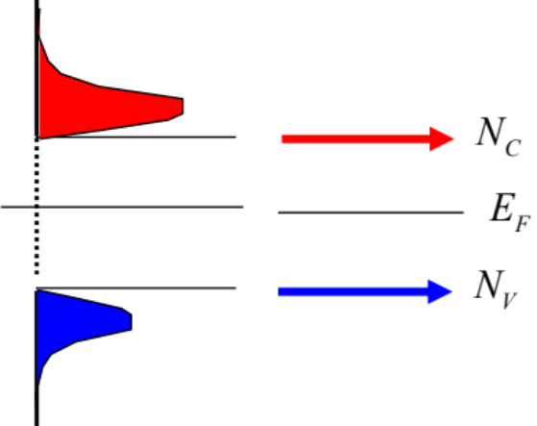

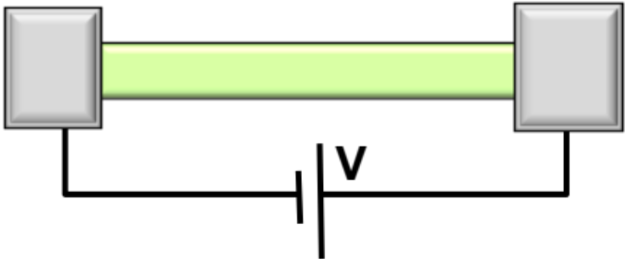
Section 15
Introduction to Non-Equilibrium
I = G ^{x} V
I
= q ^{x} n ^{x} v ^{x} A
charge
density
velocity
area
Materials, composition, crystals
Tabulated for “known” bulk materials
Environment
Quantum Mechanics Mechanics
Concepts of density of states and masses
How does the system
go BACK to
equilibrium?
Equilibrium Statistical Mechanics
Occupation factors
Transport with scattering, non-equilibrium Stat. Mech.
Drift-diffusion equation with recombination-generation
Video
15.1 Steady State, Transient, Equilibrium
15.2 Recombination & Generation Overview
Understanding transport in devices
Diodes, BJT/HBT, MOS
Video

Slide 3
Equilibrium, Steady state, Transient
Equilibrium
Device
Steady state
(n,p)
time
Environment

Slide 4
Equilibrium, Steady state, Transient
Equilibrium
Device
Steady state
(n,p)
time
Environment
Transient
(n,p)
time

Slide 5
Detailed Balance: Simple Explanation
Equilibrium
Equilibrium is a very active place
typical semiconductor device there are 1e17 to 1e20 electrons in the conduction band. All electrons carry charge and are occupying their respective DOS.
Device
Fermi-Dirac distribution demands exploration of allowed states
Mexico
3
USA
2
In equilibrium each process is balanced by its counter process
=> Detailed Balance
=> Externally it looks as if nothing is happening.
1
4
6
Environment
China
5
This is different from steady state!!!
4
Mexico
2
USA
2
India
1
3
3
China
4
4
India
9 in & 9 out
All numbers are people/unit time.

Slide 6
Detailed Balance: Simple Explanation
Equilibrium
Equilibrium is a very active place
Device
Fermi-Dirac distribution demands exploration of allowed states
In equilibrium each process is balanced by its counter process
=> Detailed Balance
=> Externally it looks as if nothing is happening for each site.
Environment
Mexico
3
This is different from steady state!!!
USA
2
Mexico
2
The rates of exchange of people (particles) between every pair of countries (energy levels) is balanced. Hence the name “Detailed Balance”.
Detailed balance is the property of equilibrium
The population of each of the countries (energy levels) remains constant under detailed balance.
The concept of detailed balance is powerful, because it can be used for many things
derive particle distributions Fermi-Dirac, Bose-Einstein
reduce the number of unknown rate constants by half
USA
2
1
4
6
China
5
3
3
4
China
4
4
India
1
India
9 in & 9 out from USA
All numbers are people/unit time.

Slide 7
Steady State Response
Equilibrium is a very active place
Fermi-Dirac distribution demands exploration of allowed states
Equilibrium
In equilibrium each process is balanced by its counter process
=> Detailed Balance
=> Externally it looks as if nothing is happening for each site.
Disturbing the detailed balance requires
non-equilibrium conditions (needs energy). Unidirectional forces (red lines) can create such
Non-equilibrium conditions
Device
`
3+1 in and 5 out from Mexico
Environment
The population of a country (energy level) remains constant with time after steady state is reached.
This is different from steady state!!!
Mexico
2
Mexico
3
USA
USA
2
2
3
`
3
1
4
6
China
4
5
China
4
4
India
India
4+1 in and 5 out from India
`
1
9 in & 9 out from USA
All numbers are people/unit time.
12 in and 12 out from USA

Slide 8
Steady State Response
Equilibrium is a very active place
Fermi-Dirac distribution demands exploration of allowed states
Equilibrium
In equilibrium each process is balanced by its counter process
=> Detailed Balance
=> Externally it looks as if nothing is happening for each site.
Disturbing the detailed balance requires
non-equilibrium conditions (needs energy). Unidirectional forces (red lines) can create such
Non-equilibrium conditions
Device
`
Environment
The population of a country (energy level) remains constant with time after steady state is reached.
This is different from steady state!!!
Mexico
2
Mexico
3
USA
USA
2
2
The rates of exchange of people (particles)
between every pair of countries (energy
levels) is NOT balanced.
3
`
3
1
4
`
6
China
4
5
China
`
4
4
India
India
`
1
9 in & 9 out from USA
All numbers are people/unit time.
12 in and 12 out from USA

Slide 9
Steady State Response
Equilibrium is a very active place
Fermi-Dirac distribution demands exploration of allowed states
Equilibrium
In equilibrium each process is balanced by its counter process
=> Detailed Balance
=> Externally it looks as if nothing is happening for each site.
Disturbing the detailed balance requires
non-equilibrium conditions (needs energy). Unidirectional forces (red lines) can create such
Non-equilibrium conditions
Device
Environment
The population of a country (energy level) remains constant with time after steady state is reached.
This is different from steady state!!!
Mexico
2
Mexico
3
USA
USA
2
2
The rates of exchange of people (particles)
between every pair of countries (energy
levels) is NOT balanced.
3
3
1
4
6
China
4
5
The flux at steady state is balanced overall,
China
4
4
India
India
1
9 in & 9 out from USA
All numbers are people/unit time.

Slide 10
Steady State Response
Equilibrium is a very active place
Fermi-Dirac distribution demands exploration of allowed states
Equilibrium
In equilibrium each process is balanced by its counter process
=> Detailed Balance
=> Externally it looks as if nothing is happening for each site.
Disturbing the detailed balance requires
non-equilibrium conditions (needs energy). Unidirectional forces (red lines) can create such
Non-equilibrium conditions
Device
Environment
The population of a country (energy level) remains constant with time after steady state is reached.
This is different from steady state!!!
Mexico
2
Mexico
3
USA
USA
2
2
The rates of exchange of people (particles)
between every pair of countries (energy
levels) is NOT balanced.
3
3
1
4
6
China
4
5
The flux at steady state is balanced overall,
China
4
4
India
India
1
One can use the requirement that net flux at steady state be zero to calculate steady state population of a country
9 in & 9 out from USA
All numbers are people/unit time.

Slide 11
Transient Response
I
Equilibrium is a very active place
Fermi-Dirac distribution demands exploration of allowed states
In equilibrium each process is balanced by its counter process
=> Detailed Balance
=> Externally it looks as if nothing is happening for each site.
Materials, composition, crystals
Tabulated for “known” bulk materials
This is different from steady state!!!
Disturbing the detailed balance requires
non-equilibrium conditions (needs energy). Unidirectional forces (red lines) can create such
Non-equilibrium conditions
Forced unidirectional connections
(red lines) disturbs equilibrium
(e.g. 10 in/12 out at time t1
local populations not conserved,
but global population is ….
Transient populations
=> Externally it looks as if nothing is happening for the overall system.
Quantum Mechanics Mechanics
Concepts of density of states and masses
Equilibrium Statistical Mechanics
Occupation factors
The population of a country (energy level) remains constant with time after steady state is reached.
Transport with scattering, non-equil, Stat. Mech.
Drift-diffusion eq. with recombination-generation
Mexico
2
Mexico
2
Mexico
3
USA
USA
USA
2
3
2
Understanding device transport
Diodes, BJT/HBT, MOS
The rates of exchange of people (particles)
between every pair of countries (energy
levels) is NOT balanced.
3
3
1
3
5
1
4
6
China
4
China
5
5
China
4
4
4
The flux at steady state is balanced overall,
India
India
India
1
1
One can use the requirement that net flux at steady state be zero to calculate steady state population of a country (Eq. 5.21)
9 in & 9 out from USA
All numbers are people/unit time.

Slide 12
Section 15
Introduction to Non-Equilibrium
I
I = G ^{x} V
Materials, composition, crystals
Tabulated for “known” bulk materials
= q ^{x} n ^{x} v ^{x} A
Quantum Mechanics Mechanics
Concepts of density of states and masses
charge
density
velocity
area
Equilibrium Statistical Mechanics
Occupation factors
How does the system
go BACK to
equilibrium?
Transport with scattering, non-equil, Stat. Mech.
Drift-diffusion eq. with recombination-generation
Understanding device transport
Diodes, BJT/HBT, MOS
15.1 Steady State, Transient, Equilibrium
  Critical conceptual differences!
  Need to understand these!
15.2 Recombination & Generation Overview
Video
Mexico
2
USA
Mexico
2
3
USA
2
3
3
1
4
China
4
6
Video
4
China
5
4
India
India
1
12 in 12 out
Population stabilized
Steady State
But NOT Equilibrium

Slide 13
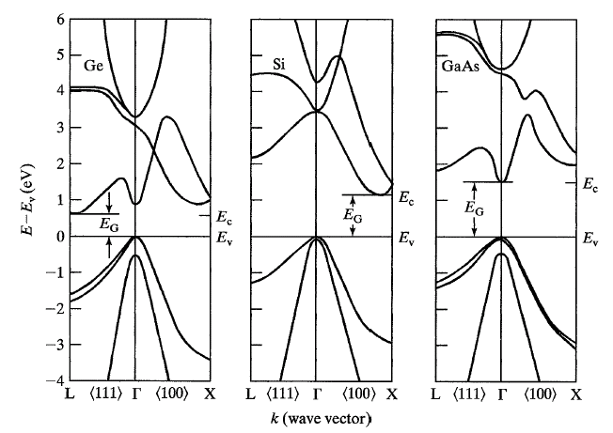
Section 15
Introduction to Non-Equilibrium
I
I = G ^{x} V
Materials, composition, crystals
Tabulated for “known” bulk materials
= q ^{x} n ^{x} v ^{x} A
Quantum Mechanics Mechanics
Concepts of density of states and masses
charge
density
velocity
area
Equilibrium Statistical Mechanics
Occupation factors
How does the system
go BACK to
equilibrium?
Transport with scattering, non-equil, Stat. Mech.
Drift-diffusion eq. with recombination-generation
Understanding device transport
Diodes, BJT/HBT, MOS
15.1 Steady State, Transient, Equilibrium
  Critical conceptual differences!
  Need to understand these!
15.2 Recombination & Generation Overview
Video
Mexico
2
USA
Mexico
2
3
USA
2
3
3
1
4
China
4
6
Video
4
China
5
4
India
India
1
12 in 12 out
Population stabilized
Steady State
But NOT Equilibrium

Slide 14
Section 15
Introduction to Non-Equilibrium
Solid State Devices
15.2 Recombination & Generation Overview

Slide 15
Section 15
Introduction to Non-Equilibrium
I
I = G ^{x} V
Materials, composition, crystals
Tabulated for “known” bulk materials
= q ^{x} n ^{x} v ^{x} A
Quantum Mechanics Mechanics
Concepts of density of states and masses
charge
density
velocity
area
Equilibrium Statistical Mechanics
Occupation factors
How does the system
go BACK to
equilibrium?
Transport with scattering, non-equil, Stat. Mech.
Drift-diffusion eq. with recombination-generation
Understanding device transport
Diodes, BJT/HBT, MOS
15.1 Steady State, Transient, Equilibrium
  Critical conceptual differences!
  Need to understand these!
15.2 Recombination & Generation Overview
Video
Mexico
2
USA
Mexico
2
3
USA
2
3
3
1
4
China
4
6
Video
4
China
5
4
India
India
1
12 in 12 out
Population stabilized
Steady State
But NOT Equilibrium

Slide 16
Indirect vs. Direct Bandgap
The top & bottom of bands do not align at
same wavevector k for indirect bandgap material

Slide 17
Direct Band-to-band Recombination
In real space …
In energy space …
Photon
Photon
e and h must
have same wavelength
1 in 1,000,000 encounters
Direct transistion –
direct gap material
GaAs, InP, InSb (3D)
Lasers, LEDs, etc.

Slide 18
Direct Excitonic Recombination
Mostly in 1D systems
Requires strong
coulomb interactions
In energy space …
Photon
(wavelength reduced from bulk)
In real space …
CNT, InP, ID-systems
Transistors, Lasers, Solar cells, etc.

Slide 19
Indirect Recombination (Trap-assisted)
Trap needs to be mid-gap to be effective.
Cu or Au in Si
States close to Ec or Ev do not help efficiently.
Phonon
Ge, Si, ….
Transistors, Solar cells, etc.
Cu in Si is extremely efficient in providing recombination
Cu in Si was avoided completely for many years
Intel introduced Cu for interconnects – special precautions so Cu does not enter the Si.

Slide 20
Indirect Recombination (Trap-assisted)
Trap needs to be mid-gap to be effective.
Cu or Au in Si
States close to Ec or Ev do not help efficiently.
Phonon
Recombination rate is in general slower than direct via photon.
Why?
1 electron and one hole need to localize AND find a trap. … less likely event.
Ge, Si, ….
Transistors, Solar cells, etc.
Cu in Si is extremely efficient in providing recombination
Cu in Si was avoided completely for many years
Intel introduced Cu for interconnects – special precautions so Cu does not enter the Si.

Slide 21
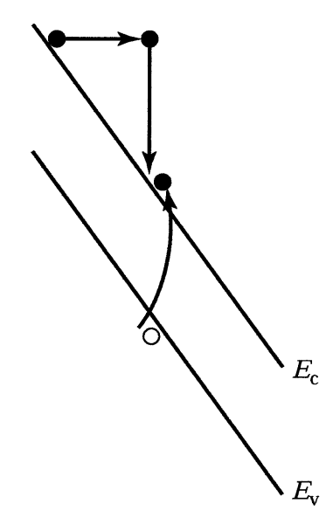
Impact Ionization – A Generation Mechanism
Requires very high electric field
1
3
Inverse of the Auger recombination
4
2
Si, Ge, InP
Lasers, Transistors, etc.

Slide 22
Auger Recombination
3
Requires very high electron density
Phonon (heat)
2
1
4
3
InP, GaAs, …
Lasers, etc.
1
2
4

Slide 23

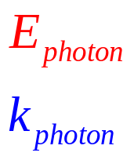

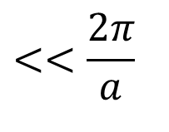




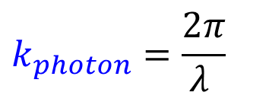
Photon Energy and Wavevector
$$E_{V}+E_{photon}=E_{C}$$
$$ℏk_{V}+ℏk_{photon}=ℏk_{C}$$
$$E_{photon}\left(red HeNe\right): λ=633nm$$
$$E_{photon}\left(green YAG\right): λ=532nm$$
Si lattice$:a=0.5nm$
$$k_{photon}=\frac{2π}{λ }$$
$$<<\frac{2π}{a}$$
Photon has large energy for excitation through bandgap,
but its wavevector is negligible compared to size of BZ

Slide 24
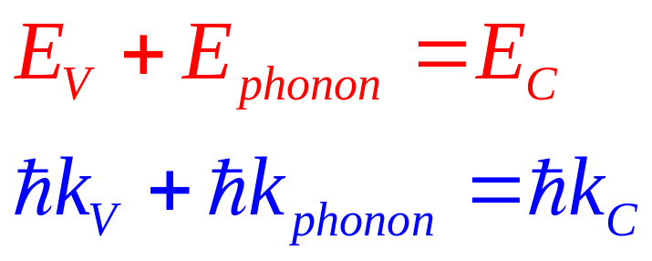
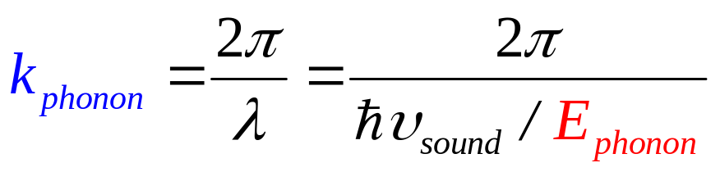
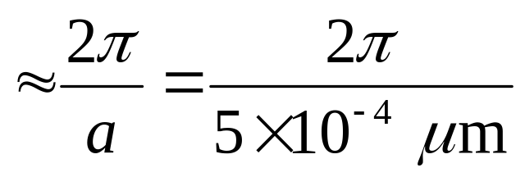
Phonon Energy and Wavevector
v_{sound} ~ 10³ m/s << v_{light}=c ~ 10⁶m/s
λ^{sound} >> λ^{light}
Phonon has large wavevector comparable to BZ,
but negligible energy compared to bandgap

Slide 25
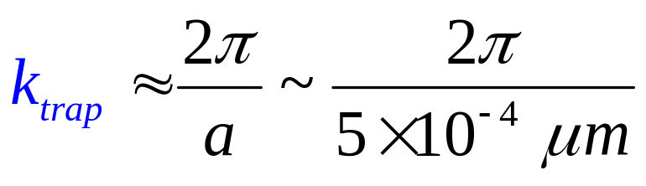
Localized Traps and Wavevector
a
Trap provides the wavevector
necessary for indirect transition

Slide 26
Conclusions
Concepts of equilibrium, steady state, and transient dynamics should be clearly understood.
There are wide variety of generation-recombination events that allow restoration of equilibrium once the stimulus is removed.
Direct recombination is photon-assisted, indirect recombination phonon assisted.
Mexico
2
USA
Mexico
2
3
USA
2
3
3
1
4
China
4
6
4
China
5
4
India
India
1
12 in 12 out
Population stabilized
Steady State
But NOT Equilibrium

Slide 27
Section 15
Introduction to Non-Equilibrium
I
I = G ^{x} V
Materials, composition, crystals
Tabulated for “known” bulk materials
= q ^{x} n ^{x} v ^{x} A
Quantum Mechanics Mechanics
Concepts of density of states and masses
charge
density
velocity
area
Equilibrium Statistical Mechanics
Occupation factors
How does the system
go BACK to
equilibrium?
Transport with scattering, non-equil, Stat. Mech.
Drift-diffusion eq. with recombination-generation
Video
Understanding device transport
Diodes, BJT/HBT, MOS
15.1 Steady State, Transient, Equilibrium
15.2 Recombination & Generation Overview
Mexico
2
USA
Mexico
Video
2
3
USA
2
3
3
1
4
China
4
6
4
China
5
4
India
India
1
12 in 12 out
Population stabilized
Steady State
But NOT Equilibrium

Slide 28
Section 15
Introduction to Non-Equilibrium
I
Section 16
Recombination & Generation
I = G ^{x} V
Materials, composition, crystals
Tabulated for “known” bulk materials
= q ^{x} n ^{x} v ^{x} A
Quantum Mechanics Mechanics
Concepts of density of states and masses
charge
density
velocity
area
Equilibrium Statistical Mechanics
Occupation factors
Transport with scattering, non-equil, Stat. Mech.
Drift-diffusion eq. with recombination-generation
How does the system
go BACK to
equilibrium?
Video
Understanding device transport
Diodes, BJT/HBT, MOS
15.1 Steady State, Transient, Equilibrium
15.2 Recombination & Generation Overview
Mexico
2
USA
Mexico
Video
2
3
USA
2
3
3
1
4
China
4
6
4
China
5
4
India
India
1
12 in 12 out
Population stabilized
Steady State
But NOT Equilibrium

