Slide 1

Section 14
Doping
Solid State Devices

Slide 2
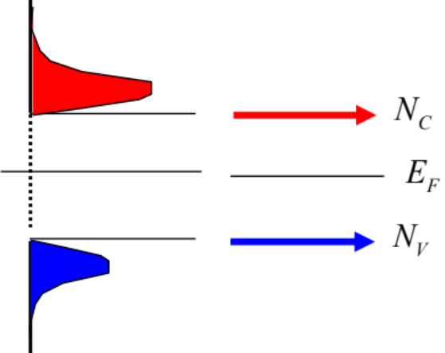
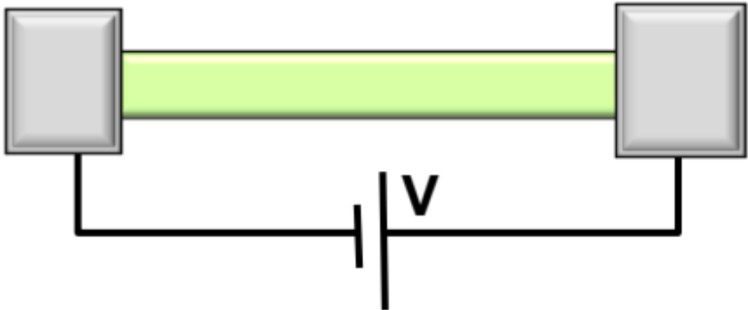
Section 14
Doping
I = G ^{x} V
= q ^{x} n ^{x} v ^{x} A
charge
density
velocity
area
Metal:
  Conducts electrons even at very low temperatures
  Fermi Level crosses multiple bands
  => large density of states at Fermi level
Materials, composition, crystals
Tabulated for “known” bulk materials
At nm-scale properties change with geometry => theory
Quantum Mechanics Mechanics
Concepts of density of states and masses
Semiconductor
  Ge: Eg=0.8eV n_{i}~10¹³/cm³ 0.1 in a billion
  Si: Eg=1.1eV n_{i}~10¹⁰/cm³ 0.1 in a trillion
  GaAs: Eg=1.42eV n_{i}~10⁶/cm³ 1 in 10¹⁷
  Very weakly conducting
  Fermi level about midgap – no DOS
Equilibrium Statistical Mechanics
Occupation factors
Transport with scattering, non-equilibrium Stat. Mech.
Drift-diffusion equation with recombination-generation
Not Enough Electrons available
Understanding transport in concrete devices
Diodes, BJT/HBT, MOS

Slide 3
Section 14
Doping
I = G ^{x} V
= q ^{x} n ^{x} v ^{x} A
charge
density
velocity
area
Metal:
  Conducts electrons even at very low temperatures
  Fermi Level crosses multiple bands
  => large density of states at Fermi level
Materials, composition, crystals
Tabulated for “known” bulk materials
At nm-scale properties change with geometry => theory
Quantum Mechanics Mechanics
Concepts of density of states and masses
Semiconductor
  Ge: Eg=0.8eV n_{i}~10¹³/cm³ 0.1 in a billion
  Si: Eg=1.1eV n_{i}~10¹⁰/cm³ 0.1 in a trillion
  GaAs: Eg=1.42eV n_{i}~10⁶/cm³ 1 in 10¹⁷
  Very weakly conducting
  Fermi level about midgap – no DOS
Not Enough Electrons available
Equilibrium Statistical Mechanics
Occupation factors
Transport with scattering, non-equilibrium Stat. Mech.
Drift-diffusion equation with recombination-generation
Understanding transport in concrete devices
Diodes, BJT/HBT, MOS
semiconductor

Slide 4
Section 14
Doping
I = G ^{x} V
= q ^{x} n ^{x} v ^{x} A
charge
density
velocity
area
Metal:
  Conducts electrons even at very low temperatures
  Fermi Level crosses multiple bands
  => large density of states at Fermi level
Materials, composition, crystals
Tabulated for “known” bulk materials
At nm-scale properties change with geometry => theory
Semiconductor
  Ge: Eg=0.8eV n_{i}~10¹³/cm³ 0.1 in a billion
  Si: Eg=1.1eV n_{i}~10¹⁰/cm³ 0.1 in a trillion
  GaAs: Eg=1.42eV n_{i}~10⁶/cm³ 1 in 10¹⁷
  Very weakly conducting
  Fermi level about midgap – no DOS
Transport with scattering, non-equilibrium Stat. Mech.
Drift-diffusion equation with recombination-generation
Not Enough Electrons available
metal
semiconductor

Slide 5
Section 14
Doping
I = G ^{x} V
= q ^{x} n ^{x} v ^{x} A
charge
density
velocity
area
Metal:
  Conducts electrons even at very low temperatures
  Fermi Level crosses multiple bands
  => large density of states at Fermi level
Materials, composition, crystals
Tabulated for “known” bulk materials
At nm-scale properties change with geometry => theory
Semiconductor
  Ge: Eg=0.8eV n_{i}~10¹³/cm³ 0.1 in a billion
  Si: Eg=1.1eV n_{i}~10¹⁰/cm³ 0.1 in a trillion
  GaAs: Eg=1.42eV n_{i}~10⁶/cm³ 1 in 10¹⁷
  Very weakly conducting
  Fermi level about midgap – no DOS
Transport with scattering, non-equilibrium Stat. Mech.
Drift-diffusion equation with recombination-generation
Not Enough Electrons available
Insulator
  “Not” conducting – Fermi level midgap
  SiO2, Eg= 9eV, ni~10⁻⁶⁸/cm3
    The whole earth has about 10⁵⁰ atoms! If you made the whole world out of glass, there would be not one electron conductive at room temperature!
metal
semiconductor

Slide 6
Section 14
Doping
I = G ^{x} V
= q ^{x} n ^{x} v ^{x} A
Materials, composition, crystals
Tabulated for “known” bulk materials
charge
density
velocity
area
Transport with scattering, non-equilibrium Stat. Mech.
Metal:
  Conducts electrons even at very low temperatures
  Fermi Level crosses multiple bands
  => large density of states at Fermi level
Semiconductor
  Ge: Eg=0.8eV n_{i}~10¹³/cm³ 0.1 in a billion
  Si: Eg=1.1eV n_{i}~10¹⁰/cm³ 0.1 in a trillion
  GaAs: Eg=1.42eV n_{i}~10⁶/cm³ 1 in 10¹⁷
  Very weakly conducting
  Fermi level about midgap – no DOS
Not Enough Electrons available
  Need to “move” the Fermi level
  ”add” electrons – n-type doping – E_{F} close to E_{c}
  “add” holes – p-type doping – E_{F} close to E_{v}
semiconductor

Slide 7
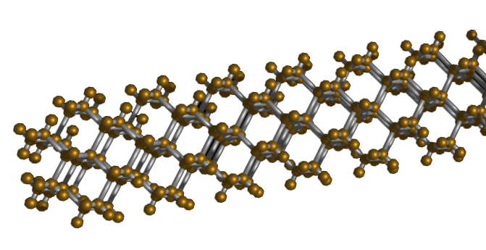
Section 14
Doping
I = G ^{x} V
Materials, composition, crystals
Tabulated for “known” bulk materials
= q ^{x} n ^{x} v ^{x} A
Transport with scattering, non-equilibrium Stat. Mech.
charge
density
velocity
area
Video
14.1 Basic concepts of donors and acceptors
14.2 Statistics of donor and acceptor levels
14.3 Temperature dependence of carrier concentration
14.4 Multiple doping, co-doping, and heavy-doping
  Need to “move” the Fermi level
  ”add” electrons – n-type doping – E_{F} close to E_{c}
  “add” holes – p-type doping – E_{F} close to E_{v}
Video
Video
semiconductor
Video
https://commons.wikimedia.org/wiki/File:Band_filling_diagram.svg

Slide 8
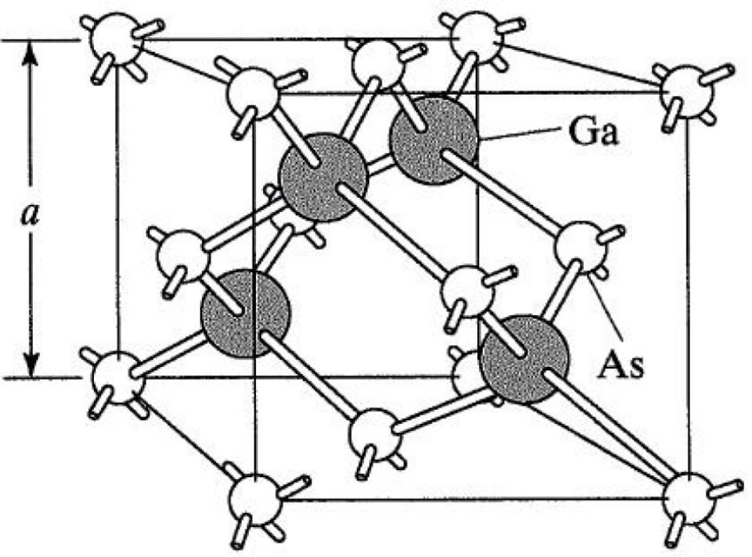
Simplified Planar View of Atoms

Slide 9
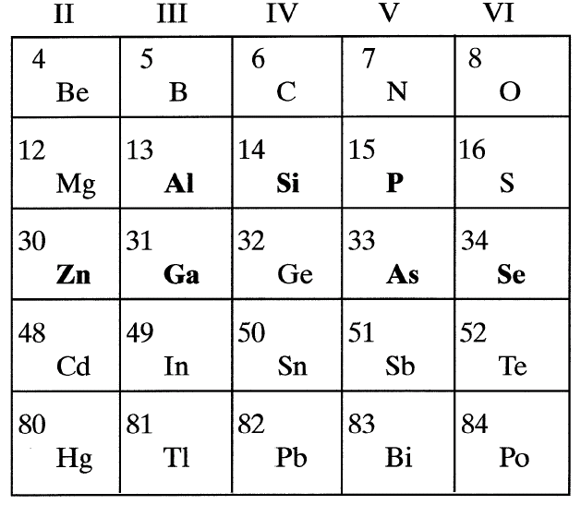
Donor Atoms
Even with donors, material
is charge neutral

Slide 10
Donor Atoms in H2-analogy
=
r₀
+
=
r₀

Slide 11
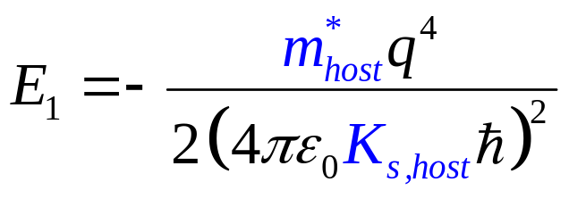
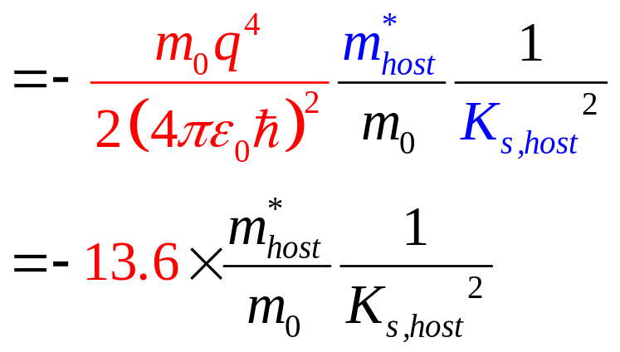
Donor Atoms in Real and Energy Space
~10s meV
E_{T}=E₁
1/β~k_{B}T~25meV at T=300K
r₀

Slide 12
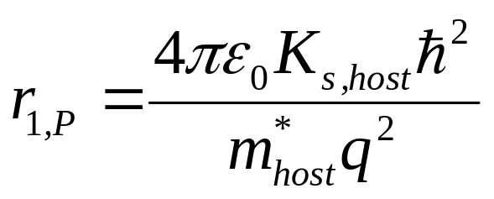
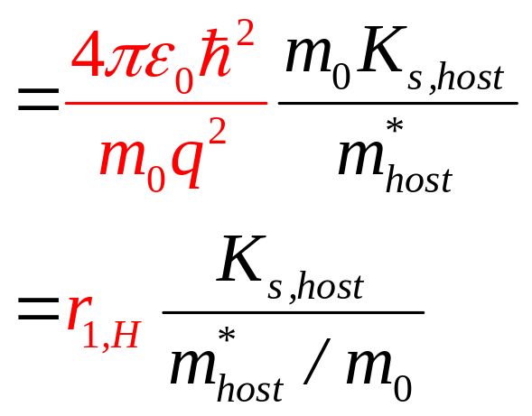
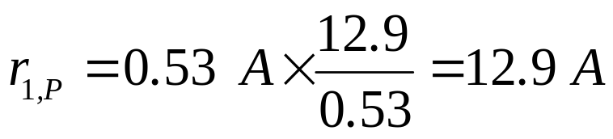
Assumption of Large Radius …
~10s meV
E_{T}=E₁
1/β~k_{B}T~25meV at T=300K
r₀
a~0.5nm=5A => hundreds of Si atoms

Slide 13
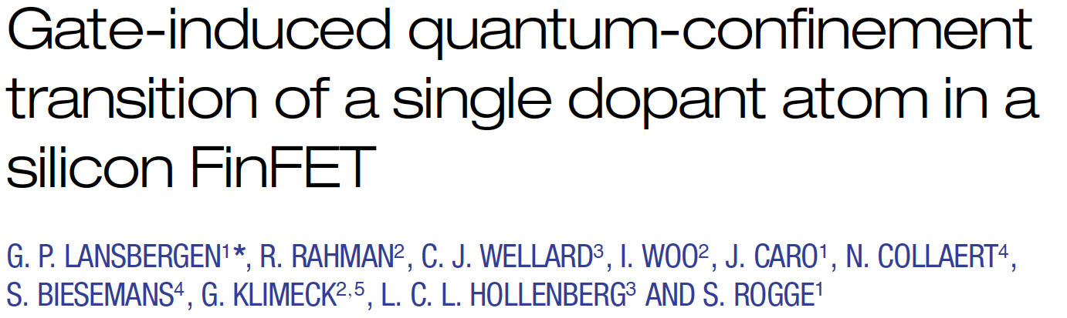
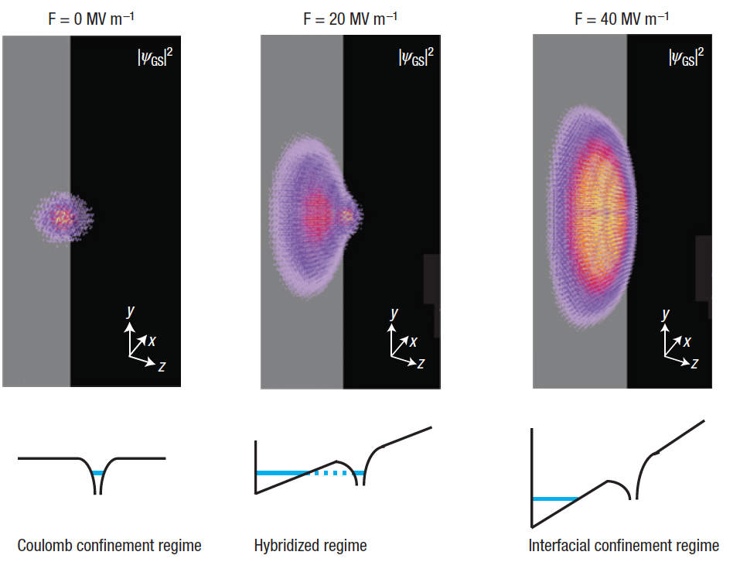
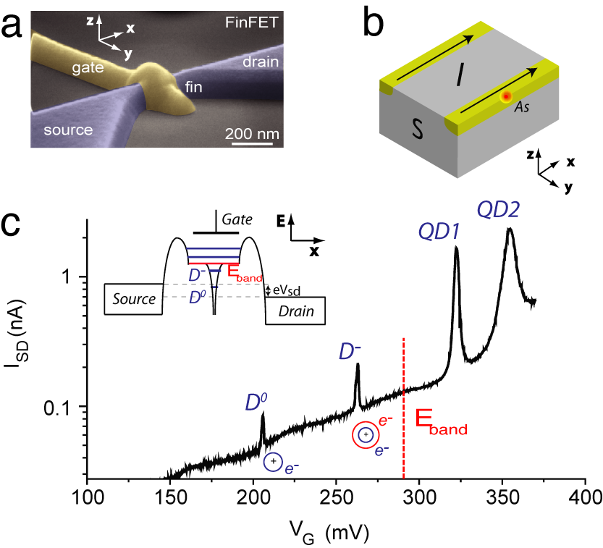

Single Impurity / Donor in a modern FinFET
~10s meV
E_{T}=E₁
a~0.5nm=5A => hundreds of Si atoms
1/β~k_{B}T~25meV at T=300K
r₀

Slide 14
Single Impurity / Donor in a modern FinFET
E_{T}=E₁
a~0.5nm=5A => hundreds of Si atoms
r₀

Slide 15
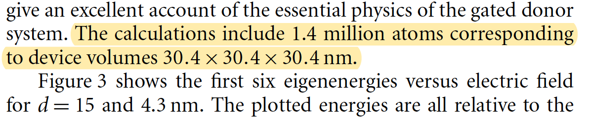
Single Impurity / Donor in a modern FinFET
E_{T}=E₁
a~0.5nm=5A => hundreds of Si atoms
r₀

Slide 16

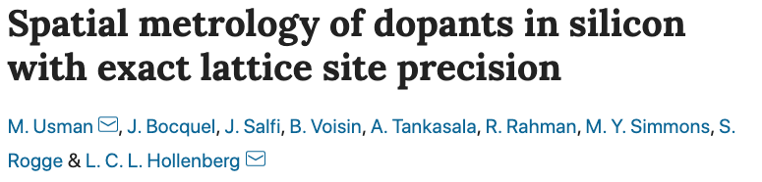
Measurement of Donor Wavefunctions
a~0.5nm=5A => hundreds of Si atoms
E_{T}=E₁
r₀
Usman, M., Bocquel, J., Salfi, J. et al. Spatial metrology of dopants in silicon with exact lattice site precision. Nature Nanotech 11, 763–768 (2016). https://doi.org/10.1038/nnano.2016.83

Slide 17
Measurement of Donor Wavefunctions
a~0.5nm=5A => hundreds of Si atoms
E_{T}=E₁
r₀
Usman, M., Bocquel, J., Salfi, J. et al. Spatial metrology of dopants in silicon with exact lattice site precision. Nature Nanotech 11, 763–768 (2016). https://doi.org/10.1038/nnano.2016.83

Slide 18
Measurement of Donor Wavefunctions
E_{T}=E₁
a~0.5nm=5A => hundreds of Si atoms
r₀
Usman, M., Bocquel, J., Salfi, J. et al. Spatial metrology of dopants in silicon with exact lattice site precision. Nature Nanotech 11, 763–768 (2016). https://doi.org/10.1038/nnano.2016.83

Slide 19
Characteristics of Donor Atoms
The number of donor atoms is much smaller compared to host atoms. Therefore, the electrons from one donor atom can go to the other donor atoms only via the conduction /valence bands of the host crystal.
Just like a Hydrogen atom, it is possible to have multiple localized level for a given atom (see the blue levels).
Good donors live close to the conduction band, so that they can offer electrons easily. However, if they are below the midgap, the donor levels are marked with (D) to differentiate them from acceptor atoms (which live close to the valence band).
E_{T}=E₁
(D)
r₀

Slide 20
Acceptor Atoms
Even with acceptor, material
is charge neutral
r₀

Slide 21
Characteristics of Acceptor Atoms
E_{T}
A
r₀

Slide 22
Amphoteric Dopants
Donor-type
acceptor-type
r₀

Slide 23
Table of Donors and Acceptors
r₀

Slide 24
Conclusion
Intrinsic carrier concentration is so small that semiconductor must be doped to make it useful.
A doping atom behaves like a H-atom, except that the dielectric constant and effective masses are given by by those of the host atom.
r₀

Slide 25
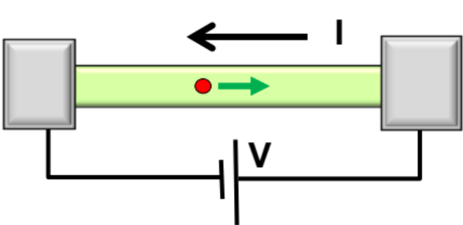
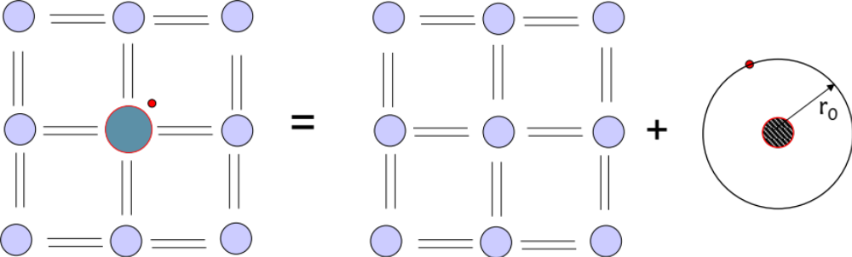
Section 14
Doping
Not Enough Electrons available
I = G ^{x} V
= q ^{x} n ^{x} v ^{x} A
charge
density
velocity
area
14.1 Basic concepts of donors and acceptors
14.2 Statistics of donor and acceptor levels
14.3 Temperature dependence of carrier concentration
14.4 Multiple doping, co-doping, and heavy-doping
  Need to “move” the Fermi level
  ”add” electrons – n-type doping – E_{F} close to E_{c}
  “add” holes – p-type doping – E_{F} close to E_{v}
=
r₀
Video
A doping atom behaves like a H-atom, except that the dielectric constant and effective masses are given by by those of the host atom.
Video
Video
Video

Slide 26
Section 14
Doping
Not Enough Electrons available
I = G ^{x} V
= q ^{x} n ^{x} v ^{x} A
charge
density
velocity
area
14.1 Basic concepts of donors and acceptors
14.2 Statistics of donor and acceptor levels
14.3 Temperature dependence of carrier concentration
14.4 Multiple doping, co-doping, and heavy-doping
  Need to “move” the Fermi level
  ”add” electrons – n-type doping – E_{F} close to E_{c}
  “add” holes – p-type doping – E_{F} close to E_{v}
=
r₀
Video
A doping atom behaves like a H-atom, except that the dielectric constant and effective masses are given by by those of the host atom.
Video
Video
Video

Slide 27
Section 14
Doping
Solid State Devices
14.2 Statistics of donor and acceptor levels

Slide 28
Section 14
Doping
Not Enough Electrons available
I = G ^{x} V
= q ^{x} n ^{x} v ^{x} A
charge
density
velocity
area
14.1 Basic concepts of donors and acceptors
14.2 Statistics of donor and acceptor levels
14.3 Temperature dependence of carrier concentration
14.4 Multiple doping, co-doping, and heavy-doping
  Need to “move” the Fermi level
  ”add” electrons – n-type doping – E_{F} close to E_{c}
  “add” holes – p-type doping – E_{F} close to E_{v}
=
r₀
Video
A doping atom behaves like a H-atom, except that the dielectric constant and effective masses are given by by those of the host atom.
Video
Video
Video

Slide 29
Localized vs. Band Electrons
E6 ← 12π/L_{x}
Two electrons (even with
opposite spin) can not
be at the same position
and same energy because
of electrostatic repulsion
E5 ← 10π/L_{x}
E4 ← 8π/L_{x}
E3 ← 6π/L_{x}
E2 ← 4π/L_{x}
E1 ← 2π/L_{x}
Lx
Band electrons (with
opposite spin) need not
be at the same position,
so they can share occupy
same energy level.
E3’ ← 6π/(L_{x}/2)
E2’ ← 4π/(L_{x}/2)
E1’ ← 2π/(L_{x}/2)
When we divide space by a factor of 2, the number of states (e.g. 6 here) does not change.
L_{x}/2
L_{x}/2

Slide 30
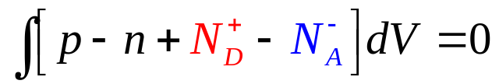

Looking ahead: Carrier-Density w/Doping
A bulk material must be charge neutral over all …
Further if the material is spatially homogenous
Let us see how the formula comes about …

Slide 31
Characteristics of Donor Atoms
r₀
(D)
E_{T}

Slide 32
Localized vs. Delocalized States
2N states/per-band (with spin)
r₀
2N-2 states/per-band (with spin)

Slide 33
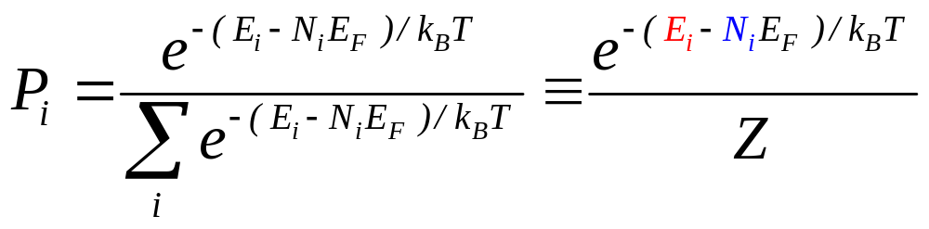
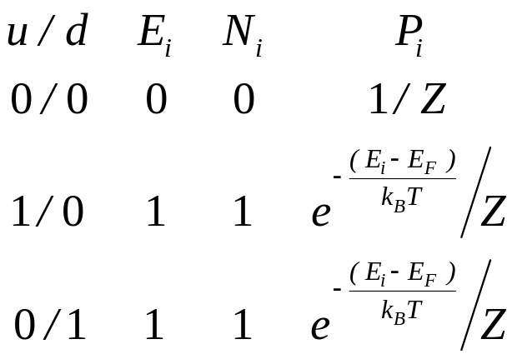
Statistics of Donor Levels

Slide 34
Statistics of Donor Levels
1/1 x x x
Coulomb interaction
forbids this configuration

Slide 35
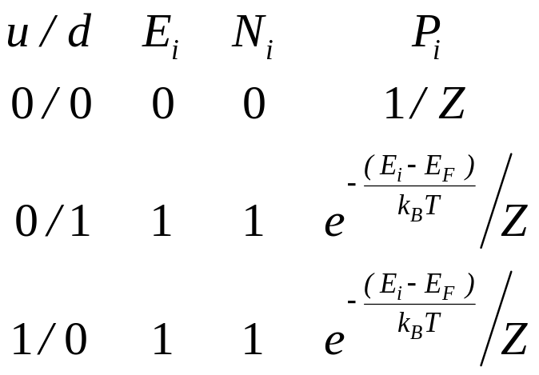
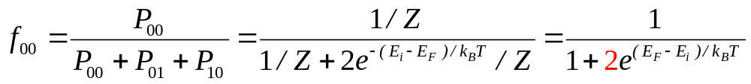
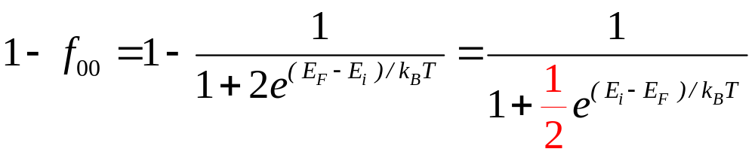
Statistics of Donor Levels
Probability that the donor
is empty (charged)
Probability that the donor
is filled with at least
one electron (neutral)
Note the extra factor ….

Slide 36
Acceptor Atoms
State [1] …. Hole present … N-1 charges
State [0] … Hole filled …. N charges

Slide 37
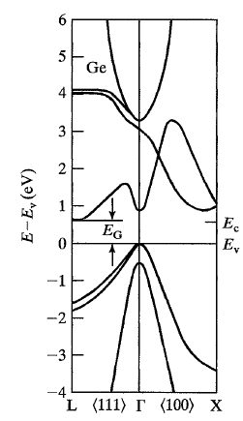
Statistics of Acceptor Levels in Si and Ge
1. Each atom contributes 2 states (up & down spin)
  to a band, therefore a band has 2N states.
2. Every time a host atom is replaced by a impurity atom, 2 states are disappear per a band and
  appear as localized states (sort of).
3. Therefore an acceptor atom close to hh and lh bands removes four states from those bands.
4. Because of Coulomb interaction only 1 hole can seat in these 4 states: the states are
  0000, 0001, 0010, 0100, 1000.
5. One now uses P_{i} to compute the occupation of acceptors.
E_{C}
from lh
from hh
E_{V}

Slide 38
Number and Energy Considerations …
0000 1000 0100 0010 0001
4N-4 States
In HH/LH bands
[0000] is the charged state as it has N electrons, but N-1 protons.
Single hole configuration [0001] is uncharged, as we have N-1 electrons, and N-1 protons … same is true for [0010], [0100], [1000] states.
Going from [0000] to [0001] states, the number of electrons goes down by 1 (N_{i}=-1).
Going from [0000] to [0001] states energy goes down by –E_{A}, because one electron is no longer occupying the high energy level at E_{A}.

Slide 39
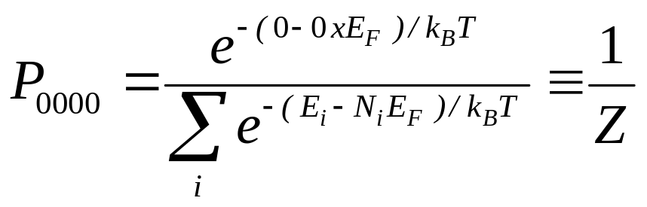
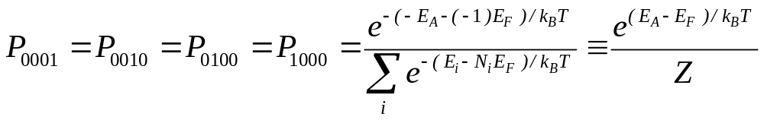
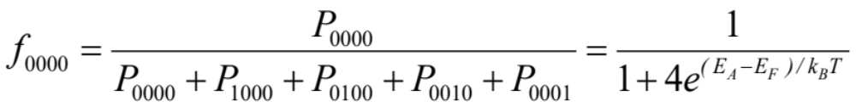
Statistics of Acceptor Levels
0000 1000 0100 0010 0001
Steps 3 & 4
2N-2 states
00 10 01

Slide 40
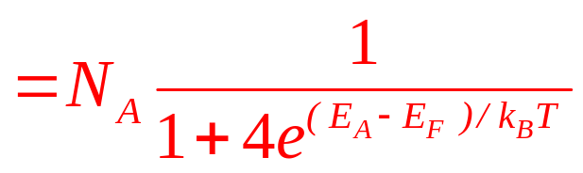
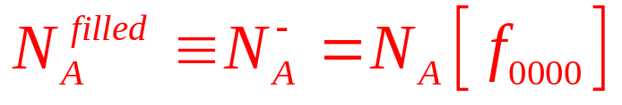
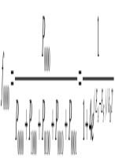
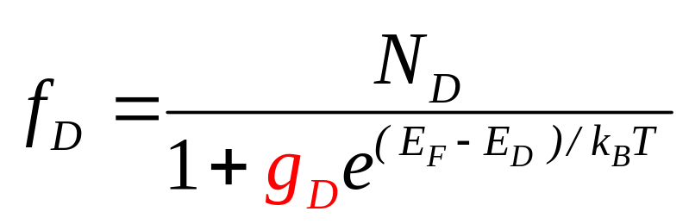
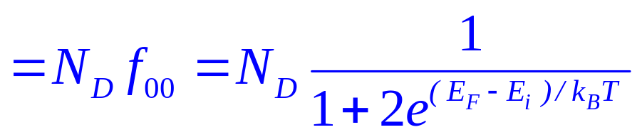
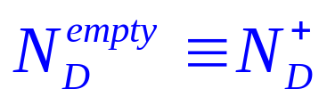
Filled and empty Donor/Acceptor Levels
0000 1000 0100 0010 0001
4N-4 States
In HH/LH bands
(Two holes can not seat together)
2N-2 states
00 10 01

Slide 41
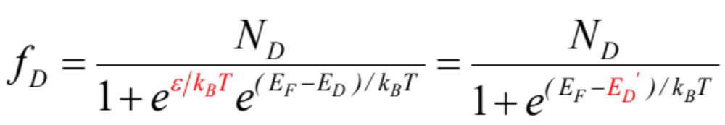
Distributions are physical …. Define an effective donor level
Degeneracy factor …
Effective donor level

Slide 42
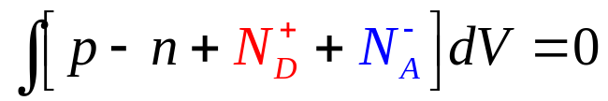

Carrier-density with Uniform Doping
A bulk material must be charge neutral over all …
Further if the doping is spatially homogenous
FD integral vs. FD function ?
(approx.)
Once you know E_{F}, you can calculate n, p, N_{D}⁺, N_{A}⁻.

Slide 43
Summary …
A bulk material must be charge neutral over all …
Further if the material is spatially homogenous

Slide 44

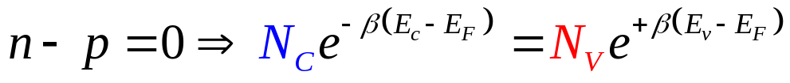
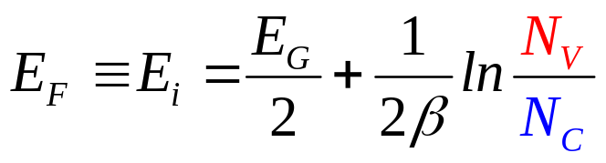
Intrinsic Concentration

Slide 45
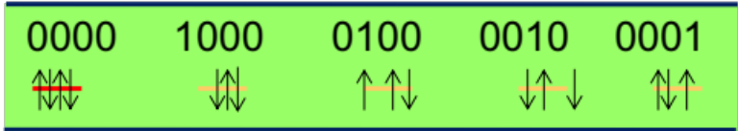
Section 14
Doping
I = G ^{x} V
= q ^{x} n ^{x} v ^{x} A
charge
density
velocity
area
14.1 Basic concepts of donors and acceptors
14.2 Statistics of donor and acceptor levels
14.3 Temperature dependence of carrier concentration
14.4 Multiple doping, co-doping, and heavy-doping
Video
  Need to “move” the Fermi level
  ”add” electrons – n-type doping – E_{F} close to E_{c}
  “add” holes – p-type doping – E_{F} close to E_{v}
=
r₀
Video
Video
Video

Slide 46
Section 14
Doping
I = G ^{x} V
= q ^{x} n ^{x} v ^{x} A
charge
density
velocity
area
14.1 Basic concepts of donors and acceptors
14.2 Statistics of donor and acceptor levels
14.3 Temperature dependence of carrier concentration
14.4 Multiple doping, co-doping, and heavy-doping
Video
  Need to “move” the Fermi level
  ”add” electrons – n-type doping – E_{F} close to E_{c}
  “add” holes – p-type doping – E_{F} close to E_{v}
=
r₀
Video
Video
Video

Slide 47
Section 14
Doping
Solid State Devices
14.3 Temperature dependence of carrier concentration

Slide 48
Section 14
Doping
I = G ^{x} V
= q ^{x} n ^{x} v ^{x} A
charge
density
velocity
area
14.1 Basic concepts of donors and acceptors
14.2 Statistics of donor and acceptor levels
14.3 Temperature dependence of carrier concentration
14.4 Multiple doping, co-doping, and heavy-doping
Video
  Need to “move” the Fermi level
  ”add” electrons – n-type doping – E_{F} close to E_{c}
  “add” holes – p-type doping – E_{F} close to E_{v}
=
r₀
Video
Video
Video

Slide 49
Carrier Density with Donors
In spatially homogenous field-free region …
Assume
N-type doping …
n
(will plot in next slide)

Slide 50
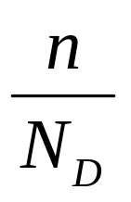
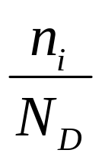
Temperature-dependent Concentration
Freeze
out
Intrinsic
Extrinsic
1
Temperature

Slide 51
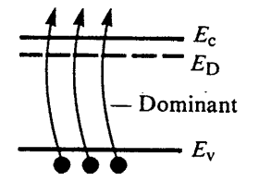
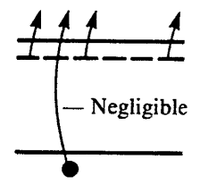
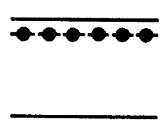
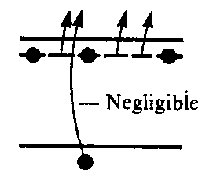
Physical Interpretation
Freeze
out
Intrinsic
Extrinsic
1
Temperature

Slide 52
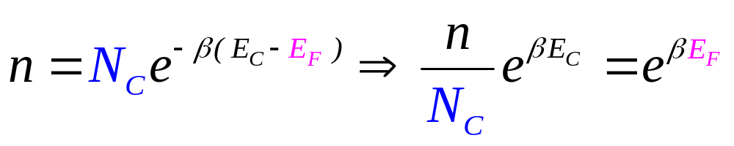
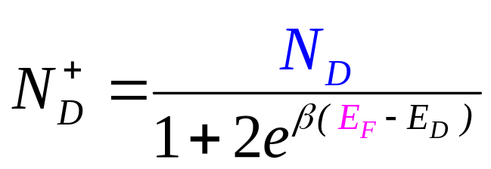
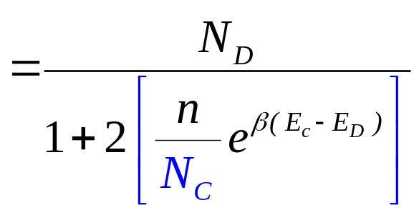
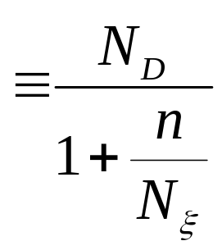
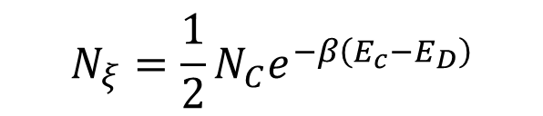
Electron Concentration with Donors
$$N_{ξ}=\frac{1}{2}N_{C}e^{−β\left(E_{c}−E_{D}\right)}$$

Slide 53

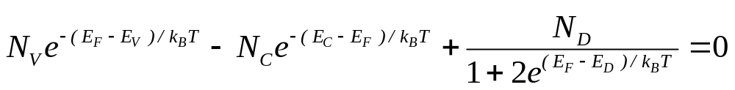



Electron concentration with Donors
$$N_{ξ}=\frac{1}{2}N_{C}e^{−β\left(E_{c}−E_{D}\right)}$$
No approximation so far ….

Slide 54






High Donor Density / Freeze out T
$$N_{D}≈n≫n_{i}$$
Freeze
out
Intrinsic
Extrinsic
1
Temperature
$$N_{ξ}=\frac{1}{2}N_{C}e^{−β\left(E_{c}−E_{D}\right)}$$

Slide 55




Extrinsic T
$$N_{ξ}=\frac{1}{2}N_{C}e^{−β\left(E_{c}−E_{D}\right)}$$
$${Assume: N}_{ξ}≫ N_{D}$$
Freeze
out
Intrinsic
Extrinsic
1
Temperature
Electron concentration equals donor density
hole concentration by nxp=n_{i}²

Slide 56





Intrinsic T
0
Freeze
out
Intrinsic
Extrinsic
1
Temperature

Slide 57




Extrinsic/Intrinsic T
$${Assume: N}_{D}≫ n_{i}$$
Freeze
out
Intrinsic
Extrinsic
1
$${Assume: N}_{D}≪ n_{i}$$
Temperature
What will happen if you use silicon circuits at very high temperatures ?
Bandgap determines the intrinsic carrier density.

Slide 58



Determination of Fermi-level
Freeze
out
Intrinsic
Extrinsic
1
Temperature

Slide 59
Section 14
Doping
I = G ^{x} V
= q ^{x} n ^{x} v ^{x} A
charge
density
velocity
area
14.1 Basic concepts of donors and acceptors
14.2 Statistics of donor and acceptor levels
14.3 Temperature dependence of carrier concentration
14.4 Multiple doping, co-doping, and heavy-doping
Video
  Need to “move” the Fermi level
  ”add” electrons – n-type doping – E_{F} close to E_{c}
  “add” holes – p-type doping – E_{F} close to E_{v}
=
r₀
Video
Freeze
out
Intrinsic
Extrinsic
1
Video
Video
Temperature

Slide 60
Section 14
Doping
I = G ^{x} V
= q ^{x} n ^{x} v ^{x} A
charge
density
velocity
area
14.1 Basic concepts of donors and acceptors
14.2 Statistics of donor and acceptor levels
14.3 Temperature dependence of carrier concentration
14.4 Multiple doping, co-doping, and heavy-doping
Video
  Need to “move” the Fermi level
  ”add” electrons – n-type doping – E_{F} close to E_{c}
  “add” holes – p-type doping – E_{F} close to E_{v}
=
r₀
Video
Freeze
out
Intrinsic
Extrinsic
1
Video
Video
Temperature

Slide 61
Section 14
Doping
Solid State Devices
14.4 Multiple doping, co-doping, and heavy-doping

Slide 62
Section 14
Doping
I = G ^{x} V
= q ^{x} n ^{x} v ^{x} A
charge
density
velocity
area
14.1 Basic concepts of donors and acceptors
14.2 Statistics of donor and acceptor levels
14.3 Temperature dependence of carrier concentration
14.4 Multiple doping, co-doping, and heavy-doping
Video
  Need to “move” the Fermi level
  ”add” electrons – n-type doping – E_{F} close to E_{c}
  “add” holes – p-type doping – E_{F} close to E_{v}
=
r₀
Video
Freeze
out
Intrinsic
Extrinsic
1
Video
Video
Temperature

Slide 63


Multiple Donor Levels
Multiple levels of same donor …
Codoping…

Slide 64
Heavy Doping Effects: Bandtail States
E
k
E
k ?

Slide 65

Heavy Doping Effects: Hopping Conduction
E
E
Bandgap narrowing
k
K?
e.g. Base of HBTs
Band transport
vs.
hopping-transport
e.g. a-silicon, OLED

Slide 66
Conclusions
Charge neutrality condition and law of mass-action allows calculation of Fermi-level and all carrier concentration.
For semiconductors with field, charge neutrality will not hold and we will need to use Poisson equation.
Heaving doping effects play an important role in carrier transport.

Slide 67

Section 14
Doping
I = G ^{x} V
= q ^{x} n ^{x} v ^{x} A
charge
density
velocity
area
14.1 Basic concepts of donors and acceptors
14.2 Statistics of donor and acceptor levels
14.3 Temperature dependence of carrier concentration
14.4 Multiple doping, co-doping, and heavy-doping
Video
  Need to “move” the Fermi level
  ”add” electrons – n-type doping – E_{F} close to E_{c}
  “add” holes – p-type doping – E_{F} close to E_{v}
=
r₀
Video
Video
Video

