Slide 1
Section 13
Band Diagrams
Solid State Devices

Slide 2

Section 13
Band Diagrams
I
I = G ^{x} V
= q ^{x} n ^{x} v ^{x} A
V
charge
density
velocity
area
Materials, composition, crystals
Tabulated for “known” bulk materials
At nm-scale properties change with geometry => theory
Quantum Mechanics Mechanics
Concepts of density of states and masses
Equilibrium Statistical Mechanics
Occupation factors
Transport with scattering, non-equilibrium Stat. Mech.
Drift-diffusion equation with recombination-generation
Understanding transport in concrete devices
Diodes, BJT/HBT, MOS

Slide 3
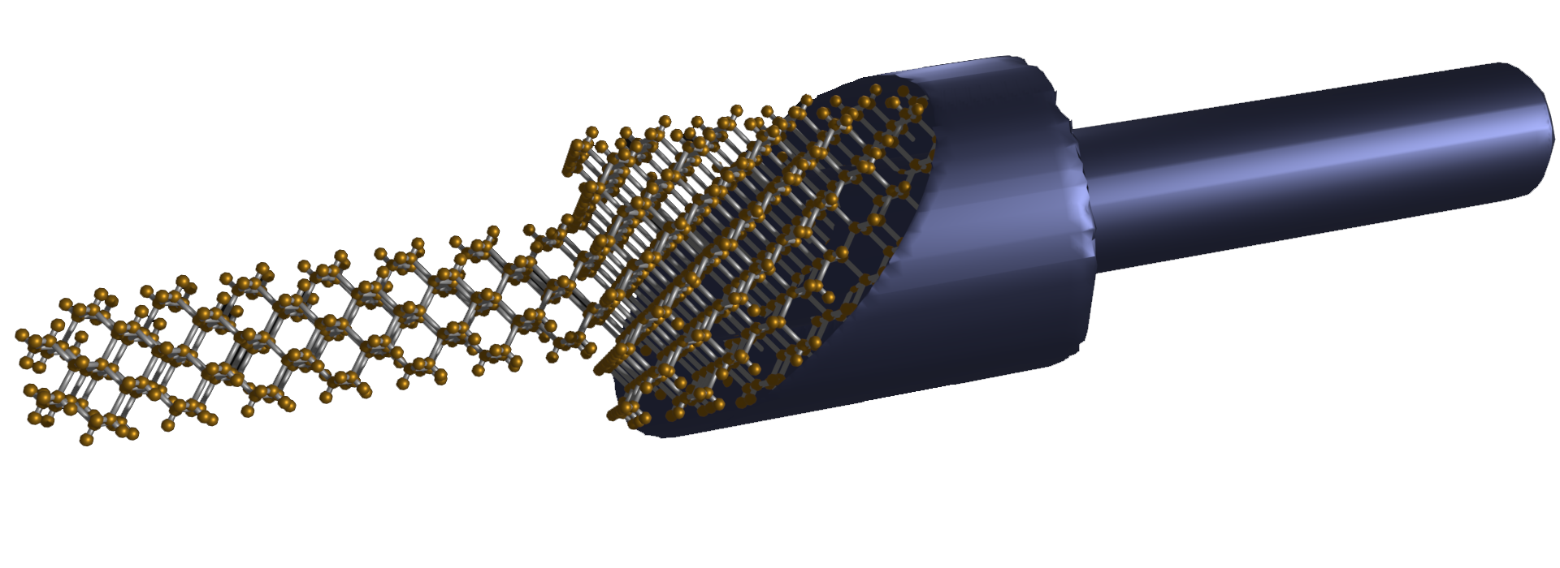
Section 13
Band Diagrams
I
I = G ^{x} V
= q ^{x} n ^{x} v ^{x} A
V
charge
density
velocity
area
Materials, composition, crystals
Tabulated for “known” bulk materials
At nm-scale properties change with geometry => theory
Quantum Mechanics Mechanics
Concepts of density of states and masses
Equilibrium Statistical Mechanics
Occupation factors
Transport with scattering, non-equilibrium Stat. Mech.
Drift-diffusion equation with recombination-generation
Understanding transport in concrete devices
Diodes, BJT/HBT, MOS

Slide 4
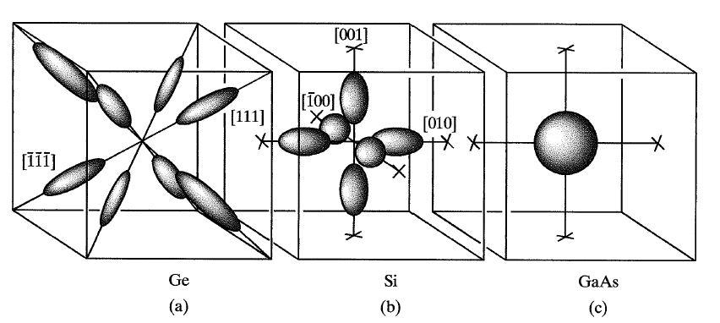
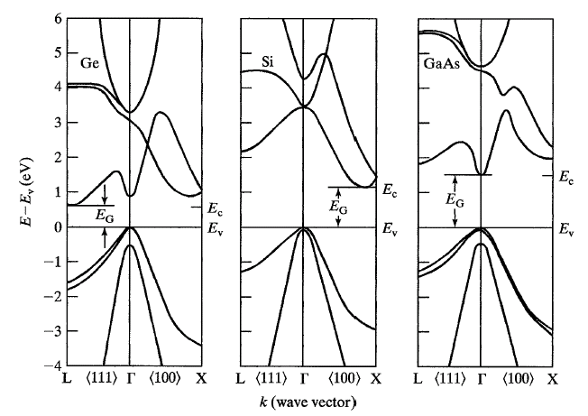
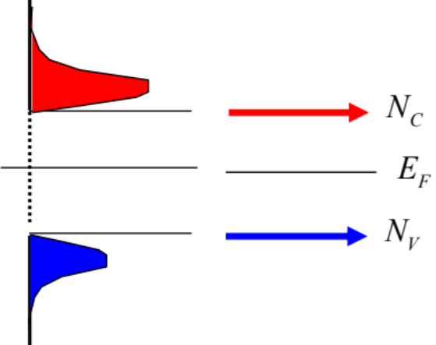
Section 13
Band Diagrams
I
I = G ^{x} V
= q ^{x} n ^{x} v ^{x} A
V
charge
density
velocity
area
Materials, composition, crystals
Tabulated for “known” bulk materials
At nm-scale properties change with geometry => theory
Quantum Mechanics Mechanics
Concepts of density of states and masses
Equilibrium Statistical Mechanics
Occupation factors
Transport with scattering, non-equilibrium Stat. Mech.
Drift-diffusion equation with recombination-generation
Understanding transport in concrete devices
Diodes, BJT/HBT, MOS

Slide 5
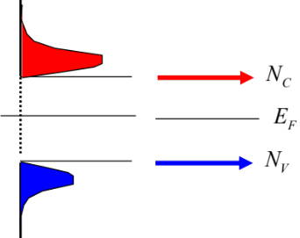

Section 13
Band Diagrams
I
I = G ^{x} V
= q ^{x} n ^{x} v ^{x} A
V
charge
density
velocity
area
Materials, composition, crystals
Tabulated for “known” bulk materials
At nm-scale properties change with geometry => theory
Quantum Mechanics Mechanics
Concepts of density of states and masses
Equilibrium Statistical Mechanics
Occupation factors
Transport with scattering, non-equilibrium Stat. Mech.
Drift-diffusion equation with recombination-generation
Understanding transport in concrete devices
Diodes, BJT/HBT, MOS

Slide 6
Section 13
Band Diagrams
I = G ^{x} V
= q ^{x} n ^{x} v ^{x} A
charge
density
velocity
area
Materials, composition, crystals
Tabulated for “known” bulk materials
At nm-scale properties change with geometry => theory
Quantum Mechanics Mechanics
Concepts of density of states and masses
Equilibrium Statistical Mechanics
Occupation factors
I
Transport with scattering, non-equilibrium Stat. Mech.
Drift-diffusion equation with recombination-generation
V
Understanding transport in concrete devices
Diodes, BJT/HBT, MOS

Slide 7
Section 13
Band Diagrams
I = G ^{x} V
= q ^{x} n ^{x} v ^{x} A
charge
density
velocity
area
Materials, composition, crystals
Tabulated for “known” bulk materials
At nm-scale properties change with geometry => theory
Quantum Mechanics Mechanics
Concepts of density of states and masses
Equilibrium Statistical Mechanics
Occupation factors
I
Transport with scattering, non-equilibrium Stat. Mech.
Drift-diffusion equation with recombination-generation
V
Understanding transport in concrete devices
Diodes, BJT/HBT, MOS

Slide 8
Section 13
Band Diagrams
I = G ^{x} V
= q ^{x} n ^{x} v ^{x} A
charge
density
velocity
area
Materials, composition, crystals
Tabulated for “known” bulk materials
At nm-scale properties change with geometry => theory
Quantum Mechanics Mechanics
Concepts of density of states and masses
Equilibrium Statistical Mechanics
Occupation factors
I
Transport with scattering, non-equilibrium Stat. Mech.
Drift-diffusion equation with recombination-generation
V
Understanding transport in concrete devices
Diodes, BJT/HBT, MOS

Slide 9
E-k Diagram
V

Slide 10


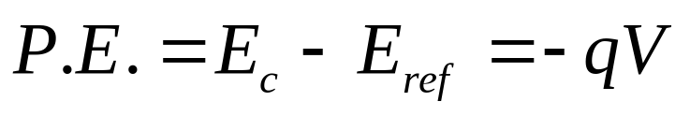
E-k Diagram
V
Potential
Energy
Kinetic energy

Slide 11
Position Resolved E-k Diagram

Slide 12
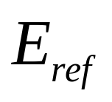
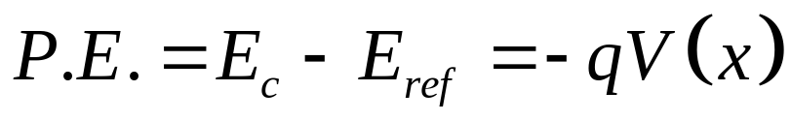
Position Resolved E-k Diagram with Applied Potential
V=0
V=V₁

Slide 13
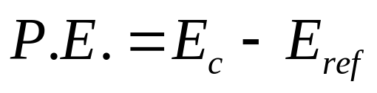
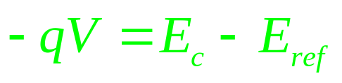
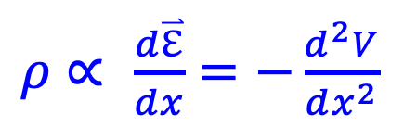
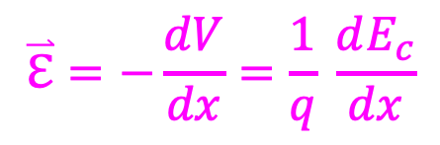
Position Resolved E-k Diagram with Applied Potential,
Potential, Field, and Charge
$$\overset{⃑}{ℇ}=−\frac{dV}{dx}=\frac{1}{q} \frac{dE_{c}}{dx}$$
$ρ$ $∝$ $\frac{d\overset{⃑}{ℇ}}{dx}=−\frac{d^{2}V}{dx^{2}}$
In most practical cases start from charge and derive potentials!
=> Useful to learn “graphical” integration

Slide 14
Position Resolved E-k Diagram with Applied Potential,
Potential, Field, and Charge
Can we replace the E(k) with a compact representation?
Band Diagram!
We will use that throughout the rest of the course!
$$\overset{⃑}{ℇ}=−\frac{dV}{dx}=\frac{1}{q} \frac{dE_{c}}{dx}$$
$ρ$ $∝$ $\frac{d\overset{⃑}{ℇ}}{dx}=−\frac{d^{2}V}{dx^{2}}$
In most practical cases start from charge and derive potentials!
=> Useful to learn “graphical” integration

Slide 15

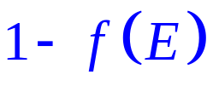
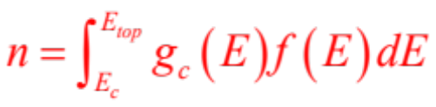

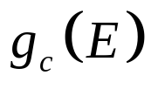
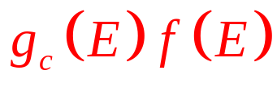



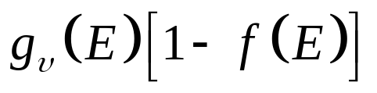

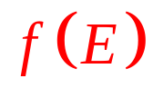
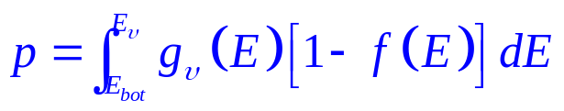
Carrier Distribution => Effective Density of States
Can we replace the E(k) with a compact representation?
DOS
F-D
Charge Distribution
No energy Distribution!
Delta Function Charge
1
As if all states are at a single level E_{C}

Slide 16
Carrier Distribution => Effective Density of States
Why does this work?
n_{i} is of the order of 10¹⁰/cm³ in 10²²/cm³ atoms!
Each atom has ~10-20 electrons
=> ~1 in 10¹³ electrons is mobile
Typical doped devices have 10¹⁸ mobile electrons
=> ~1 in 10⁵ electrons is mobile
=> Do not include the coulomb interactions of
individual free electrons
DOS
F-D
Charge Distribution
No energy Distribution!
Delta Function Charge
1
As if all states are at a single level E_{C}
Consider system to be in local equilibrium

Slide 17


E-k Diagram vs. Band-diagram
V=0
V=V₁
Consider system to be in local equilibrium
All quantum mechanics is now hidden in a single point per band!

Slide 18
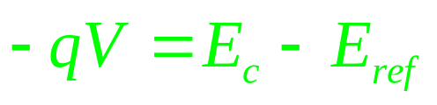
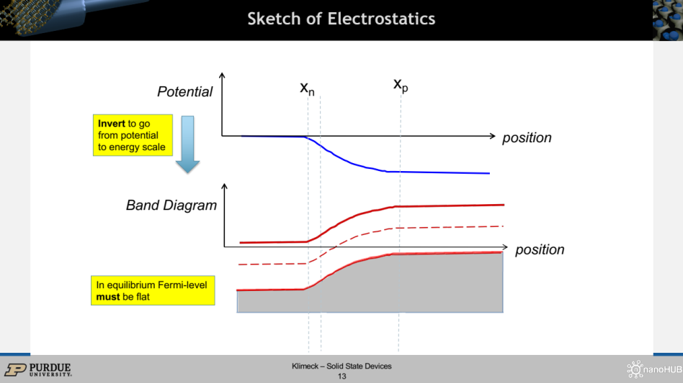
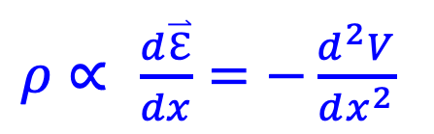
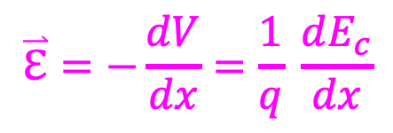
Potential, Field and Charge
Consider system to be in local equilibrium
$$\overset{⃑}{ℇ}=−\frac{dV}{dx}=\frac{1}{q} \frac{dE_{c}}{dx}$$
$ρ$ $∝$ $\frac{d\overset{⃑}{ℇ}}{dx}=−\frac{d^{2}V}{dx^{2}}$
In most practical cases start from charge and derive potentials!
=> Useful to learn “graphical” integration

Slide 19

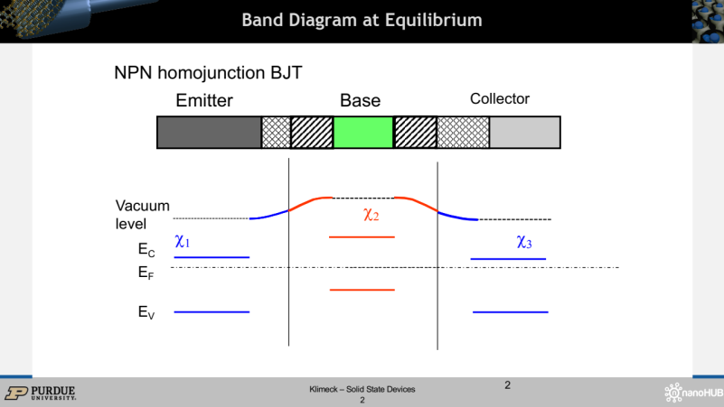
Potential, Field and Charge
$$\overset{⃑}{ℇ}=−\frac{dV}{dx}=\frac{1}{q} \frac{dE_{c}}{dx}$$
$ρ$ $∝$ $\frac{d\overset{⃑}{ℇ}}{dx}=−\frac{d^{2}V}{dx^{2}}$
In most practical cases start from charge and derive potentials!
=> Useful to learn “graphical” integration
Consider system to be in local equilibrium

Slide 20
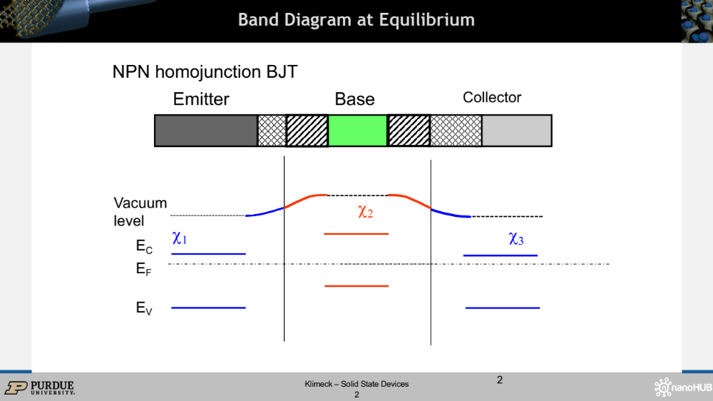
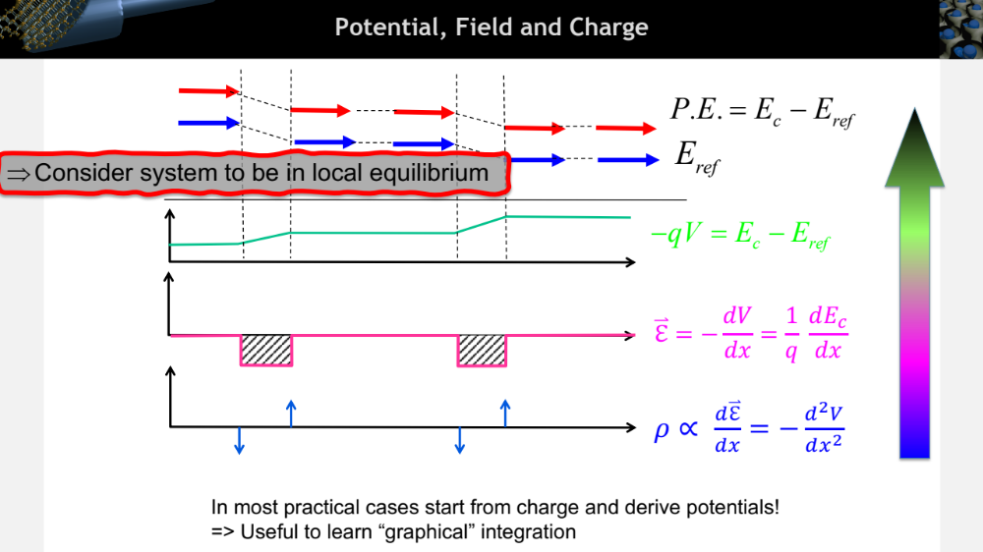
Potential, Field and Charge
$$\overset{⃑}{ℇ}=−\frac{dV}{dx}=\frac{1}{q} \frac{dE_{c}}{dx}$$
$ρ$ $∝$ $\frac{d\overset{⃑}{ℇ}}{dx}=−\frac{d^{2}V}{dx^{2}}$
In most practical cases start from charge and derive potentials!
=> Useful to learn “graphical” integration
Consider system to be in local equilibrium

Slide 21
Section 13
Band Diagrams
I = G ^{x} V
= q ^{x} n ^{x} v ^{x} A
charge
density
velocity
area
Materials, composition, crystals
Tabulated for “known” bulk materials
At nm-scale properties change with geometry => theory
Quantum Mechanics Mechanics
Concepts of density of states and masses
Consider system to be in local equilibrium
Equilibrium Statistical Mechanics
Occupation factors
Transport with scattering, non-equilibrium Stat. Mech.
Drift-diffusion equation with recombination-generation
Understanding transport in concrete devices
Diodes, BJT/HBT, MOS
V

