Slide 1
Section 12
Occupation of States
Solid State Devices

Slide 2

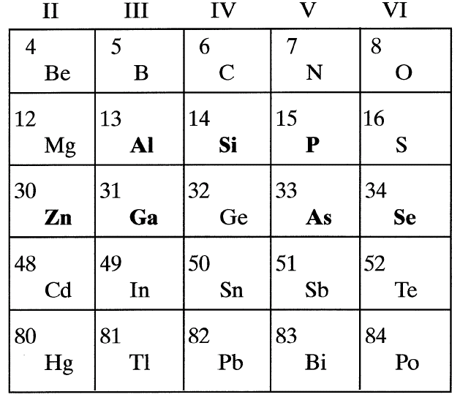
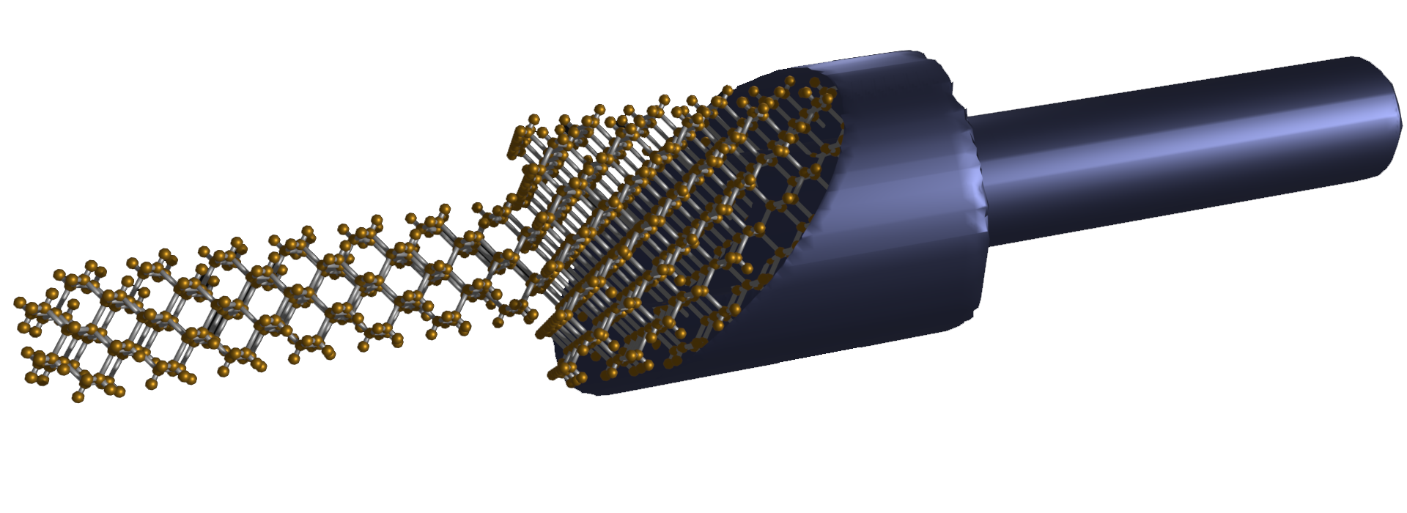
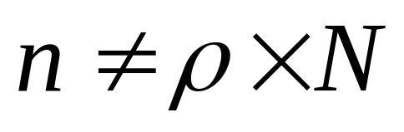
Section 12
Occupation of States
I
I = G ^{x} V
= q ^{x} n ^{x} v ^{x} A
V
charge
density
velocity
area
Number of carriers
available for conduction
Number of
electrons/atoms
Carrier number =
Number of states x filling factor
Number of atoms/volume
from crystal structure
Materials, composition, crystals
Tabulated for “known” bulk materials
At nm-scale properties change with geometry => theory

Slide 3
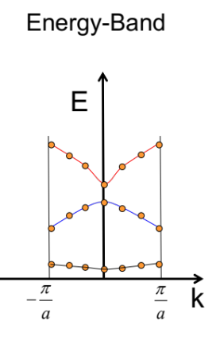
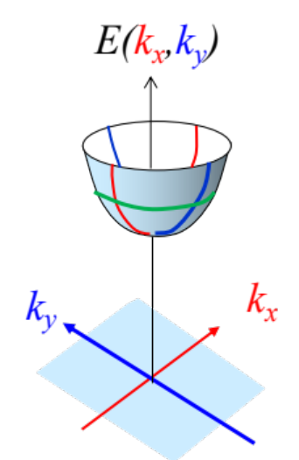
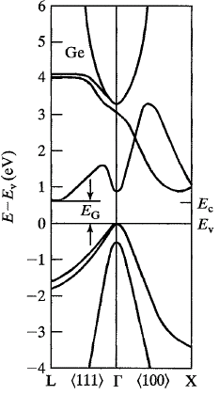
Section 12
Occupation of States
I
I = G ^{x} V
= q ^{x} n ^{x} v ^{x} A
V
charge
density
velocity
area
Number of carriers
available for conduction
Number of
electrons/atoms
Carrier number =
Number of states x filling factor
Number of atoms/volume
from crystal structure
Materials, composition, crystals
Tabulated for “known” bulk materials
At nm-scale properties change with geometry => theory
Quantum Mechanics Mechanics
Concepts of density of states and masses

Slide 4
Section 12
Occupation of States
I
I = G ^{x} V
= q ^{x} n ^{x} v ^{x} A
V
charge
density
velocity
area
Number of carriers
available for conduction
Number of
electrons/atoms
Carrier number =
Number of states x filling factor
Number of atoms/volume
from crystal structure
Materials, composition, crystals
Tabulated for “known” bulk materials
At nm-scale properties change with geometry => theory
Quantum Mechanics Mechanics
Concepts of density of states and masses

Slide 5
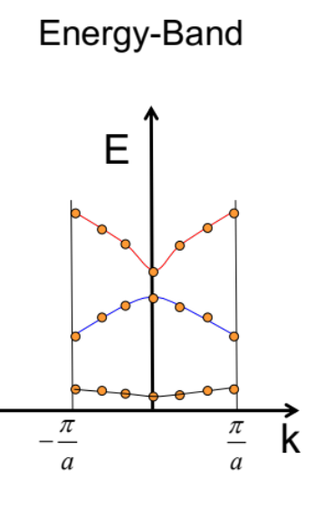
Section 12
Occupation of States
I
I = G ^{x} V
= q ^{x} n ^{x} v ^{x} A
V
charge
density
velocity
area
Number of carriers
available for conduction
Number of
electrons/atoms
Carrier number =
Number of states x filling factor
Number of atoms/volume
from crystal structure
Materials, composition, crystals
Tabulated for “known” bulk materials
At nm-scale properties change with geometry => theory
Quantum Mechanics Mechanics
Concepts of density of states and masses
Equilibrium Statistical Mechanics
Occupation factors

Slide 6
Section 12
Occupation of States
I
I = G ^{x} V
= q ^{x} n ^{x} v ^{x} A
V
charge
density
velocity
area
Materials, composition, crystals
Tabulated for “known” bulk materials
At nm-scale properties change with geometry => theory
Quantum Mechanics Mechanics
Concepts of density of states and masses
Equilibrium Statistical Mechanics
Occupation factors
Transport with scattering, non-equilibrium Statistical Mechanics
Drift-diffusion equation with recombination-generation
Carrier number =
Number of states x filling factor
Understanding transport in concrete devices
Diodes, BJT/HBT, MOS

Slide 7

Section 12
Occupation of States
I
I = G ^{x} V
= q ^{x} n ^{x} v ^{x} A
V
charge
density
velocity
area
Materials, composition, crystals
Tabulated for “known” bulk materials
At nm-scale properties change with geometry => theory
Quantum Mechanics Mechanics
Concepts of density of states and masses
Equilibrium Statistical Mechanics
Occupation factors
12.1 Rules of filling electronic states
12.2 Three Derivations of Fermi-Dirac Statistics
12.3 Intrinsic carrier concentration
Carrier number =
Number of states x filling factor

Slide 8

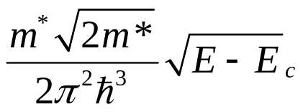
E-k diagram and Electronic States
Density of States
E
E₃
E₂
E₁
g(E)

Slide 9
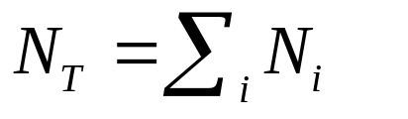
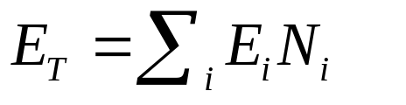
Rules for filling up the States
E₃
E₂
E₁
Pauli Principle: Only one electron per state
Total number of electrons is conserved
Total energy of the system is conserved

Slide 10
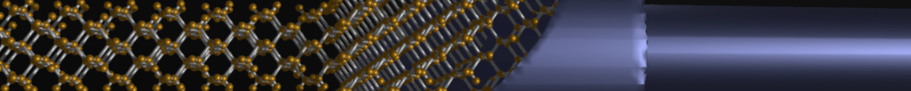
Section 12
Occupation of States
12.1 Rules of filling electronic states
  Pauli exclusion
  Total particle conservation
  Total energy conservation
12.2 Derivation of Fermi-Dirac Statistics: three techniques
  Microcanonical ensemble - statistics
  Detailed Balance – thermal equilibrium & Pauli exclusion
  Partition Function – statistical mechanics
12.3 Intrinsic carrier concentration
  Fermi Integral
  Law of mass action
Carrier number =
Number of states x filling factor
One Video Segment
status
One Video Segment
E₃
E₂
E₁
One Video Segment
Reference: Vol. 6, Ch. 4

Slide 11
Section 12
Occupation of States
12.1 Rules of filling electronic states
  Pauli exclusion
  Total particle conservation
  Total energy conservation
12.2 Derivation of Fermi-Dirac Statistics: three techniques
  Microcanonical ensemble - statistics
  Detailed Balance – thermal equilibrium & Pauli exclusion
  Partition Function – statistical mechanics
12.3 Intrinsic carrier concentration
  Fermi Integral
  Law of mass action
Carrier number =
Number of states x filling factor
One Video Segment
status
One Video Segment
E₃
E₂
E₁
One Video Segment
Reference: Vol. 6, Ch. 4

Slide 12
Section 12
Occupation of States
Solid State Devices
12.2 Derivation of Fermi-Dirac Statistics

Slide 13
Section 12
Occupation of States
12.1 Rules of filling electronic states
  Pauli exclusion
  Total particle conservation
  Total energy conservation
12.2 Derivation of Fermi-Dirac Statistics: three techniques
  Microcanonical ensemble - statistics
  Detailed Balance – thermal equilibrium & Pauli exclusion
  Partition Function – statistical mechanics
12.3 Intrinsic carrier concentration
  Fermi Integral
  Law of mass action
Carrier number =
Number of states x filling factor
One Video Segment
status
One Video Segment
E₃
E₂
E₁
One Video Segment
Reference: Vol. 6, Ch. 4

Slide 14
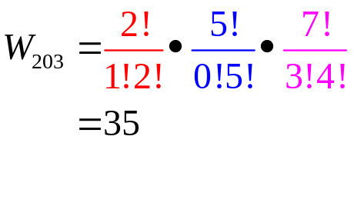
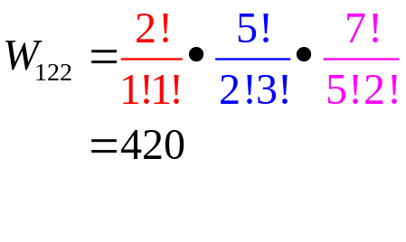
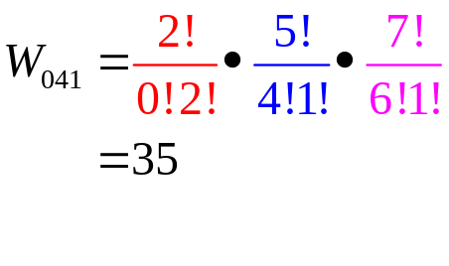
Ensemble of 3 Energy Levels
Particle conservation
Energy conservation
N_{T}=5
E_{T}=12
E=4
E=2
E=0

Slide 15
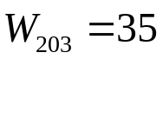
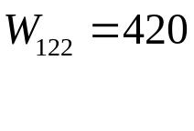
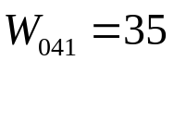
Occupation Statistics
E=4
E=2
E=0
Choose the most
probable configuration.
W (E)
2,0,3 1,2,2 0,4,1

Slide 16
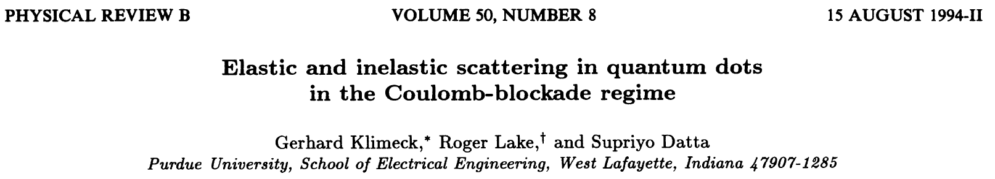
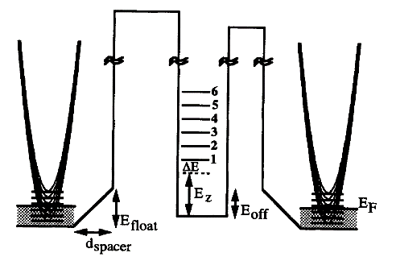
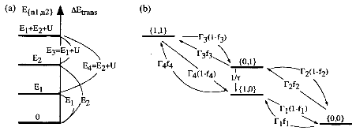
Occupation Statistics
E=4
W (E)
E=2
2,0,3 1,2,2 0,4,1
E=0
Side note:
So far everything shown here is EXACT!
No approximations on the occupation probability!
=> direct application to
nano-scale electronics!
Coulomb blockage
Single electronics

Slide 17
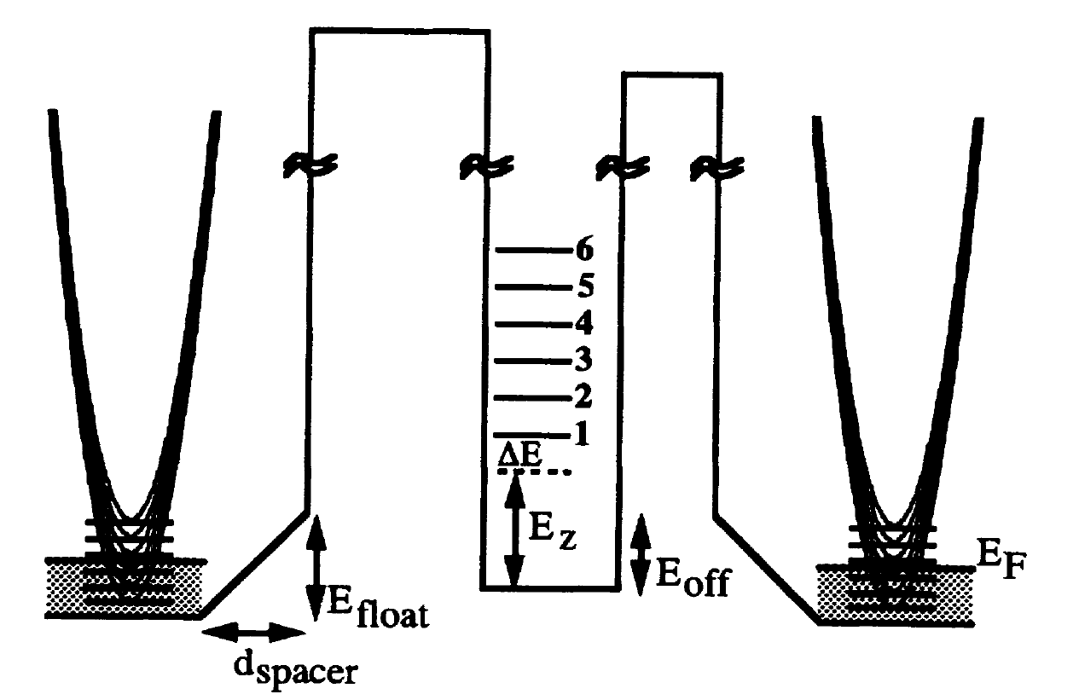
Occupation Statistics
E=4
W (E)
E=2
2,0,3 1,2,2 0,4,1
E=0
Side note:
So far everything shown here is EXACT!
No approximations on the occupation probability!
=> direct application to
nano-scale electronics!
Coulomb blockage
Single electronics

Slide 18
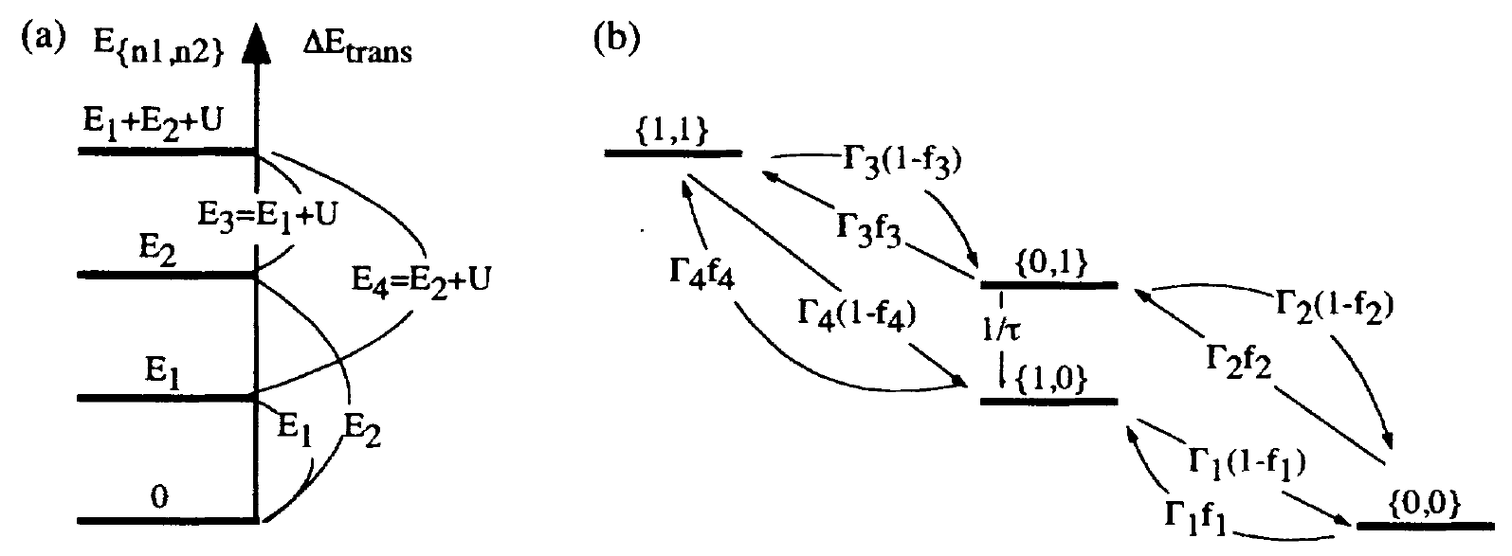
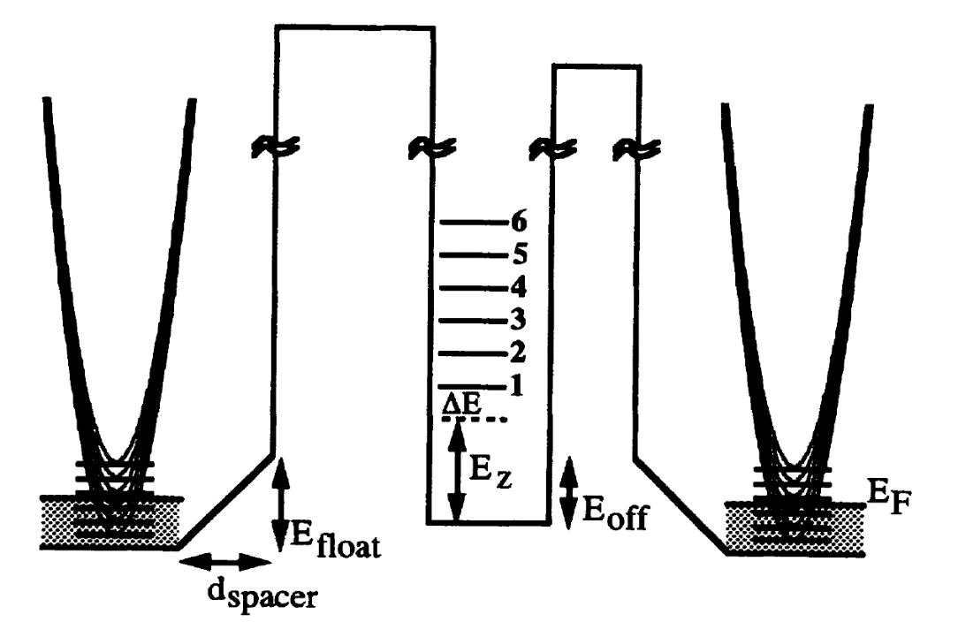
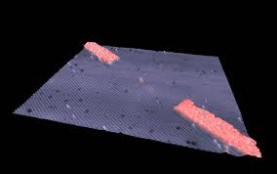
Occupation Statistics
E=4
W (E)
E=2
2,0,3 1,2,2 0,4,1
E=0
Side note:
So far everything shown here is EXACT!
No approximations on the occupation probability!
=> direct application to
nano-scale electronics!
Coulomb blockage
Single electronics

Slide 19

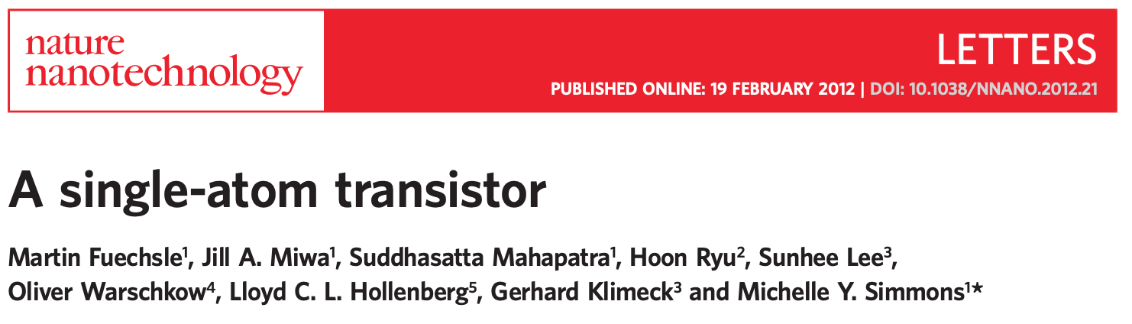
Occupation Statistics
E=4
W (E)
E=2
2,0,3 1,2,2 0,4,1
E=0
Side note:
So far everything shown here is EXACT!
No approximations on the occupation probability!
=> direct application to
nano-scale electronics!
Coulomb blockage
Single electronics

Slide 20
Occupation Statistics
E=4
W (E)
E=2
2,0,3 1,2,2 0,4,1
E=0
Side note:
So far everything shown here is EXACT!
No approximations on the occupation probability!
=> direct application to
nano-scale electronics!
Coulomb blockage
Single electronics

Slide 21

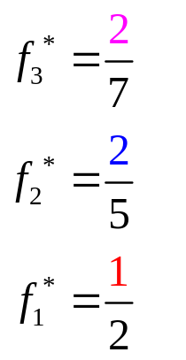

Occupation Statistics
E=4
E
E=2
E=0
Side note:
So far everything shown here is EXACT!
No approximations on the occupation probability!
=> direct application to
nano-scale electronics!
f(E)
W (E)
Coulomb blockage
Single electronics
2,0,3 1,2,2 0,4,1

Slide 22
Occupation Statistics
E=4
E
E=2
E=0
f(E)
W (E)
Coulomb blockage
Single electronics
configurations
2,0,3 1,2,2 0,4,1
For large numbers of states, what is the most probably configuration?

Slide 23
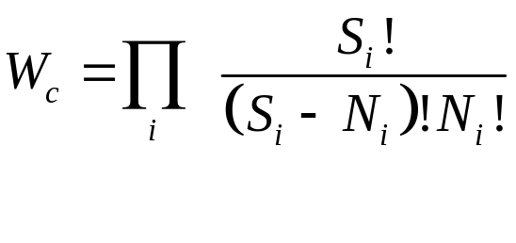
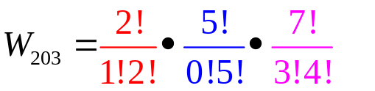
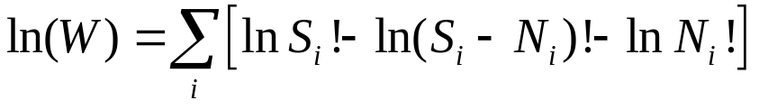

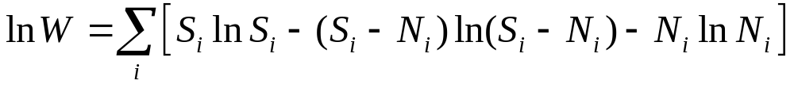
Occupation Statistics
N_{i}
Choose the most
probable
configuration.
S_{i}
W (E)
2,0,3 1,2,2 0,4,1
configurations
Recall.
Stirling approx.
For large numbers of states, what is the most probably configuration?

Slide 24
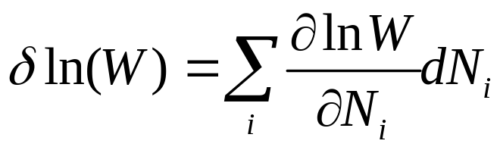
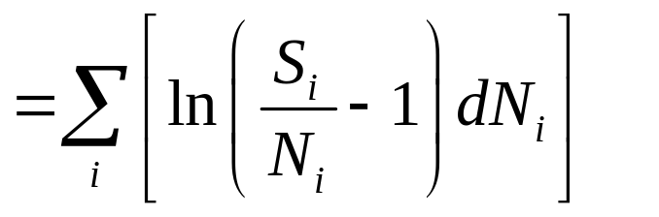
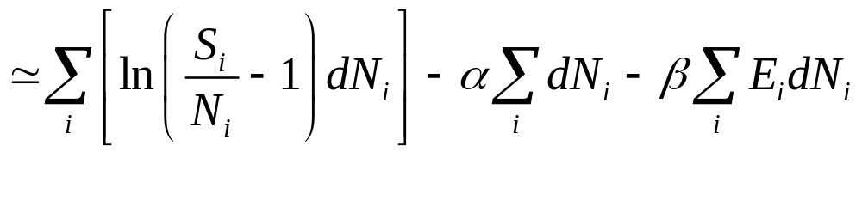
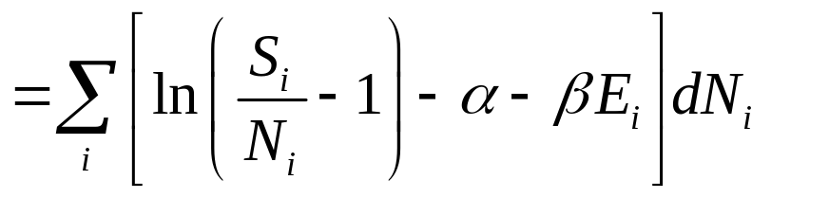
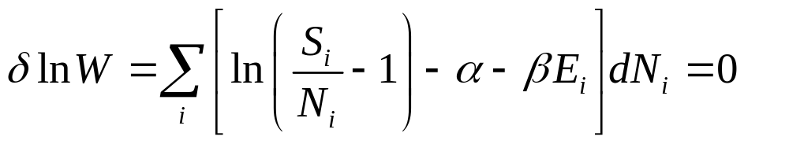
Optimization with Lagrange-Multiplier
Choose the most
probable
configuration.
lnW
configurations
Optimization with constraints!
Energy conservation
Particle conservation
Lagrange multipliers at https://en.wikipedia.org/wiki/Lagrange_multiplier
For large numbers of states, what is the most probably configuration?

Slide 25
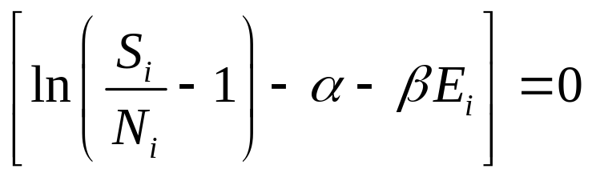
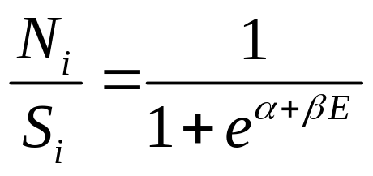
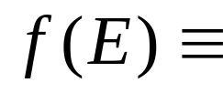
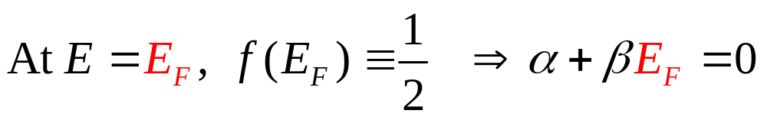
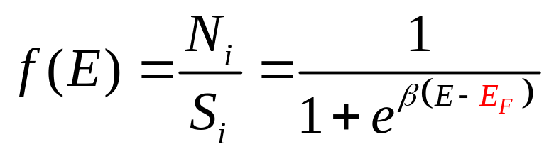
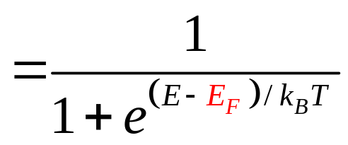
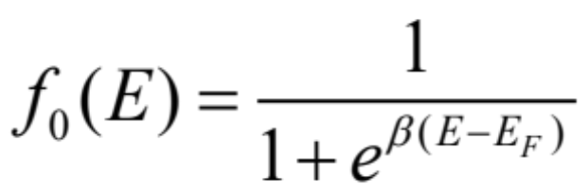
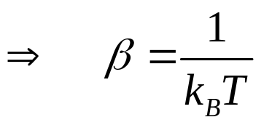
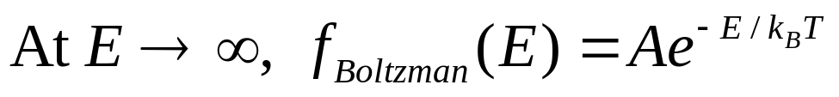
Final steps …
E
E_{F}
f_{max}(E)=1
f(E)

Slide 26
Section 12
Occupation of States
12.1 Rules of filling electronic states
  Pauli exclusion
  Total particle conservation
  Total energy conservation
12.2 Derivation of Fermi-Dirac Statistics: three techniques
  Microcanonical ensemble - statistics
  Detailed Balance – thermal equilibrium & Pauli exclusion
  Partition Function – statistical mechanics
12.3 Intrinsic carrier concentration
  Fermi Integral
  Law of mass action
Carrier number =
Number of states x filling factor
One Video Segment
One Video Segment
status
One Video Segment
Reference: Vol. 6, Ch. 4

Slide 27





Derivation by Detailed Balance
E=4
full
E=2
empty
empty
E=0
full
Detailed Balance in Equilibrium
full
full
empty
empty
Pauli Exclusion

Slide 28



Derivation by Detailed Balance
E=4
E=2
E=0
Detailed Balance in Equilibrium
Pauli Exclusion
Energy conversation
Only solution is ….
Pauli Principle, energy, and number conservation all satisfied
A Note on the Use of the Principle of Detailed Balance in Obtaining the Fermi-Dirac Distribution Function,
John E. Walsh: American Journal of Physics38, 392 (1970); doi: 10.1119/1.1976344

Slide 29
Section 12
Occupation of States
12.1 Rules of filling electronic states
  Pauli exclusion
  Total particle conservation
  Total energy conservation
12.2 Derivation of Fermi-Dirac Statistics: three techniques
  Microcanonical ensemble - statistics
  Detailed Balance – thermal equilibrium & Pauli exclusion
  Partition Function – statistical mechanics
12.3 Intrinsic carrier concentration
  Fermi Integral
  Law of mass action
Carrier number =
Number of states x filling factor
One Video Segment
One Video Segment
status
One Video Segment
Reference: Vol. 6, Ch. 4

Slide 30
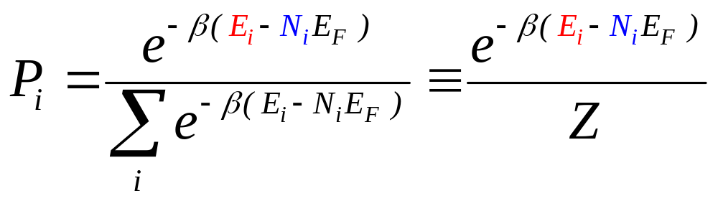
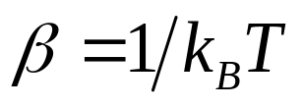
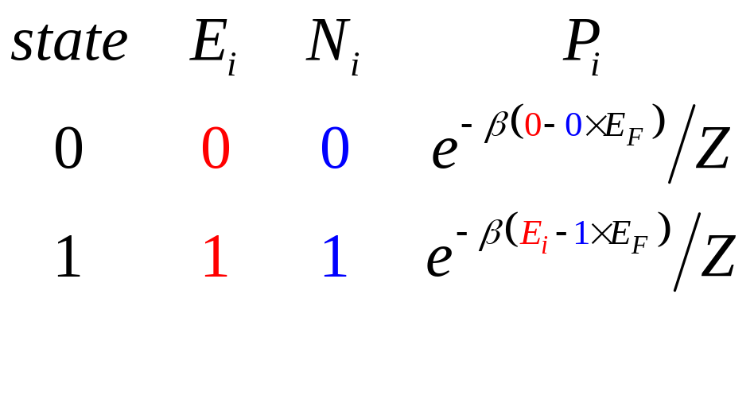
Derivation by Partition Function
E=4
E=2
E=0
E_{i}

Slide 31
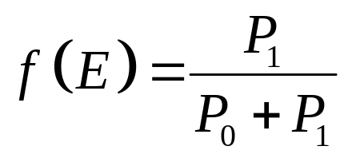
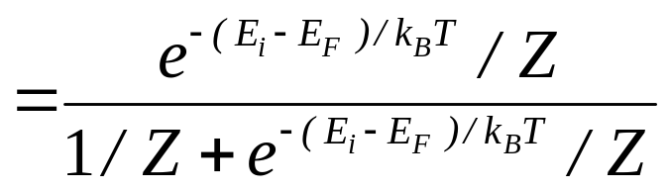
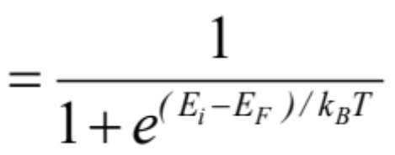
Derivation by Partition Function
1
Probability that state is filled ….
f(E)
f(E)
1
1
1/2
1/2
E_{F}
E
E
E_{F}

Slide 32

Derivation by Partition Function
1
Probability that state is filled ….
f(E)
f(E)
1
1
1/2
1/2
Partition Function or Statistical Mechanics
Approach also holds for single electronics!
E_{F}
E
E
E_{F}

Slide 33


Temperature Dependence
f(E)
1
1/2
E_{F}
E
Hot electrons reach higher energy states
Cold electrons are “frozen” to lowest possible states
https://commons.wikimedia.org/wiki/File:Fermi.gif
another nanoHUB animation on Wikipedia
https://nanohub.org/tools/fermi

Slide 34

Few comments on Fermi-Dirac Statistics
Applies to all spin-1/2 particles
Typically, information about spin is not explicit; multiply DOS by 2.
May be more complicated for magnetic semiconductors,
Topological insulators, quantum computing, coulomb blockade etc
Coulomb-interaction among particles is neglected,
Therefore it applies to extended solids, not to small molecules
L_{x}

Slide 35
Section 12
Occupation of States
12.1 Rules of filling electronic states
  Pauli exclusion
  Total particle conservation
  Total energy conservation
12.2 Derivation of Fermi-Dirac Statistics: three techniques
  Microcanonical ensemble - statistics
  Detailed Balance – thermal equilibrium & Pauli exclusion
  Partition Function – statistical mechanics
12.3 Intrinsic carrier concentration
  Fermi Integral
  Law of mass action
Carrier number =
Number of states x filling factor
One Video Segment
One Video Segment
status
In 1926, Fowler studied collapse of a star to white dwarf by F-D statistics, before Sommerfeld used the F-D statistics to develop a theory of electrons in metals in 1927. Wikipedia has a nice article on this topic.
One Video Segment
Reference: Vol. 6, Ch. 4

Slide 36
Section 12
Occupation of States
12.1 Rules of filling electronic states
  Pauli exclusion
  Total particle conservation
  Total energy conservation
12.2 Derivation of Fermi-Dirac Statistics: three techniques
  Microcanonical ensemble - statistics
  Detailed Balance – thermal equilibrium & Pauli exclusion
  Partition Function – statistical mechanics
12.3 Intrinsic carrier concentration
  Fermi Integral
  Law of mass action
Carrier number =
Number of states x filling factor
One Video Segment
One Video Segment
In 1926, Fowler studied collapse of a star to white dwarf by F-D statistics, before Sommerfeld used the F-D statistics to develop a theory of electrons in metals in 1927. Wikipedia has a nice article on this topic.
status
One Video Segment
Reference: Vol. 6, Ch. 4

Slide 37
Section 12
Occupation of States
Solid State Devices
12.3 Intrinsic carrier concentration

Slide 38
Section 12
Occupation of States
12.1 Rules of filling electronic states
  Pauli exclusion
  Total particle conservation
  Total energy conservation
12.2 Derivation of Fermi-Dirac Statistics: three techniques
  Microcanonical ensemble - statistics
  Detailed Balance – thermal equilibrium & Pauli exclusion
  Partition Function – statistical mechanics
12.3 Intrinsic carrier concentration
  Fermi Integral
  Law of mass action
Carrier number =
Number of states x filling factor
One Video Segment
One Video Segment
status
One Video Segment
Reference: Vol. 6, Ch. 4

Slide 39












Carrier Distribution
DOS
F-D
concentration
1

Slide 40



Electron Concentration in 3D solids
Include spin
factor of 2
Assume
wide bands

Slide 41






Fermi Integral is Painful to Evaluate
(not analytic – lookup tables or expensive numerical)
Boltzmann Statistics!
For non-degenerate systems

Slide 42

Carrier Distribution => Effective Density of States
DOS
F-D
Charge Distribution
No energy Distribution!
Delta Function Charge
1
As if all states are at a single level E_{C}

Slide 43

Law of Mass-Action
Product is independent of the Fermi level!
Very useful balance equation! Will use it often

Slide 44



Fermi-Level for Intrinsic Semiconductors
Notes:
Need to restart on the quilibrium distribution!

Slide 45





Section 12
Occupation of States
12.1 Rules of filling electronic states
  Pauli exclusion
  Total particle conservation
  Total energy conservation
12.2 Derivation of Fermi-Dirac Statistics: three techniques
  Microcanonical ensemble - statistics
  Detailed Balance – thermal equilibrium & Pauli exclusion
  Partition Function – statistical mechanics
12.3 Intrinsic carrier concentration
  Fermi Integral
  Law of mass action
One Video Segment
Carrier number =
Number of states x filling factor
One Video Segment
One Video Segment
Quantum Mechanics Mechanics
Concepts of density of states and masses
Equilibrium Statistical Mechanics
Occupation factors
What’s Next?
Reference: Vol. 6, Ch. 4

Slide 46
Section 12
Occupation of States
I
I = G ^{x} V
= q ^{x} n ^{x} v ^{x} A
V
charge
density
velocity
area
Materials, composition, crystals
Tabulated for “known” bulk materials
At nm-scale properties change with geometry => theory
Quantum Mechanics Mechanics
Concepts of density of states and masses
Equilibrium Statistical Mechanics
Occupation factors
Transport with scattering, non-equilibrium Statistical Mechanics
Drift-diffusion equation with recombination-generation
Understanding transport in concrete devices
Diodes, BJT/HBT, MOS

