Slide 1
Section 11
Bandstructure Measurements
Solid State Devices

Slide 2
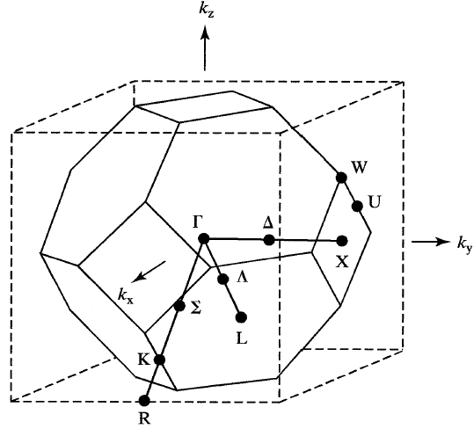
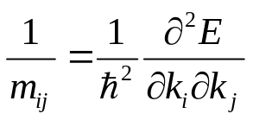

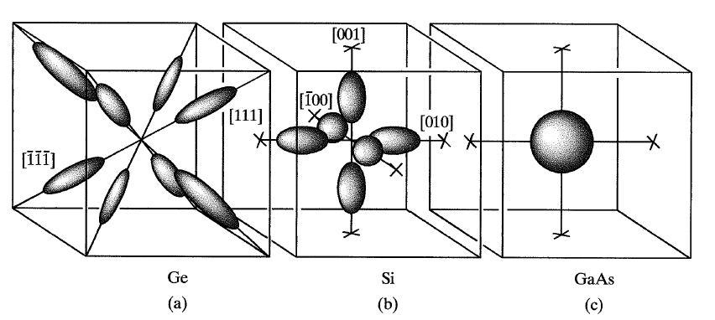
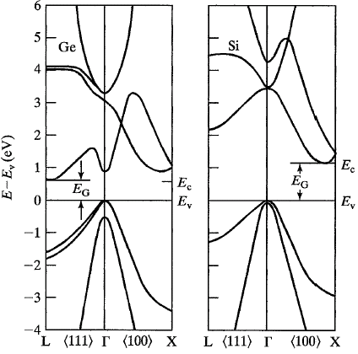
Section 11
Bandstructure Measurements
Original
Problem
Periodic
Structure
E
U
Section 7 – Bandstructure in 1D Periodic Potentials
Section 8 – Brillouin Zone - Reciprocal Lattice
Section 9 – Constant Energy Surfaces & DOS
Section 10 – Bandstructure in Real Materials (Si, Ge, GaAs)
11.1 Bandgap measurements
11.2 Effective mass measurements
Reference: Vol. 6, Ch. 3

Slide 3
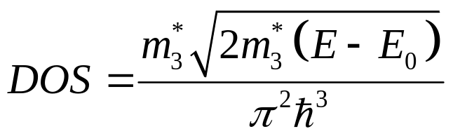


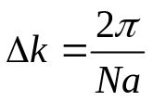
Reminder: Momentum vs. DOS
E
E
k
DOS
Important things to remember:
Momentum k entered our thinking as a quantum number
Each quantum number is creating ONE state
Often “just” need the number of available states in an energy range
=> Density of States
=> appears to be solely determined by
  1) band edge,
  2) effective mass

Slide 4
Measurement of Band Gap
E
Photons are only absorbed between
bands that have filled and empty states
4
3
absorption
2
1
E₂₃
k

Slide 5
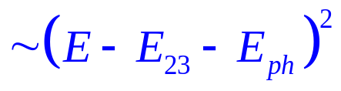
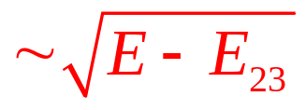
Measurement of Energy Gap
E
hν
I_{in}
4
I_{out}
3
I_{out} - I_{in}
2
1
E₂₃
E₂₃+Δ
k
k

Slide 6
Direct Bandgaps
Photons are only absorbed between
bands that have filled and empty states
E
Particle-particle interaction –
Energy and momentum must be conserved
4
Photon momentum negligible
compared to electron momentum
absorption
3
Electron transition is “vertical”
E₂₃
2
1
k
https://en.wikipedia.org/wiki/Direct_and_indirect_band_gaps
https://upload.wikimedia.org/wikipedia/commons/thumb/7/7a/Direct.svg/600px-Direct.svg.png

Slide 7
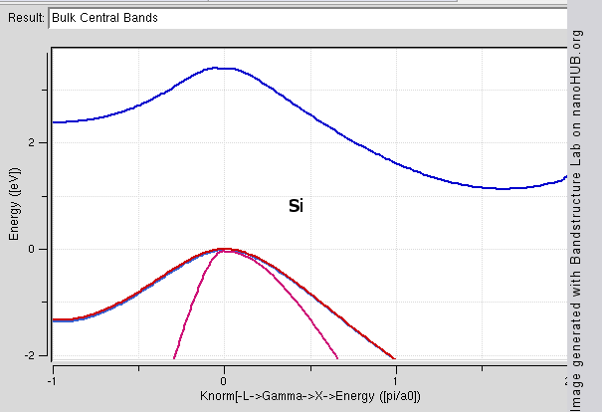
Direct Bandgaps
Particle-particle interaction –
Energy and momentum must be conserved
E
Photon momentum negligible
compared to electron momentum
4
Electron transition is “vertical”
In Si and Ge the smallest bandgap is not at Γ
nanoHUB result on wikipedia
3
2
1
k
https://en.wikipedia.org/wiki/Direct_and_indirect_band_gaps
https://upload.wikimedia.org/wikipedia/commons/thumb/7/7a/Direct.svg/600px-Direct.svg.png
https://en.wikipedia.org/wiki/File:Bulkbandstructure.gif
https://upload.wikimedia.org/wikipedia/en/b/ba/Indirect_Bandgap.svg

Slide 8
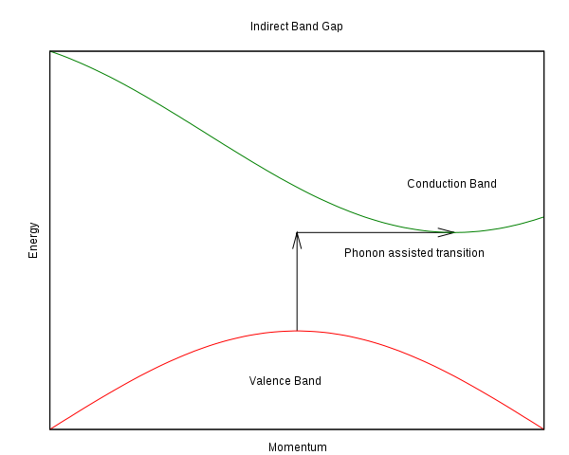
Direct and Indirect Bandgaps
Particle-particle interaction –
Energy and momentum must be conserved
Photon momentum negligible
compared to electron momentum
E
Electron transition is “vertical”
4
In Si and Ge the smallest bandgap is not at Γ
Need a “phonon” to compensate momentum conservation
nanoHUB result on wikipedia
3-particles - less efficient
3
2
1
k
https://en.wikipedia.org/wiki/Direct_and_indirect_band_gaps
https://upload.wikimedia.org/wikipedia/commons/thumb/7/7a/Direct.svg/600px-Direct.svg.png
https://en.wikipedia.org/wiki/File:Bulkbandstructure.gif
https://upload.wikimedia.org/wikipedia/en/b/ba/Indirect_Bandgap.svg

Slide 9
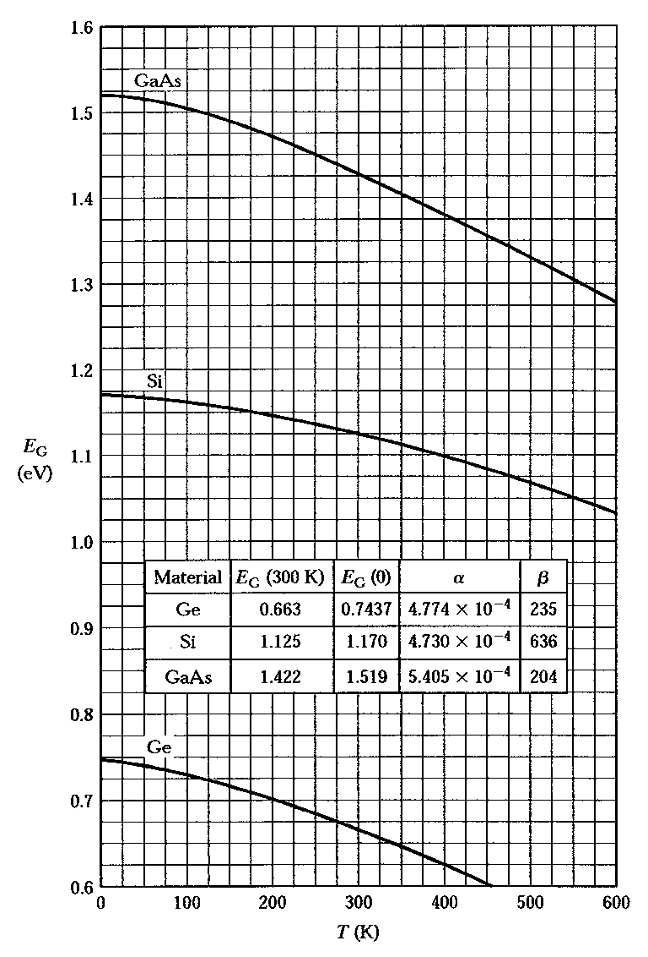
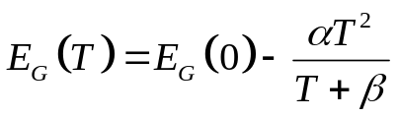
Temperature-dependent Band Gap
E
4
3
2
1
k

Slide 10
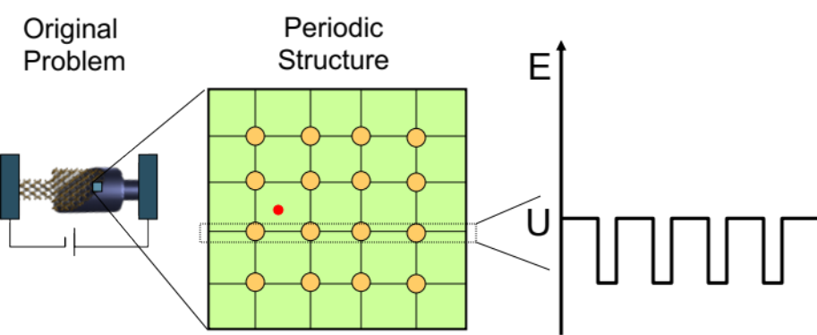

Section 11
Bandstructure Measurements
Section 7 – Bandstructure in 1D Periodic Potentials
Section 8 – Brillouin Zone - Reciprocal Lattice
Section 9 – Constant Energy Surfaces & DOS
Section 10 – Bandstructure in Real Materials (Si, Ge, GaAs)
Bandstructure Measurements test and validate the theories
11.1 Bandgap measurements
11.2 Effective mass measurements
status
Video Segment
Video Segment
Reference: Vol. 6, Ch. 3

Slide 11
Section 11
Bandstructure Measurements
Section 7 – Bandstructure in 1D Periodic Potentials
Section 8 – Brillouin Zone - Reciprocal Lattice
Section 9 – Constant Energy Surfaces & DOS
Section 10 – Bandstructure in Real Materials (Si, Ge, GaAs)
Bandstructure Measurements test and validate the theories
11.1 Bandgap measurements
11.2 Effective mass measurements
Video Segment
status
Video Segment
Reference: Vol. 6, Ch. 3

Slide 12
Section 11
Bandstructure Measurements
Solid State Devices
11.2 Effective mass measurements

Slide 13
Section 11
Bandstructure Measurements
Section 7 – Bandstructure in 1D Periodic Potentials
Section 8 – Brillouin Zone - Reciprocal Lattice
Section 9 – Constant Energy Surfaces & DOS
Section 10 – Bandstructure in Real Materials (Si, Ge, GaAs)
Bandstructure Measurements test and validate the theories
11.1 Bandgap measurements
Video Segment
11.2 Effective mass measurements
status
Video Segment
Reference: Vol. 6, Ch. 3

Slide 14
11.2 Effective mass measurements
E
Important things to remember:
Full bands do not conduct –
electrons have no space to go
Empty bands to not conduct –
there are no electrons to go around
Question:
We are interested in the top-most valence band holes and the bottom-most electron states
We want to figure out the slope of the bands
How can we probe just one particular species of electrons/holes?
We do not want to transfer them from one band to the next!
=> can we rotate the electrons around in a single band?
3
2
1
k

Slide 15
Motion in Real Space and Phase Space
Energy=constant.
x
Liquid He temperature …
k_{y}
(k_{x,}0)
(0,k_{y})
y
k_{x}
(-k_{x,}0)
(0,-k_{y})
k_{z}
k_{y}
k_{x}
Notes:
df_s/dp_x=0 because f=exp(-p^2) df_s/dp=p*f_s sum p*f_s = 0

Slide 16
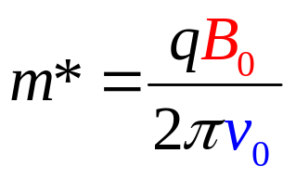
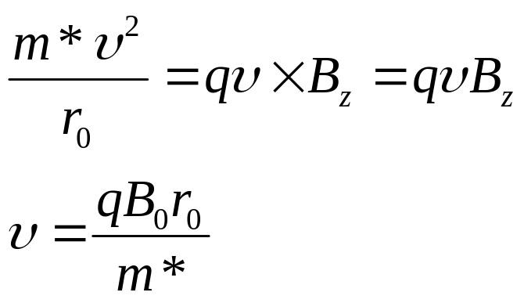
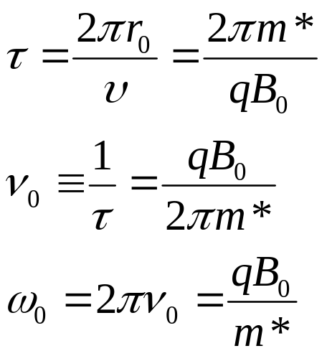
Derive the Cyclotron Formula
For an particle in (x-y) plane with B-field in z-direction,
the Lorentz force is …
B

Slide 17
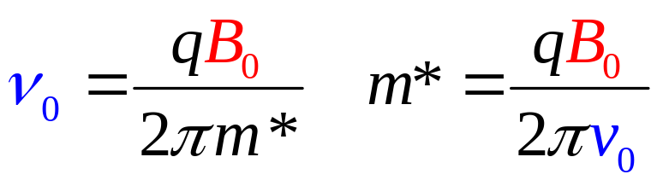
Measurement of Effective Mass
k_{z}
ν₀=24 GHz
(fixed)
B field variable …
I_{in}
I_{out}
k_{y}
k_{x}
k_{z}
I_{in} - I_{out}
B_{val}
B
k_{y}
k_{x}
B_{con}
Measurement “easy” for spherical surfaces

Slide 18
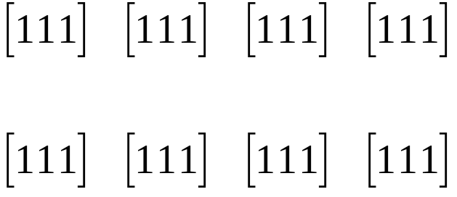
Effective mass in Ge
B
4 symmetry angles between B field and the ellipsoids …
(in Si, there would 6 equivalent valleys, 3 specific directions)

Slide 19
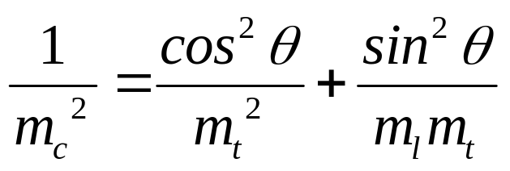
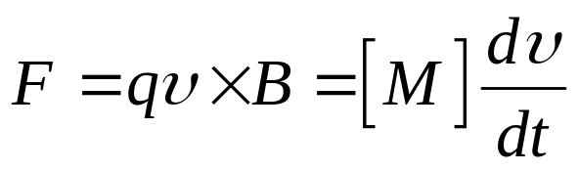
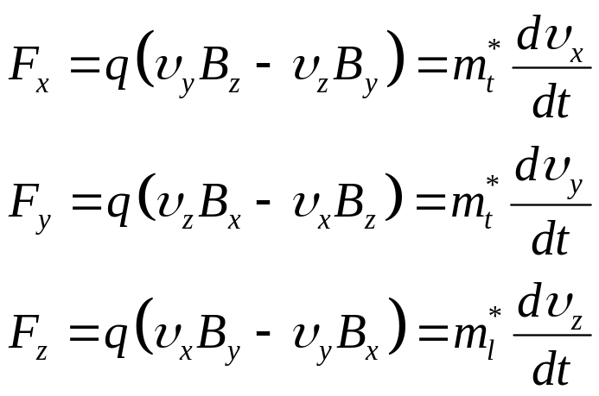

Cyclotron Formula for Multiple Valleys
Show that
Experiment looks at three θ,
and measures three m_{c}
From this expression you derive m_{t}, and m_{l}
The Lorentz force on electrons in a B-field
k_{z}
B₀
In other words,
B
k_{y}
k_{x}

Slide 20
Continued …
k_{z}
Let (B) make an angle (θ) with longitudinal axis of the ellipsoid (ellipsoids oriented along k_{z})
B₀
k_{y}
k_{x}

Slide 21
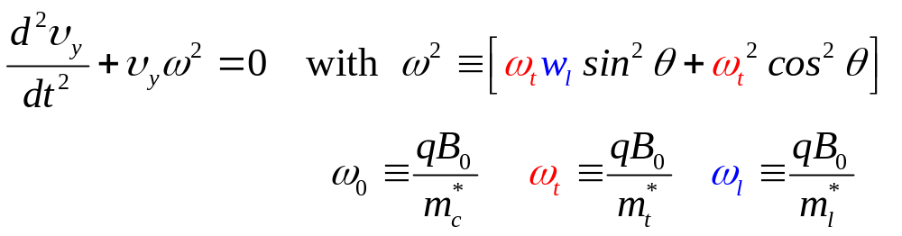
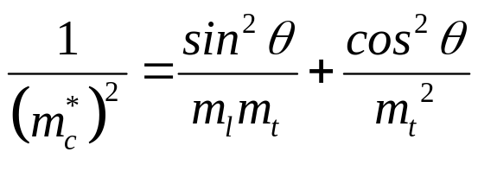
Continued …
k_{z}
Let (B) make an angle (θ) with longitudinal axis of the ellipsoid (ellipsoids oriented along k_{z})
B₀
k_{y}
k_{x}
Differentiate (v_{y}) and use other equations to find …
so that …

Slide 22
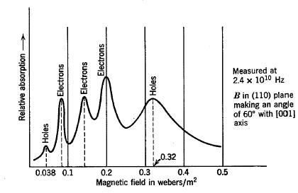
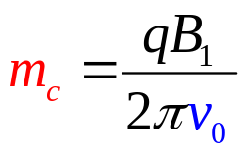
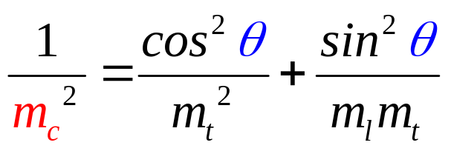
Measurement of Effective Mass
B=[0.61, 0.61, 0.5]
[110]
Magnetic Field
Picks 3
symmetry angles
Three peaks B₁, B₂, B₃
Three masses m_{c1},m_{c2},m_{c3}
Three unique angles: 7, 65, 73
Known θ and m_{c} allows calculation of m_{t} and m_{l}.

Slide 23
Valence Band Effective Mass
Which peaks relate to valence band?
Why are there two valence band peaks?

Slide 24
Section 11
Bandstructure Measurements
Section 7 – Bandstructure in 1D Periodic Potentials
Section 8 – Brillouin Zone - Reciprocal Lattice
Section 9 – Constant Energy Surfaces & DOS
Section 10 – Bandstructure in Real Materials (Si, Ge, GaAs)
Bandstructure Measurements test and validate the theories
11.1 Bandgap measurements
11.2 Effective mass measurements
Video Segment
Video Segment
status
Reference: Vol. 6, Ch. 3

