Slide 1
Section 10
Bandstructure in Real Materials (Si, Ge, GaAs)
Solid State Devices

Slide 2
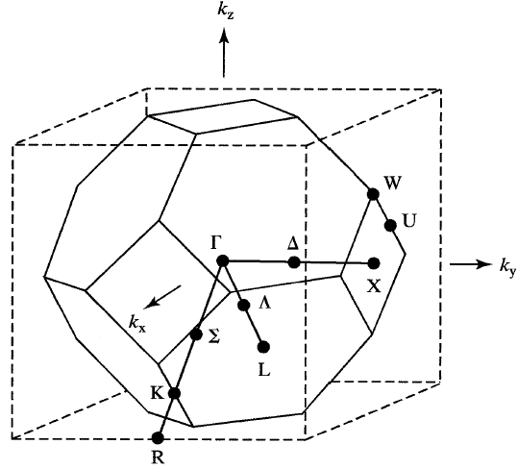
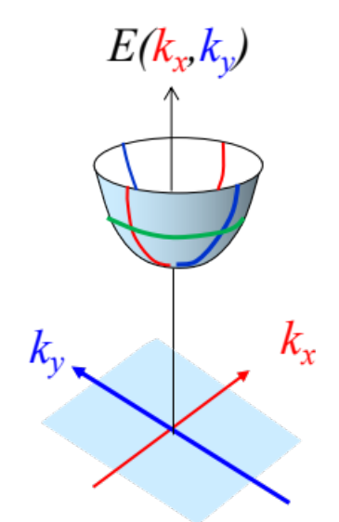

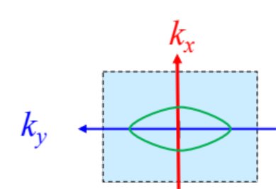
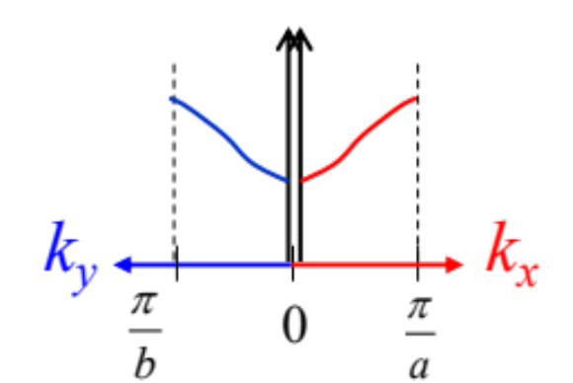
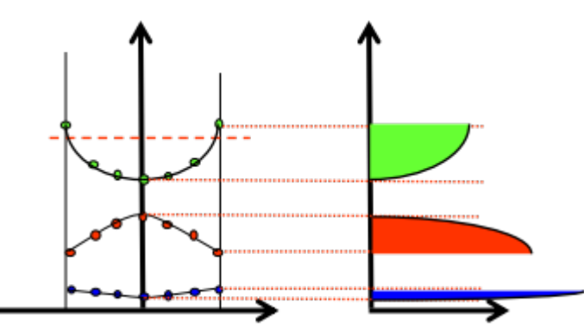
Section 10
Bandstructure in Real Materials (Si, Ge, GaAs)
Original
Problem
Periodic
Structure
E
U
Section 7 – Bandstructure in 1D Periodic Potentials
Section 8 – Brillouin Zone - Reciprocal Lattice
Section 9 – Constant Energy Surfaces & DOS
10.1 E(k) diagrams in specific crystal directions
10.2 Constant Energy Surfaces – Effective Mass Tensor
10.3 Density of States Effective Mass
Reference: Vol. 6, Ch. 3

Slide 3
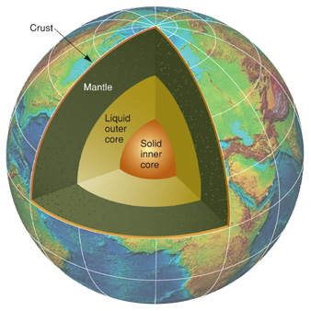
Analogy for E-k Diagram: 4D info through 2D Plots
Density (x,y,z)
4D information
φ₁
θ₁
Cut along (θ₁, φ₁) …
ρ
A series of line-sections can
Represent the 4D info in 2D plots
r

Slide 4
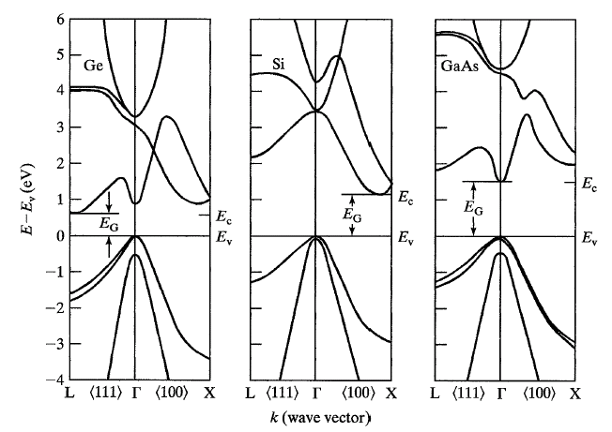
E-k along Γ-X Direction
Ge

Slide 5
E-k along Γ-X Direction
Ge

Slide 6
E-k along Γ-X Direction
Ge

Slide 7
E-k Diagram – Dispersion for Ge, Si, GaAs
Minima may not be at zone center
(Ge: 8 L valleys, Si: 6 X valleys, and GaAs: Γ valleys)

Slide 8
E-k Diagram – Dispersion for Ge, Si, GaAs
Minima may not be at zone center
(Ge: 8 L valleys, Si: 6 X valleys, and GaAs: Γ valleys)
3 valence bands (light hole, heavy hole, split-off)
valence bands near k=0 is essentially E ~ k²

Slide 9
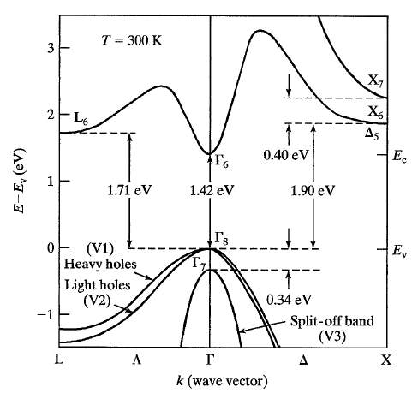
E-k diagram for GaAs
Direct bandgap material
Zone-edge gaps (L₆-Γ₈,
X₆-Γ₈) close to direct gap
Has important implications
For transport

Slide 10
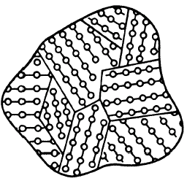
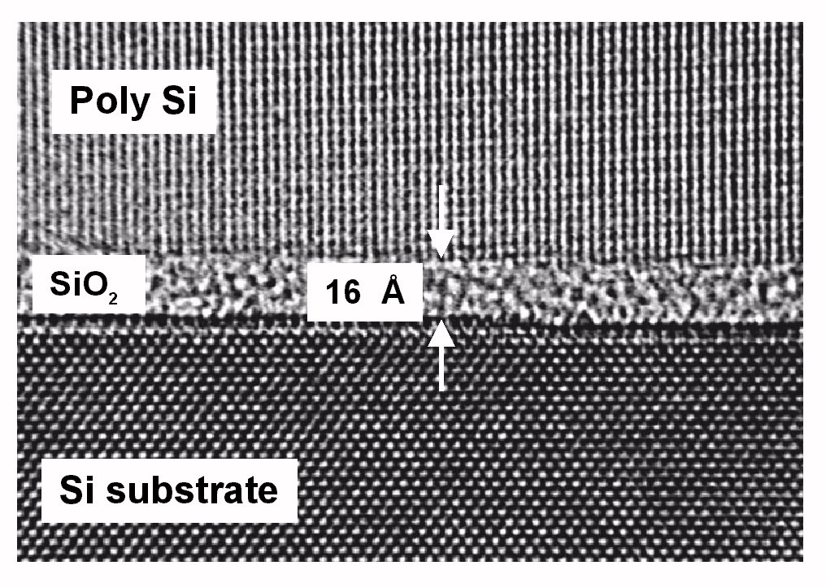
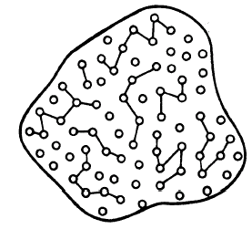
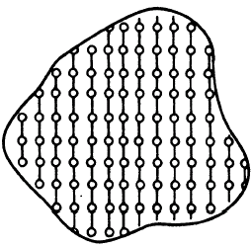
Arrangement of Atoms
Poly-crystalline
Thin Film
Transistors
Amorphous
Oxides
Crystalline

Slide 11
Poly-crystalline material
Isotropic bandgap and increase in scattering

Slide 12
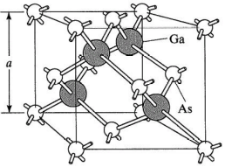
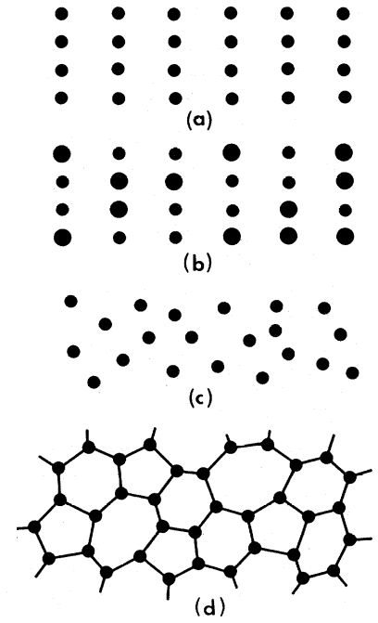
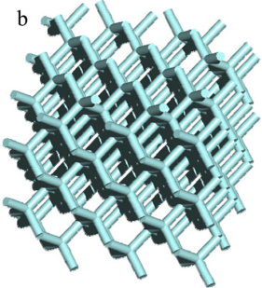
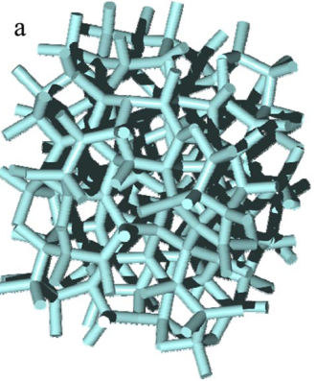
Band-structure and Periodicity
PRB, 4, 2508, 1971
Edagawa, PRL, 100,013901, 2008
Periodicity is sufficient, but not necessary for bandgap.
Many amorphous material show full isotropic bandgap

Slide 13
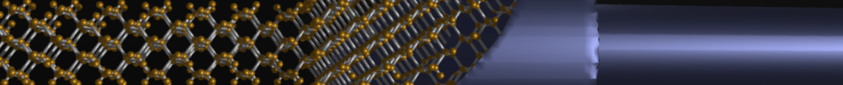
Section 10
Bandstructure in Real Materials (Si, Ge, GaAs)
10.1 E(k) diagrams in specific crystal directions
10.2 Constant Energy Surfaces – Effective Mass Tensor
10.3 Density of States Effective Mass
status
One Video Segment
One Video Segment
One Video Segment
Reference: Vol. 6, Ch. 3

Slide 14
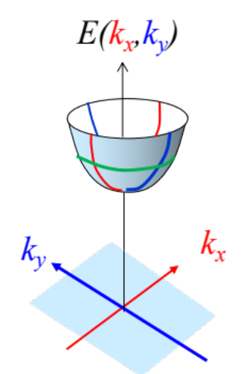
Section 10
Bandstructure in Real Materials (Si, Ge, GaAs)
10.1 E(k) diagrams in specific crystal directions
10.2 Constant Energy Surfaces – Effective Mass Tensor
10.3 Density of States Effective Mass
One Video Segment
status
One Video Segment
One Video Segment
Reference: Vol. 6, Ch. 3

Slide 15
Section 10
Bandstructure in Real Materials (Si, Ge, GaAs)
Solid State Devices
10.2 Constant Energy Surfaces – Effective Mass Tensor

Slide 16
Section 10
Bandstructure in Real Materials (Si, Ge, GaAs)
10.1 E(k) diagrams in specific crystal directions
10.2 Constant Energy Surfaces – Effective Mass Tensor
10.3 Density of States Effective Mass
One Video Segment
status
One Video Segment
One Video Segment
Reference: Vol. 6, Ch. 3

Slide 17
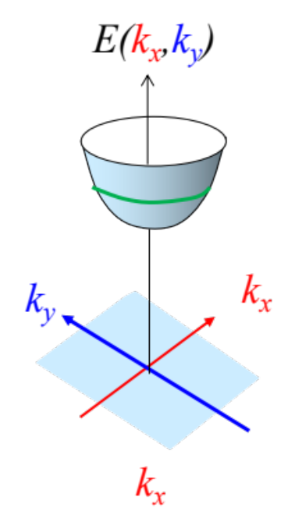
Analogy for E-k Diagram
Contours of density ….
Density (x,y,z)

Slide 18
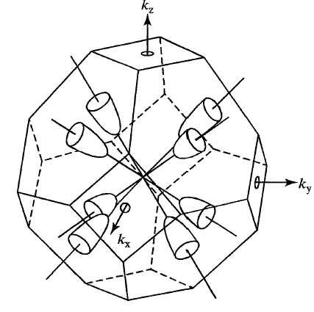
Four valleys (8 halves) inside BZ for Germanium

Slide 19
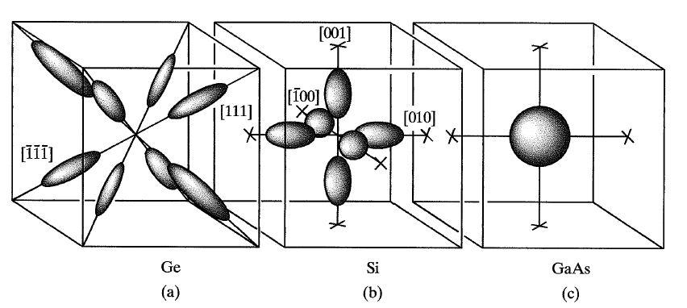
Constant-E surface for Conduction Band

Slide 20
Constant-E surface for Conduction Band

Slide 21
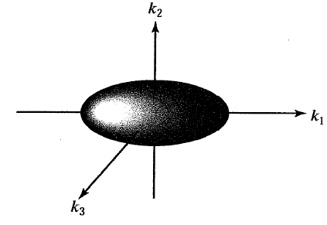
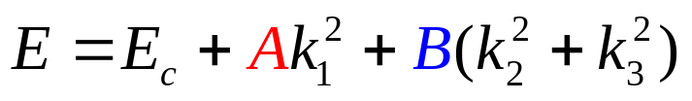
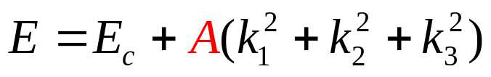
Constant-E surface for Conduction Band

Slide 22
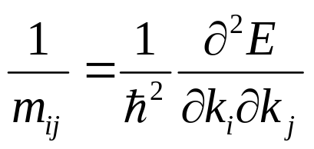
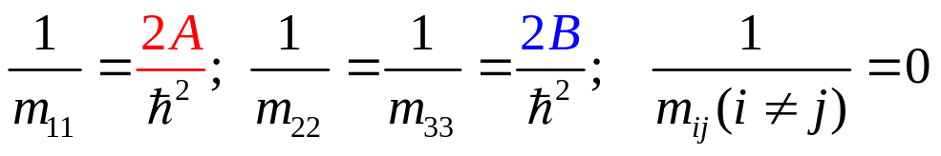
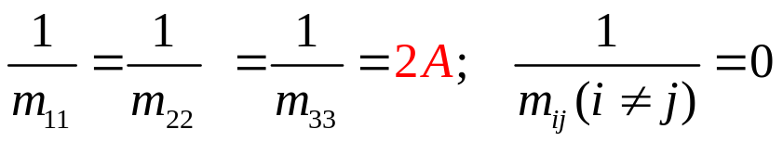
Constant E-surface and Effective Mass Tensor
Ge: 8 valleys
Si: 6 valleys
1 heavy mass
2 light masses
Offdiagonal Elements=0
=> Force and movement aligned

Slide 23
Constant E-surface for Valence Band

Slide 24
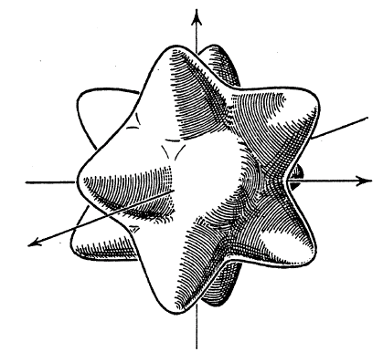
Constant E-surface for Valence Band
HH and LH are NOT
Isotropic
=> NOT spheres
=> strong spatial variations
3 bands:
HH – Heavy Hole
LH – Light Hole
SO – Split-off band
Rotated substrate
technology at TI
Robert C. Bowen
Enhanced PMOS
Si: A=4.29, B=0.68, C=4.87; Ge: A=13.38, B=8.48, C=13.15

Slide 25
Section 10
Bandstructure in Real Materials (Si, Ge, GaAs)
10.1 E(k) diagrams in specific crystal directions
10.2 Constant Energy Surfaces – Effective Mass Tensor
10.3 Density of States Effective Mass
One Video Segment
status
One Video Segment
One Video Segment
Reference: Vol. 6, Ch. 3

Slide 26
Section 10
Bandstructure in Real Materials (Si, Ge, GaAs)
10.1 E(k) diagrams in specific crystal directions
10.2 Constant Energy Surfaces – Effective Mass Tensor
10.3 Density of States Effective Mass
One Video Segment
One Video Segment
status
One Video Segment
Reference: Vol. 6, Ch. 3

Slide 27
Section 10
Bandstructure in Real Materials (Si, Ge, GaAs)
Solid State Devices
10.3 Density of States Effective Mass

Slide 28
Section 10
Bandstructure in Real Materials (Si, Ge, GaAs)
10.1 E(k) diagrams in specific crystal directions
10.2 Constant Energy Surfaces – Effective Mass Tensor
10.3 Density of States Effective Mass
One Video Segment
One Video Segment
status
One Video Segment
Reference: Vol. 6, Ch. 3

Slide 29
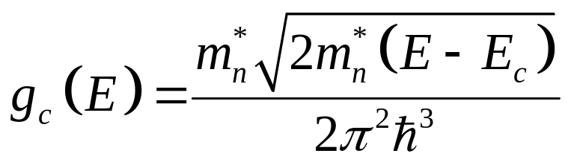
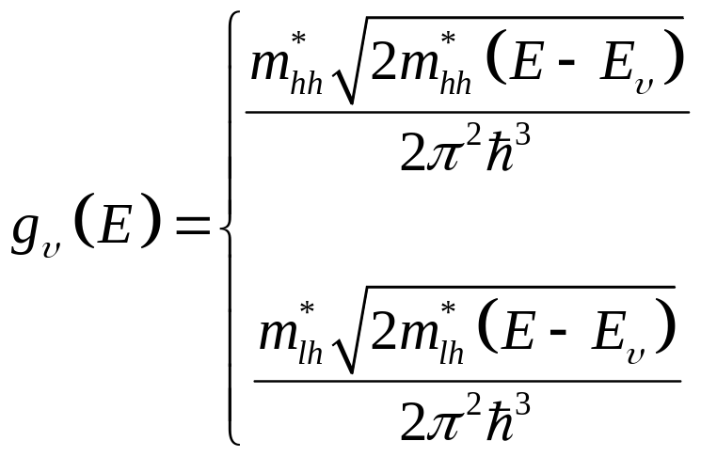

Density of States of GaAs: Conduction/Valence Bands
$$D_{3D}\left(E\right)∝\sqrt{E}$$

Slide 30
Four valleys (8 halves) inside BZ for Germanium

Slide 31
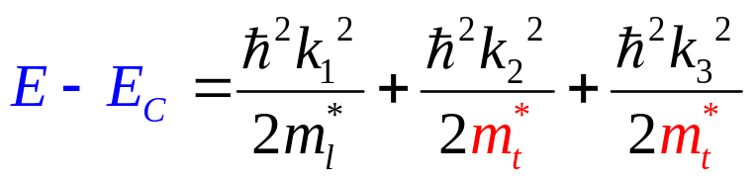
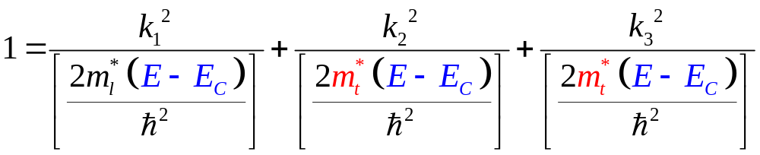


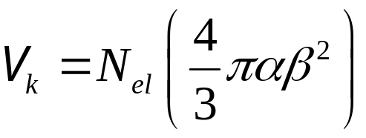
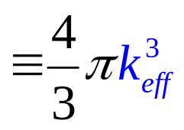
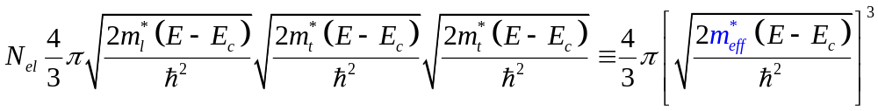
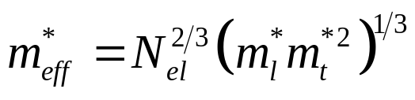
Ellipsoidal Bands and DOS Effective Mass
k₂
const. E
E=const. ellipsoid
k₁
k₃
Transform into …
N_{el} is number of equivalent ellipsoids

Slide 32
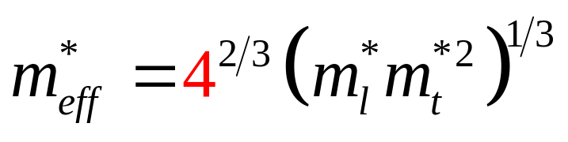
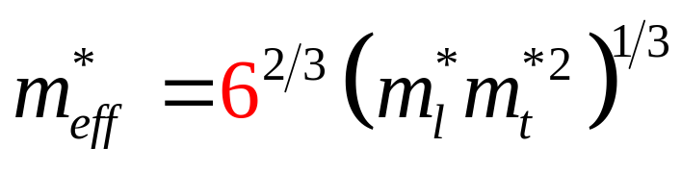
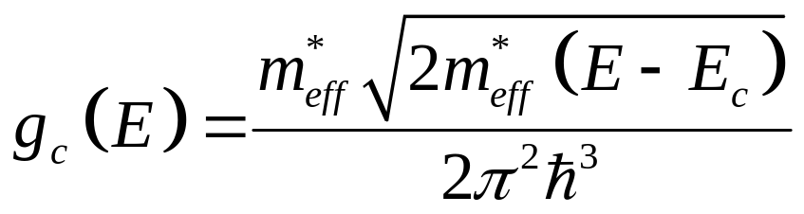
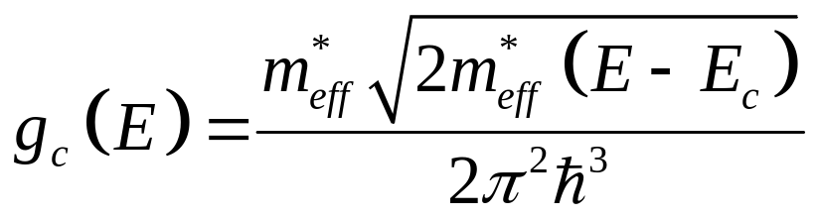
DOS Effective Mass for Conduction Band

Slide 33
Section 10
Bandstructure in Real Materials (Si, Ge, GaAs)
Video
10.1 E(k) diagrams in specific crystal directions
10.2 Constant Energy Surfaces – Effective Mass Tensor
10.3 Density of States Effective Mass
Video
Video
E-k diagrams emerge from the solution of Schrödinger’s Eq.
E-k diagrams at which energy an electron with a specific crystal momentum can reside.
E-k diagrams depend on the underlying crystal symmetry
Only a fraction of the available states are occupied. The number of available states change with energy.
DOS of g(E) describes the number of available states in a small energy window around energy E
DOS is an important and useful characteristic of a material

