Slide 1
Section 9
Constant Energy Surfaces & Density of States
Solid State Devices

Slide 2

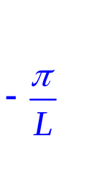

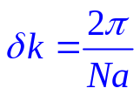
Section 9
Constant Energy Surfaces & Density of States
Original
Problem
Periodic
Structure
E
E
U
Section 7 – Bandstructure in 1D Periodic Potentials
Section 8 – Brillouin Zone - Reciprocal Lattice
Section 9 – Some fundamental methods
9.1 Constant Energy Surfaces
9.2 Density of States
k

Slide 3




Brillouin Zone and Bandstructure for 1D Solids
Real-space
k_{x}
1st B-Z
E
E(k) diagram
k

Slide 4





Brillouin Zone and Bandstructure for 2D Rectangular Lattice
a
b
E(k_{x},k_{y})
Real-space
k_{y}
E=constant
k_{x}
1st B-Z
k_{x}
k_{y}
k_{x}
E
E(k) diagram
E(k_{x},k_{y})
k_{y}
k_{x}
k_{x}
k
0
k_{y}
E(k) lines in symmetry directions used all the time
Constant Energy Lines (2D) and Surfaces (3D) are used for Evaluating / Visualizing E(k)

Slide 5
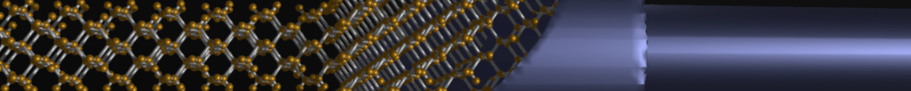
Section 9
Constant Energy Surfaces & Density of States
Original
Problem
Periodic
Structure
E(k_{x},k_{y})
E
k_{y}
k_{x}
U
Section 7 – Bandstructure in 1D Periodic Potentials
Section 8 – Brillouin Zone - Reciprocal Lattice
Section 9 – Some fundamental methods
k_{x}
Video
k_{y}
9.1 Constant Energy Surfaces
9.2 Density of States
status
Video
k_{y}
k_{x}
0

Slide 6
Section 9
Constant Energy Surfaces & Density of States
Original
Problem
Periodic
Structure
E(k_{x},k_{y})
E
k_{y}
k_{x}
U
Section 7 – Bandstructure in 1D Periodic Potentials
Section 8 – Brillouin Zone - Reciprocal Lattice
Section 9 – Some fundamental methods
k_{x}
Video
k_{y}
9.1 Constant Energy Surfaces
9.2 Density of States
status
Video
k_{y}
k_{x}
0

Slide 7
9.2 Density of States
Solid State Devices
Section 9
Constant Energy Surfaces & Density of States

Slide 8
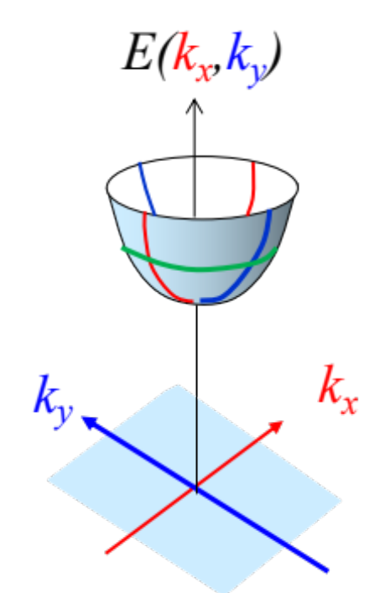
Section 9
Constant Energy Surfaces & Density of States
Original
Problem
Periodic
Structure
E
U
Section 7 – Bandstructure in 1D Periodic Potentials
Section 8 – Brillouin Zone - Reciprocal Lattice
Section 9 – Some fundamental methods
k_{x}
Video
k_{y}
9.1 Constant Energy Surfaces
9.2 Density of States
status
Video
k_{y}
k_{x}
0

Slide 9
Density of States
E
A single band has total of N-states
Only a fraction of states are occupied
How many states are occupied up to E?
Helpful for an answer…
How many states available per unit energy ?
(Density of States - DOS)?
-k
k
k

Slide 10


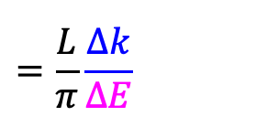


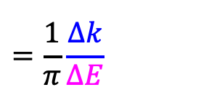
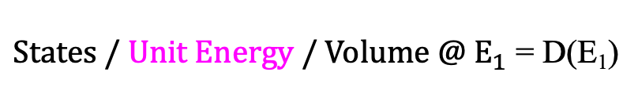
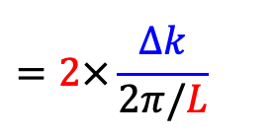
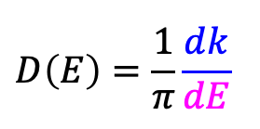
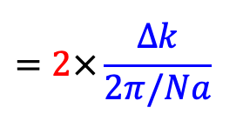
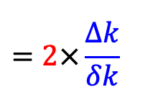
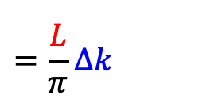
Density of States in 1-D Semiconductors
$$=2×\frac{Δk}{δk}$$
$$=2×\frac{Δk}{2π/Na}$$
$$=2×\frac{Δk}{2π/L}$$
$$=\frac{L}{π}Δk$$
$$States between{ E}_{1} and E_{1}+ΔE$$
N atoms
$$=\frac{L}{π}\frac{Δk}{ΔE}$$
a
$$L=Na$$
$States / Unit Energy @ E_{1}$ = D(E₁)
$States / Unit Energy / Volume @ E_{1}$ = D(E₁)
$$=\frac{1}{π}\frac{Δk}{ΔE}$$
E
$$D\left(E\right)=\frac{1}{π}\frac{dk}{dE}$$
k₁+Δk
k₁
E₁+ΔE
E₁
k

Slide 11
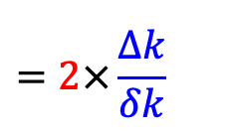
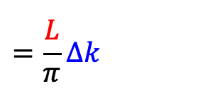
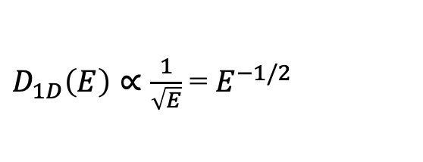
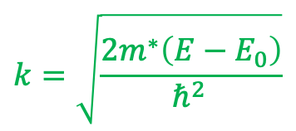
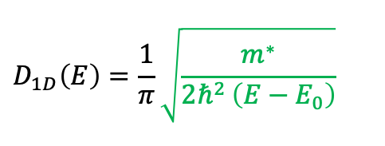
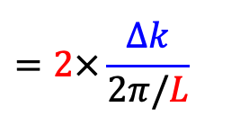
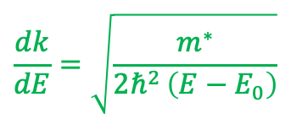
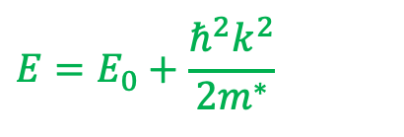
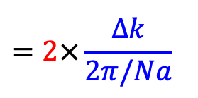
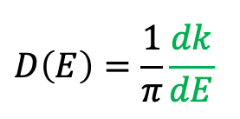
Density of States in 1-D Semiconductors
$$=2×\frac{Δk}{δk}$$
$$=2×\frac{Δk}{2π/Na}$$
$$=2×\frac{Δk}{2π/L}$$
$$=\frac{L}{π}Δk$$
$$States between{ E}_{1} and E_{1}+ΔE$$
N atoms
$$=\frac{L}{π}\frac{Δk}{ΔE}$$
a
$$L=Na$$
$States / Unit Energy @ E_{1}$ = D(E₁)
$States / Unit Energy / Volume @ E_{1}$ = D(E₁)
$$=\frac{1}{π}\frac{Δk}{ΔE}$$
E
$$D\left(E\right)=\frac{1}{π}\frac{dk}{dE}$$
Assume:
k₁
$$D\left(E\right)=\frac{1}{π}\frac{dk}{dE}$$
$$E=E_{0}+\frac{ℏ^{2}k^{2}}{2m^{∗}}$$
E₁+ΔE
E₁
$$D_{1D}\left(E\right)=\frac{1}{π}\sqrt{\frac{m^{∗}}{{2ℏ}^{2 }\left(E−E_{0}\right)}}$$
$$k=\sqrt{\frac{2m^{∗}\left(E−E_{0}\right)}{ℏ^{2 }}}$$
k
$D_{1D}\left(E\right)∝\frac{1}{\sqrt{E}}$ = $E^{−1/2}$
$$\frac{dk}{dE}=\sqrt{\frac{m^{∗}}{{2ℏ}^{2 }\left(E−E_{0}\right)}}$$

Slide 12
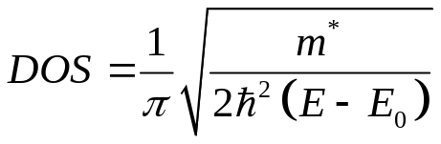
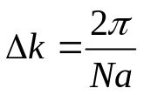
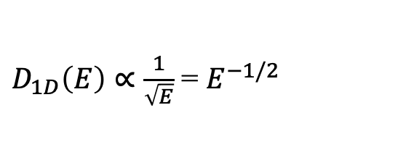
1D-DOS
E
E
k
DOS
$D_{1D}\left(E\right)∝\frac{1}{\sqrt{E}}$ = $E^{−1/2}$
Conservation of DOS
(total area must be the same for each band)

Slide 13
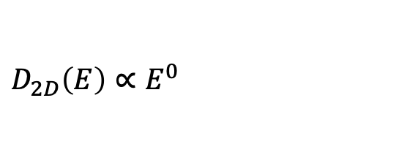
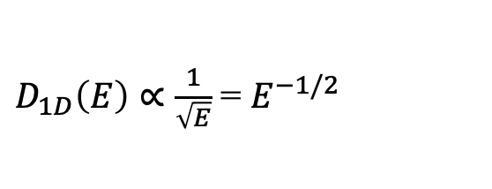
2D-DOS
b
a
Show that 2D DOS is a constant independent of energy!
$D_{1D}\left(E\right)∝\frac{1}{\sqrt{E}}$ = $E^{−1/2}$
$$D_{2D}\left(E\right)∝E^{0}$$

Slide 14
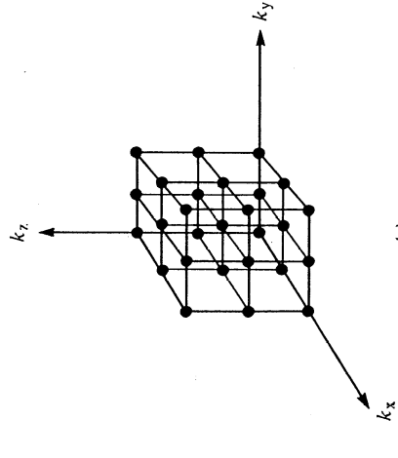
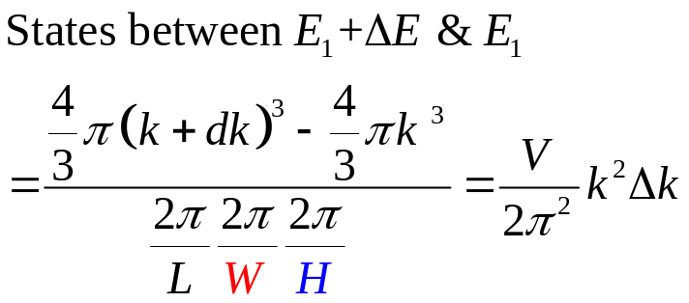
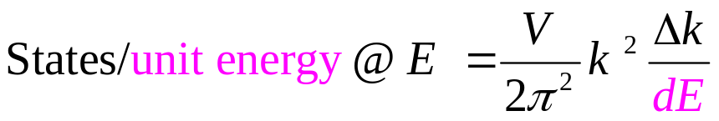
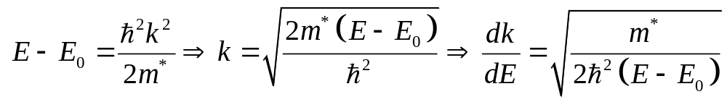
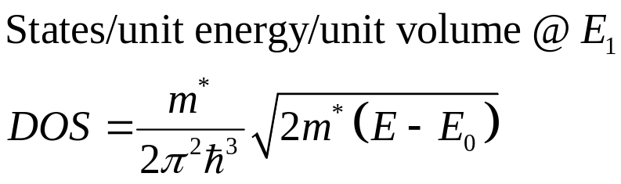
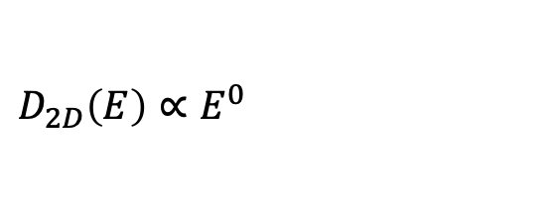
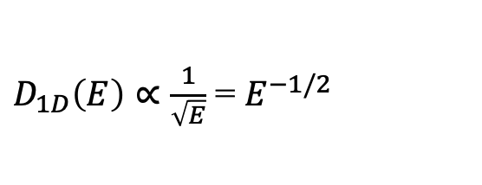
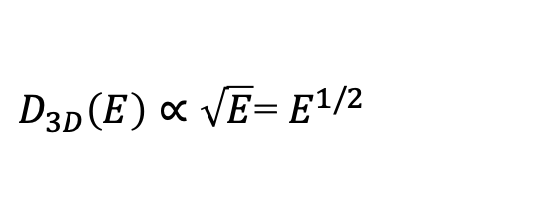
3D-DOS
Macroscopic Sample
H
W
L
2π/H
2π/W
2π/L
$D_{1D}\left(E\right)∝\frac{1}{\sqrt{E}}$ = $E^{−1/2}$
k
K+dk
$$D_{2D}\left(E\right)∝E^{0}$$
$D_{3D}\left(E\right)∝\sqrt{E}$= $E^{1/2}$

Slide 15
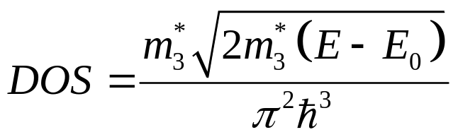


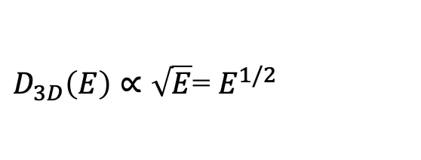
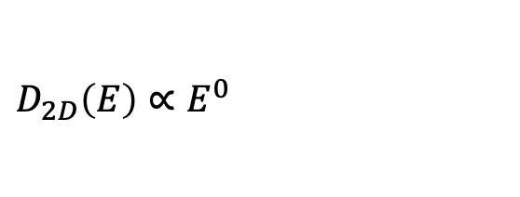
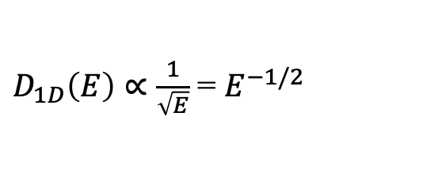
3D-DOS
E
E
$D_{1D}\left(E\right)∝\frac{1}{\sqrt{E}}$ = $E^{−1/2}$
k
DOS
$$D_{2D}\left(E\right)∝E^{0}$$
$D_{3D}\left(E\right)∝\sqrt{E}$= $E^{1/2}$
Conservation of DOS

Slide 16
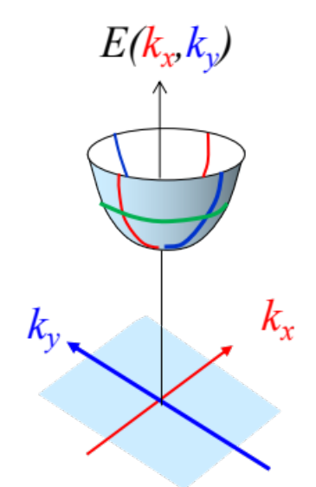
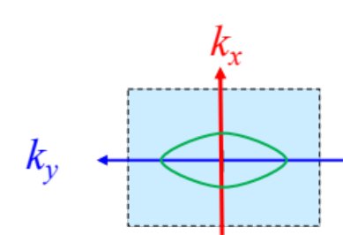
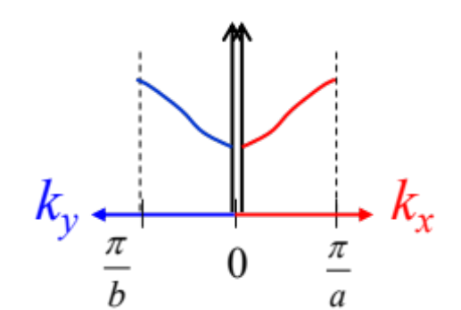
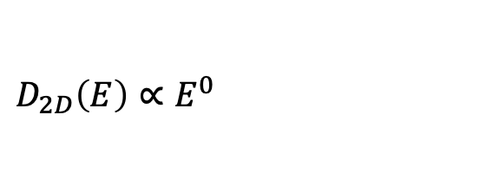
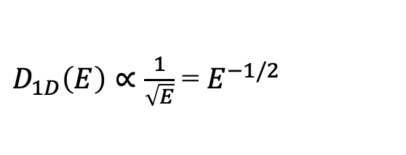
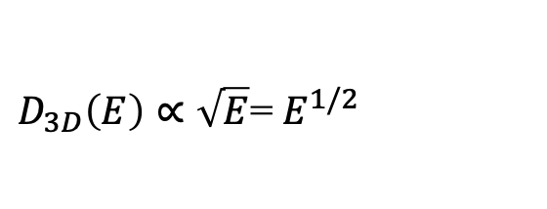
Section 9
Constant Energy Surfaces & Density of States
Original
Problem
Periodic
Structure
E
U
Section 7 – Bandstructure in 1D Periodic Potentials
Section 8 – Brillouin Zone - Reciprocal Lattice
Section 9 – Some fundamental methods
$D_{1D}\left(E\right)∝\frac{1}{\sqrt{E}}$ = $E^{−1/2}$
Video
9.1 Constant Energy Surfaces
9.2 Density of States
$$D_{2D}\left(E\right)∝E^{0}$$
status
Video
$D_{3D}\left(E\right)∝\sqrt{E}$= $E^{1/2}$

