Slide 1
Section 8
Brillouin Zone and Reciprocal Lattice
Solid State Devices

Slide 2

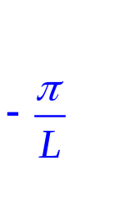

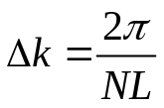
Section 8
Brillouin Zone and Reciprocal Lattice
Original
Problem
Periodic
Structure
E
E
U
Section 7 – Bandstructure in 1D Periodic Potentials
8.1 1D Brillouin Zone - Reciprocal Lattice
8.2 2D
8.3 3D
k
Reference: Vol. 6, Ch. 3
Daniel Mejia, Gerhard Klimeck (2019), "Periodic Potential Lab - Kronig Penney Model,
" https://nanohub.org/resources/kronigpenneylab. (DOI: 10.21981/TT2Y-A185).

Slide 3
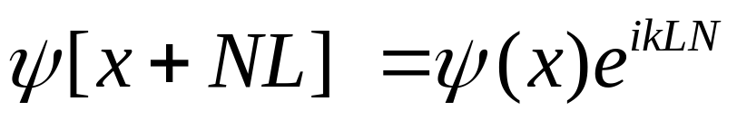
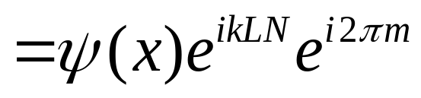
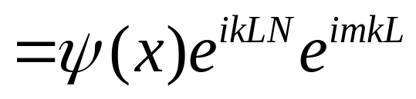
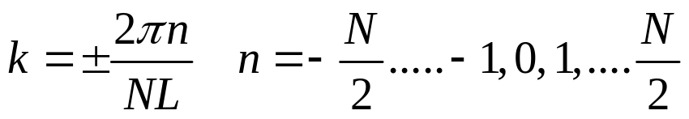
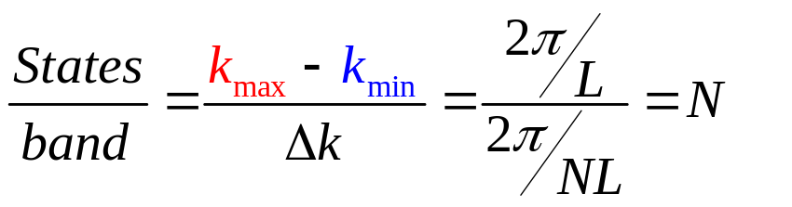
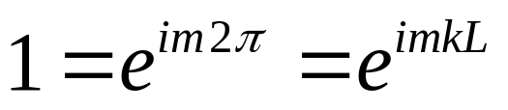
1D Brillouin Zone and Number of States
L
E
Physical
Real Space
1
2
3
….
x
N-1
k
4 states per atom, N atoms
=> 4 bands, N states in each band
All states are included in the first zone
Invariant to shift by

Slide 4
1D Brillouin Zone and Number of States
L
E
Physical
Real Space
1
2
3
….
x
N-1
k
4 states per atom, N atoms
=> 4 bands, N states in each band
All states are included in the first zone
Invariant to shift by

Slide 5

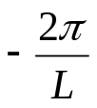


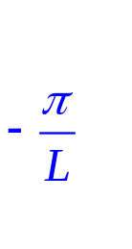
1D Brillouin Zone and Number of States
L
E
Physical
Real Space
1
2
3
….
x
N-1
k-lattice
k
Reciprocal
Space
Brillouin
Zone
Collapse of a periodic (infinite) space into a discrete space
k
4 states per atom, N atoms
=> 4 bands, N states in each band
All states are included in the first zone
Invariant to shift by

Slide 6


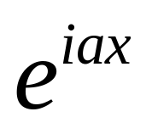
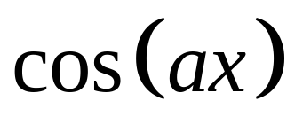





Fourier Transform Reminders
Space Mapping
Periodic => discrete
Collapse of a periodic (infinite) space into a discrete space
finite <=> infinite
infinite <=> infinite

Slide 7
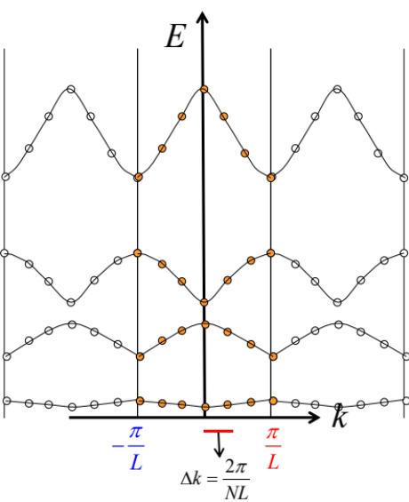
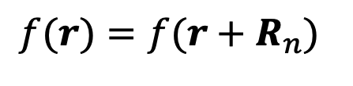
Critical Conceptual Steps
Basis State Selection
  Physical problem is based on a 1D/2D/3D periodic array of atoms
  Desired system/signal response is periodic in space
  Physical space is infinitely extended
    Can the physical space be collapsed into a different representation?
  Chose a basis system of plane waves
  New finite reciprocal space is representative of the original system
Solution of the Schrödinger Equation
  Solution with plane waves in reciprocal space
  1D solution performed in Kronig-Penney model (last Section 7)
    Band formation
$$f(r)=f(r+R_{n})$$
Collapse of a periodic (infinite) space into a discrete space

Slide 8
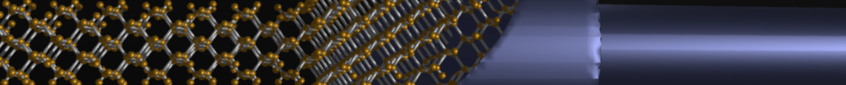
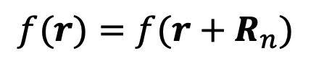
Section 8
Brillouin Zone and Reciprocal Lattice
8.1 1D Problems
  Brillouin Zone
  Solution strategy
  Reciprocal Lattice
8.2 2D Problems
  Reciprocal Lattice Recipe
  Examples - Square and Hexagonal
8.3 3D Problems
  Reciprocal Lattice Recipe
  Examples
One Video Segment
status
One Video Segment
$$f(r)=f(r+R_{n})$$
One Video Segment
Collapse of a periodic (infinite) space into a discrete space
Prasad Sarangapani, Arun Goud Akkala, Sebastian Steiger, Hong-Hyun Park, Yosef Borga, Tillmann Christoph Kubis, Michael Povolotskyi, Gerhard Klimeck (2014),
"Brillouin Zone Viewer," https://nanohub.org/resources/brillouin. (DOI: 10.4231/D3DB7VQ35).

Slide 9
Section 8
Brillouin Zone and Reciprocal Lattice
8.1 1D Problems
  Brillouin Zone
  Solution strategy
  Reciprocal Lattice
8.2 2D Problems
  Reciprocal Lattice Recipe
  Examples - Square and Hexagonal
8.3 3D Problems
  Reciprocal Lattice Recipe
  Examples
One Video Segment
status
One Video Segment
$$f(r)=f(r+R_{n})$$
One Video Segment
Collapse of a periodic (infinite) space into a discrete space
Prasad Sarangapani, Arun Goud Akkala, Sebastian Steiger, Hong-Hyun Park, Yosef Borga, Tillmann Christoph Kubis, Michael Povolotskyi, Gerhard Klimeck (2014),
"Brillouin Zone Viewer," https://nanohub.org/resources/brillouin. (DOI: 10.4231/D3DB7VQ35).

Slide 10
Section 8
Brillouin Zone and Reciprocal Lattice
Solid State Devices
8.2 2D Problems

Slide 11
Section 8
Brillouin Zone and Reciprocal Lattice
8.1 1D Problems
  Brillouin Zone
  Solution strategy
  Reciprocal Lattice
8.2 2D Problems
  Reciprocal Lattice Recipe
  Examples - Square and Hexagonal
8.3 3D Problems
  Reciprocal Lattice Recipe
  Examples
One Video Segment
status
One Video Segment
$$f(r)=f(r+R_{n})$$
One Video Segment
Prasad Sarangapani, Arun Goud Akkala, Sebastian Steiger, Hong-Hyun Park, Yosef Borga, Tillmann Christoph Kubis, Michael Povolotskyi, Gerhard Klimeck (2014),
"Brillouin Zone Viewer," https://nanohub.org/resources/brillouin. (DOI: 10.4231/D3DB7VQ35).

Slide 12
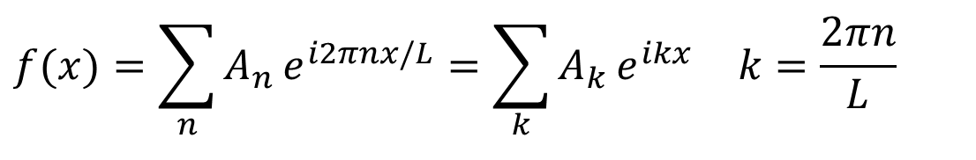
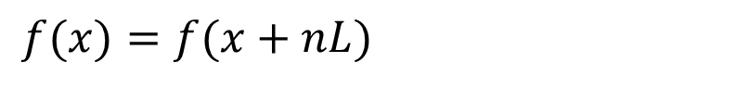
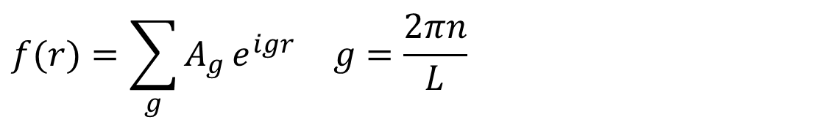
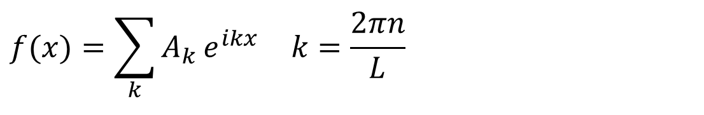
Reciprocal Space in 1D
$$f(x)=f(x+nL)$$
A 1D periodic function:
can be expanded in a Fourier series:
$$f(x)=\sum_{n}{A_{n}}e^{i2πnx/L}=\sum_{k}{A_{k}}e^{ikx} k=\frac{2πn}{L}$$
The Fourier components are defined on a discrete set of periodically arranged points (analogy: frequencies) in a reciprocal space to physical coordinate space.
There are multiple notations in the literature:
$$f(x)=\sum_{k}{A_{k}}e^{ikx} k=\frac{2πn}{L}$$
$$f(r)=\sum_{g}{A_{g}}e^{igr} g=\frac{2πn}{L}$$

Slide 13
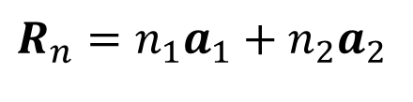
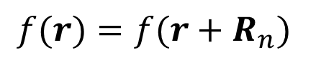
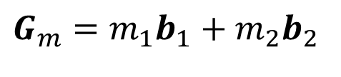
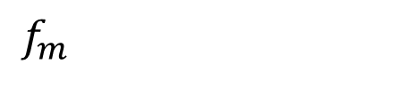
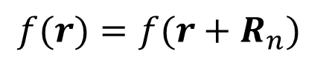
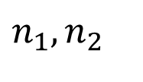
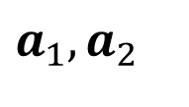
Fourier Expansion of any Periodic Function in 2D
$$f(r)=f(r+R_{n})$$
$$R_{n}=n_{1}a_{1}+n_{2}a_{2}$$
$$a_{1}, a_{2}$$
Primitive Bravais Lattice Vectors
$$n_{1},n_{2}$$
Any integer
Fourier expansion
$$f_{m}$$
Fourier coefficients
$$G_{m}=m_{1}b_{1}+m_{2}b_{2}$$
=> Reciprocal Space Basis
What is the Reciprocal Space Basis – Given a Bravais Lattice?
$$f(r)=f(r+R_{n})$$
with
Results in:
This requires that:
=>
https://en.wikipedia.org/wiki/Reciprocal_lattice

Slide 14
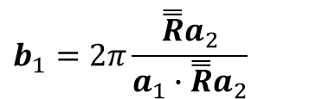

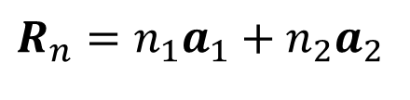
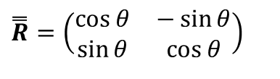
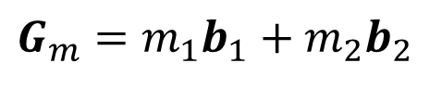
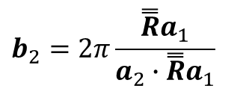
Reciprocal Space of a 2D Bravis Lattice
$$f(r)=f(r+R_{n})$$
$$R_{n}=n_{1}a_{1}+n_{2}a_{2}$$
$$a_{1}, a_{2}$$
Primitive Bravais Lattice Vectors
$$n_{1},n_{2}$$
Any integer
Fourier expansion
$$f_{m}$$
Fourier coefficients
$$G_{m}=m_{1}b_{1}+m_{2}b_{2}$$
=> Reciprocal Space Basis
What is the Reciprocal Space Basis – Given a Bravais Lattice?
This requires that:
=>
=> Reciprocal Space Basis
$$G_{m}=m_{1}b_{1}+m_{2}b_{2}$$
Is the Fourier Transform of Bravais Lattice
$$R_{n}=n_{1}a_{1}+n_{2}a_{2}$$
$$b_{1}=2π\frac{\overset{̿}{R}a_{2}}{a_{1}∙\overset{̿}{R}a_{2}}$$
$$b_{2}=2π\frac{\overset{̿}{R}a_{1}}{a_{2}∙\overset{̿}{R}a_{1}}$$
$$\overset{̿}{R}=\left(\begin{matrix}\cos{θ} & −\sin{θ} \\ \sin{θ} & \cos{θ}\end{matrix}\right)$$
$$\cos{θ}=a_{1}∙a_{2}$$
https://en.wikipedia.org/wiki/Reciprocal_lattice
This is the full 2D Recipe!

Slide 15
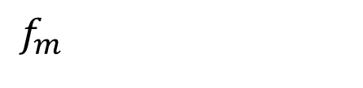
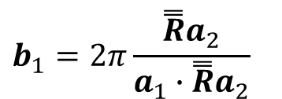
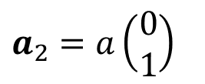
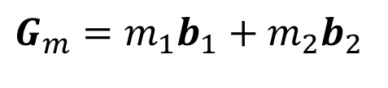
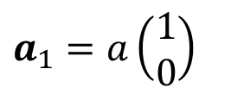

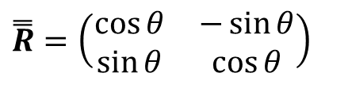
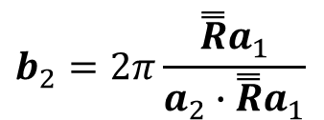
Reciprocal Space of a 2D Square Lattice
$$f(r)=f(r+R_{n})$$
$$R_{n}=n_{1}a_{1}+n_{2}a_{2}$$
$$a_{1}, a_{2}$$
Primitive Bravais Lattice Vectors
$$n_{1},n_{2}$$
Any integer
$$f_{m}$$
Fourier coefficients
$$G_{m}=m_{1}b_{1}+m_{2}b_{2}$$
=> Reciprocal Space Basis
$$b_{1}=2π\frac{\overset{̿}{R}a_{2}}{a_{1}∙\overset{̿}{R}a_{2}}$$
$$b_{2}=2π\frac{\overset{̿}{R}a_{1}}{a_{2}∙\overset{̿}{R}a_{1}}$$
$$\overset{̿}{R}=\left(\begin{matrix}\cos{θ} & −\sin{θ} \\ \sin{θ} & \cos{θ}\end{matrix}\right)$$
$$\cos{θ}=a_{1}∙a_{2}$$
This is the full 2D Recipe!
https://en.wikipedia.org/wiki/Reciprocal_lattice
Example of a square lattice:
$$a_{1}=a\left(\begin{matrix}1 \\ 0\end{matrix}\right)$$
$$a_{2}=a\left(\begin{matrix}0 \\ 1\end{matrix}\right)$$

Slide 16
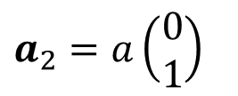
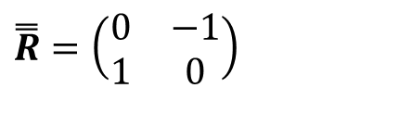
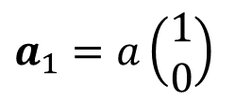

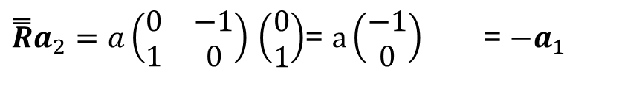

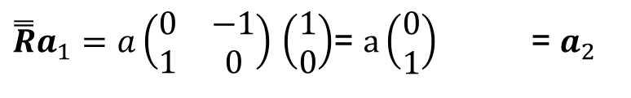
Reciprocal Space of a 2D Square Lattice
$$f(r)=f(r+R_{n})$$
$$R_{n}=n_{1}a_{1}+n_{2}a_{2}$$
$$a_{1}, a_{2}$$
Primitive Bravais Lattice Vectors
$$n_{1},n_{2}$$
Any integer
$$f_{m}$$
Fourier coefficients
$$G_{m}=m_{1}b_{1}+m_{2}b_{2}$$
=> Reciprocal Space Basis
$$b_{1}=2π\frac{\overset{̿}{R}a_{2}}{a_{1}∙\overset{̿}{R}a_{2}}$$
$$b_{2}=2π\frac{\overset{̿}{R}a_{1}}{a_{2}∙\overset{̿}{R}a_{1}}$$
$$\overset{̿}{R}=\left(\begin{matrix}\cos{θ} & −\sin{θ} \\ \sin{θ} & \cos{θ}\end{matrix}\right)$$
$$\cos{θ}=a_{1}∙a_{2}$$
This is the full 2D Recipe!
Example of a square lattice:
$$a_{1}=a\left(\begin{matrix}1 \\ 0\end{matrix}\right)$$
$$a_{2}=a\left(\begin{matrix}0 \\ 1\end{matrix}\right)$$
=>
=>
$$\overset{̿}{R}=\left(\begin{matrix}0 & −1 \\ 1 & 0\end{matrix}\right)$$
=>
$$θ=90$$
$$\cos{θ}=a_{1}∙a_{2}=0$$
$\overset{̿}{R}a_{1}=a\left(\begin{matrix}0 & −1 \\ 1 & 0\end{matrix}\right)$ $\left(\begin{matrix}1 \\ 0\end{matrix}\right)$= $a\left(\begin{matrix}0 \\ 1\end{matrix}\right)$ = $a_{2}$
$\overset{̿}{R}a_{2}=a\left(\begin{matrix}0 & −1 \\ 1 & 0\end{matrix}\right)$ $\left(\begin{matrix}0 \\ 1\end{matrix}\right)$= $a\left(\begin{matrix}−1 \\ 0\end{matrix}\right)$ = ${−a}_{1}$
https://en.wikipedia.org/wiki/Reciprocal_lattice

Slide 17

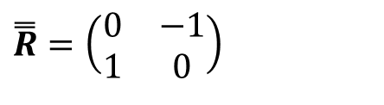
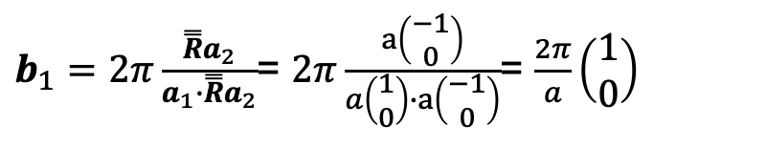
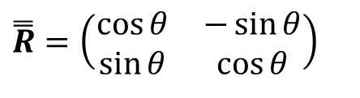


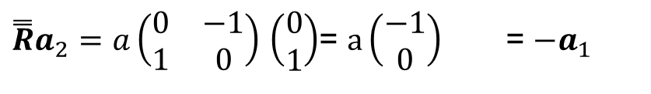
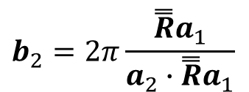
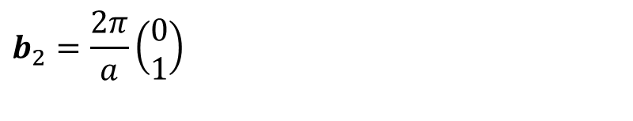







Reciprocal Space of a 2D Square Lattice
$$f(r)=f(r+R_{n})$$
$$R_{n}=n_{1}a_{1}+n_{2}a_{2}$$
$$a_{1}, a_{2}$$
Primitive Bravais Lattice Vectors
$$n_{1},n_{2}$$
Any integer
$$G_{m}=m_{1}b_{1}+m_{2}b_{2}$$
=> Reciprocal Space Basis
$$b_{1}=2π\frac{\overset{̿}{R}a_{2}}{a_{1}∙\overset{̿}{R}a_{2}}$$
$$b_{2}=2π\frac{\overset{̿}{R}a_{1}}{a_{2}∙\overset{̿}{R}a_{1}}$$
$$\overset{̿}{R}=\left(\begin{matrix}\cos{θ} & −\sin{θ} \\ \sin{θ} & \cos{θ}\end{matrix}\right)$$
$$\cos{θ}=a_{1}∙a_{2}$$
Example of a square lattice:
$$a_{1}=a\left(\begin{matrix}1 \\ 0\end{matrix}\right)$$
$$a_{2}=a\left(\begin{matrix}0 \\ 1\end{matrix}\right)$$
=>
=>
$$\overset{̿}{R}=\left(\begin{matrix}0 & −1 \\ 1 & 0\end{matrix}\right)$$
=>
$$θ=90$$
$$\cos{θ}=a_{1}∙a_{2}=0$$
$\overset{̿}{R}a_{1}=a\left(\begin{matrix}0 & −1 \\ 1 & 0\end{matrix}\right)$ $\left(\begin{matrix}1 \\ 0\end{matrix}\right)$= $a\left(\begin{matrix}0 \\ 1\end{matrix}\right)$ = $a_{2}$
$\overset{̿}{R}a_{2}=a\left(\begin{matrix}0 & −1 \\ 1 & 0\end{matrix}\right)$ $\left(\begin{matrix}0 \\ 1\end{matrix}\right)$= $a\left(\begin{matrix}−1 \\ 0\end{matrix}\right)$ = ${−a}_{1}$
$b_{1}=2π\frac{\overset{̿}{R}a_{2}}{a_{1}∙\overset{̿}{R}a_{2}}$= $2π\frac{a\left(\begin{matrix}−1 \\ 0\end{matrix}\right)}{a\left(\begin{matrix}1 \\ 0\end{matrix}\right)∙a\left(\begin{matrix}−1 \\ 0\end{matrix}\right)}$= $\frac{2π}{a}\left(\begin{matrix}1 \\ 0\end{matrix}\right)$
$b_{2}=2π\frac{\overset{̿}{R}a_{1}}{a_{2}∙\overset{̿}{R}a_{1}}$= $2π\frac{a\left(\begin{matrix}0 \\ 1\end{matrix}\right)}{a\left(\begin{matrix}0 \\ 1\end{matrix}\right)∙a\left(\begin{matrix}0 \\ 1\end{matrix}\right)}$= $\frac{2π}{a}\left(\begin{matrix}0 \\ 1\end{matrix}\right)$
$$b_{1}=\frac{2π}{a}\left(\begin{matrix}1 \\ 0\end{matrix}\right)$$
$$b_{2}=\frac{2π}{a}\left(\begin{matrix}0 \\ 1\end{matrix}\right)$$
https://en.wikipedia.org/wiki/Reciprocal_lattice

Slide 18



Reciprocal Space of a 2D Square Lattice
$$f(r)=f(r+R_{n})$$
$$R_{n}=n_{1}a_{1}+n_{2}a_{2}$$
$$a_{1}, a_{2}$$
Primitive Bravais Lattice Vectors
$$n_{1},n_{2}$$
Any integer
$$G_{m}=m_{1}b_{1}+m_{2}b_{2}$$
=> Reciprocal Space Basis
$$b_{1}=2π\frac{\overset{̿}{R}a_{2}}{a_{1}∙\overset{̿}{R}a_{2}}$$
$$b_{2}=2π\frac{\overset{̿}{R}a_{1}}{a_{2}∙\overset{̿}{R}a_{1}}$$
$$\overset{̿}{R}=\left(\begin{matrix}\cos{θ} & −\sin{θ} \\ \sin{θ} & \cos{θ}\end{matrix}\right)$$
$$\cos{θ}=a_{1}∙a_{2}$$
Example of a square lattice:
$$a_{1}=a\left(\begin{matrix}1 \\ 0\end{matrix}\right)$$
$$a_{2}=a\left(\begin{matrix}0 \\ 1\end{matrix}\right)$$
$$b_{1}=\frac{2π}{a}\left(\begin{matrix}1 \\ 0\end{matrix}\right)$$
$$b_{2}=\frac{2π}{a}\left(\begin{matrix}0 \\ 1\end{matrix}\right)$$
Square ⬄ Square
Wigner Seitz algorithm
=> unit cell in reciprocal space.
https://en.wikipedia.org/wiki/Reciprocal_lattice
https://upload.wikimedia.org/wikipedia/commons/thumb/2/22/Brillouin_zone.svg/

Slide 19

Reciprocal Space of a 2D Hexagonal Lattice
$$f(r)=f(r+R_{n})$$
$$R_{n}=n_{1}a_{1}+n_{2}a_{2}$$
$$a_{1}, a_{2}$$
Primitive Bravais Lattice Vectors
$$n_{1},n_{2}$$
Any integer
$$G_{m}=m_{1}b_{1}+m_{2}b_{2}$$
=> Reciprocal Space Basis
$$b_{1}=2π\frac{\overset{̿}{R}a_{2}}{a_{1}∙\overset{̿}{R}a_{2}}$$
$$b_{2}=2π\frac{\overset{̿}{R}a_{1}}{a_{2}∙\overset{̿}{R}a_{1}}$$
$$\overset{̿}{R}=\left(\begin{matrix}\cos{θ} & −\sin{θ} \\ \sin{θ} & \cos{θ}\end{matrix}\right)$$
$$\cos{θ}=a_{1}∙a_{2}$$
Example of a square lattice:
$$a_{1}=a\left(\begin{matrix}1 \\ 0\end{matrix}\right)$$
$$a_{2}=a\left(\begin{matrix}0 \\ 1\end{matrix}\right)$$
$$b_{1}=\frac{2π}{a}\left(\begin{matrix}1 \\ 0\end{matrix}\right)$$
$$b_{2}=\frac{2π}{a}\left(\begin{matrix}0 \\ 1\end{matrix}\right)$$
Example of a hexagonal lattice:
Wigner Seitz algorithm
=> unit cell in reciprocal space.
https://en.wikipedia.org/wiki/Reciprocal_lattice
https://upload.wikimedia.org/wikipedia/commons/thumb/2/22/Brillouin_zone.svg/
https://en.wikipedia.org/wiki/Brillouin_zone
The number of lattices to “test students” on is limited!

Slide 20




Reciprocal Spaces of 2D Bravais Lattices
$$f(r)=f(r+R_{n})$$
$$R_{n}=n_{1}a_{1}+n_{2}a_{2}$$
$$a_{1}, a_{2}$$
Primitive Bravais Lattice Vectors
$$a_{1}=a\left(\begin{matrix}1 \\ 0\end{matrix}\right)$$
$$a_{2}=a\left(\begin{matrix}0 \\ 1\end{matrix}\right)$$
$$n_{1},n_{2}$$
Any integer
Example of a square lattice:
$$G_{m}=m_{1}b_{1}+m_{2}b_{2}$$
=> Reciprocal Space Basis
$$b_{1}=−\frac{2π}{a}\left(\begin{matrix}1 \\ 0\end{matrix}\right)$$
$$b_{2}=\frac{2π}{a}\left(\begin{matrix}0 \\ 1\end{matrix}\right)$$
$$b_{1}=2π\frac{\overset{̿}{R}a_{2}}{a_{1}∙\overset{̿}{R}a_{2}}$$
$$b_{2}=2π\frac{\overset{̿}{R}a_{1}}{a_{2}∙\overset{̿}{R}a_{1}}$$
$$\overset{̿}{R}=\left(\begin{matrix}\cos{θ} & −\sin{θ} \\ \sin{θ} & \cos{θ}\end{matrix}\right)$$
$$\cos{θ}=a_{1}∙a_{2}$$
Example of a hexagonal lattice:
The number of lattices to “test students” on is limited!
https://en.wikipedia.org/wiki/Reciprocal_lattice
https://upload.wikimedia.org/wikipedia/commons/thumb/2/22/Brillouin_zone.svg/
https://en.wikipedia.org/wiki/Brillouin_zone

Slide 21





Section 8
Brillouin Zone and Reciprocal Lattice
8.1 1D Problems
  Brillouin Zone
  Solution strategy
  Reciprocal Lattice
8.2 2D Problems
  Reciprocal Lattice Recipe
  Examples - Square and Hexagonal
8.3 3D Problems
  Reciprocal Lattice Recipe
  Examples
$$f(r)=f(r+R_{n})$$
One Video Segment
$$b_{1}=2π\frac{\overset{̿}{R}a_{2}}{a_{1}∙\overset{̿}{R}a_{2}}$$
$$b_{2}=2π\frac{\overset{̿}{R}a_{1}}{a_{2}∙\overset{̿}{R}a_{1}}$$
One Video Segment
$$\cos{θ}=a_{1}∙a_{2}$$
$$\overset{̿}{R}=\left(\begin{matrix}\cos{θ} & −\sin{θ} \\ \sin{θ} & \cos{θ}\end{matrix}\right)$$
status
One Video Segment
Prasad Sarangapani, Arun Goud Akkala, Sebastian Steiger, Hong-Hyun Park, Yosef Borga, Tillmann Christoph Kubis, Michael Povolotskyi, Gerhard Klimeck (2014),
"Brillouin Zone Viewer," https://nanohub.org/resources/brillouin. (DOI: 10.4231/D3DB7VQ35).

Slide 22
Section 8
Brillouin Zone and Reciprocal Lattice
8.1 1D Problems
  Brillouin Zone
  Solution strategy
  Reciprocal Lattice
8.2 2D Problems
  Reciprocal Lattice Recipe
  Examples - Square and Hexagonal
8.3 3D Problems
  Reciprocal Lattice Recipe
  Examples
$$f(r)=f(r+R_{n})$$
One Video Segment
$$b_{1}=2π\frac{\overset{̿}{R}a_{2}}{a_{1}∙\overset{̿}{R}a_{2}}$$
$$b_{2}=2π\frac{\overset{̿}{R}a_{1}}{a_{2}∙\overset{̿}{R}a_{1}}$$
One Video Segment
$$\cos{θ}=a_{1}∙a_{2}$$
$$\overset{̿}{R}=\left(\begin{matrix}\cos{θ} & −\sin{θ} \\ \sin{θ} & \cos{θ}\end{matrix}\right)$$
status
One Video Segment
Prasad Sarangapani, Arun Goud Akkala, Sebastian Steiger, Hong-Hyun Park, Yosef Borga, Tillmann Christoph Kubis, Michael Povolotskyi, Gerhard Klimeck (2014),
"Brillouin Zone Viewer," https://nanohub.org/resources/brillouin. (DOI: 10.4231/D3DB7VQ35).

Slide 23
Section 8
Brillouin Zone and Reciprocal Lattice
Solid State Devices
8.3 3D Problems

Slide 24
Section 8
Brillouin Zone and Reciprocal Lattice
8.1 1D Problems
  Brillouin Zone
  Solution strategy
  Reciprocal Lattice
8.2 2D Problems
  Reciprocal Lattice Recipe
  Examples - Square and Hexagonal
8.3 3D Problems
  Reciprocal Lattice Recipe
  Examples
$$f(r)=f(r+R_{n})$$
One Video Segment
$$b_{1}=2π\frac{\overset{̿}{R}a_{2}}{a_{1}∙\overset{̿}{R}a_{2}}$$
$$b_{2}=2π\frac{\overset{̿}{R}a_{1}}{a_{2}∙\overset{̿}{R}a_{1}}$$
One Video Segment
$$\cos{θ}=a_{1}∙a_{2}$$
$$\overset{̿}{R}=\left(\begin{matrix}\cos{θ} & −\sin{θ} \\ \sin{θ} & \cos{θ}\end{matrix}\right)$$
status
One Video Segment
Prasad Sarangapani, Arun Goud Akkala, Sebastian Steiger, Hong-Hyun Park, Yosef Borga, Tillmann Christoph Kubis, Michael Povolotskyi, Gerhard Klimeck (2014),
"Brillouin Zone Viewer," https://nanohub.org/resources/brillouin. (DOI: 10.4231/D3DB7VQ35).

Slide 25














Reciprocal Spaces of 2D & 3D Bravais Lattices
$$f(r)=f(r+R_{n})$$
$$R_{n}=n_{1}a_{1}+n_{2}a_{2}$$
$$a_{1}, a_{2}$$
Primitive Bravais Lattice Vectors
$$n_{1},n_{2},m_{1},m_{2}$$
Any integer
$$G_{m}=m_{1}b_{1}+m_{2}b_{2}$$
=> Reciprocal Space Basis
$$b_{1}=2π\frac{\overset{̿}{R}a_{2}}{a_{1}∙\overset{̿}{R}a_{2}}$$
$$b_{2}=2π\frac{\overset{̿}{R}a_{1}}{a_{2}∙\overset{̿}{R}a_{1}}$$
$$\overset{̿}{R}=\left(\begin{matrix}\cos{θ} & −\sin{θ} \\ \sin{θ} & \cos{θ}\end{matrix}\right)$$
$$\cos{θ}=a_{1}∙a_{2}$$
$$R_{n}=n_{1}a_{1}+n_{2}a_{2}+n_{3}a_{3}$$
$$a_{1}, a_{2}, a_{3}$$
Primitive Bravais Lattice Vectors
$$n_{1},n_{2},n_{3}$$
Any integer
$$G_{m}=m_{1}b_{1}+m_{2}b_{2}+m_{3}b_{3}$$
$$m_{1},m_{2},m_{3}$$
$$b_{1}=2π\frac{a_{2}×a_{3}}{a_{1}∙\left(a_{2}×a_{3}\right)}$$
$$b_{2}=2π\frac{a_{3}×a_{1}}{a_{2}∙\left(a_{3}×a_{1}\right)}$$
$$b_{3}=2π\frac{a_{1}×a_{2}}{a_{3}∙\left(a_{1}×a_{2}\right)}$$
Do a quick sanity check!
This is the full 3D Recipe!
https://en.wikipedia.org/wiki/Reciprocal_lattice
The number of lattices to “test students” on is limited!

Slide 26








Reciprocal Spaces of 3D Bravais Lattices
$$f(r)=f(r+R_{n})$$
$$R_{n}=n_{1}a_{1}+n_{2}a_{2}+n_{3}a_{3}$$
$$a_{1}, a_{2}, a_{3}$$
Primitive Bravais Lattice Vectors
$$n_{1},n_{2},n_{3}$$
Any integer
$$G_{m}=m_{1}b_{1}+m_{2}b_{2}+m_{3}b_{3}$$
$$m_{1},m_{2},m_{3}$$
$$b_{1}=2π\frac{a_{2}×a_{3}}{a_{1}∙\left(a_{2}×a_{3}\right)}$$
$$b_{2}=2π\frac{a_{3}×a_{1}}{a_{2}∙\left(a_{3}×a_{1}\right)}$$
$$b_{3}=2π\frac{a_{1}×a_{2}}{a_{3}∙\left(a_{1}×a_{2}\right)}$$
This is the full 3D Recipe!
Wigner Seitz algorithm
=> unit cell in reciprocal space
The number of lattices to “test students” on is limited!
https://en.wikipedia.org/wiki/Reciprocal_lattice

Slide 27
Wigner-Seitz Method for Reciprocal Space
Primitive cell in real space
Unit-cell in reciprocal lattice
a2
b1
a1
b2

Slide 28











Reciprocal Lattice of a Cube
Brillouin Zone in Cubic Lattice …
$$b_{1}=2π\frac{a_{2}×a_{3}}{a_{1}∙\left(a_{2}×a_{3}\right)}$$
$$b_{2}=2π\frac{a_{3}×a_{1}}{a_{2}∙\left(a_{3}×a_{1}\right)}$$
$$b_{3}=2π\frac{a_{1}×a_{2}}{a_{3}∙\left(a_{1}×a_{2}\right)}$$
$$a_{2}×a_{3}∥a_{1}$$
$${ b}_{1}∥a_{1}$$
$$a_{3}×a_{1}∥a_{2}$$
$${ b}_{2}∥a_{2}$$
$$a_{1}×a_{2}∥a_{3}$$
$${ b}_{3}∥a_{3}$$
Real Space
Cubic Lattice
Reciprocal Lattice
Brillouin Zone
Follow W-S algorithm, but
now for reciprocal lattice

Slide 29



Reciprocal Lattices and Brillouin Zone in Real FCC Lattices …
Real Space FCC
(for Si, Ge, GaAs)
Brillouin Zone of
Reciprocal Lattice
Reciprocal Lattice
Diamond lattice and bcc are
Fourier Transforms of each other!

Slide 30

Brillouin Zone in Real FCC Lattices …
Real Space FCC
(for Si, Ge, GaAs)
Brillouin Zone of
Reciprocal Lattice
Reciprocal Lattice
π/a
Diamond lattice and bcc are
Fourier Transforms of each other!
0.87∗π/a
Note unlike cubic lattice, zone edge is not at π/a

Slide 31

Brillouine Zone is Space Filling
Brillouin Zone of
Reciprocal Lattice
π/a
0.87∗π/a
Note unlike cubic lattice, zone edge is not at π/a

Slide 32



Critical Conceptual Steps
Basis State Selection
  Physical problem is based on a 1D/2D/3D periodic array of atoms
  Desired system/signal response is periodic in space
  Physical space is infinitely extended
    Can the physical space be collapsed into a different representation?
  Chose a basis system of plane waves
  New finite reciprocal space is representative of the original system
  In 2D and 3D the reciprocal space may have critical axes/symmetries
Solution of the Schrödinger Equation
  Solution with plane waves in reciprocal space
  1D solution performed in Kronig-Penney model (last Section 7)
    Band formation
  2D/3D solution along critical paths in the reciprocal space (next Section 9)
$$f(r)=f(r+R_{n})$$

Slide 33



Section 8
Brillouin Zone and Reciprocal Lattice
8.1 1D Problems
  Brillouin Zone
  Solution strategy
  Reciprocal Lattice
8.2 2D Problems
  Reciprocal Lattice Recipe
  Examples - Square and Hexagonal
8.3 3D Problems
  Reciprocal Lattice Recipe
  Examples
$$f(r)=f(r+R_{n})$$
One Video Segment
$$b_{1}=2π\frac{\overset{̿}{R}a_{2}}{a_{1}∙\overset{̿}{R}a_{2}}$$
$$b_{2}=2π\frac{\overset{̿}{R}a_{1}}{a_{2}∙\overset{̿}{R}a_{1}}$$
One Video Segment
$$\cos{θ}=a_{1}∙a_{2}$$
$$\overset{̿}{R}=\left(\begin{matrix}\cos{θ} & −\sin{θ} \\ \sin{θ} & \cos{θ}\end{matrix}\right)$$
$$b_{1}=2π\frac{a_{2}×a_{3}}{a_{1}∙\left(a_{2}×a_{3}\right)}$$
One Video Segment
$$b_{2}=2π\frac{a_{3}×a_{1}}{a_{2}∙\left(a_{3}×a_{1}\right)}$$
$$b_{3}=2π\frac{a_{1}×a_{2}}{a_{3}∙\left(a_{1}×a_{2}\right)}$$
Prasad Sarangapani, Arun Goud Akkala, Sebastian Steiger, Hong-Hyun Park, Yosef Borga, Tillmann Christoph Kubis, Michael Povolotskyi, Gerhard Klimeck (2014),
"Brillouin Zone Viewer," https://nanohub.org/resources/brillouin. (DOI: 10.4231/D3DB7VQ35).

