Slide 1
Section 6
Electron Tunneling – Emergence of Bandstructure
Solid State Devices

Slide 2
Section 6
Electron Tunneling – Emergence of Bandstructure
Video
6.1 Transfer Matrix Method
6.2 Tunneling through a single barrier
  Analytical Solution
  Numerical observations
6.3 Tunneling through a double barrier structure
  Resonant Transmission
  Transmission Peak Width
6.4 Tunneling through N barriers - Formation of bandstructure
  N wells – N Peaks
  S states per well – S Bands
6.5 Analytical and Numerical Solution Strategies
  Analytical segmentation
  Transfer Matrix Method
  Discretizing Schrödinger’s equation for numerical implementations
Video Segment
Video Segment
Video Segment
Video Segment
Reference:
piece-wise-constant-potential-barrier tool http://nanohub.org/tools/pcpbt

Slide 3
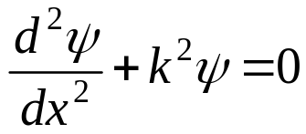
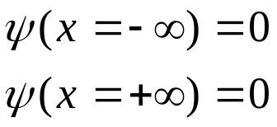

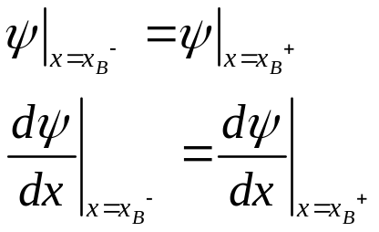
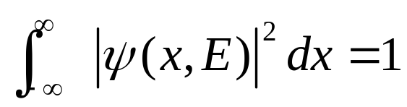
Reminder of Section 5
Analytical Solutions to Free and Bound Electrons
Original
Problem
Periodic
Structure
E
Case 1:
Free electron
E >> U
1)
2)
Case 3:
Electron in finite well
E < U
U
3)
Case 2:
Electron in infinite well
E << U
Det (coefficient matrix)=0
And find E by graphical
or numerical solution
4)
Section 5
Section 5.1 – Free and Tightly Bound Electrons
  Time Independent Schrödinger Equation
  (Almost) Free Electrons
  Tightly bound electrons – infinite potential well
Section 5.2 - Electrons in a finite potential well
5)

Slide 4
Reminder of Section 5
Analytical Solutions to Free and Bound Electrons
Original
Problem
Periodic
Structure
E
Case 1:
Free electron
E >> U
1)
2)
Case 3:
Electron in finite well
E < U
U
3)
Tunneling
Case 2:
Electron in infinite well
E << U
Det (coefficient matrix)=0
And find E by graphical
or numerical solution
4)
Section 5
Bound and free states
Not tunneling
5)
Section 6
Electron Tunneling – Emergence of Bandstructure

Slide 5
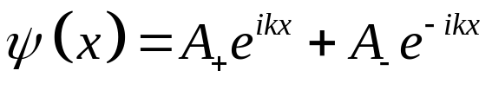
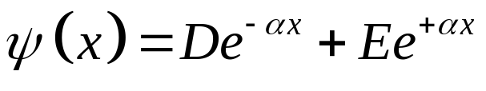
Reminder of Section 5:
Five Steps for Closed System Analytical Solution
Open
Solution Ansatz
2N unknowns
for N regions
1)
2)
Boundary Conditions at the edge
Reduces 2 unknowns
Open
3)
Boundary Condition at each interface:
Set 2N-2 equations for
2N-2 unknowns (for continuous U)
4)
Det (coefficient matrix)=0
And find E by graphical
or numerical solution
5)
Normalization of unity probability
for wave function

Slide 6
Reminder:
Five Steps for Closed System Analytical Solution
Open
1)
2)
3)
4)
Det (coefficient matrix)=0
And find E by graphical
or numerical solution

Slide 7
Transmission through a single barrier
Scattering Matrix approach
Define our system : Single barrier
One matrix each for each interface: 2 S-matrices
Incident : A
D
Transmitted : E
C
Reflected : B
Incident : F
No particles lost! Typically A=1 and F=0.

Slide 8
Transmission through a single barrier
Scattering Matrix approach
Define our system : Single barrier
One matrix each for each interface: 2 S-matrices
Incident : A
D
Transmitted : E
C
Reflected : B
Boundary Conditions at the edge
Reduces 2 unknowns
Open
No particles lost! Typically A=1 and F=0.

Slide 9
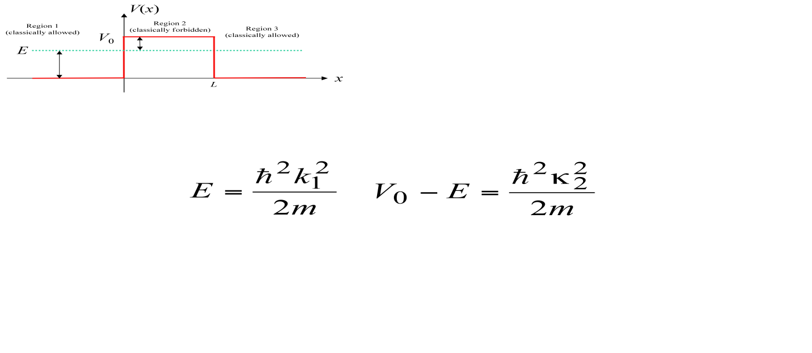
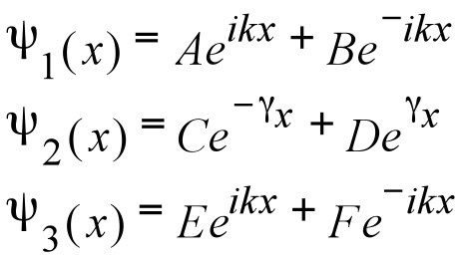
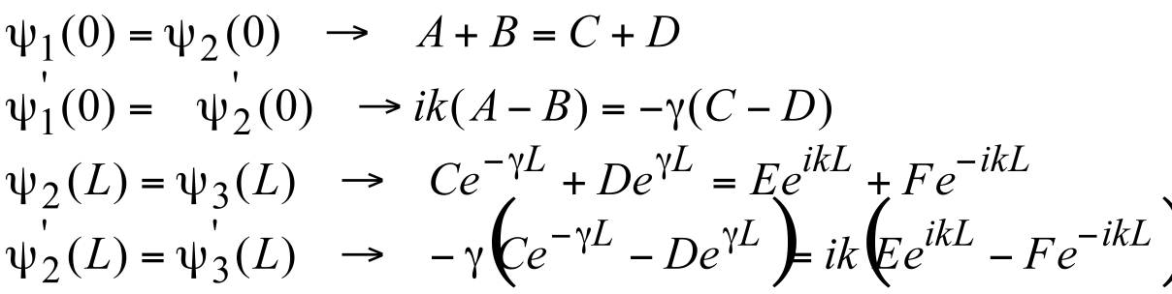
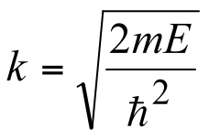
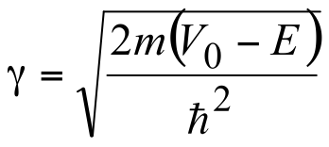
Tunneling through a single barrier
D
Incident : A
Transmitted : E
C
Incident : F
Reflected : B
Wave-function each region,
Applying boundary conditions at each interface (x=0 and x=L) gives,

Slide 10
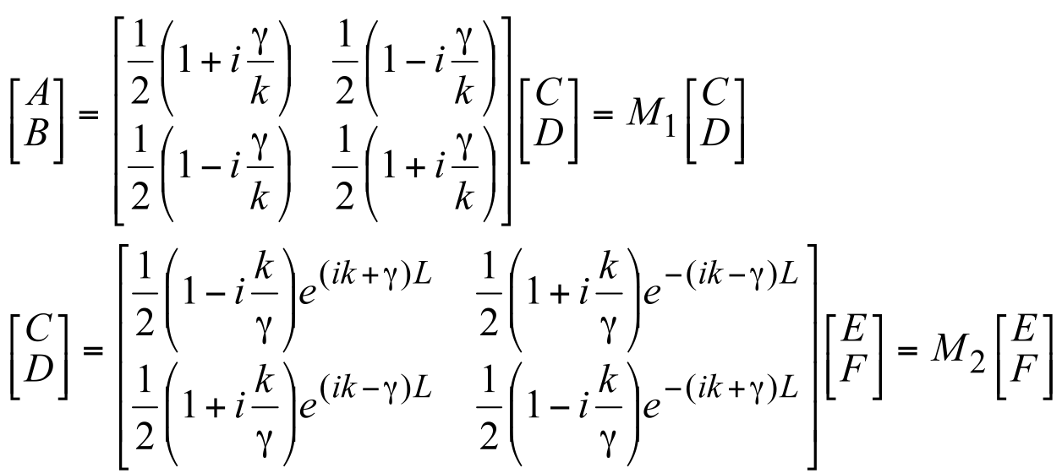
Tunneling through a single barrier
D
Incident : A
Transmitted : E
C
Incident : F
Reflected : B
Applying boundary conditions at each interface (x=0 and x=L) gives,
Wave-function each region,
Applying boundary conditions at each interface (x=0 and x=L) gives,
Which in matrix can be written as,

Slide 11
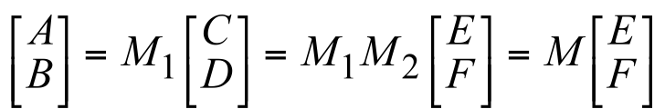
Interface Boundary Conditions
Incident : A
D
Transmitted : E
Reflected : B
C
Incident : F
Wave-function each region,
Applying boundary conditions at each interface (x=0 and x=L) gives,
Which in matrix can be written as,
The complete transfer matrix
A
D
E
B
C
F

Slide 12
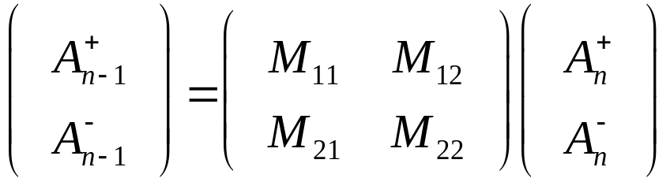
Generalization to Transfer Matrix Method
Applying boundary conditions at each interface (x=0 and x=L) gives,
Incident : A
D
Transmitted : E
Reflected : B
C
Incident : F
Wave-function each region,
Which in matrix can be written as,
The complete transfer matrix
A
D
E
B
C
F
In general for any intermediate set of layers, the TMM is expressed as:

Slide 13

Generalization to Transfer Matrix Method
The complete transfer matrix
A
D
E
B
C
F
In general for any intermediate set of layers, the TMM is expressed as:
For multiple layers the overall transfer matrix will be
Looks conceptually very simple and analytically pleasing
Use it for your homework assignment for a double barrier structure!

Slide 14
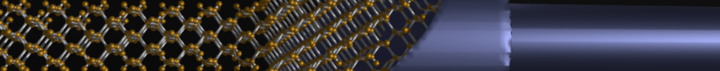
Section 6
Electron Tunneling – Emergence of Bandstructure
6.1 Transfer Matrix Method
6.2 Tunneling through a single barrier
  Analytical Solution
  Numerical observations
6.3 Tunneling through a double barrier structure
  Resonant Transmission
  Transmission Peak Width
6.4 Tunneling through N barriers - Formation of bandstructure
  N wells – N Peaks
  S states per well – S Bands
6.5 Analytical and Numerical Solution Strategies
  Analytical segmentation
  Transfer Matrix Method
  Discretizing Schrödinger’s equation for numerical implementations
Video
status
Video Segment
Video Segment
Video Segment
Video Segment
Reference:
piece-wise-constant-potential-barrier tool http://nanohub.org/tools/pcpbt

Slide 15
Section 6
Electron Tunneling – Emergence of Bandstructure
Video
6.1 Transfer Matrix Method
6.2 Tunneling through a single barrier
  Analytical Solution
  Numerical observations
6.3 Tunneling through a double barrier structure
  Resonant Transmission
  Transmission Peak Width
6.4 Tunneling through N barriers - Formation of bandstructure
  N wells – N Peaks
  S states per well – S Bands
6.5 Analytical and Numerical Solution Strategies
  Analytical segmentation
  Transfer Matrix Method
  Discretizing Schrödinger’s equation for numerical implementations
status
Video Segment
Video Segment
Video Segment
Video Segment
Reference:
piece-wise-constant-potential-barrier tool http://nanohub.org/tools/pcpbt

Slide 16
Section 6
Electron Tunneling – Emergence of Bandstructure
6.2 Tunneling through a single barrier
Solid State Devices

Slide 17
Section 6
Electron Tunneling – Emergence of Bandstructure
Video
6.1 Transfer Matrix Method
6.2 Tunneling through a single barrier
  Analytical Solution
  Numerical observations
6.3 Tunneling through a double barrier structure
  Resonant Transmission
  Transmission Peak Width
6.4 Tunneling through N barriers - Formation of bandstructure
  N wells – N Peaks
  S states per well – S Bands
6.5 Analytical and Numerical Solution Strategies
  Analytical segmentation
  Transfer Matrix Method
  Discretizing Schrödinger’s equation for numerical implementations
status
Video Segment
Video Segment
Video Segment
Video Segment
Reference:
piece-wise-constant-potential-barrier tool http://nanohub.org/tools/pcpbt

Slide 18
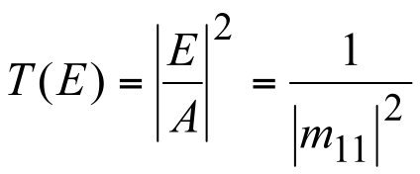
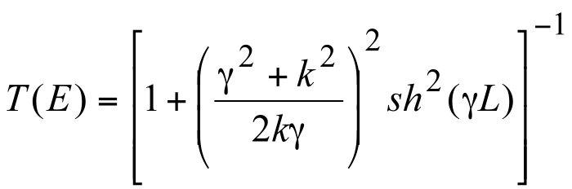
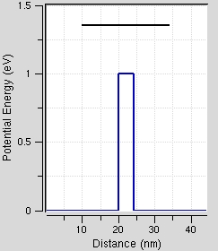
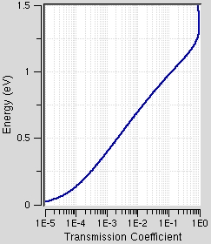
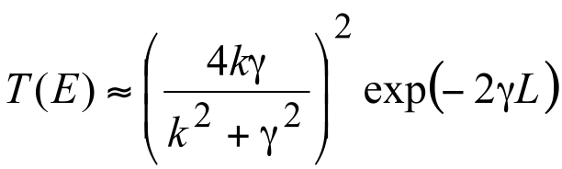
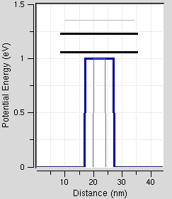
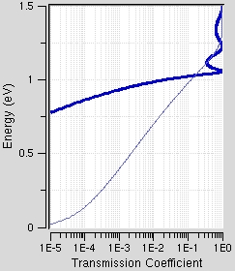
Single Barrier Transmission Solution
A
D
E
B
C
F
Case: E<V_{o} Transmission below barrier
Propagation
Attenuation
/ Decay
Case(γL large): Strong barrier
Exponential decay with
1) barrier width L
2) barrier height V₀
Transmission NOT unity=1
Above Barrier

Slide 19
Single Barrier Transmission Solution
A
D
E
B
C
F
Case: E<V_{o} Transmission below barrier
Propagation
Attenuation
/ Decay
Case(γL large): Strong barrier
Exponential decay with
1) barrier width L
2) barrier height V₀
Transmission NOT unity=1
Above Barrier

Slide 20
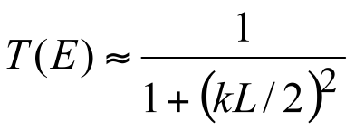
Single Barrier Transmission Solution
Case: E<V_{o} Transmission below barrier
Propagation
Attenuation
/ Decay
Case(γL large): Strong barrier
Exponential decay with
1) barrier width L
2) barrier height V₀
Transmission NOT unity=1
Above Barrier
Case(γL<<1): Weak barrier
Lorentzian decay with
1) barrier width
Independent of barrier height

Slide 21
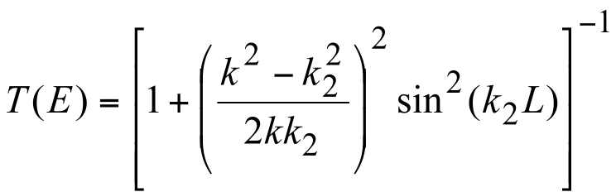
Single Barrier Transmission Solution
Case: E>V_{o} Transmission above barrier
Propagation
Attenuation
/ Decay
k₂=-iγ
Propagation
above barrier
Transmission NOT unity=1
Above Barrier
Case: E<V_{o} Transmission below barrier
Transmission oscillates
Above Barrier
Period is k₂L

Slide 22
Single Barrier Transmission Solution
Case: E<V_{o} Transmission above barrier
Propagation
Attenuation
/ Decay
k₂=-iγ
Propagation
above barrier
Case: E<V_{o} Transmission below barrier
Transmission NOT unity=1
Above Barrier
Transmission oscillates
Above Barrier
Period is k₂L

Slide 23
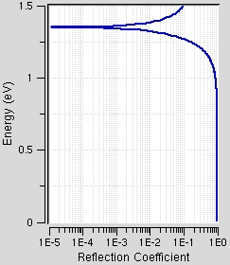
Single Barrier Transmission Solution
Case: E<V_{o} Transmission above barrier
Propagation
Attenuation
/ Decay
k₂=-iγ
Propagation
above barrier
Case: E<V_{o} Transmission below barrier
Transmission NOT unity=1
Above Barrier
Transmission oscillates
Above Barrier
Period is k₂L

Slide 24
Single barrier : Concepts
Reflection
= 1 - T
Transmission is finite under the barrier – tunneling!
Transmission above the barrier is not perfect unity!
Quasi-bound state above the barrier.
Transmission goes to one.
Computed with – http://nanohub.org/tools/pcpbt
Case: E>V_{o}

Slide 25
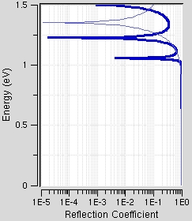
Effect of barrier thickness below the barrier
Increased barrier width reduces tunneling probability
Thicker barrier increase the reflection probability below the barrier height.
Quasi-bound states occur for the
thicker barrier too.
Computed with – http://nanohub.org/tools/pcpbt
Case: E>V_{o}

Slide 26
Single Barrier – Key Summary
Quantum wavefunctions can tunnel through barriers
Tunneling is reduced with increasing barrier height and width
Transmission above the barrier is not unity
  2 interfaces cause constructive and destructive interference
  Quasi bound states are formed that result in unity transmission

Slide 27
Section 6
Electron Tunneling – Emergence of Bandstructure
Video
6.1 Transfer Matrix Method
6.2 Tunneling through a single barrier
  Analytical Solution
  Numerical observations
6.3 Tunneling through a double barrier structure
  Resonant Transmission
  Transmission Peak Width
6.4 Tunneling through N barriers - Formation of bandstructure
  N wells – N Peaks
  S states per well – S Bands
6.5 Analytical and Numerical Solution Strategies
  Analytical segmentation
  Transfer Matrix Method
  Discretizing Schrödinger’s equation for numerical implementations
Video Segment
status
Video Segment
Video Segment
Video Segment
Reference:
piece-wise-constant-potential-barrier tool http://nanohub.org/tools/pcpbt

Slide 28
Section 6
Electron Tunneling – Emergence of Bandstructure
Video
6.1 Transfer Matrix Method
6.2 Tunneling through a single barrier
  Analytical Solution
  Numerical observations
6.3 Tunneling through a double barrier structure
  Resonant Transmission
  Transmission Peak Width
6.4 Tunneling through N barriers - Formation of bandstructure
  N wells – N Peaks
  S states per well – S Bands
6.5 Analytical and Numerical Solution Strategies
  Analytical segmentation
  Transfer Matrix Method
  Discretizing Schrödinger’s equation for numerical implementations
Video Segment
status
Video Segment
Video Segment
Video Segment
Reference:
piece-wise-constant-potential-barrier tool http://nanohub.org/tools/pcpbt

Slide 29
Section 6
Electron Tunneling – Emergence of Bandstructure
6.3 Tunneling through a double barrier structure
Solid State Devices

Slide 30
Section 6
Electron Tunneling – Emergence of Bandstructure
Video
6.1 Transfer Matrix Method
6.2 Tunneling through a single barrier
  Analytical Solution
  Numerical observations
6.3 Tunneling through a double barrier structure
  Resonant Transmission
  Transmission Peak Width
6.4 Tunneling through N barriers - Formation of bandstructure
  N wells – N Peaks
  S states per well – S Bands
6.5 Analytical and Numerical Solution Strategies
  Analytical segmentation
  Transfer Matrix Method
  Discretizing Schrödinger’s equation for numerical implementations
Video Segment
status
Video Segment
Video Segment
Video Segment
Reference:
piece-wise-constant-potential-barrier tool http://nanohub.org/tools/pcpbt

Slide 31
Double Barrier Transmission:
Scattering Matrix approach
Define our system : Double barrier
One matrix each for each interface: 4 S-matrices
Left Incident
Transmitted
Reflected
Right Incident
No particles lost!
Typically Left Incident wave is normalized to one.
Right incident is assumed to be zero.
Also this problem is analytically solvable! => Homework assignment

Slide 32
Reminder: Single barrier
Transmission is finite under the barrier – tunneling!
Transmission above the barrier is not perfect unity!
Quasi-bound state above the barrier.
Transmission goes to one.

Slide 33
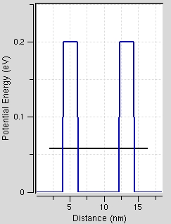
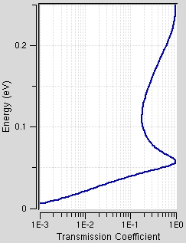
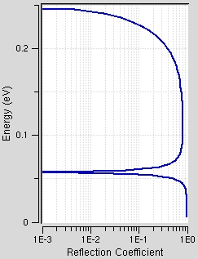
Double barrier: Concepts
Double barriers allow a transmission probability of one / unity for discrete energies
(reflection probability of zero) for some energies below the barrier height.
This is in sharp contrast to the single barrier case
Cannot be predicted by classical physics.

Slide 34
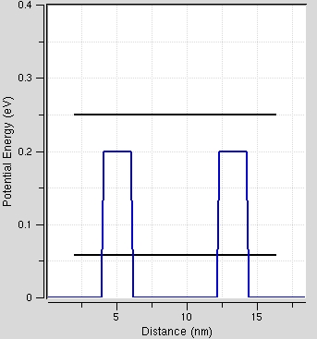
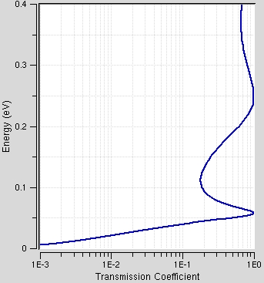
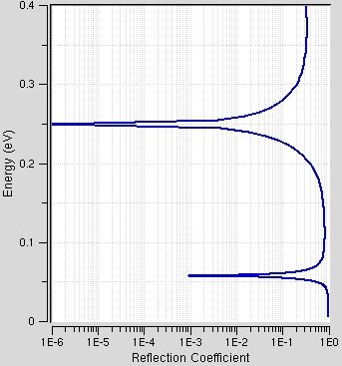
Double barrier: Quasi-bound states
In addition to states inside the well, there could be states above the barrier height.
States above the barrier height are quasi-bound or weakly bound.
How strongly bound a state is can be seen by the width of the transmission peak.
The transmission peak of the quasi-bound state is much broader than the peak for the state inside the well.

Slide 35
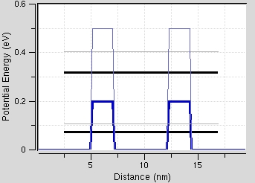
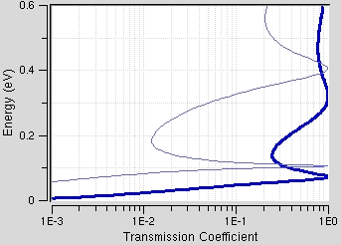
Effect of barrier height
Increasing the barrier height makes the resonance sharper.
By increasing the barrier height, the confinement in the well is made stronger, increasing the lifetime of the resonance.
A longer lifetime corresponds to a sharper resonance.

Slide 36
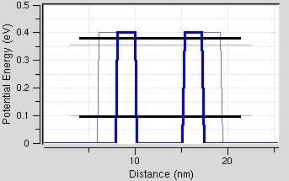
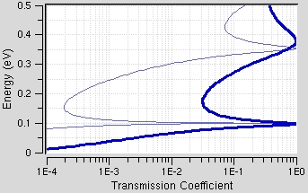
Effect of barrier thickness
Increasing the barrier thickness makes the resonance sharper.
By increasing the barrier thickness, the confinement in the well is made stronger, increasing the lifetime of the resonance.
A longer lifetime corresponds to a sharper resonance.

Slide 37
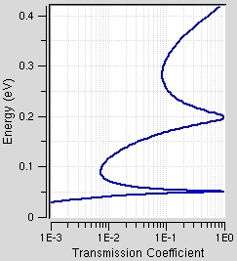
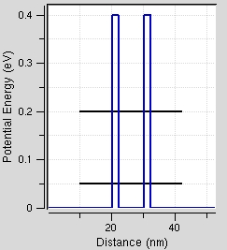
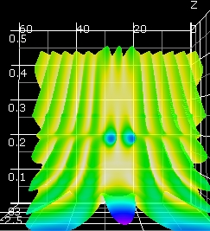
Double barrier energy levels Vs Closed system
The well region in the double barrier case can be thought of as a particle in a box.

Slide 38
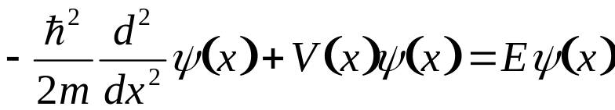
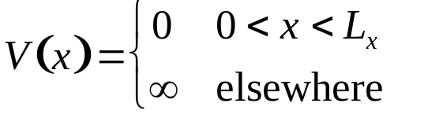
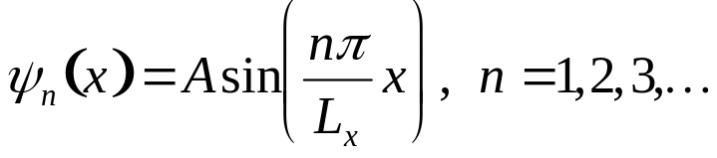


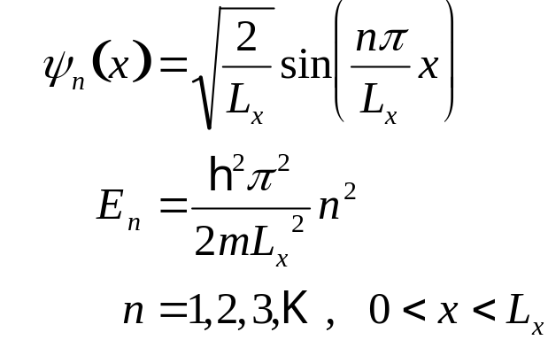






Reminder:
Particle in a Box
The time independent Schrödinger equation is
where,
• The solution in the well is:
• Plugging the normalized wave-functions back into the Schrödinger equation we find that energy levels are quantized.

Slide 39
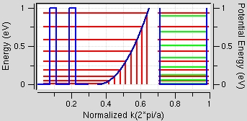
Double barrier & particle in a box
Green: Particle in a box energies.
Red: Double barrier energies
Double barrier: Thick Barriers(10nm), Tall Barriers(1eV), Well(20nm).
First few resonance energies match well with the particle in a box energies.
The well region resembles the particle in a box setup.

Slide 40
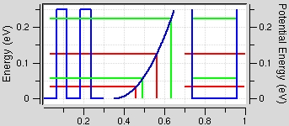
Open systems Vs closed systems
Green: Particle in a box energies.
Red: Double barrier energies
Double barrier: Thinner Barriers(8nm), Shorter Barriers(0.25eV), Well(10nm).
Even the first resonance energy does not match with the particle in a box energy.
The well region does not resemble a particle in a box.
A double barrier structure is an OPEN system, particle in a box is a CLOSED system.

Slide 41
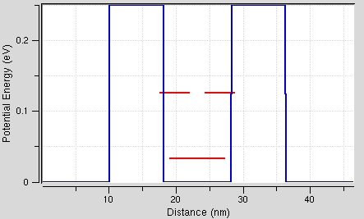
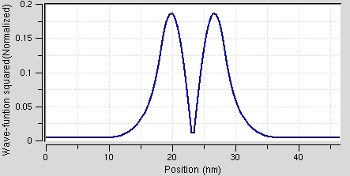
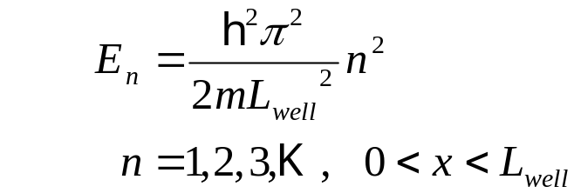
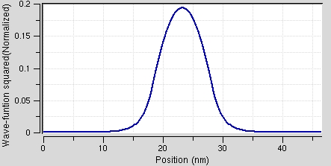
Reason for deviation?
Potential profile and resonance energies using tight-binding.
Wave-function penetrates into the barrier region.
The effective length of the well region is modified.
The effective length of the well is crucial in determining the energy levels in the closed system.
First excited state wave-function amplitude using tight binding.
Ground state wave-function amplitude using tight binding.

Slide 42
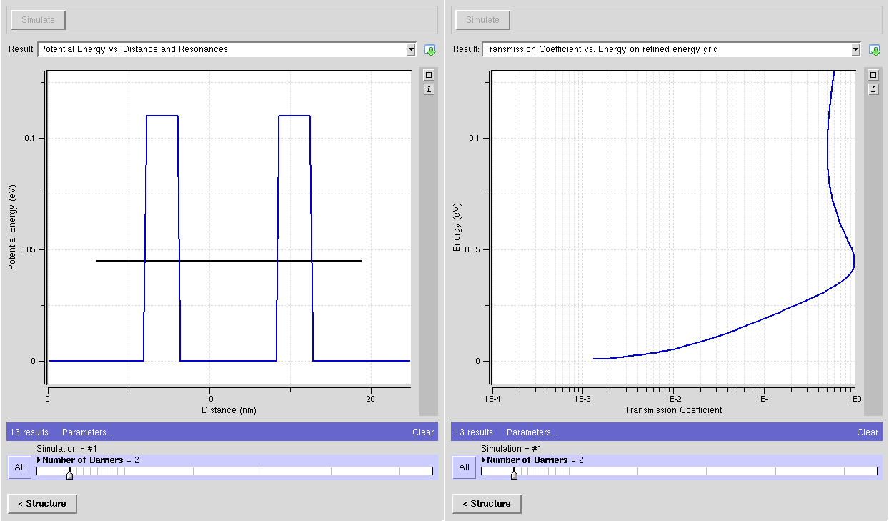
Double Barrier Structures - Key Summary
Double barrier structures can show unity transmission for energies BELOW the barrier height
  Resonant Tunneling
Resonance can be associated with a quasi bound state
  Can relate the bound state to a particle in a box
  State has a finite lifetime / resonance width
Increasing barrier heights and widths:
  Increases resonance lifetime / electron residence time
  Sharpens the resonance width

Slide 43
Section 6
Electron Tunneling – Emergence of Bandstructure
Video
6.1 Transfer Matrix Method
6.2 Tunneling through a single barrier
  Analytical Solution
  Numerical observations
6.3 Tunneling through a double barrier structure
  Resonant Transmission
  Transmission Peak Width
6.4 Tunneling through N barriers - Formation of bandstructure
  N wells – N Peaks
  S states per well – S Bands
6.5 Analytical and Numerical Solution Strategies
  Analytical segmentation
  Transfer Matrix Method
  Discretizing Schrödinger’s equation for numerical implementations
Video Segment
Video Segment
status
Video Segment
Video Segment
Reference:
piece-wise-constant-potential-barrier tool http://nanohub.org/tools/pcpbt

Slide 44
Section 6
Electron Tunneling – Emergence of Bandstructure
Video
6.1 Transfer Matrix Method
6.2 Tunneling through a single barrier
  Analytical Solution
  Numerical observations
6.3 Tunneling through a double barrier structure
  Resonant Transmission
  Transmission Peak Width
6.4 Tunneling through N barriers - Formation of bandstructure
  N wells – N Peaks
  S states per well – S Bands
6.5 Analytical and Numerical Solution Strategies
  Analytical segmentation
  Transfer Matrix Method
  Discretizing Schrödinger’s equation for numerical implementations
Video Segment
Video Segment
status
Video Segment
Video Segment
Reference:
piece-wise-constant-potential-barrier tool http://nanohub.org/tools/pcpbt

Slide 45
Section 6
Electron Tunneling – Emergence of Bandstructure
6.4 Tunneling through N barriers
Solid State Devices

Slide 46
Section 6
Electron Tunneling – Emergence of Bandstructure
Video
6.1 Transfer Matrix Method
6.2 Tunneling through a single barrier
  Analytical Solution
  Numerical observations
6.3 Tunneling through a double barrier structure
  Resonant Transmission
  Transmission Peak Width
6.4 Tunneling through N barriers - Formation of bandstructure
  N wells – N Peaks
  S states per well – S Bands
6.5 Analytical and Numerical Solution Strategies
  Analytical segmentation
  Transfer Matrix Method
  Discretizing Schrödinger’s equation for numerical implementations
Video Segment
Video Segment
status
Video Segment
Video Segment
Reference:
piece-wise-constant-potential-barrier tool http://nanohub.org/tools/pcpbt

Slide 47
Section 6
Electron Tunneling – Emergence of Bandstructure
Video
6.1 Transfer Matrix Method
6.2 Tunneling through a single barrier
  Analytical Solution
  Numerical observations
6.3 Tunneling through a double barrier structure
  Resonant Transmission
  Transmission Peak Width
6.4 Tunneling through N barriers - Formation of bandstructure
  N wells – N Peaks
  S states per well – S Bands
6.5 Analytical and Numerical Solution Strategies
  Analytical segmentation
  Transfer Matrix Method
  Discretizing Schrödinger’s equation for numerical implementations
Video Segment
Video Segment
status
Video Segment
Video Segment
Reference:
piece-wise-constant-potential-barrier tool http://nanohub.org/tools/pcpbt

Slide 48
1 Well => 1 Transmission Peak
Vb=110meV, W=6nm, B=2nm

Slide 49

2 Wells => 2 Transmission Peaks
Vb=110meV, W=6nm, B=2nm Bonding/Anti-bonding State

Slide 50

3 Wells => 3 Transmission Peaks
Vb=110meV, W=6nm, B=2nm

Slide 51

4 Wells => 4 Transmission Peaks
Vb=110meV, W=6nm, B=2nm

Slide 52

5 Wells => 5 Transmission Peaks
Vb=110meV, W=6nm, B=2nm

Slide 53

6 Wells => 6 Transmission Peaks
Vb=110meV, W=6nm, B=2nm

Slide 54

7 Wells => 7 Transmission Peaks
Vb=110meV, W=6nm, B=2nm

Slide 55

8 Wells => 8 Transmission Peaks
Vb=110meV, W=6nm, B=2nm

Slide 56

9 Wells => 9 Transmission Peaks
Bandpass filter formed
Band transmission not symmetric

Slide 57

19 Wells => 19 Transmission Peaks
Bandpass filter formed
Band transmission not symmetric

Slide 58

29 Wells => 29 Transmission Peaks
Bandpass filter formed
Band transmission not symmetric

Slide 59

39 Wells => 39 Transmission Peaks
Bandpass filter formed
Band transmission not symmetric

Slide 60

49 Wells => 49 Transmission Peaks
Bandpass filter formed
Band transmission not symmetric

Slide 61

N Wells => N Transmission Peaks
Bandpass filter formed
Band transmission not symmetric
Bandpass sharpens with
increasing number of wells

Slide 62

1 Well => 1 Transmission Peak => 1 State
Bandpass filter formed
Band transmission not symmetric
Bandpass sharpens with
increasing number of wells

Slide 63

2 Wells => 2 Transmission Peaks => 2 States
Bandpass filter formed
Band transmission not symmetric

Slide 64

3 Wells => 3 Transmission Peaks => 3 States
Bandpass filter formed
Band transmission not symmetric

Slide 65

4 Wells => 4 Transmission Peaks => 4 States
Bandpass filter formed
Band transmission not symmetric

Slide 66

5 Wells => 5 Transmission Peaks => 5 States
Bandpass filter formed
Band transmission not symmetric

Slide 67

6 Wells => 6 Transmission Peaks => 6 States
Bandpass filter formed
Band transmission not symmetric

Slide 68

7 Wells => 7 Transmission Peaks => 7 States
Bandpass filter formed
Band transmission not symmetric

Slide 69

8 Wells => 8 Transmission Peaks => 8 States
Bandpass filter formed
Band transmission not symmetric

Slide 70

9 Wells => 9 Transmission Peaks => 9 States
Bandpass filter formed
Band transmission not symmetric

Slide 71

19 Wells => 19 Transmission Peaks => 19 States
Bandpass filter formed
Band transmission not symmetric

Slide 72

29 Wells => 29 Transmission Peaks => 29 States
Bandpass filter formed
Band transmission not symmetric

Slide 73

39 Wells => 39 Transmission Peaks => 39 States
Bandpass filter formed
Band transmission not symmetric

Slide 74

49 Wells => 49 Transmission Peaks => 49 States
Bandpass filter formed
Band transmission not symmetric
Cosine-like band formed
Band is not symmetric

Slide 75

N Wells => N Transmission Peaks => N States
Bandpass filter formed
Band transmission not symmetric
Cosine-like band formed
Band is not symmetric

Slide 76
N Wells => N States => 1 Band
Vb=110meV, W=6nm, B=2nm => ground state in each well
=> what if there were excited states in each well => Vb=400meV

Slide 77

N Wells => 2N States => 2 Bands
Vb=110meV, W=6nm, B=2nm
Vb=400meV, W=6nm, B=2nm

Slide 78

N Wells => 2N States => 2 Bands
Vb=110meV, W=6nm, B=2nm
1 state/well => 1band
Can we get more states/well?
=> Increase well width
Vb=400meV, W=6nm, B=2nm
2 states/well => 2bands

Slide 79

X States/Well
=> X Bands
Vb=110meV,
W=6nm, B=2nm
1 state/well
=> 1 band
Vb=400meV
W=6nm, B=2nm
2 states/well
=> 2 bands
Vb=400meV
W=10nm, B=2nm
3 states/well
=> 3 bands

Slide 80

X States/Well
=> X Bands
X States/Well
=> X Bands
Vb=110meV,
W=6nm, B=2nm
1 state/well
=> 1 band
Vb=400meV
W=6nm, B=2nm
2 states/well
=> 2 bands
Vb=400meV
W=10nm, B=2nm
3 states/well
=> 3 bands

Slide 81
Formation of energy bands
Each quasi-bond state will give rise to a resonance in a well.
(No. of barriers -1)
Degeneracy is lifted because of interaction between these states.
Cosine-like bands are formed as the number of wells/barriers is increased
Each state per well forms a band
Lower bands have smaller slope = > heavier mass

Slide 82



Section 6
Electron Tunneling – Emergence of Bandstructure
Video
6.1 Transfer Matrix Method
6.2 Tunneling through a single barrier
  Analytical Solution
  Numerical observations
6.3 Tunneling through a double barrier structure
  Resonant Transmission
  Transmission Peak Width
6.4 Tunneling through N barriers - Formation of bandstructure
  N wells – N Peaks
  S states per well – S Bands
6.5 Analytical and Numerical Solution Strategies
  Analytical segmentation
  Transfer Matrix Method
  Discretizing Schrödinger’s equation for numerical implementations
Video Segment
Video Segment
Video Segment
Video Segment
status
Reference:
piece-wise-constant-potential-barrier tool http://nanohub.org/tools/pcpbt

