Slide 1
Section 5
Analytical Solutions to
Free and Bound Electrons
Solid State Devices

Slide 2

Section 5
Analytical Solutions to Free and Bound Electrons
Original
Problem
Periodic
Structure
Case 1:
Free electron
E >> U
E
Case 3:
Electron in finite well
E < U
U
Case 2:
Electron in infinite well
E << U

Slide 3
Section 5
Analytical Solutions to Free and Bound Electrons
Original
Problem
Periodic
Structure
Case 1:
Free electron
E >> U
E
Case 3:
Electron in finite well
E < U
U
Case 2:
Electron in infinite well
E << U
Section 5.1 – Free and Tightly Bound Electrons
  Time Independent Schrödinger Equation
  (Almost) Free Electrons
  Reflection at and Transmission over 1 Step
  Tightly bound electrons – infinite potential well
Section 5.2 - Electrons in a finite potential well
Reference: Vol. 6, Ch. 2 (pages 29-45)
One Video Segment
One Video Segment

Slide 4
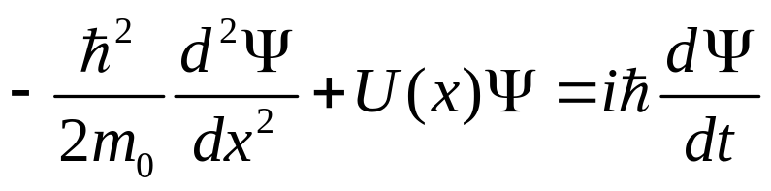
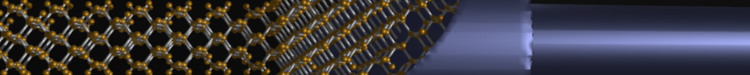
Section 5
Analytical Solutions to Free and Bound Electrons
Original
Problem
Periodic
Structure
E
U
Section 5.1 – Free and Tightly Bound Electrons
  Time Independent Schrödinger Equation
  (Almost) Free Electrons
  Reflection at and Transmission over 1 Step
  Tightly bound electrons – infinite potential well
Section 5.2 - Electrons in a finite potential well
Reference: Vol. 6, Ch. 2 (pages 29-45)
status
One Video Segment
One Video Segment

Slide 5
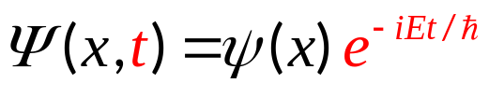
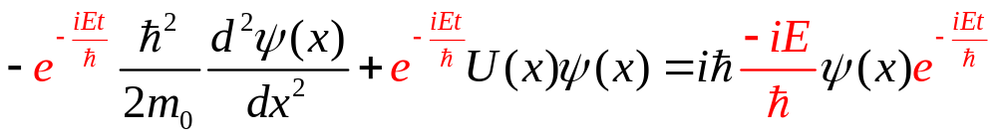
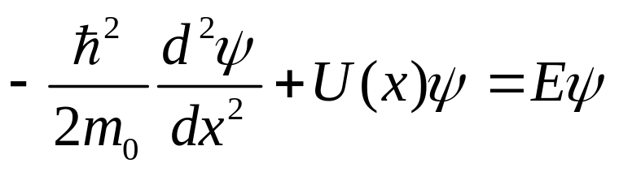
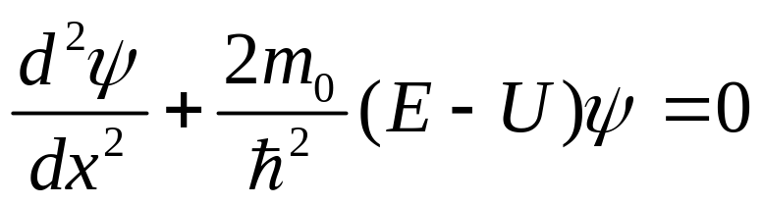
Schrodinger Equation time dependent to time independent
Assume

Slide 6
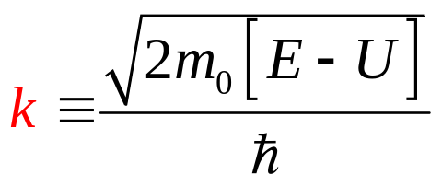
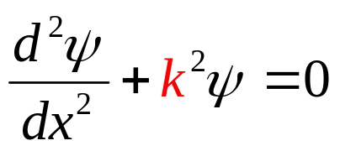
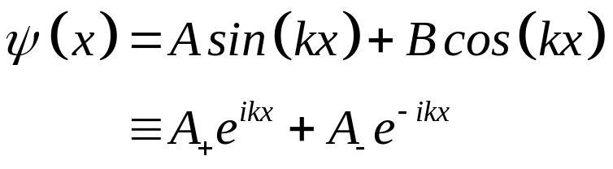
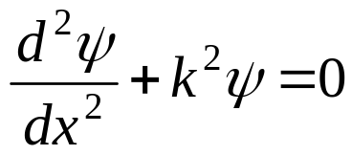
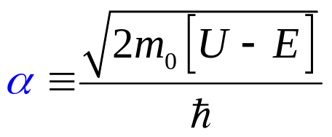
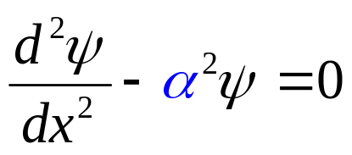
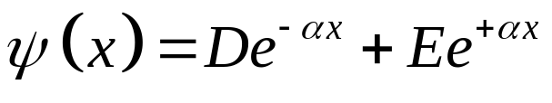
Solution Ansatz to the
Time-independent Schrödinger Equation
If E >U, then ….
If U>E, then ….

Slide 7

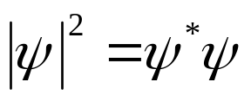
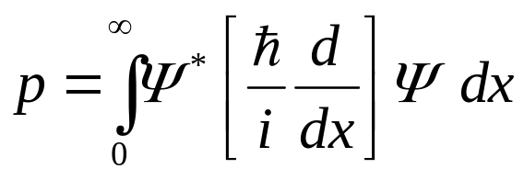
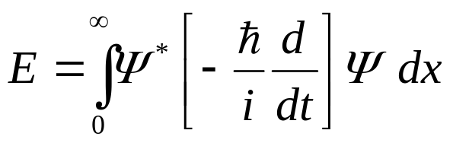
Schrödinger Equation
A Simple Differential Equation
Obtain U(x) and the boundary conditions for a given problem.
Solve the 2nd order equation – pretty basic
Interpret as the probability of finding an electron at x
Compute anything else you need, e.g.,

Slide 8
Section 5
Analytical Solutions to Free and Bound Electrons
Original
Problem
Periodic
Structure
E
Case 1:
Free electron
E >> U
U
Section 5.1 – Free and Tightly Bound Electrons
  Time Independent Schrödinger Equation
  (Almost) Free Electrons
  Reflection at and Transmission over 1 Step
  Tightly bound electrons – infinite potential well
Section 5.2 - Electrons in a finite potential well
Reference: Vol. 6, Ch. 2 (pages 29-45)
status
One Video Segment
One Video Segment

Slide 9
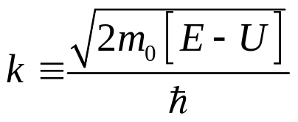
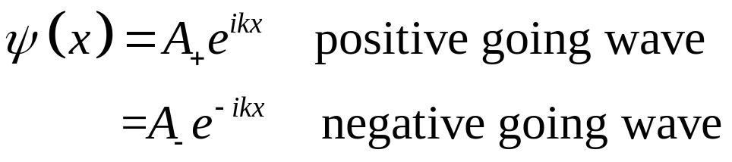
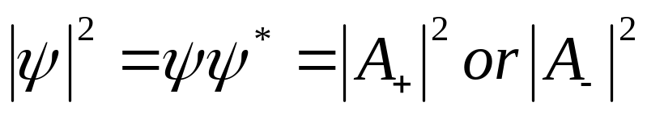
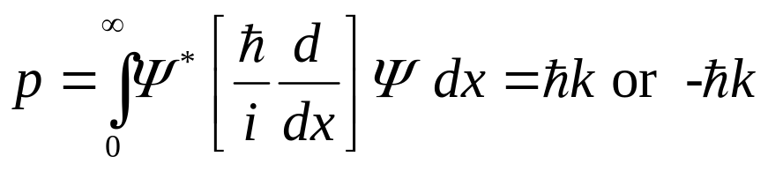
Case 1: Solution for Particles with E>>U
Case 1:
Free electron
E >> U
E
1) Solution
U(x) ~ 0
2) Boundary condition
Probability:
Momentum:

Slide 10
Section 5
Analytical Solutions to Free and Bound Electrons
Original
Problem
Periodic
Structure
E
Case 1:
Free electron
E >> U
U
Section 5.1 – Free and Tightly Bound Electrons
  Time Independent Schrödinger Equation
  (Almost) Free Electrons
  Reflection at and Transmission over 1 Step
  Tightly bound electrons – infinite potential well
Section 5.2 - Electrons in a finite potential well
Reference: Vol. 6, Ch. 2 (pages 29-45)
status
One Video Segment
One Video Segment

Slide 11

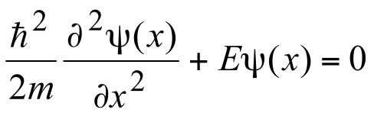
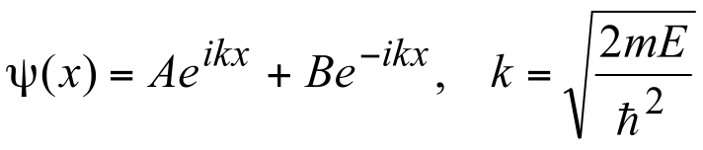
Stationary states for a free particle
TISE for a free particle.
Solution:
All positive energies are allowed and are doubly degenerate.

Slide 12
Scattering Matrix approach for a Single Step
Define our system : Step potential
One matrix represents our system: S-matrix
Incident:A1
Incident:A2
No particles lost!
Reflected:B1
Transmitted:B2
Typical Boundary condition:
A1=1 Incident wave from the left
A2=0 NO incident wave from the right

Slide 13
S-matrix: Consider 2 Cases
Case 1:E<V₀
Waves reflected
V₀
Case 2:E>V₀
Waves transmitted and reflected
V₀

Slide 14
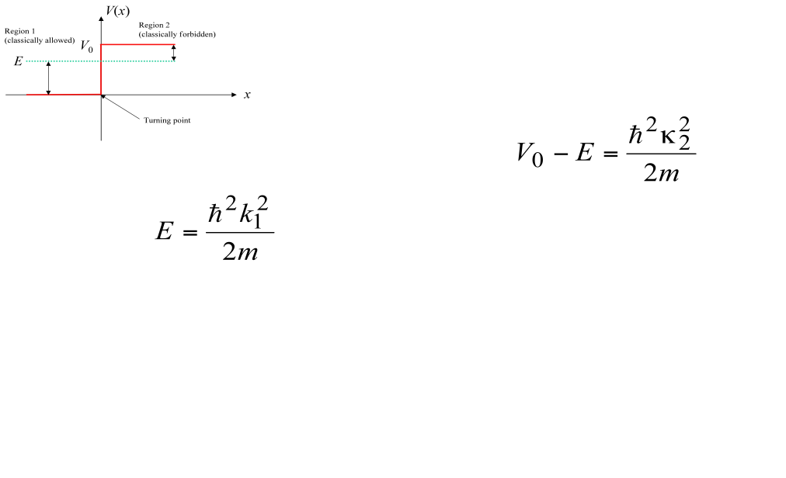
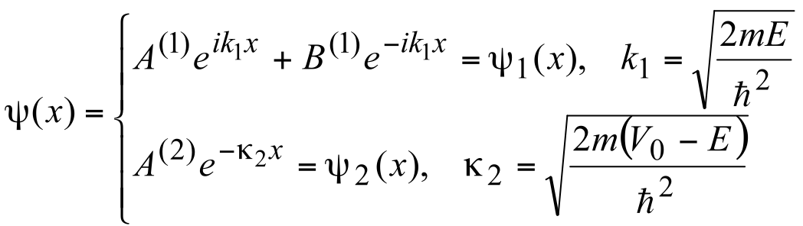
Potential Step:E<Vo
E<V₀
Incident:A1
Reflected:B1
Evanescent:A2
Wave-function in each region.

Slide 15
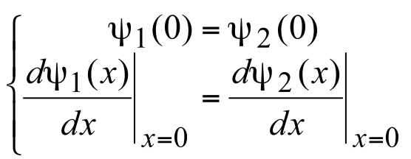
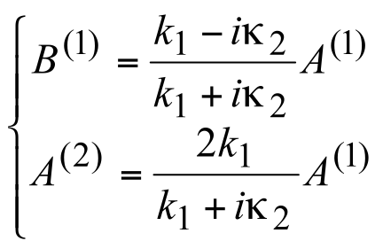
Potential Step: Boundary Conditions
Match wave-functions and the derivatives at each turning point.
We obtain:
Region 1: Standing Waves
Region 2: Evanescent Waves
Classical Physics will also give this result
No probability associated with evanescent waves.

Slide 16
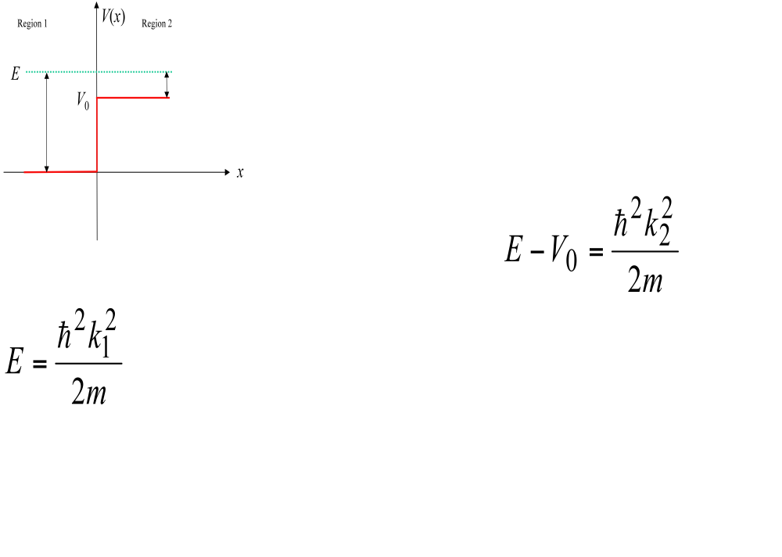
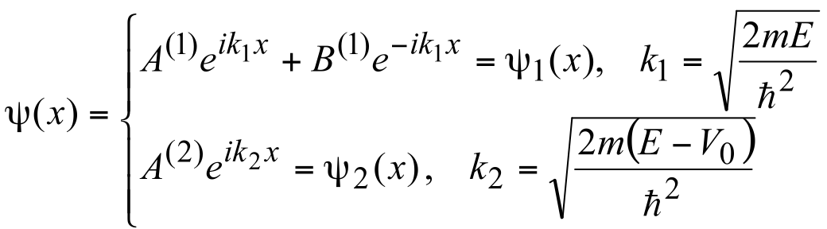
Potential Step: E>Vo
Incident:A1
Transmitted:A2
Reflected:B1
E>V₀
Wave-function in each region.

Slide 17
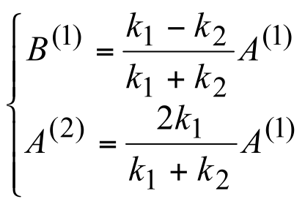
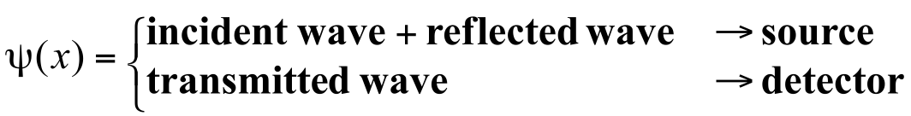
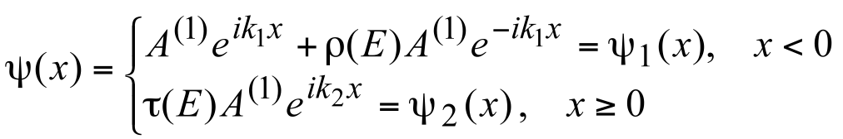


Potential Step: Boundary Conditions
Match wave-functions and the derivatives at the interface.
We can conclude:
We get,

Slide 18
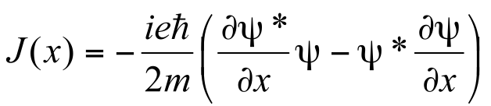
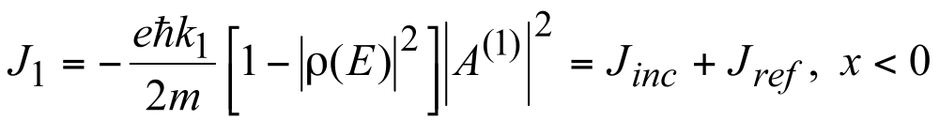
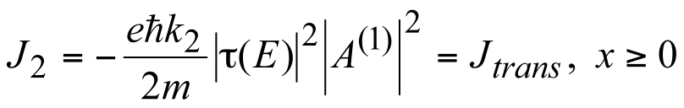
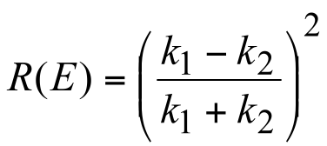
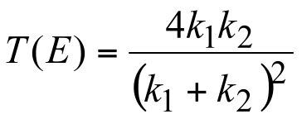
Analysis
Probability Current given by,
We get,
Reflection probability: (Reflected)/(Incident)
Transmission probability: (Transmission)/(Incident)
Results do not agree with classical physics.

Slide 19
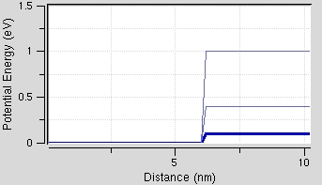
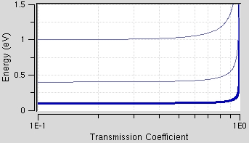
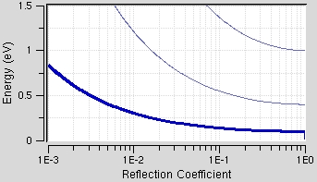
Numerical Example: Transmission and Reflection
3
3
3
2
2
2
1
1
1
Transmission not unity immediately above step.
As the height of the step is increased the transmission takes a wider energy range to go from zero to one.
The gradual change of transmission from zero to one is not comprehended by classical physics.
This gradual change can be understood in terms of the nature of the propagation constant in the two regions.

Slide 20
Key Messages
Electron wave can penetrate into a barrier
Electron wave is not completely transmitted above a barrier
There is a finite reflection above the barrier

Slide 21
Section 5
Analytical Solutions to Free and Bound Electrons
Original
Problem
Periodic
Structure
E
Case 1:
Free electron
E >> U
U
Section 5.1 – Free and Tightly Bound Electrons
  Time Independent Schrödinger Equation
  (Almost) Free Electrons
  Reflection at and Transmission over 1 Step
  Tightly bound electrons – infinite potential well
Section 5.2 - Electrons in a finite potential well
Reference: Vol. 6, Ch. 2 (pages 29-45)
One Video Segment
status
One Video Segment

Slide 22
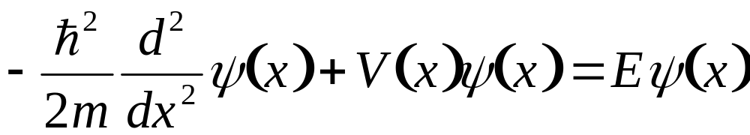

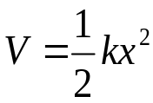

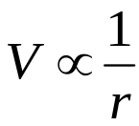





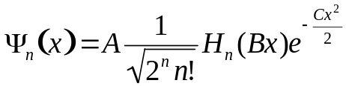



Case 2: Bound State Problems
Mathematical interpretation of Quantum Mechanics(QM)
  Only a few number of problems have exact solutions
  They involve specialized functions
Case 2:
Electron in infinite well
E << U
Coulomb Potential
by nucleus in an atom
Particle in a box
Harmonic Oscillator
Triangular Potential Well

Slide 23
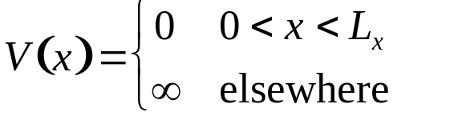
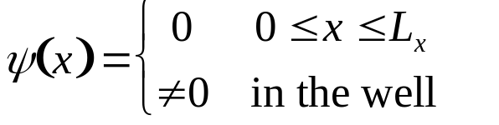
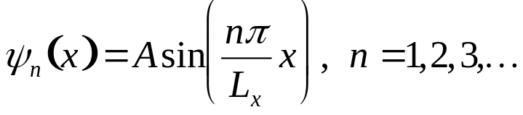
1-D Particle in a Box – A Solution Guess
(Step 1) Formulate time independent Schrödinger equation
Case 2:
Electron in infinite well
E << U
where,
• (Step 2) Use your intuition that the particle will never exist outside the energy barriers to guess,
• (Step 3) Think of a solution in the well as:

Slide 24





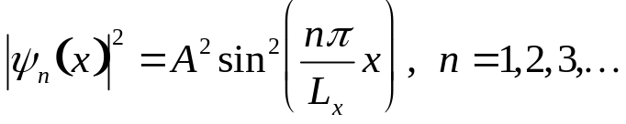
1-D Particle in a Box – Visualization
• (Step 4) Plot first few solutions
Case 2:
Electron in infinite well
E << U
Matches the condition we guessed at step 2!
But what do the NEGATIVE numbers mean?
• (Step 5) Plot corresponding electron densities
The distribution of SINGLE particle
“s-type”
“p-type”
“d-type”
“f-type”
ONE particle => density is normalized to ONE

Slide 25
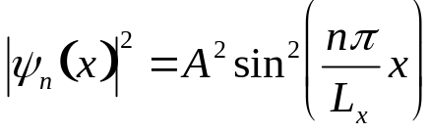
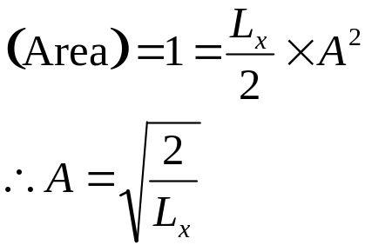



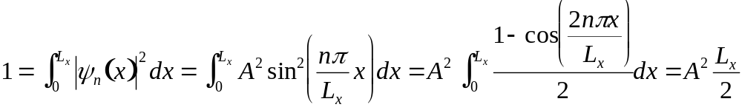


1-D Particle in a Box – Normalization to ONE particle
Case 2:
Electron in infinite well
E << U
(Step 6) Normalization (determine the constant A)
Method 1) Use symmetry property of sinusoidal function
Method 2) Integrate over

Slide 26





1-D Particle in a Box – The Solution
Case 2:
Electron in infinite well
E << U
(Step 7) Plug the wave function back into the Schrödinger equation
Discrete Energy Levels!

Slide 27



1-D Particle in a Box – Quantum vs. Macroscopic
Quantum world → Macroscopic world
Effect of system size
Case 2:
Electron in infinite well
E << U
Energy level spacing becomes smaller as physical dimension increases.
In macroscopic world, where the energy spacing is too small to resolve,
we see continuum of energy values.
Therefore, this electronic quantum phenomenon is only observed in nanoscale environment.
1980s ~ 2000 - A whole research field struggles to make systems small enough to uncover quantum effects reliably

Slide 28
Section 5
Analytical Solutions to Free and Bound Electrons
Original
Problem
Periodic
Structure
E
Case 1:
Free electron
E >> U
U
Section 5.1 – Free and Tightly Bound Electrons
  Time Independent Schrödinger Equation
  (Almost) Free Electrons
  Reflection at and Transmission over 1 Step
  Tightly bound electrons – infinite potential well
Section 5.2 - Electrons in a finite potential well
Reference: Vol. 6, Ch. 2 (pages 29-45)
One Video Segment
status
One Video Segment

Slide 29
Section 5
Analytical Solutions to Free and Bound Electrons
Original
Problem
Periodic
Structure
Case 1:
Free electron
E >> U
E
Case 3:
Electron in finite well
E < U
U
Section 5.1 – Free and Tightly Bound Electrons
  Time Independent Schrödinger Equation
  (Almost) Free Electrons
  Tightly bound electrons – infinite potential well
Section 5.2 - Electrons in a finite potential well
Reference: Vol. 6, Ch. 2 (pages 29-45)
Case 2:
Electron in infinite well
E << U
One Video Segment
status
One Video Segment

Slide 30
Section 5
Analytical Solutions to Free and Bound Electrons
Original
Problem
Periodic
Structure
Case 1:
Free electron
E >> U
E
Case 3:
Electron in finite well
E < U
U
Section 5.1 – Free and Tightly Bound Electrons
  Time Independent Schrödinger Equation
  (Almost) Free Electrons
  Tightly bound electrons – infinite potential well
Section 5.2 - Electrons in a finite potential well
Reference: Vol. 6, Ch. 2 (pages 29-45)
Case 2:
Electron in infinite well
E << U
One Video Segment
status
One Video Segment

Slide 31
Section 5
Analytical Solutions to Free and Bound Electrons
Original
Problem
Periodic
Structure
Case 1:
Free electron
E >> U
E
Case 3:
Electron in finite well
E < U
U
Section 5.1 – Free and Tightly Bound Electrons
  Time Independent Schrödinger Equation
  (Almost) Free Electrons
  Tightly bound electrons – infinite potential well
Section 5.2 - Electrons in a finite potential well
Reference: Vol. 6, Ch. 2 (pages 29-45)
Case 2:
Electron in infinite well
E << U
One Video Segment
status
One Video Segment

Slide 32
Section 5
Analytical Solutions to Free and Bound Electrons
5.2 Electrons in a finite potential well
Solid State Devices

Slide 33
Section 5
Analytical Solutions to Free and Bound Electrons
Original
Problem
Periodic
Structure
Case 1:
Free electron
E >> U
E
Case 3:
Electron in finite well
E < U
U
Section 5.1 – Free and Tightly Bound Electrons
  Time Independent Schrödinger Equation
  (Almost) Free Electrons
  Tightly bound electrons – infinite potential well
Section 5.2 - Electrons in a finite potential well
Reference: Vol. 6, Ch. 2 (pages 29-45)
Case 2:
Electron in infinite well
E << U
One Video Segment
status
One Video Segment

Slide 34
Select a Single Well
Original
Problem
Periodic
Structure
Case 3:
Electron in finite well
E < U
E
U
0
a

Slide 35
Assume Other Wells are De-Coupled
Original
Problem
Periodic
Structure
Case 3:
Electron in finite well
E < U
E
U
Assume the other wells
are very far away
0
a

Slide 36

Assume a Reasonable Wavefunction Shape
Original
Problem
Periodic
Structure
Case 3:
Electron in finite well
E < U
E
U
Assume some general
shape of the wavefunction
Decaying in barrier
Bound
in
well
Decaying in barrier
0
a

Slide 37
Wavefunction Continuity Conditions
Case 3:
Electron in finite well
E < U
Second order differential equation
First and second order differential cannot be infinite!
Wavefunction must be continuous!
First differential must be continuous!
Assume some general
shape of the wavefunction
Decaying in barrier
Bound
in
well
Decaying in barrier
0
a

Slide 38

First Differential Must be Continuous
Case 3:
Electron in finite well
E < U
Second order differential equation
First and second order differential cannot be infinite!
Wavefunction must be continuous!
First differential must be continuous!
Decaying in barrier
Bound
in
well
Decaying in barrier
0
a

Slide 39





Solution Ansatz
Case 3:
Electron in finite well
E < U
$$k≡\frac{\sqrt{2m_{0}E}}{ℏ}$$
$$α≡\frac{\sqrt{2m_{0}\left[U_{0}−E\right]}}{ℏ}$$
U₀
Bound
in
well
0
Decaying in barrier
Decaying in barrier
0
a

Slide 40
Solution Ansatz
Case 3:
Electron in finite well
E < U
$$k≡\frac{\sqrt{2m_{0}E}}{ℏ}$$
$$α≡\frac{\sqrt{2m_{0}\left[U_{0}−E\right]}}{ℏ}$$
U₀
Bound
in
well
0
Decaying in barrier
Decaying in barrier
0
a

Slide 41





Apply Boundary Conditions at Interfaces
3) Boundary at each interface
Case 3:
Electron in finite well
E < U
x=0
+
x=a
U₀
+
0
0
a

Slide 42




Apply Boundary Conditions at Interfaces
Case 3:
Electron in finite well
E < U
Only unknown is E
Use Matlab function
Use graphical method
$$k≡\frac{\sqrt{2m_{0}E}}{ℏ}$$
$$α≡\frac{\sqrt{2m_{0}\left[U_{0}−E\right]}}{ℏ}$$
det (Matrix)=0
U₀
+
0
0
a

Slide 43



Graphical Solution
Case 3:
Electron in finite well
E < U
x₀
E₁
y
x

Slide 44
Graphical Solution
Case 3:
Electron in finite well
E < U
E₁
E₁

Slide 45
Graphical Solution
Case 3:
Electron in finite well
E < U
E₁
E₁
Obtained the eigenvalue => could stop here in many cases
Did not compute the explicit wavefunction yet

Slide 46


Wave Function Normalization
Need another boundary condition!
Case 3:
Electron in finite well
E < U
det (Matrix)=0
=> Linear dependent system
=> Only 3 variables are unique
=> One variable is undetermined
Let’s assume A can be freely Chosen => can get B,C,D

Slide 47

Step 5: Wave-functions
Another boundary condition!
Case 3:
Electron in finite well
E < U
Non-linear => no simple linear algebra expression
=> Linear dependent system
=> Only 3 variables are unique
=> One variable is undetermined
Let’s assume A can be freely Chosen => can get B,C,D

Slide 48


Step 5: Wave-functions
Another boundary condition!
Case 3:
Electron in finite well
E < U
Non-linear => no simple linear algebra expression
Get “A”
Get
“B,C,D”

Slide 49


Five Steps for Closed System Analytical Solution
Solution Ansatz
2N unknowns
for N regions
E
Case 1:
Free electron
E >> U
1)
U
2)
Boundary Conditions at the edge
Reduces 2 unknowns
Case 2:
Electron in infinite well
E << U
3)
Boundary Condition at each interface:
Set 2N-2 equations for
2N-2 unknowns (for continuous U)
Case 3:
Electron in finite well
E < U
4)
Det (coefficient matrix)=0
And find E by graphical
or numerical solution
5)
Normalization of unity probability
for wave function

Slide 50

Key Summary of a Finite Quantum Well
Problem is analytically solvable
Electron energy is quantized and wavefunction is localized
In the classical world:
  Particles are not allowed inside the barriers / walls => C=D=0
In the quantum world:
  C and D have a non-zero value!
  Electrons can tunnel inside a barrier
Case 1:
Free electron
E >> U
E
U
Case 2:
Electron in infinite well
E << U
Case 3:
Electron in finite well
E < U

Slide 51

Key Summary of a Finite Quantum Well
Problem is analytically solvable
Electron energy is quantized and wavefunction is localized
In the classical world:
  Particles are not allowed inside the barriers / walls => C=D=0
In the quantum world:
  C and D have a non-zero value!
  Electrons can tunnel inside a barrier
E
U
Si
SiO₂
Si
Problem is technically relevant
  Confinement under a gate
  Gate tunneling
Case 1:
Free electron
E >> U
Heterostructures in general
  Multiple layered materials
  3D Structures
Applications:
  Transistors
  Optical devices
Case 3:
Electron in finite well
E < U
Case 2:
Electron in infinite well
E << U

Slide 52
Section 5
Analytical Solutions to Free and Bound Electrons
Original
Problem
Periodic
Structure
Case 1:
Free electron
E >> U
E
Case 3:
Electron in finite well
E < U
U
Section 5.1 – Free and Tightly Bound Electrons
  Time Independent Schrödinger Equation
  (Almost) Free Electrons
  Tightly bound electrons – infinite potential well
Section 5.2 - Electrons in a finite potential well
Reference: Vol. 6, Ch. 2 (pages 29-45)
Case 2:
Electron in infinite well
E << U
One Video Segment
status
One Video Segment

