Slide 1

Section 4
Elements of Quantum Mechanics
Solid State Devices

Slide 2
Section 4
Elements of Quantum Mechanics
4.1 Classical Systems
  Particles
  Propagating Waves
  Standing Waves
  Chromatography
4.2 Strange Experimental Results => The Advent of Quantum Mechanics
  Black Body Radiation => light emission is quantized
  Discrete Optical Spectra => light emission/absorption quantized – Bohr Atom
  Photoelectric Effect => light is described by particles
  Particle-Wave Duality
4.3 Why do we need quantum mechanics?
4.4 Formulation of Schrödinger's Eq.
One Video Segment
One Video Segment
One Video Segment
One Video Segment

Slide 3
Section 4
Elements of Quantum Mechanics
4.1 Classical Systems
  Particles
  Propagating Waves
  Standing Waves
  Chromatography
4.2 Strange Experimental Results => The Advent of Quantum Mechanics
  Black Body Radiation => light emission is quantized
  Discrete Optical Spectra => light emission/absorption quantized – Bohr Atom
  Photoelectric Effect => light is described by particles
  Particle-Wave Duality
4.3 Why do we need quantum mechanics?
4.4 Formulation of Schrödinger's Eq.
Classical Macroscopic Particles
One Video Segment
One Video Segment
One Video Segment
One Video Segment

Slide 4
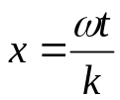
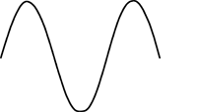
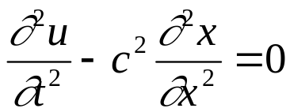
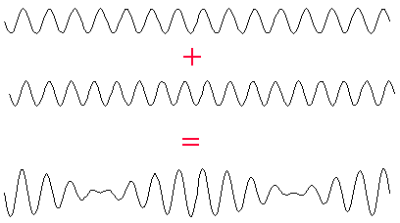


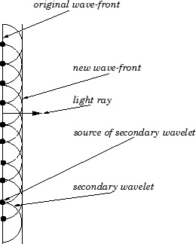
Propagating Plane Waves
Properties:
Have infinite extent
Have finite wavelength
Have a finite frequency
Laws of Motion
Wave equation
One solution
Interactions with other waves / environment
Coherent superposition
=> interference, constructive and destructive
=> one wave can cancel out another
Huygens principle:
one plane wave made up by many circular waves
=> diffraction
=> waves go around corners
http://www.qmw.ac.uk/~zgap118/5/
http://farside.ph.utexas.edu/teaching/
302l/lectures/node135.html

Slide 5
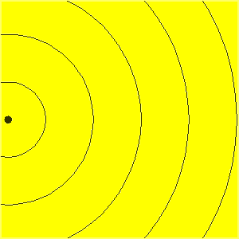
Huygens’ Principle
All waves can be represented by point sources
This animation shows an example of a single point source
http://id.mind.net/~zona/mstm/physics/waves/propagatio

Slide 6
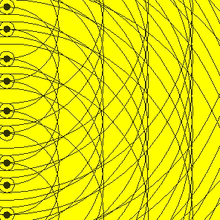
Huygens’ Principle
All waves can be represented by point sources
This animation shows an example of multiple single point sources creating a wavefront.
http://id.mind.net/~zona/mstm/physics/waves/propagatio

Slide 7
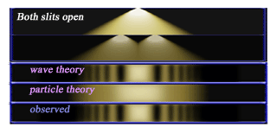
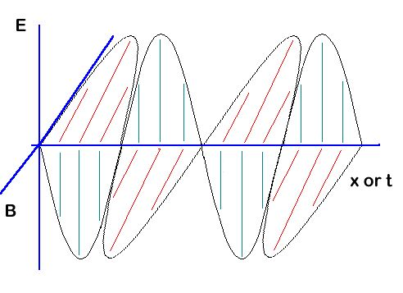
Propagating Plane Waves
Light is an Electromagnetic Wave
Not countable
Continuous
Continuous
Properties:
Have infinite extent
Have finite wavelength
Have a finite frequency
Laws of Motion
Wave equation
One solution
Interactions with other waves / environment
Coherent superposition
=> interference, constructive and destructive
=> one wave can cancel out another
Huygens principle:
one plane wave made up by many circular waves
=> diffraction
=> light goes around corners
Accepted Proof:
Light is an electromagnetic wave
Double Slit Experiment
http://en.wikipedia.org/wiki/Double-slit_experiment
Standing Waves
http://www.qmw.ac.uk/~zgap118/2/
Properties:
Have finite extent
Have discrete wavelengths
Have discrete frequencies

Slide 8


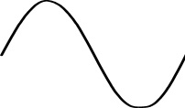


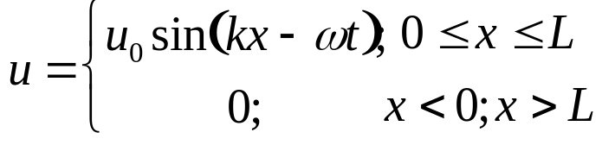
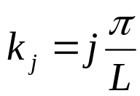
Standing Waves
Properties:
Countable in 1/2 wavelength
Integer multiples
Integer fractions
Have finite extent
Have discrete wavelengths
Have discrete frequencies
Laws of Motion
Wave equation
One solution
Interactions with other waves / environment
Coherent superposition
=> e.g. sounds add in an instrument
A standing wave is a resonator
one resonator can couple to another
=> e.g. string <=> guitar
=> energy is transferred between resonators
=> energy conservation
resonators must be “in-tune”
=> momentum conservation
Quantized momentum k_{j}

Slide 9
Particles and Waves
Classical Particles:
Have a finite extent
Have a finite weight
Are countable with integers
continuous (ignoring atomic granularity)
continuous (ignoring atomic granularity)
discrete
Standing Waves:
Countable in 1/2 wavelength
Integer multiples
Integer fractions
Have finite extent
Have discrete wavelengths
Have discrete frequencies
Quantized momentum k_{j}
Not countable
Continuous
Continuous
Propagating Waves:
Have infinite extent
Have finite wavelength
Have a finite frequency
http://en.wikipedia.org/wiki/Double-slit_experiment

Slide 10
Section 4 - Elements of Quantum Mechanics
4.2 Strange Experimental Results
=> The Advent of Quantum Mechanics
Solid State Devices

Slide 11
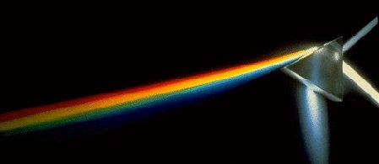
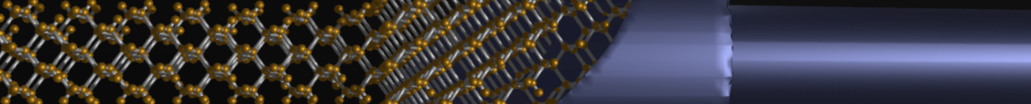
Section 4
Elements of Quantum Mechanics
4.1 Classical Systems
  Particles
  Propagating Waves
  Standing Waves
  Chromatography
4.2 Strange Experimental Results => The Advent of Quantum Mechanics
  Black Body Radiation => light emission is quantized
  Discrete Optical Spectra => light emission/absorption quantized – Bohr Atom
  Photoelectric Effect => light is described by particles
  Particle-Wave Duality
4.3 Why do we need quantum mechanics?
4.4 Formulation of Schrödinger's Eq.
http://en.wikipedia.org/wiki/Prism_%28optics%29
One Video Segment
status
One Video Segment
One Video Segment
One Video Segment

Slide 12
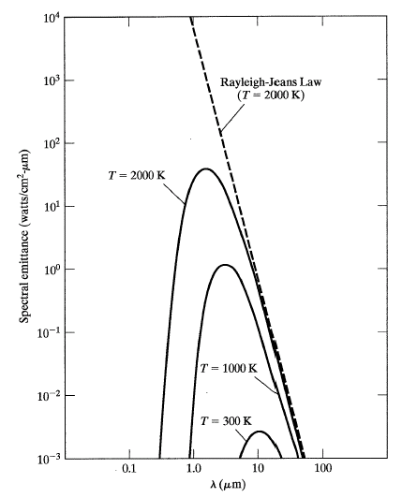
Black-body Radiation
Experiment:
Measure wavelength and
intensity of radiation
Observations:
Radiation intensity is wavelength and temperature dependent
https://en.wikipedia.org/wiki/Black-body_radiation

Slide 13
Black-body Radiation
(u)
Observations:
Intensity peak moves significantly

Slide 14
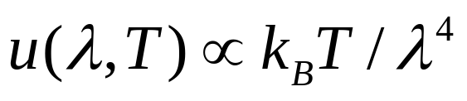

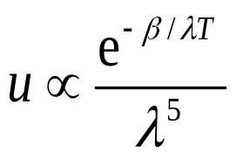
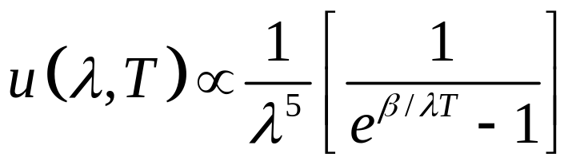
Black-body Radiation
Rayleigh-Jeans Formula
(u)
Wein’s Formula
Plank’s fitting formula

Slide 15
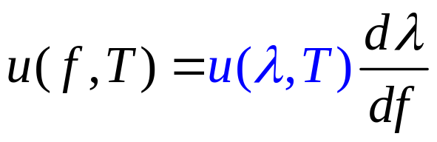
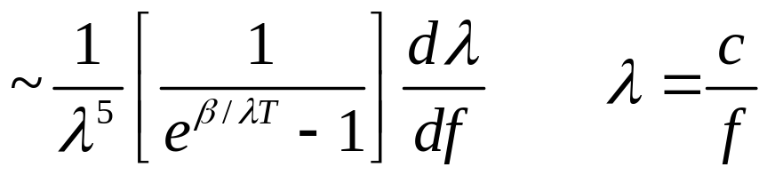
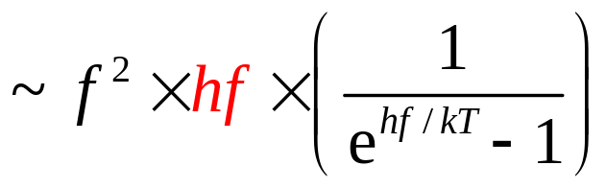
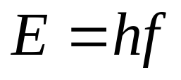
Interpretation of Plank’s Formula
nos. of
modes
Occupation
Probability
Energy
of mode
EM emission occurs in discrete quanta of
n=1,2, …….. N

Slide 16
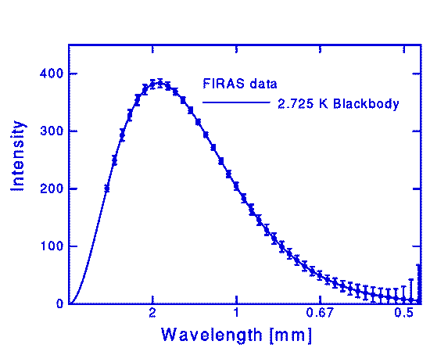
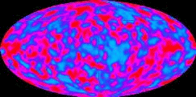
COBE Satellite Data
Measuring Black Body Radiation
J.C. Mather, Astrophysics J., 1990.
Data points are shown superimposed on the theoretical blackbody curve. The fit of the Planck radiation formula is so precise that it provides a powerful confirmation of the idea that it is a remnant of big bang expansion.
Shows that the cosmic background temperature is ~3K.

Slide 17
Section 4
Elements of Quantum Mechanics
4.1 Classical Systems
  Particles
  Propagating Waves
  Standing Waves
  Chromatography
4.2 Strange Experimental Results => The Advent of Quantum Mechanics
  Black Body Radiation => light emission is quantized
  Discrete Optical Spectra => light emission/absorption quantized – Bohr Atom
  Photoelectric Effect => light is described by particles
  Particle-Wave Duality
4.3 Why do we need quantum mechanics?
4.4 Formulation of Schrödinger's Eq.
http://en.wikipedia.org/wiki/Prism_%28optics%29
One Video Segment
One Video Segment
status
One Video Segment
One Video Segment

Slide 18

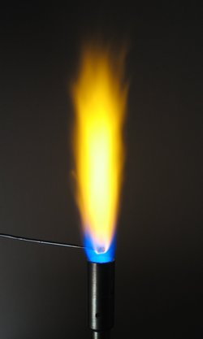

Strange Experimental Observations
The Advent of Quantum Mechanics
Discrete light spectrum:
Light emitted from hot elemental materials has a discrete spectrum
The spectrum is characteristic for the material (fingerprint)
E.g.: H spectrum
E.g.: Iron spectrum
E.g. application - bright yellow Na lamps
=> lot of excitation energy converted into single frequency
Development of atomic models
Bohr atom model - electrons in looping orbits
Images from: http://en.wikipedia.org
http://en.wikipedia.org/wiki/Prism_%28optics%29

Slide 19
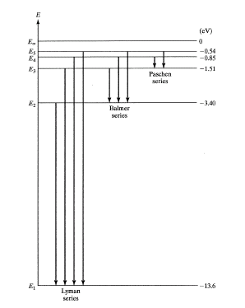
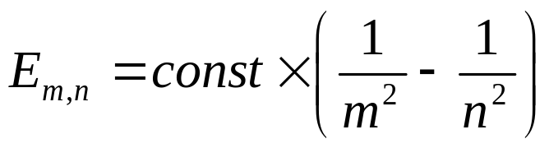
Mapping Observations to a Model
Hydrogen Emission Spectra
Chamber filled with hydrogen
emitting light
frequency
Rydberg constant
R = 13.6 eV

Slide 20

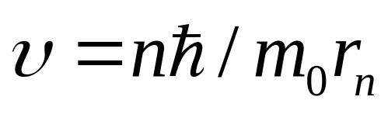
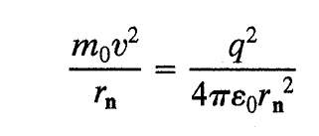
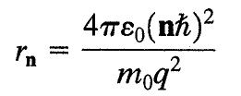
Bohr Atom Model
Charge Orbiting another Charge
Assume that angular momentum is quantized:

Slide 21
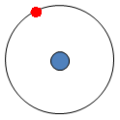
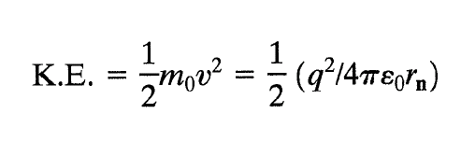

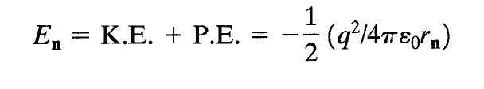
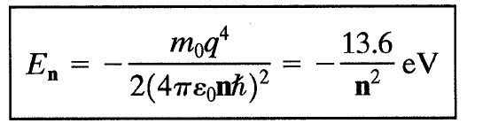
The Bohr Atom Model

Slide 22
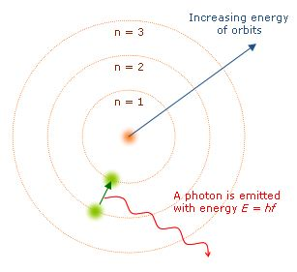
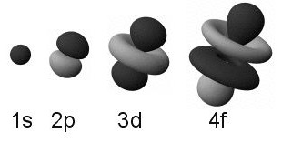
Strange Experimental Observations
The Advent of Quantum Mechanics
Discrete light spectrum:
Light emitted from hot elemental materials has a discrete spectrum
The spectrum is characteristic for the material (fingerprint)
E.g.: H spectrum
E.g.: Iron spectrum
E.g. application - bright yellow Na lamps
=> lot of excitation energy converted into single frequency
Development of atomic models
Bohr atom model - electrons in looping orbits
Quantum mechanical model
=> electrons are standing waves bound to a core
=> discrete transition energies lead to discrete spectra
Images from: http://en.wikipedia.org
http://en.wikipedia.org/wiki/Prism_%28optics%29

Slide 23
Section 4
Elements of Quantum Mechanics
4.1 Classical Systems
  Particles
  Propagating Waves
  Standing Waves
  Chromatography
4.2 Strange Experimental Results => The Advent of Quantum Mechanics
  Black Body Radiation => light emission is quantized
  Discrete Optical Spectra => light emission/absorption quantized – Bohr Atom
  Photoelectric Effect => light is described by particles
  Particle-Wave Duality
4.3 Why do we need quantum mechanics?
4.4 Formulation of Schrödinger's Eq.
http://en.wikipedia.org/wiki/Prism_%28optics%29
One Video Segment
One Video Segment
status
One Video Segment
One Video Segment

Slide 24



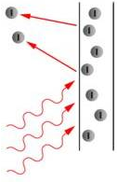




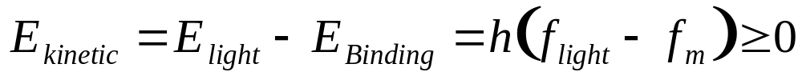
Strange Experimental Observations
The Advent of Quantum Mechanics
Photoelectric Effect:
Light can eject electrons from a clean metal
Observed by many researchers but not explained for 55 years:
1839, 1873, 1887, 1899, 1901
see details: http://en.wikipedia.org/wiki/Photoelectric_effect
Unexplained problems:
Electrons emitted immediately, no time lag
Increasing light intensity increases number of electrons but not their energy
Red light will not cause emission, no matter what intensity
Weak violet light will eject few electrons with high energy
=> Light had to have a minimum frequency / color to excite electrons
=> Emitted electrons have light dependent energy
The solution in 1905 (Nobel prize for Einstein in 1921)
Light can be described by discrete particles of discrete energy
Planck’s constant - h
Light energy is not divisible
Have to have minimum energy to kick out an electron from the bound state
http://en.wikipedia.org/wiki/Photoelectric_effect
Light consists of particles
Photons

Slide 25
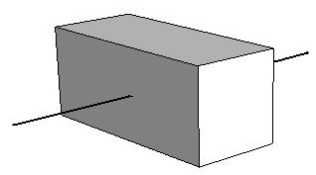
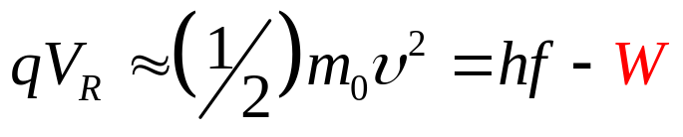

Photoelectric Effect
E = (hf-W)
Electrons
Light (hf)
υ
cathode
-W
V_{R}
V_{R}
W
hf
Absorption occurs in quanta as well, consistent with photons having E=hf

Slide 26
Wave - Particle Duality
All particles have a wave property
Can interfere
Can diffract
Can form standing waves
All waves have particle properties
Have momentum
Have an energy
Can be created and destroyed
Typical descriptions:
Energy E, frequency f, Momentum k
A set of discrete quantum numbers
Choose wave/particle description according to problem

Slide 27
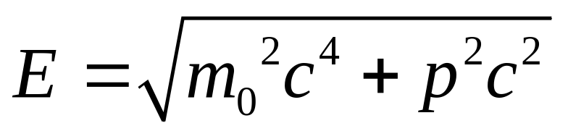
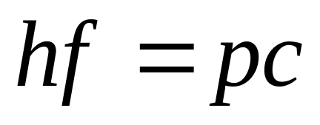
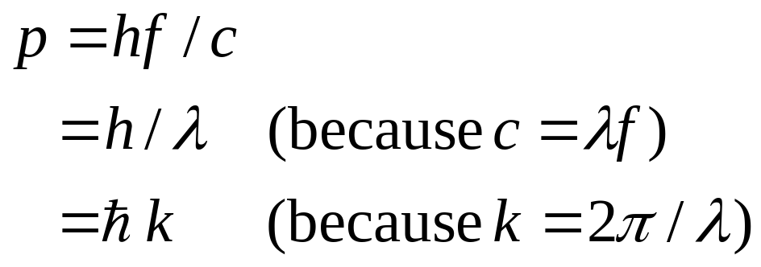
Wave - Particle Duality
Photons act both as wave and particle – simple math formulation
m₀=0 (photon rest mass)

Slide 28
Section 4 - Elements of Quantum Mechanics
4.3 Why do we need quantum mechanics?
Solid State Devices

Slide 29

Do I really need Quantum Mechanics ?
Periodic
Structure
Original
Problem
Electrons in periodic
potential: Problem
we want to solve
If it were large objects, like a skier skiing past a set of obstacles,
Newton’s mechanics would work fine, but in a micro-world ……
Some electrons are closely bound to the atomic cores
Some electrons are loosely bound
=> they can move through the structure freely
Even free electrons need empty states to flow into
=> not only the states, but their filling is important!

Slide 30
Carrier Density
Carrier number = Number of states x filling factor
Chapters 2-3
Chapter 4
Total number of occupants
= Number of apartments
X The fraction occupied

Slide 31

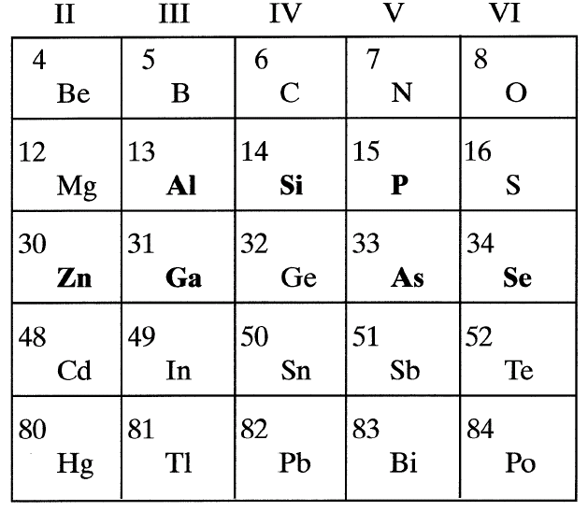
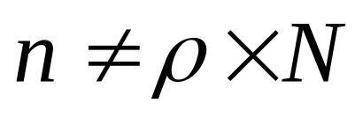
Section 4
Why do we need Quantum Mechanics?
I
I = G ^{x} V
= q ^{x} n ^{x} v ^{x} A
V
charge
density
velocity
area
Given chemical composition and atomic arrangements, we can compute electron density by using quantum mechanics.
We discussed the origin of quantum mechanics – experiments were inconsistent with the classical theory.
We saw how Schrödinger equation can arise as a consequence of quantization and relativity, but this is not a derivation.
We will solve some toy problems in the next section to get a feeling of how to use quantum mechanics.

Slide 32
Section 4 - Elements of Quantum Mechanics
4.4 Formulation of Schrödinger's Equation
Solid State Devices

Slide 33
Section 4
Elements of Quantum Mechanics
4.1 Classical Systems
  Particles
  Propagating Waves
  Standing Waves
  Chromatography
4.2 Strange Experimental Results => The Advent of Quantum Mechanics
  Black Body Radiation => light emission is quantized
  Discrete Optical Spectra => light emission/absorption quantized – Bohr Atom
  Photoelectric Effect => light is described by particles
  Particle-Wave Duality
4.3 Why do we need quantum mechanics?
4.4 Formulation of Schrödinger's Eq.
http://en.wikipedia.org/wiki/Prism_%28optics%29
One Video Segment
One Video Segment
One Video Segment
status
One Video Segment

Slide 34
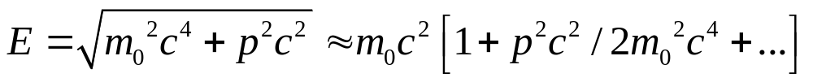
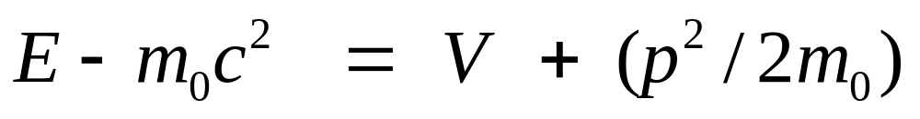
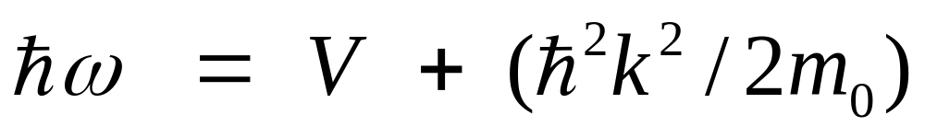
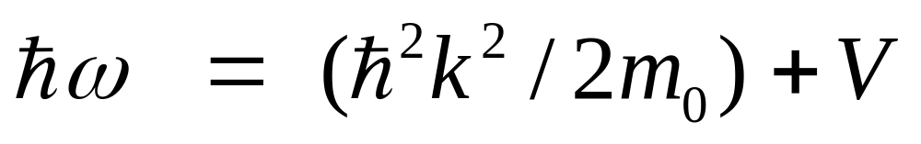
Schrödinger's Equation for electrons
hf =

Slide 35
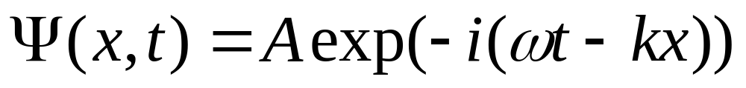

Schrödinger's Equation (continued)
Assume,

Slide 36
Section 4
Elements of Quantum Mechanics
4.1 Classical Systems
  Particles
  Propagating Waves
  Standing Waves
  Chromatography
4.2 Strange Experimental Results => The Advent of Quantum Mechanics
  Black Body Radiation => light emission is quantized
  Discrete Optical Spectra => light emission/absorption quantized – Bohr Atom
  Photoelectric Effect => light is described by particles
  Particle-Wave Duality
4.3 Why do we need quantum mechanics?
4.4 Formulation of Schrödinger's Eq.
http://en.wikipedia.org/wiki/Prism_%28optics%29
One Video Segment
One Video Segment
One Video Segment
One Video Segment

