Slide 1
Anti-ferromagnetism
Heng-Ray Chuang

Slide 2
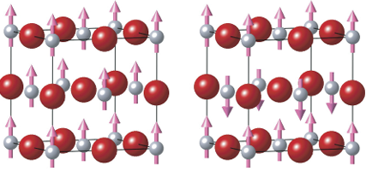
Structure
FM
AFM
P. Rivero, I. de Pr Moreira, F. Illas, Spin hamiltonian effective parameters from periodic electronic structure calculations, In: Journal of Physics: Conference Series, Vol. 117, IOP Publishing, 2008, p. 012025
Net magnetization = 0
Examples: MnO, NiO……
Notes:
net magnetization = 0
Sublattice A: spins up
Sublattice B: spins down
equal in magnitude but opposite

Slide 3
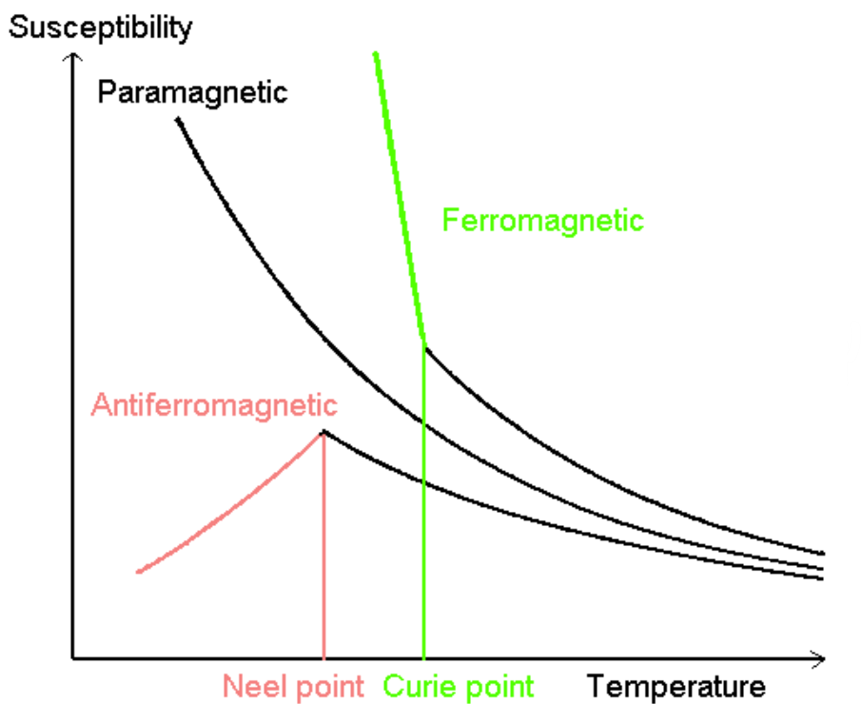
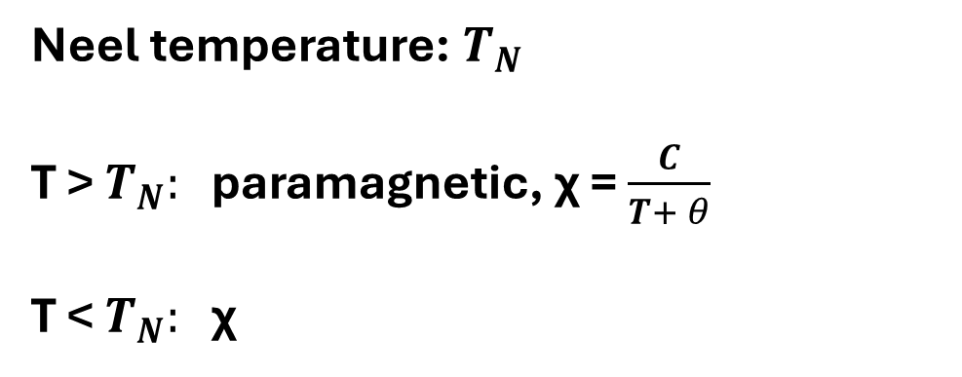
Characterization
Neel temperature: $T_{N}$
T > $T_{N}:$ paramagnetic, χ = $\frac{C}{T+ θ}$
T < $T_{N}:$ χ
Susceptibility - Temperature curve
Abdolazimi, Vahideh. Inverse− Perovskites Eu3TO (T= Si, Ge, Sn, Pb) Magnetism and Transport. Diss. MA dissertation, Max Planck Institute for Solid State Research and Physics Department of Stuttgart University, Stuttgart, Germany. DIO: 10.13140/RG. 2.2. 11899.82729, 2014.
Notes:
Susceptibility: Magnetization / applied magnetic field. How materials react with external magnetic field. Large - strong reaction
T > $T_{N}:$ Thermal energy is dominating, so the spin direction is random and is harder to be aligned by an external field. Therefore, a higher temperature lowers the susceptibility
T < $T_{N}:$ The exchange interaction is dominating, so the spin direction is strongly favored to be anti-parallel. Therefore, the material is harder to be disturbed by an external magnetic field, so the susceptibility is low

Slide 4
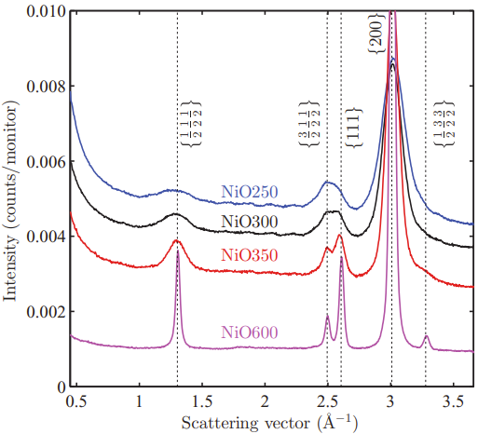
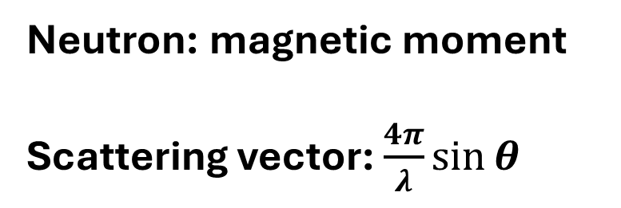
Characterization
Neutron: magnetic moment
Scattering vector: $\frac{4π}{λ}\sin{θ}$
Neutron Diffraction Pattern
Brok, Erik, et al. "Polarized neutron powder diffraction studies of antiferromagnetic order in bulk and nanoparticle NiO." Physical Review B 91.1 (2015): 014431.
Notes:
Neutron scattering
Neutron carries magnetic moments, so it can react with electron spins.
From the diffraction pattern, we can see the peak from magnetic moments and atomic nuclei positions (similar to XRD)
FM does not have extra peaks because its spin arrangement has the same periodicity as the crystal lattice, so it does not create any new diffraction conditions
AFM: Spins alternate, so there is a new periodicity different from the atomic lattice, so the alternating spin pattern produces constructive interference at new reciprocal-space positions, giving magnetic peaks.
Check the overall M. If M~0, then the material is AFM

Slide 5
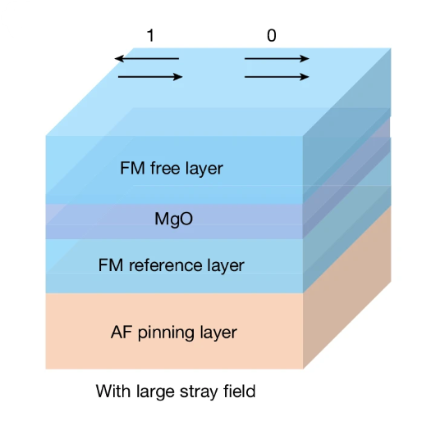
Applications
Advantages:
Ultra-fast switching
stable against external magnetic noise
MRAM:
Stabilize magnetic layers
Prevent accidental flipping of stored bits
Chen, Y., Samanta, K., Shahed, N.A. et al. Twist-assisted all-antiferromagnetic tunnel junction in the atomic limit. Nature 632, 1045–1051 (2024). https://doi.org/10.1038/s41586-024-07818-x
Notes:
AFM layers are used to pin the reference ferromagnetic layer through the interface exchange interaction. It helps stabilize the reference layer.
In MTJ, Parallel alignment and antiparallel alignment of the two ferromagnetic layer represents 0 or 1.

Slide 6
Conclusions
AFM materials: neighboring magnetic moments align in opposite directions
Characterization: Susceptibility, Neutron scattering……
Applications: Spintronics, MRAM……

