Slide 1
Talk the talk and walk the walk: Dialogue-driven navigation in unknown indoor environments
Thomas Victor Ilyevsky, Jared Sigurd Johansen, and Jeffrey Mark Siskind
This work was supported, in part, by the US National Science Foundation under Grants 1522954-IIS and 1734938-IIS, and by the Intelligence Advanced Research Projects Activity (IARPA) via Department of Interior/Interior Business Center (DOI/IBC) contract number D17PC00341. Any opinions, findings, views, and conclusions or recommendations expressed in this material are those of the authors and do not necessarily reflect the views, official policies, or endorsements, either expressed or implied, of the sponsors. The U.S. Government is authorized to reproduce and distribute reprints for Government purposes, notwithstanding any copyright notation herein. (Corresponding author: Jeffrey Mark Siskind.)
All authors were with the School of Electrical and Computer Engineering, 465 Northwestern Avenue, Purdue University, West Lafayette, IN, 47907USA e-mail:{tilyevsk,jjohanse,qobi}@purdue.edu.
Notes:
Hello, my name is Thomas Ilyevsky and I will be presenting the work in our paper: Talk the talk and walk the walk: Diaogue-driven navigation in unknown indoor environments

Slide 2
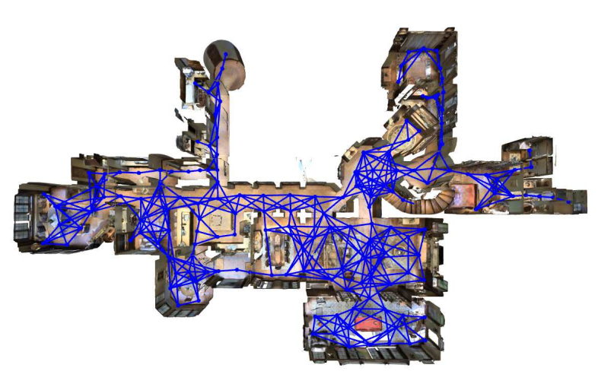
Existing vision-and-language navigation (VLN) work does not solve real navigation in real environments
Anderson, P., Wu, Q., Teney, D., Bruce, J., Johnson, M., Sünderhauf, N., ... & Van Den Hengel, A. (2018). Vision-and-language navigation: Interpreting visually-grounded navigation instructions in real environments. In Proceedings of the IEEE Conference on Computer Vision and Pattern Recognition (pp. 3674-3683).
Notes:
There is an existing body of work in the field of of vision-and-language navigation that focuses on developing methods that allow an agent to navigate a virtual environment such as the one shown here. They learn to follow natural language instructions by traversing nodes in a known discrete graph. Although the image information presented to these agents is real, the ability to perform this virtual navigation does not translate to the real world. Novel methods are required to allow a real robot to follow spoken natural language in a real unknown environment. In this talk, I will present such a method.

Slide 3
Organization
Novel framework for following directions in an unknown environment
Live trial experiments on a real robot in real unknown office environments
Comparison experiments with VLN methods deployed on a real robot
Notes:
This talk will be organized as follows: first I will discuss the novel framework we developed that allows a physical robot to follow directions in an unknown environment. Then I will talk about the live trial experiments we conducted to evaluate our method on a real robot. Then, I will discuss the comparison experiments we conducted to show that prior VLN methods are not successful in achieving real navigation on a real robot.

Slide 4
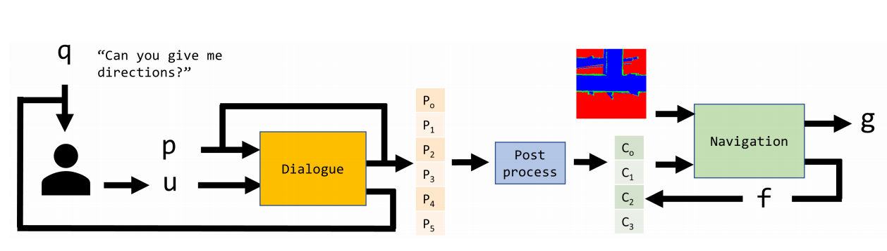
Novel framework for following directions in an unknown environment
q
g
p
u
s
Notes:
Our novel framework, shown here, consists of two main components to achieve direction following. The first, on the left, is the dialogue component whose purpose is to produce a sequence of navigational commands to execute. Because humans are imperfect and may provide incomplete or unclear instructions, it is capable of engaging in engaging in multiple turns of conversation with a person for clarification to produce a complete plan. The second component is the navigation component which uses real occupancy grids produced by a SLAM algorithm to execute each of the navigational commands one by one. It both produces goal coordinates for the robot to drive to as output as well as a status to indicate whether the command is being executed, the robot is simply driving forward, following the hallway, or the robot is unable to execute the command. First, I will talk about the dialogue component and then the navigation component

Slide 5

Dialogue inputs and outputs
“How do I get
to the elevator?”
[□]
q
p
[turn-around, int-R, right, □]
“Go back the way you came and then make a right.”
p'
Dialogue
u
q'
“What do I do after turning right?”
Notes:
The entire goal of this framework is to allow a robot to ask a real person to directions to some location such as an elevator or someone’s office. Then the robot potentially engages in multiple turns of dialogue to ask follow up questions and update its plan accordingly. Therefore, we trained a BERT transformer to take a string utterance and the current plan as input and produce an updated plan and follow up question as output. This slide shows the first turn in a conversation where the robot initially has an empty plan, P, indicated by the box and receives an utterance from a person “Go back the way you came and then make a right.” The network updates the plan with a sequence of plan concepts, which I will explain later, to represent the directions from the person. It also produces a follow-up question to clarify what it should do after turning right.

Slide 6
Engaging in dialogue to get a complete plan
“What do I do after turning right?”
[turn-around, int-R, right, □]
q'
p'
“Turn left at the end of the hallway and it will be right here.”
Dialogue
[turn-around, int-R, right,
end, left, goal-F]
u
“Got it. Thanks!”
Notes:
Then it engages in a subsequent turn of conversation where the person answers the follow up question. The network takes the current plan and their second response as input
and produces a complete plan, without a box, as output.

Slide 7
Dataset collection
27 subjects (18 male, 9 female)
Participants spoke fluent English
Participants were familiar with three buildings on our campus: (EE, MSEE, PHYS)
8797 navigational instruction utterances
Notes:
To train this network, we gathered a dataset of navigational instructions.
Participants were told a starting location and asked to give directions to some destination.
Destinations were within the same floor of the same building…or on different floors of the same building.

Slide 8
Output plan primitives
Type | Primitives
Intersections | int-L, int-R, end, elbow
Directions | turn-around, forward, left, right, either
Goals | goal-F, goal-R, goal-L
Other | change-floor, □
Notes:
We analyzed the data and established a set of primitives that would allow us to represent all of the utterances with sequences of these primitives. Participants mostly referred to intersections and turning directions.

Slide 9
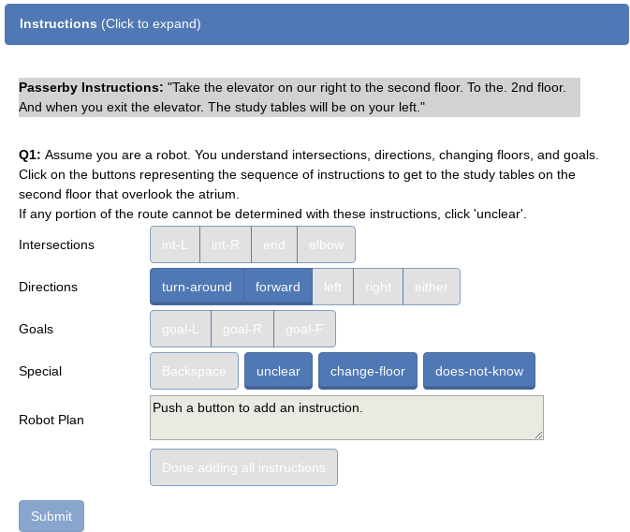
Used AMT to annotate the utterances with robot plans.
Notes:
We used AMT to annotate the utterances with robot plans. AMT workers were asked to provide a sequence of plan primitives that corresponded to the passerby instructions. They were also asked to provide a follow up question if the instructions were unclear or incomplete.

Slide 10
Augmentation is performed to balance the dataset
Category | Plan Pattern | Original Count | Augmented Count
empty | [□] | 125 | 2125
need-elevator | [□, change-floor, …] | 2100 | 2100
need-first | [□, …] | 68 | 2200
need-last | […, □] | 58 | 1818
complete | [¬□] | 7467 | 7467
Notes:
We took the resulting dataset and split it into 5 categories. Most utterance samples had complete plans, so we performed some augmentation to balance the dataset. We used utterances with complete plans and removed some key words and corresponding plan primitives to generate samples for the other categories.

Slide 11
Further augmentation is performed to facilitate multi-turn dialogue
Category | Plan Pattern | Follow-up Question
empty | [□] | Repeat original question
need-elevator | [□, change-floor, …] | Ask for navigational instructions to elevator
need-first | [□, …] | Ask which direction to start out going
need-last | […, □] | Ask what to do after last instruction
Notes:
Additionally, our dataset consisted of a single question (directions to some location) and a single response.
We did not have data for responses to follow-up questions (which would be representative of downstream turns in a conversation).
To support multi-turn dialogue, we created a list of follow-up questions and sourced our original dataset for answers to these follow-up questions. This allowed us to create training samples that had non-empty, but partial plans as input.

Slide 12
Examples of final training samples for network
Current Plan | [□]
Input Transcript | Yeah, go straight then make a right
Updated Plan | [forward, int-R, right, □]
Follow-up Question | What do I do after turning right?
Current Plan | [□, end, left, goal-R]
Input Transcript | Think you might have to turn around
Updated Plan | [turn-around, end, left, goal-R]
Follow-up Question | Got it. Thanks!
Notes:
This allowed us to create training samples of this form.
The input consists of a current plan and transcript. The current plan provides context to the person’s response.
The output consists of an updated plan and follow-up question.

Slide 13
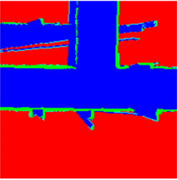
Train 2D CNN to generate goal points and status
Convolutional layers
Fully-connected layers
(x, y)
Status
1) Transition
2) Forward
3) Failure
224x224x3
1-hot encoding
[end_left, Int-R_right]
Notes:
With the dialogue component able to produce a navigational plan, we designed the navigation component to execute each step in the plan one by one.
We trained the 2D cnn shown here to take a SLAM map as input, in the form of an RGB image, and a command, in the form of a 1-hot encoding, to output
X, Y coordinates for the robot to drive to and a status, which can be 1 of 3 classes. By default, the network is trained to drive the robot forward until
A desired intersection is found, so the status of transition indicates that the command is being executed and the robot can transition to executing the next
Command, forward to indicate that the robot is driving forward down the hallway, and failure to indicate that the command cannot be executed.

Slide 14
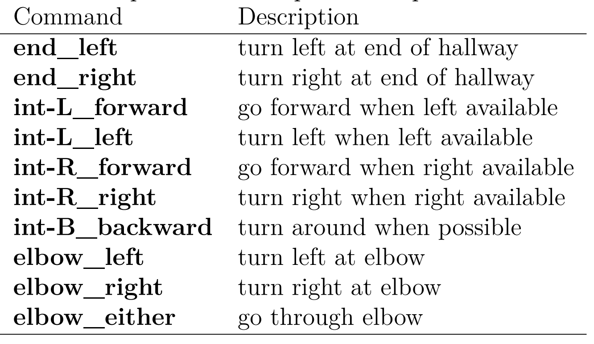
Possible commands are an intersection and direction pair
Notes:
The network is trained to take each of the following 10 possible commands as input. Consecutive steps produced by the dialogue component are concatenated to produce
One of these possible commands which consist of an intersection to reach and a direction to take at that intersection. For example, end_right is taking a right at the end
Of the hallway and int-L left is taking a left at an intersection with a left turn.

Slide 15
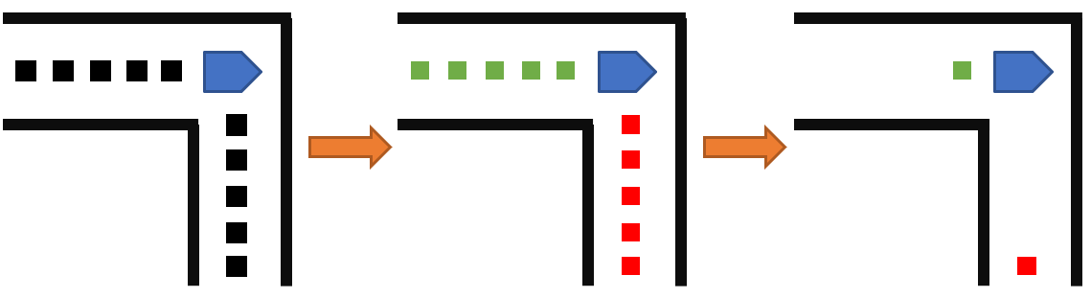
Training data obtained from robot navigation
Notes:
To train the network, we need to pair each of those 10 commands with SLAM maps and then produce the correct corresponding outputs.
To do this, we manually navigated the robot around multiple floors of 3 of our buildings and recorded each position the robot visited
And the SLAM map at each of those positions. We used this data to then determine the intersection types and available directions
At each recorded position, so they can be properly paired with each of the 10 commands.

Slide 16
Training data obtained from robot navigation
Intersections: Int-R, Int-B, end, elbow
Directions: right, backward
Notes:
The points colored in red are to the right of the robot and the points in green are behind the robot.
This tells us that the robot is in an Int-R, Int-B, end, and elbow and it can go right or backwards.
From this, we can determine the correct status output when this map is paired with one of
The input commands. The last step, is to produce the correct output coordinates for driving.

Slide 17
Training data obtained from robot navigation
(-1.0, 0)
Intersections: Int-R, end, elbow
Directions: right, backward
(0.0, -5.0)
Notes:
This is done by aggregating the points, so the red point is where the robot would go if instructed to turn right
And the green point is the destination were the robot to go backwards.

Slide 18
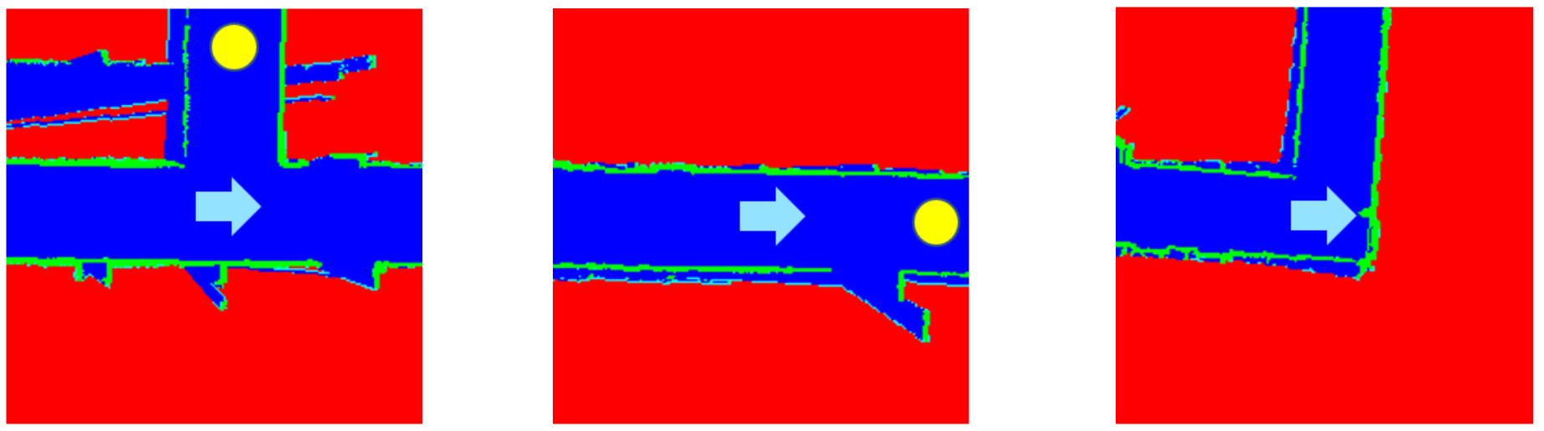
Examples of Training Samples
Status: Transition
Status: Forward
Status: Failure
Notes:
Here are some examples of the resulting training samples. Figure a shows a slam map paired with the command int-L_left. Since the robot, illustrated by the blue arrow, is in fact in an Int-L, the corresponding
Output status is transition, and the network would output coordinates corresponding to the yellow circle to result in the left turn. In Figure b, the robot is still in a hallway, so with the command of
Elbow_either, it would drive forward to that yellow circle and the status is forward. In Figure c, the robot cannot execute end_right as only a left is available and it cannot drive forward. Therefore,
The status is failure and the coordinates correspond to the robot’s current location.

Slide 19
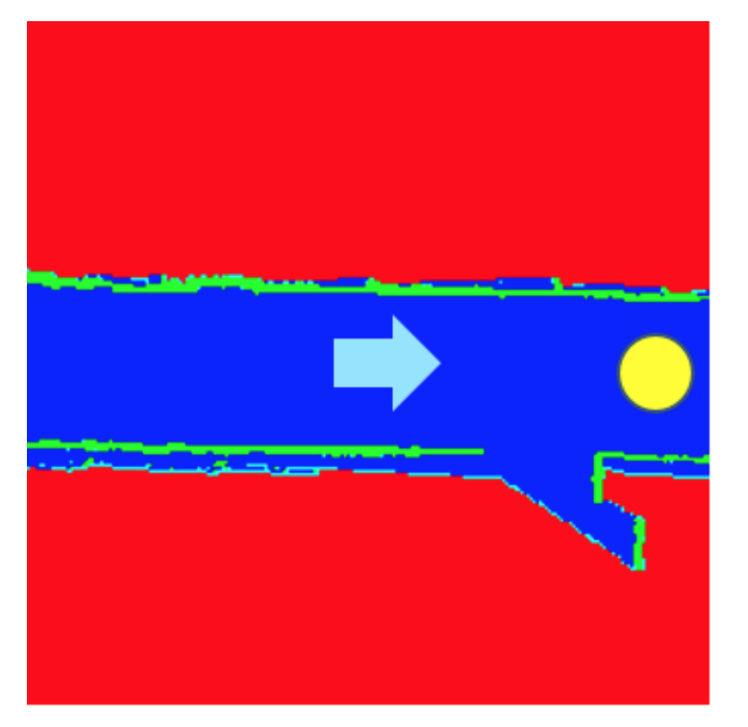


Augmentation during training
Notes:
That is how the training data is generated. During the actual training, we apply crucial augmentation so that the robot learns to produce the correct coordinates
Despite a potentially suboptimal position in the hallway.

Slide 20
Augmentation during training
Notes:
We apply random rotation and vertical shifting to represent such scenarios during training so that the network allows the robot to drive forward down
A hallway and not crash into any walls.

Slide 21
Navigation process
[Int-R_right, end_left]
Notes:
With the network trained, the final step is to apply it continuously during navigation. This is important for two reasons, one, to obtain accurate coordinates, and two, to turn at the correct intersections. Let’s say we have the robot here
In a hallway and it has two commands to execute. It starts with the first one, indicated by the blue arrow, and the dashed box represents the SLAM map that would get passed in.

Slide 22
Navigation process
[Int-R_right, end_left]
Status: Forward
Notes:
The network would produce a status of forward and the yellow circle as coordinates.

Slide 23
Navigation process
[Int-R_right, end_left]
Notes:
The robot drives there and repeats the process. But it is passing in the SLAM map and command continuously to make sure it catches the desired Int-R intersection.

Slide 24
Navigation process
[Int-R_right, end_left]
Status: Forward
Notes:
In this location, the robot would produce the yellow circle as output and a status of forward. If the robot were allowed to reach that point, it would miss the intersection.

Slide 25
Navigation process
[Int-R_right, end_left]
Notes:
But in our framework, when the robot reaches this location, the network will start producing a different output.

Slide 26
Navigation process
[Int-R_right, end_left]
Status: Transition
Notes:
It would output a status of transition and the yellow circle represents the right turn.

Slide 27
Navigation process
[Int-R_right, end_left]
Notes:
Once it reaches that location, it knows to start trying to execute the second command as indicated by the shifted blue arrow.

Slide 28
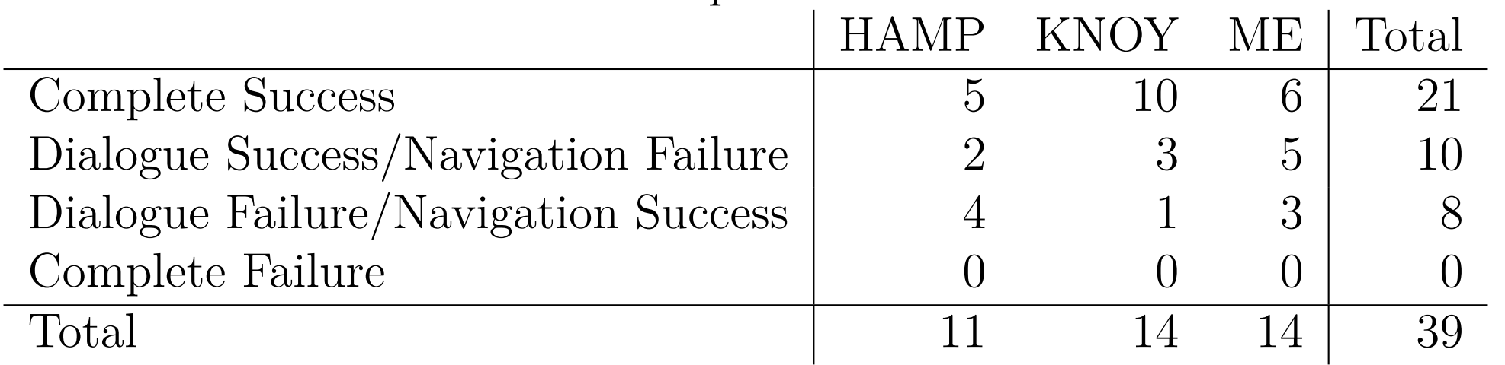
Experimental results of live trials
Notes:
In order to evaluate our system consisting of the dialogue and navigation components, we ran a set of live trials. We recruited 3 volunteers to provide spoken navigational instructions to a real physical robot on multiple floors of 3 buildings. These buildings and volunteers were not
Part of our training set. Dialogue was successful if the produced plan was correct and navigation was successful if the robot’s movement correctly corresponded to the plan it was given. Overall, our system was completely successful in 21/39 trials, approximately, 54%. Each
The dialogue component was successful about 79% of the time and the navigation component was successful 74% of the time.

Slide 29
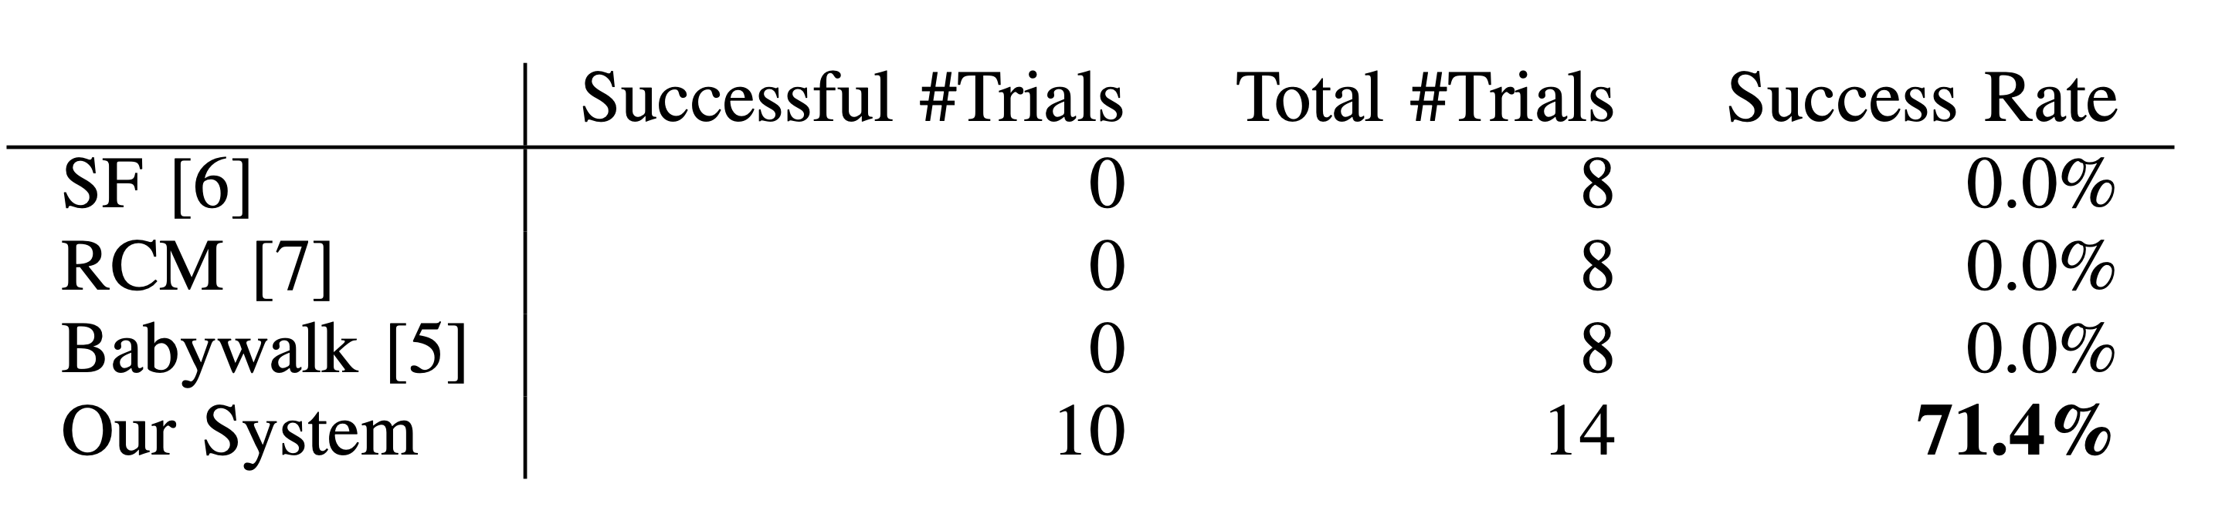
Comparison to VLN approaches
1
2
3
[1] D. Fried, R. Hu, V. Cirik, A. Rohrbach, J. Andreas, L.-P. Morency, T. Berg-Kirkpatrick, K. Saenko, D. Klein, and T. Darrell, “Speaker-follower models for vision-and-language navigation,” in Conference on Neural Information Processing Systems, 2018, pp. 3318–3329.
[2] X. Wang, Q. Huang, A. Celikyilmaz, J. Gao, D. Shen, Y.-F. Wang, W. Y. Wang, and L. Zhang, “Reinforced cross-modal matching and self-supervised imitation learning for vision-language navigation,” in Computer Vision and Pattern Recognition, 2019, pp. 6629–6638.
[3] H. Zhu Wang and- Hu, J. Chen, Z. Deng, V. Jain, E. Ie, and F. Sha, “Babywalk: Going farther in vision-and-language navigation by taking baby steps,” in Annual Meeting of the Association for Computational Linguistics, 2020, pp. 2539–2556.
Notes:
To compare our system against prior VLN methods, we ran a set of comparison experiments. These methods are trained on a dataset called room-to-room. We collected a dataset of 3 of our buildings in the same style and structure as room-to-room with pairs of paths and natural language
Utterances. We trained each of these 3 methods first on room-to-room and then finetuned on our dataset. Then we deployed them on our robot and ran 8 trials with each method in one of our buildings. All three methods failed to succeed in any of the trials, whereas our method succeeded
In 10 of the 14 trials that were run in the same building.

Slide 30
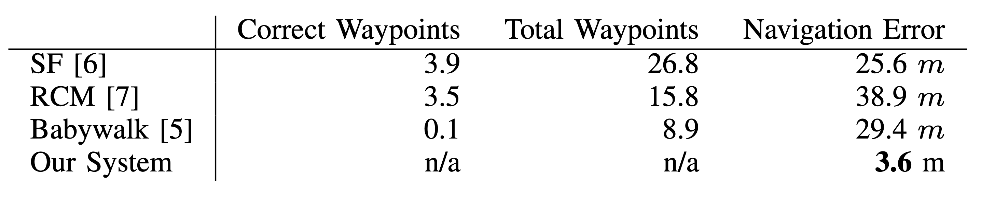


Comparison to VLN approaches
1
2
3
[1] D. Fried, R. Hu, V. Cirik, A. Rohrbach, J. Andreas, L.-P. Morency, T. Berg-Kirkpatrick, K. Saenko, D. Klein, and T. Darrell, “Speaker-follower models for vision-and-language navigation,” in Conference on Neural Information Processing Systems, 2018, pp. 3318–3329.
[2] X. Wang, Q. Huang, A. Celikyilmaz, J. Gao, D. Shen, Y.-F. Wang, W. Y. Wang, and L. Zhang, “Reinforced cross-modal matching and self-supervised imitation learning for vision-language navigation,” in Computer Vision and Pattern Recognition, 2019, pp. 6629–6638.
[3] H. Zhu Wang and- Hu, J. Chen, Z. Deng, V. Jain, E. Ie, and F. Sha, “Babywalk: Going farther in vision-and-language navigation by taking baby steps,” in Annual Meeting of the Association for Computational Linguistics, 2020, pp. 2539–2556.
Notes:
Additionally, we recorded the correct number of waypoints, which is the waypoints in which the robot was driving in the correct direction, the total number of waypoints until the method declared the that it was done, and the navigation error. This navigation error is the distance from the
Robot’s final location to the beginning of the hallway it was supposed to reach. As you can see, our system was far more successful in real unknown indoor environments than prior VLN methods.

