Slide 1
An Open Letter to Victor Veselago Professor Veselago through the (METAMATERIAL) Looking-Glass by Alexandra Boltasseva

Slide 2
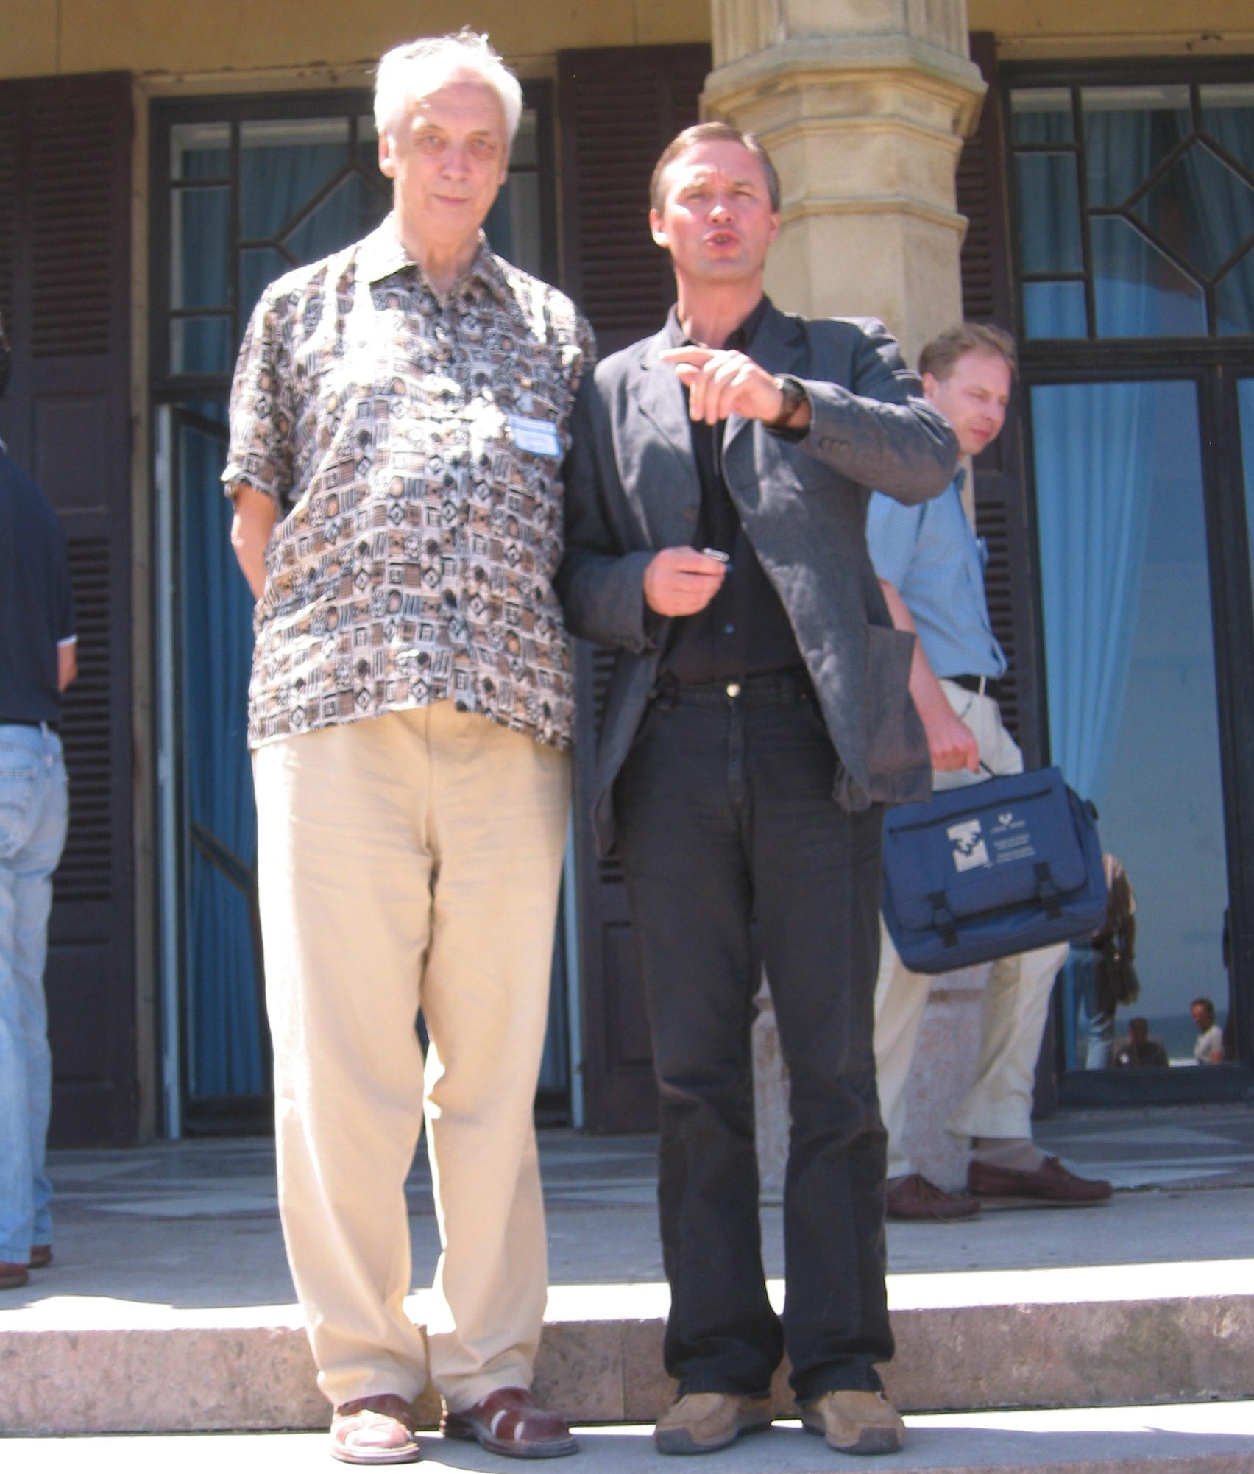
Dear Victor Georgievich,
My personal “Victor Veselago story” begins in San Sebastian in 2006.
I felt overwhelmed and humbled meeting a tall, charismatic and very kind Metamaterial Giant.
That was when Prof. Vlad Shalaev introduced me to You (and was otherwise very protective of his connection to You, the Metamaterial Father!)
San Sebastian, 2006
Notes:
Prof Shalaev was trying to protect his secret connection to the MM Father shouting: No paparazzi!

Slide 3
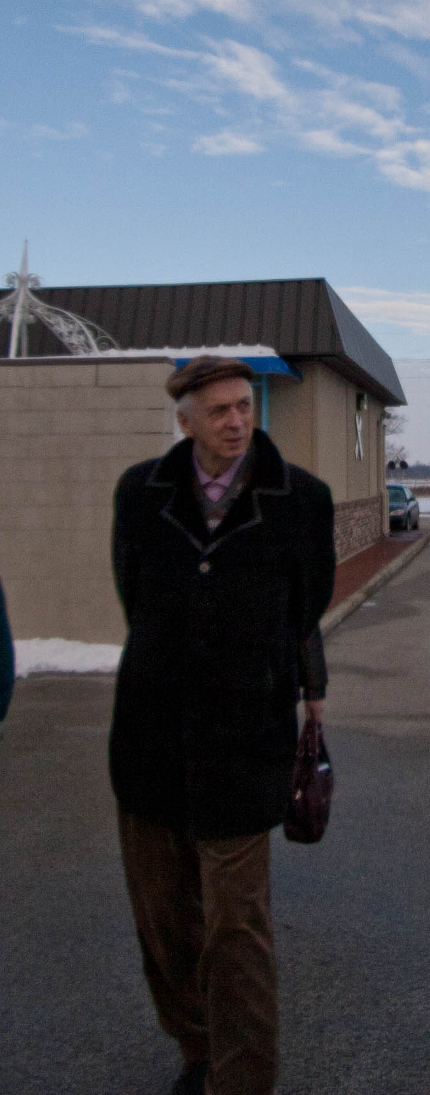
As every Soviet person going abroad Victor Veselago had a dossier…
From Victor Veselago Dossier:
“Does not speak English very well but speaks very fast and with great confidence”
Notes:
As every Soviet persona going abroad Victor Veselago had a dossier…

Slide 4
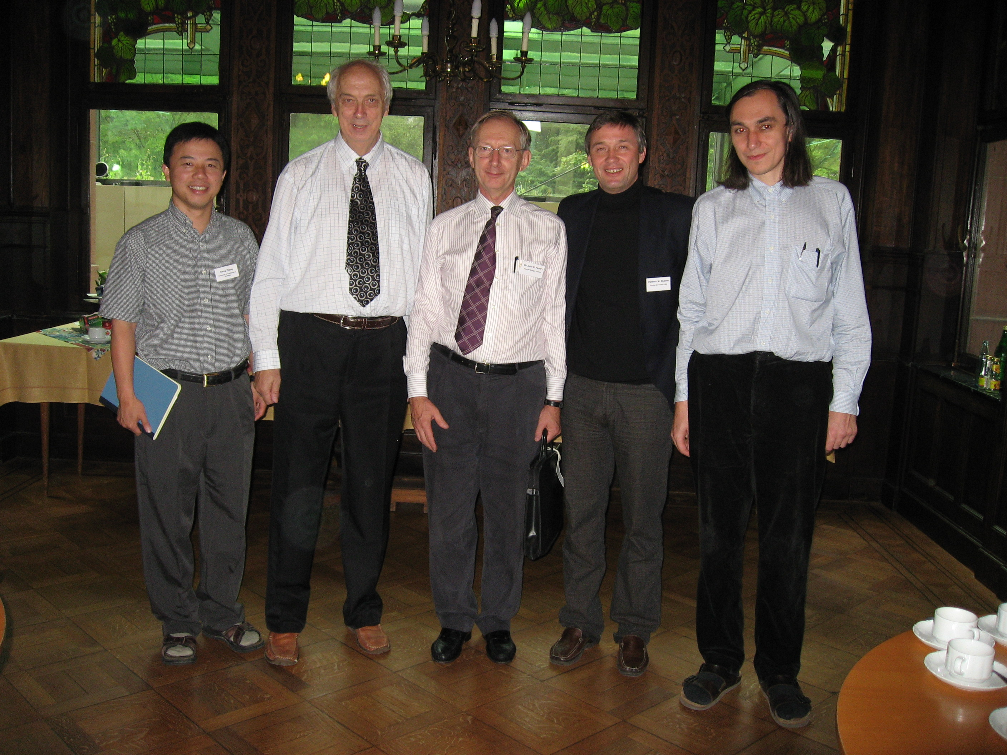
Metamaterials school, Bonn, Germany, 2006
But it was not until one of the first schools on MM in 2006, when we joined forces to lure You to join Purdue MM team…
Notes:
But it was not until one of the first schools on MM in 2006, when we joined forces to lure Prof Veselago to our team

Slide 5
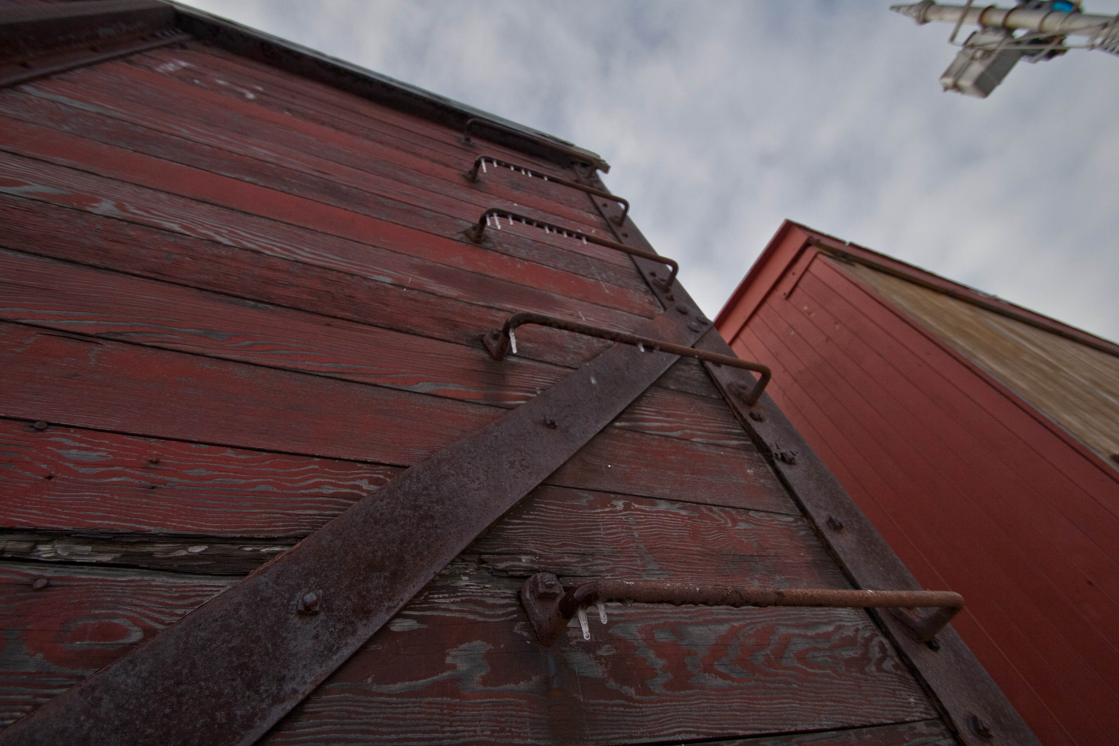
I vividly remember how attentive You were to people around; and how astonished I became when I learned that you know the small railroad town in Russia where I was born!
Notes:
But it was not until one of the first schools on MM in 2006, when we joined forces to lure Prof Veselago to our team

Slide 6
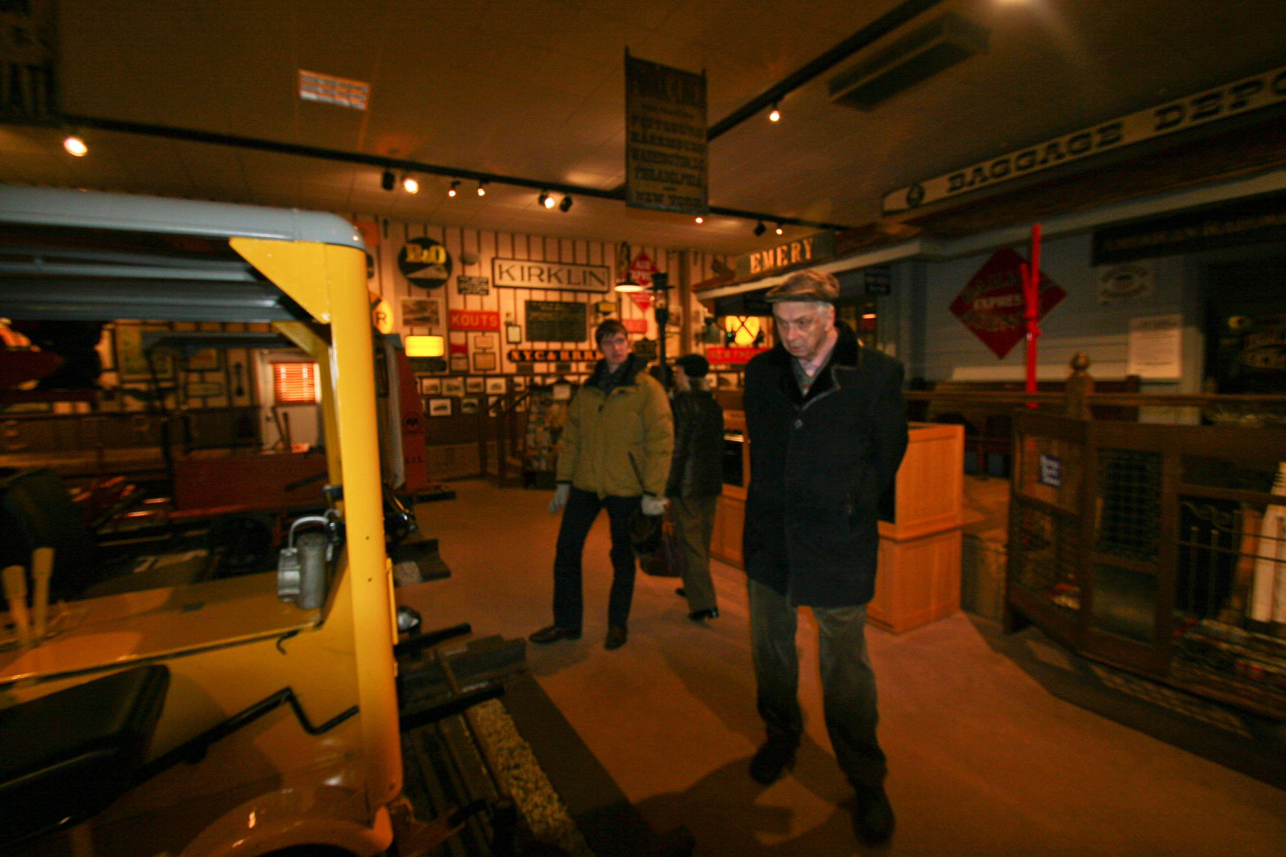
From Victor Veselago Dossier:
“Knows everything about railroads and can talk to a professional railway engineer for an entire day without his/her figuring out that he has nothing to do with railway system”
Indiana visit, 2011

Slide 7
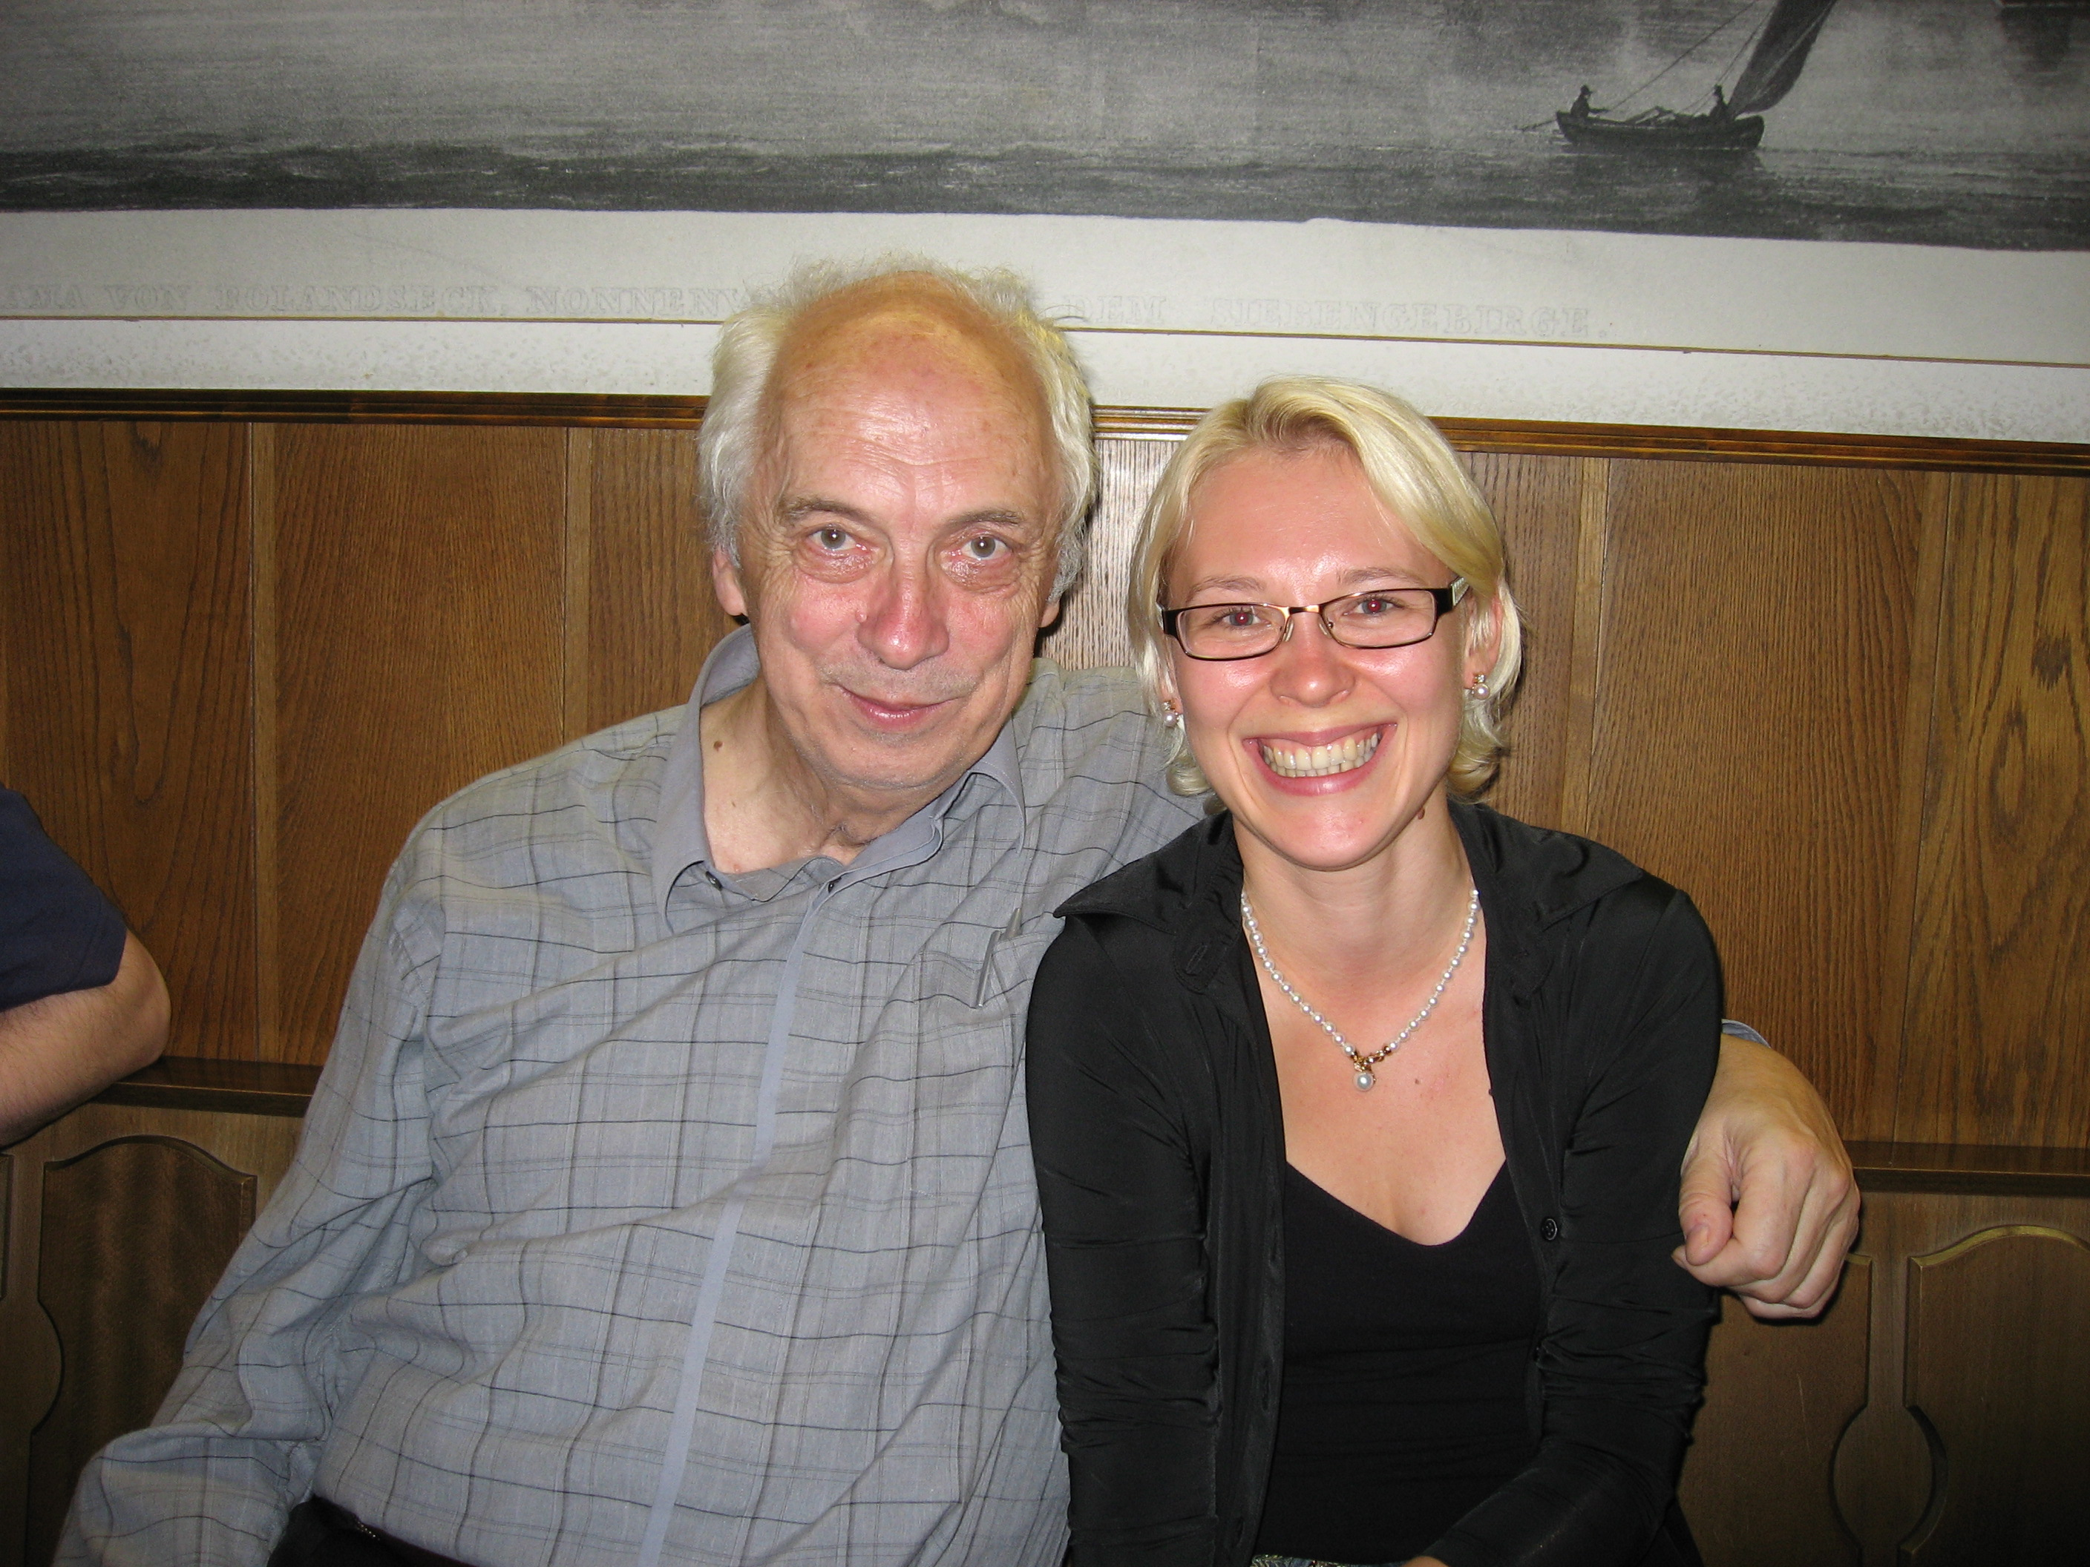
So, using my personal railway connection, I was working on recruiting You into the secret Purdue META mission…
Metamaterials school, Bonn, Germany, 2006

Slide 8
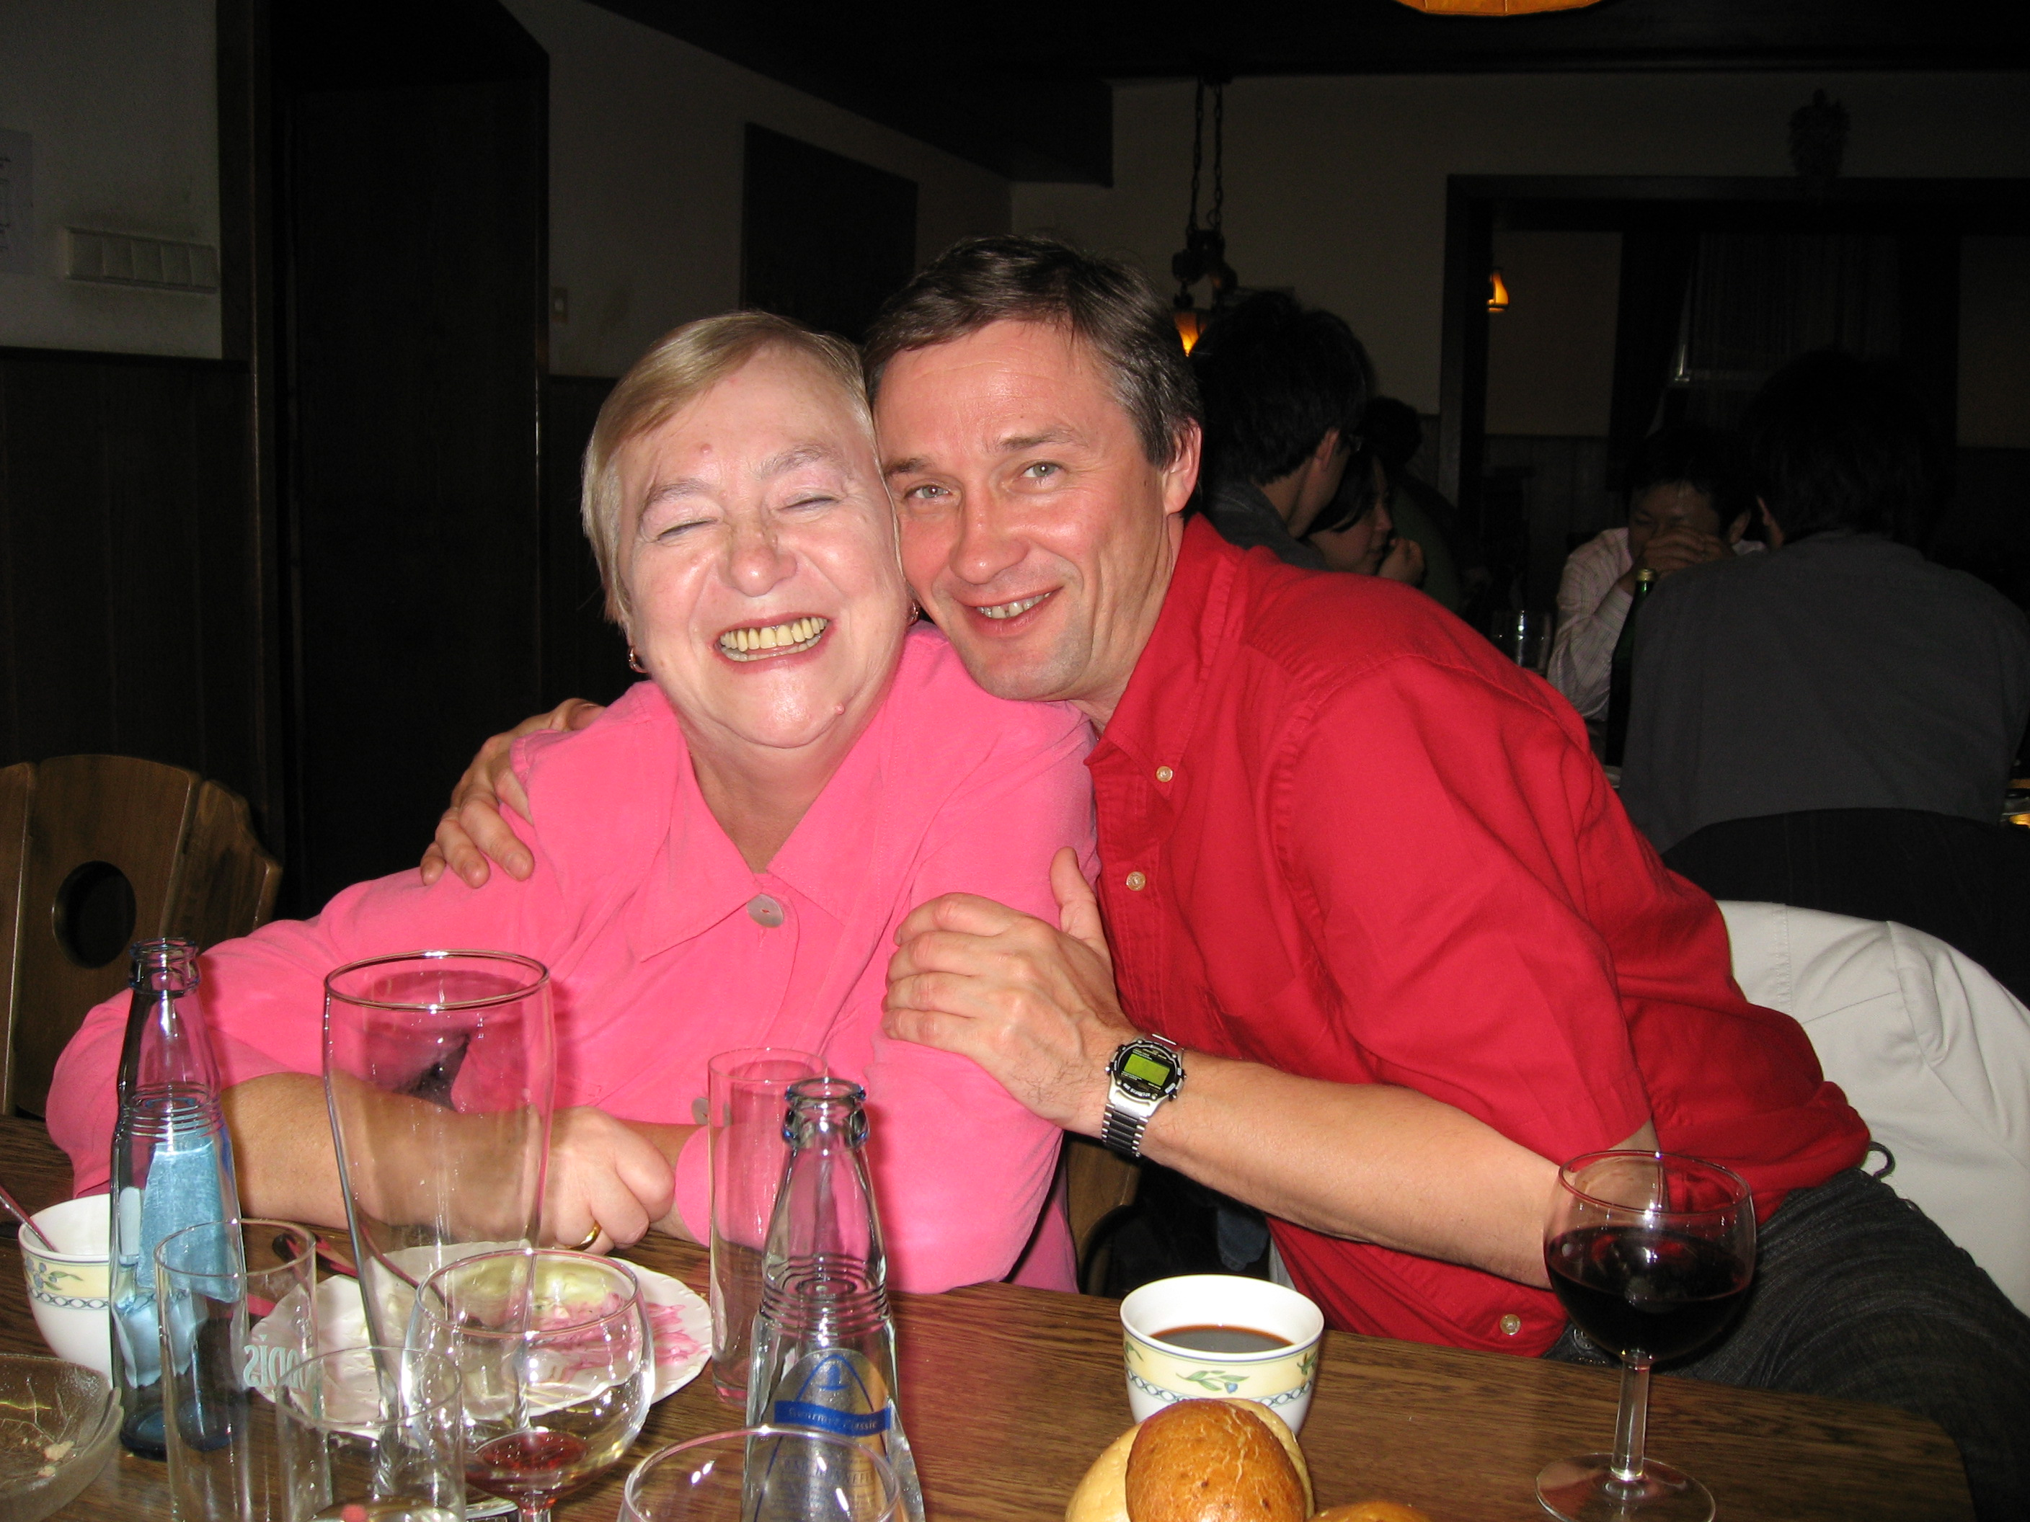
While Prof Shalaev was trying to use Your charming wife Irina as an information source…
Bonn 2006
From Victor Veselago Dossier:
“Likes Blond women”

Slide 9
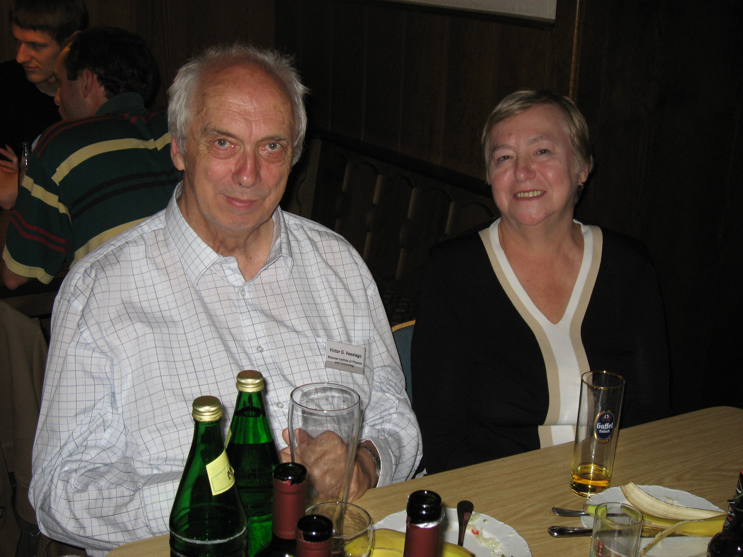
I so admired the True Partnership and Love between You and Your mathematician wife, Irina Anatolievna!
How attentive she was every time during Your talks providing her feedback and encouragement!
Victor and Irina Veselago
Notes:
To fully appreciate a true partnership and love, Prof Veselago was always seeking advice and feedback on any of his talks from his mathematician wife, Irina.

Slide 10
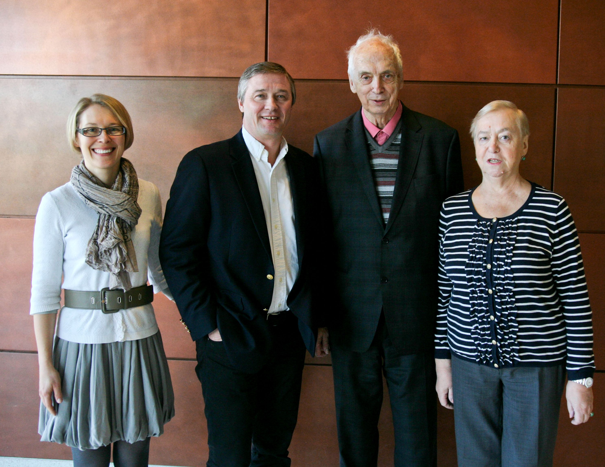
Now, knowing Your passions and Your food preferences…
From Victor Veselago Dossier:
“Hates fruits and seafood”
Purdue 2012
Notes:
Prof. Veselago was evacuated to Uzbekistan during WWII as a child where he got to eat only fruits…

Slide 11
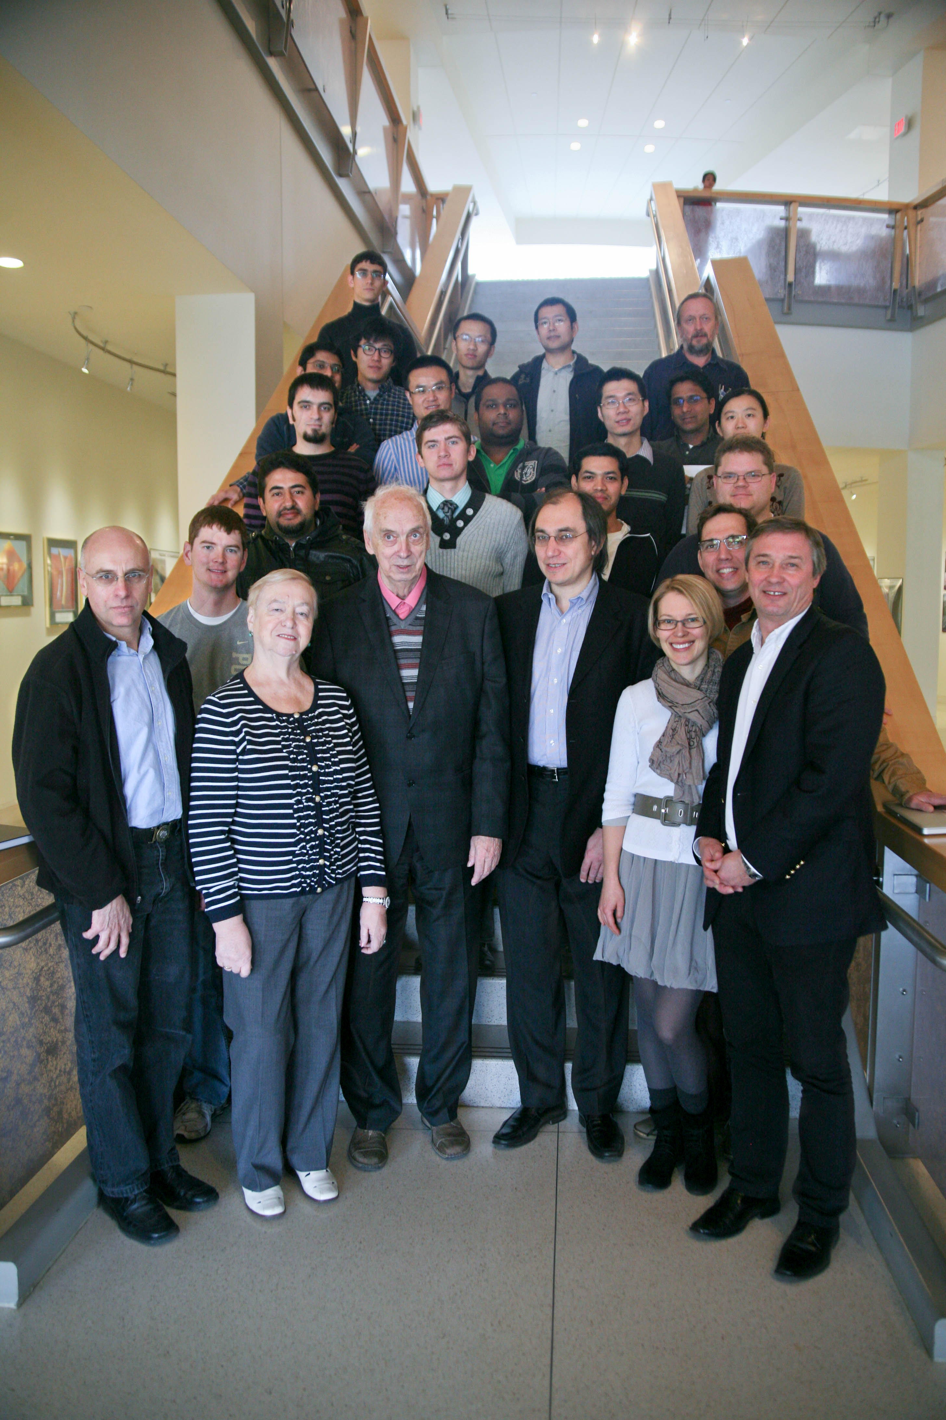
We finally got You on our team!
Purdue 2012

Slide 12
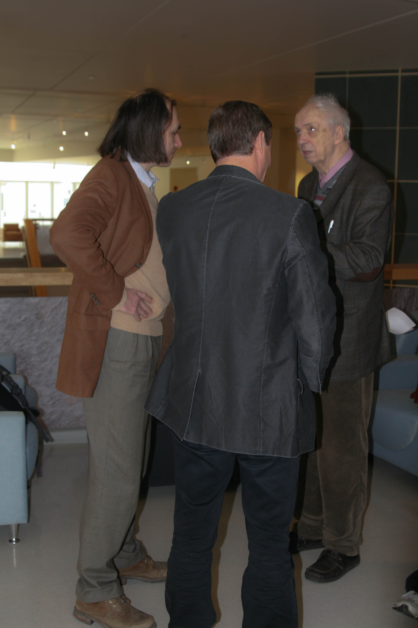
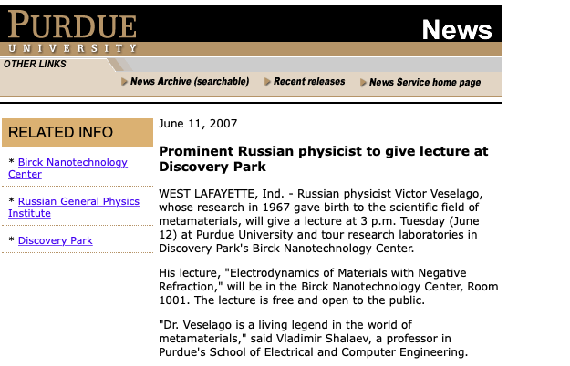
All Your visits generated so much excitement and enthusiasm!

Slide 13
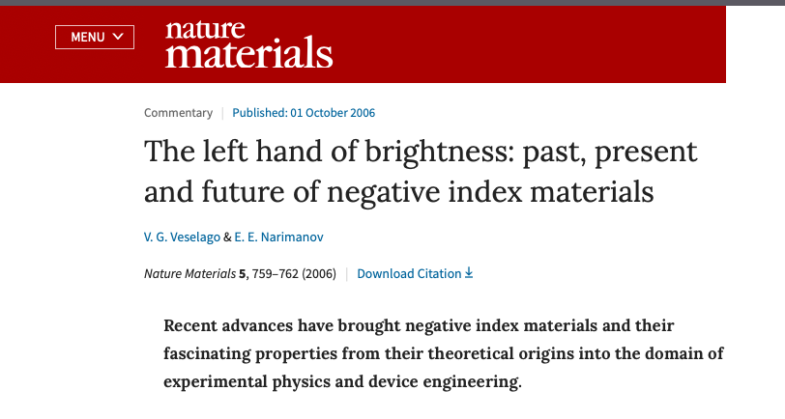
And some colleagues even got lucky to publish a paper with Professor Veselago!

Slide 14
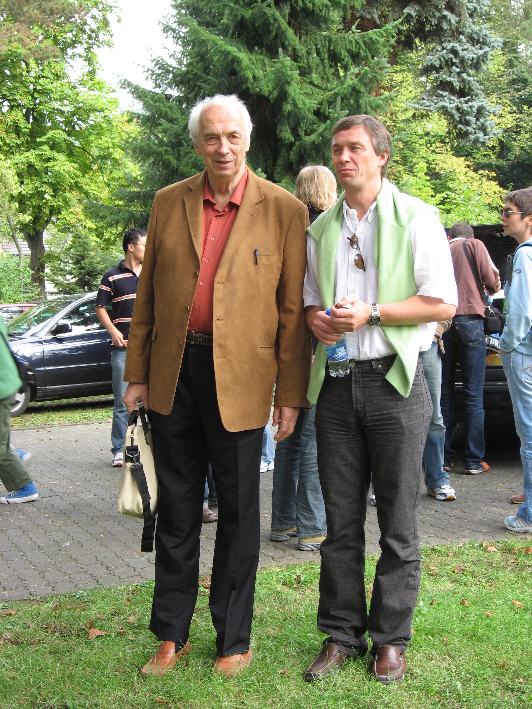
DEAR VICTOR GEORGIEVICH,
YOU ARE A LEGEND THAT WILL ALWAYS STAY WITH US.
THANK YOU
FOR BEING
OUR INSPRIRATION,
OUR VISION,
OUR PASSION,
OUR PAST AND FUTURE...

Slide 15
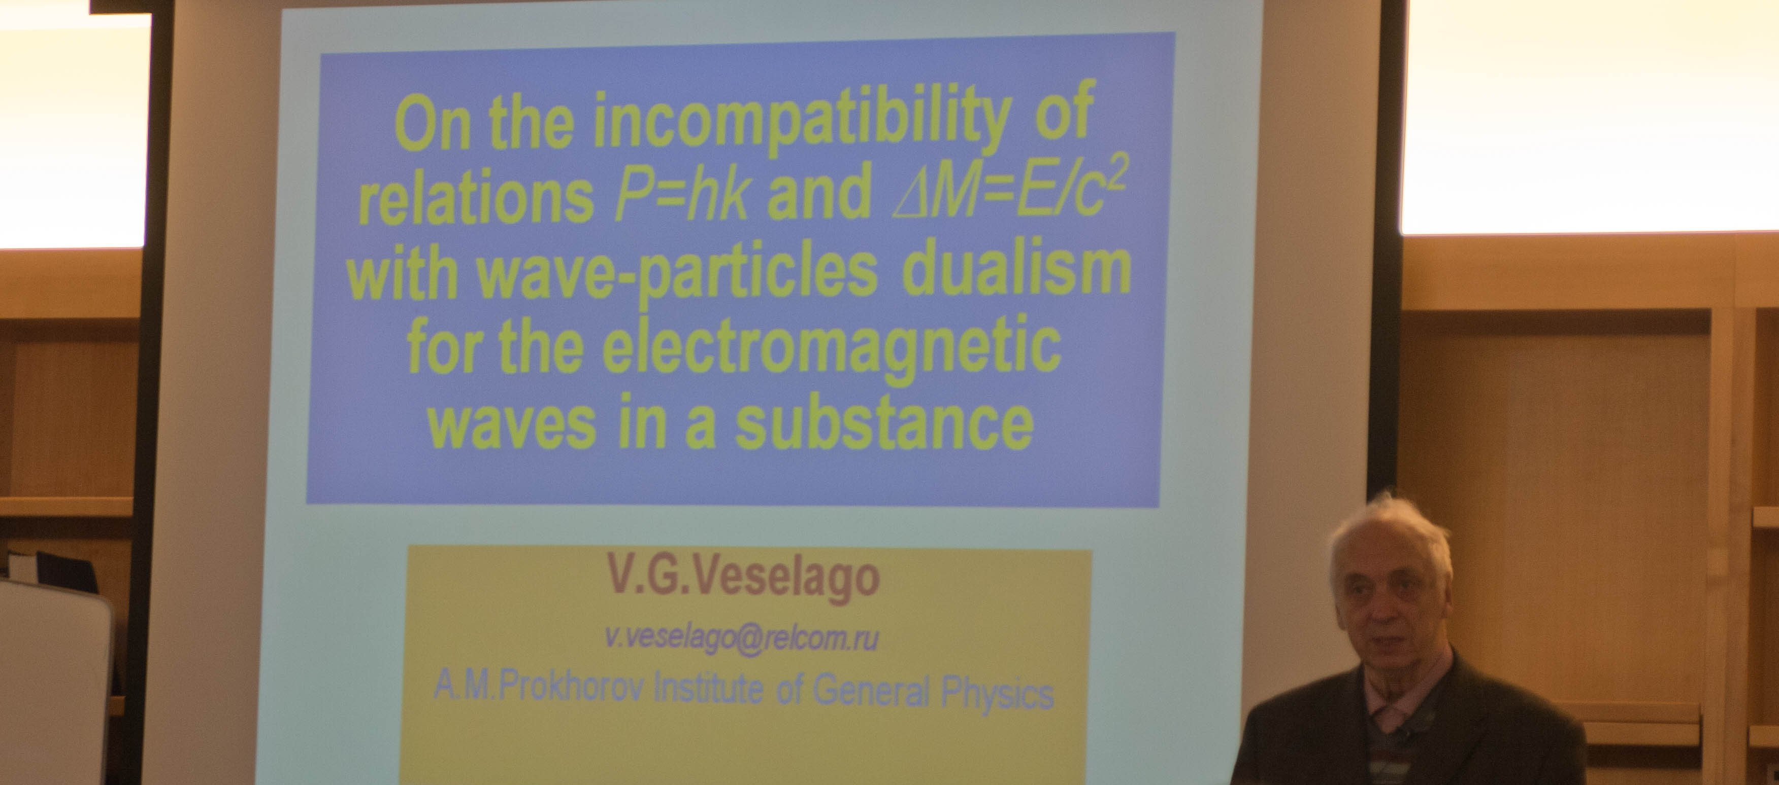
THANK YOU -
FOR YOUR LECTURES – FULL OF HISTORY, INSPRINATION, DISCOVERIES AND NEW BEGINNINGS …

Slide 16
DEAR VICTOR GEORGIEVICH,
YOU ARE OUR HERO.
THANK YOU FROM THE BOTTOM OF OUR HEARTS
FOR YOUR CONTAGIOUS ENTHUSIASM,
ENERGY,
RADIANCE
AND TRUE LOVE FOR SCIENCE;
FOR THOUSAND STORIES ABOUT SCIENCE AND SCIENTISTS,
FOR YOUR SMILE.
YOU ARE SO GREATLY MISSED…

Slide 17
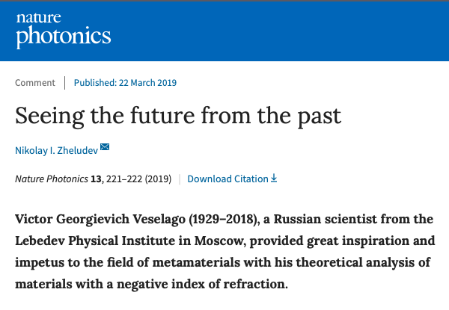

Slide 18

VICTOR VESELAGO ADDRESS
NANOPLASM CONFERENCE, JUNE 2018

