Slide 1
Errors
ECE 695
Alexander J. Quinn
3/9/2016

Slide 2
Errors
ECE 695
Alexander J. Quinn
3/11/2016

Slide 3
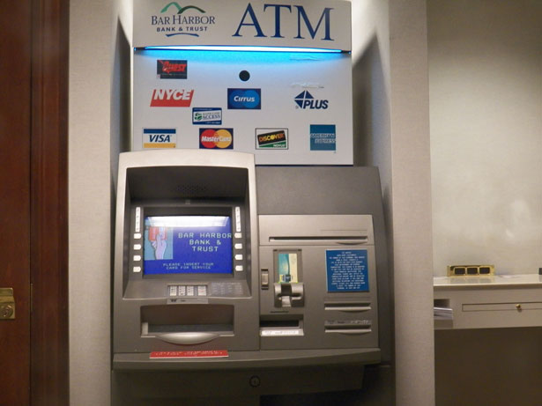
Credit: http://www.publicdomainpictures.net/view-image.php?image=25030

Slide 4
from Cognitive Dimensions of Notations
Error-Proneness
The notation invites mistakes and the system gives little protection.
Enough is known about the cognitive psychology of slips and errors to predict that certain notations will invite them. Prevention (e.g. check digits, declarations of identifiers, etc) can redeem the problem.
Credit: Alan F. Blackwell et al. (2001) Cognitive Dimensions of Notations: Design Tools for Cognitive Technology

Slide 5
from Cognitive Dimensions of Notations
Abstraction
Closeness of Mapping
Consistency
Diffuseness
Error-Proneness
Hard Mental Operations
Hidden Dependencies
Premature Commitment
Progressive Evaluation
Provisionality
Role-Expressiveness
Secondary Notation
Viscosity
Visibility
Credit: Alan F. Blackwell et al. (2001) Cognitive Dimensions of Notations: Design Tools for Cognitive Technology

Slide 6
from Cognitive Dimensions of Notations
Abstraction
Closeness of Mapping
Consistency
Diffuseness
Error-Proneness
Hard Mental Operations
Hidden Dependencies
Premature Commitment
Progressive Evaluation
Provisionality
Role-Expressiveness
Secondary Notation
Viscosity
Visibility
Credit: Alan F. Blackwell et al. (2001) Cognitive Dimensions of Notations: Design Tools for Cognitive Technology

Slide 7
Examples
Drag file to wrong place
Delete more files than you intended
if(a = 0) { … }
________________
________________
________________

Slide 8
Types of errors: stages of action
Perceptual
Cognitive
Motor

Slide 9
Types of errors: source of error
Mistakes
Failures
Slips and lapses

Slide 10
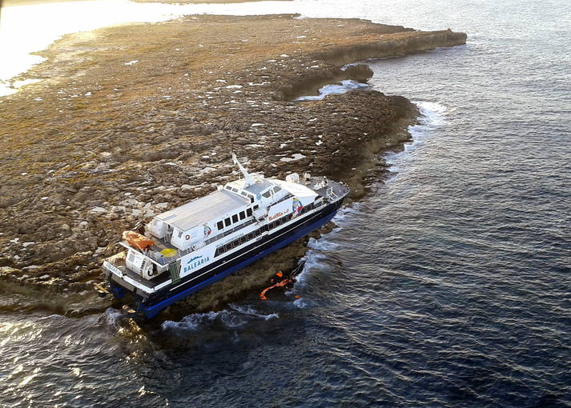
Mistakes
Action is not appropriate for the goal
Apply action in the wrong situation
Bad judgment
Credit: http://www.seanews.com.tr/news/75438/Fast-Ferry-Maverick-Dos-ran-aground-between-Ibiza-and-Formentera.html

Slide 11
Failures
Understood and decided correctly
Caused by difficulty

Slide 12
Slips and lapses
Typos
Causes
working memory failure
distractions
physical motor errors

Slide 13
Interlock
Enforce sequence of operations
Examples
car gear shift
ATM forces us to remove card before cash
____________

Slide 14
Lockin
Keep operation active, preventing it from being stopped prematurely
Examples
suspend application on smartphone
_________

Slide 15
Lockout
Require extra steps or special action to enable potentially dangerous actions
Examples
Lock screen on phone
_______________

