Slide 1
End-user programming + Supporting Undo
ECE 695
Alexander J. Quinn
March 7, 2016

Slide 2
Q: When will I get my scores for the midterm and the paper prototyping exercise?
A: Later this week

Slide 3
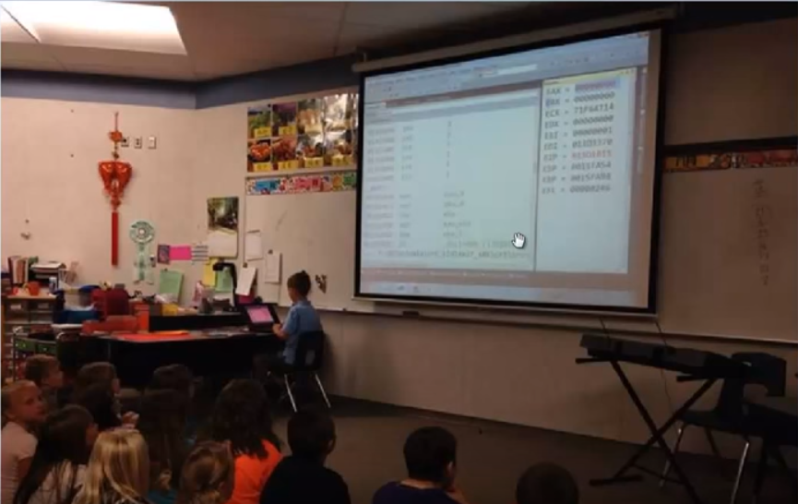
Let’s watch a 9-year-old write assembly code
Credit: Jamie King and his son, https://youtu.be/_YYOnqMN4wQ?t=58s
Notes:
Credit: icon, Egglsplode Design, https://www.iconfinder.com/Eggsplodeip
https://www.iconfinder.com/icons/278445/play_youtube_youtube_app_logo_youtube_logo_youtube_play_button_logo_icon#size=607

Slide 4
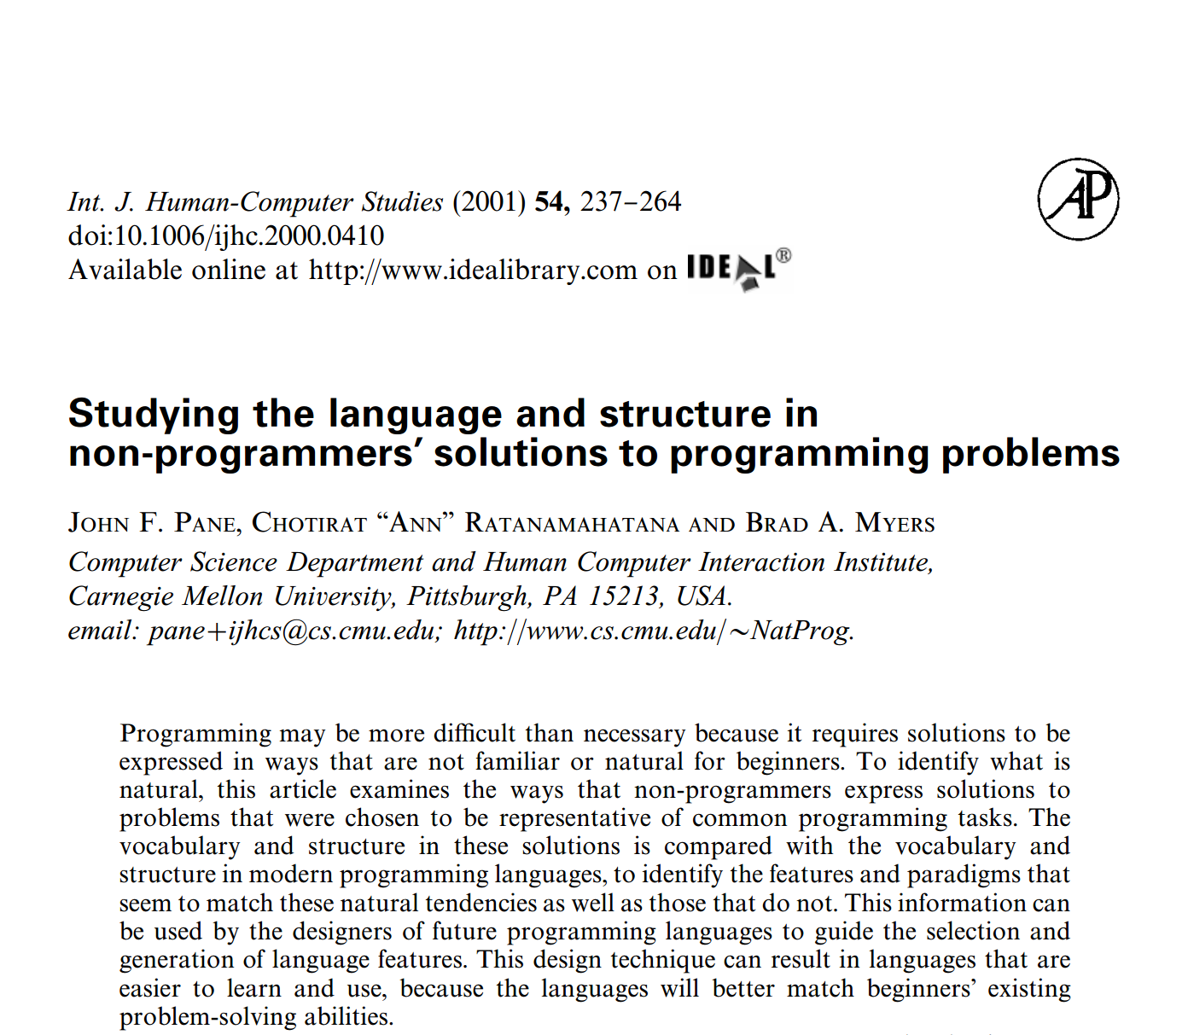

Slide 5
Key questions
Are current programming languages an accident?
What is “intuitive”?
How can we understand what is intuitive?

Slide 6
“After reading this article I remember my Uncle son who is eight years old and is able to write code in python. This study provides me proofs that indicate why python is relatively easy to learn as it has many features (like sets, lists data types) which is too close to human thinking of a solution to a problem.”
Credit: Chaityanya

Slide 7
“One important aspect of programming, which is missing in the paper, is the debugging. Since debugging is very important, I think authors should record how the participants verify the rightness of their logics, and calculate the time allocation between the program writing time and error-correcting time.”
Credit: Guizhen

Slide 8
Undo

Slide 9
Demo: Undo branches in Vim

Slide 10
Create a drawing app with html5 canvas and javascript

